Slide 1
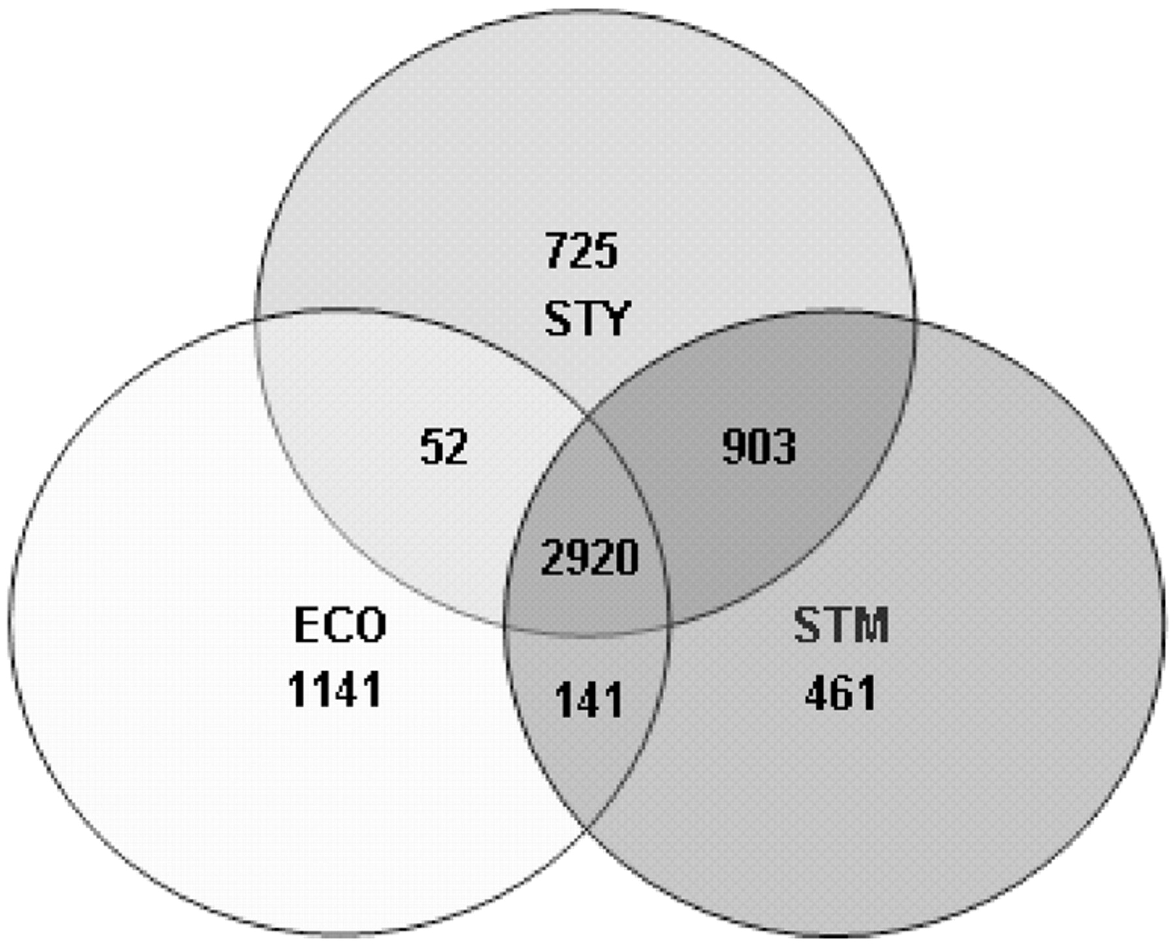
Fig. 1 Venn diagram illustrating the unique and the orthologous genes present in the genome of E.coli (ECO), S.typhi ...
Notes:
Fig. 1 Venn diagram illustrating the unique and the orthologous genes present in the genome of E.coli (ECO), S.typhi (STY) and S.typhimurium (STM).
Unless provided in the caption above, the following copyright applies to the content of this slide: © 2006 The Author(s)This is an Open Access article distributed under the terms of the Creative Commons Attribution Non-Commercial License () which permits unrestricted non-commercial use, distribution, and reproduction in any medium, provided the original work is properly cited.

Slide 2
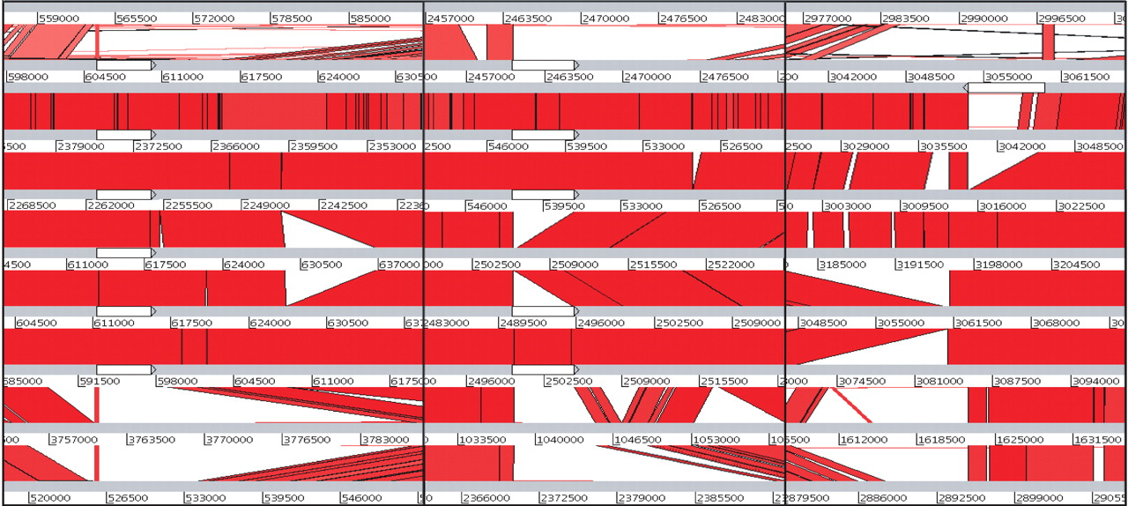
Fig. 2 ACT screenshot: BLASTN comparison between E.coli and eight Salmonella genomes (from top to bottom): E.coli ...
Notes:
Fig. 2 ACT screenshot: BLASTN comparison between E.coli and eight Salmonella genomes (from top to bottom): E.coli K12, S.typhi CT18, S.typhi TY2, S.paratyphi A, S.typhimurium LT2, S.gallinarum 287/91, S.enteritidis PT4, S.arizonae RSK2980, S.bongori 12419. Regions within the nine genomes with sequence similarity are joined by red colored bands that represent the matching regions. The three novel SPIs are illustrated as white colored features (from left to right: SPI-16, SPI-17, SPI-15). The above screenshot is a mosaic picture of three individual screenshots at different locations along the genomes that have been concatenated for ease of visualization.
Unless provided in the caption above, the following copyright applies to the content of this slide: © 2006 The Author(s)This is an Open Access article distributed under the terms of the Creative Commons Attribution Non-Commercial License () which permits unrestricted non-commercial use, distribution, and reproduction in any medium, provided the original work is properly cited.

Slide 3
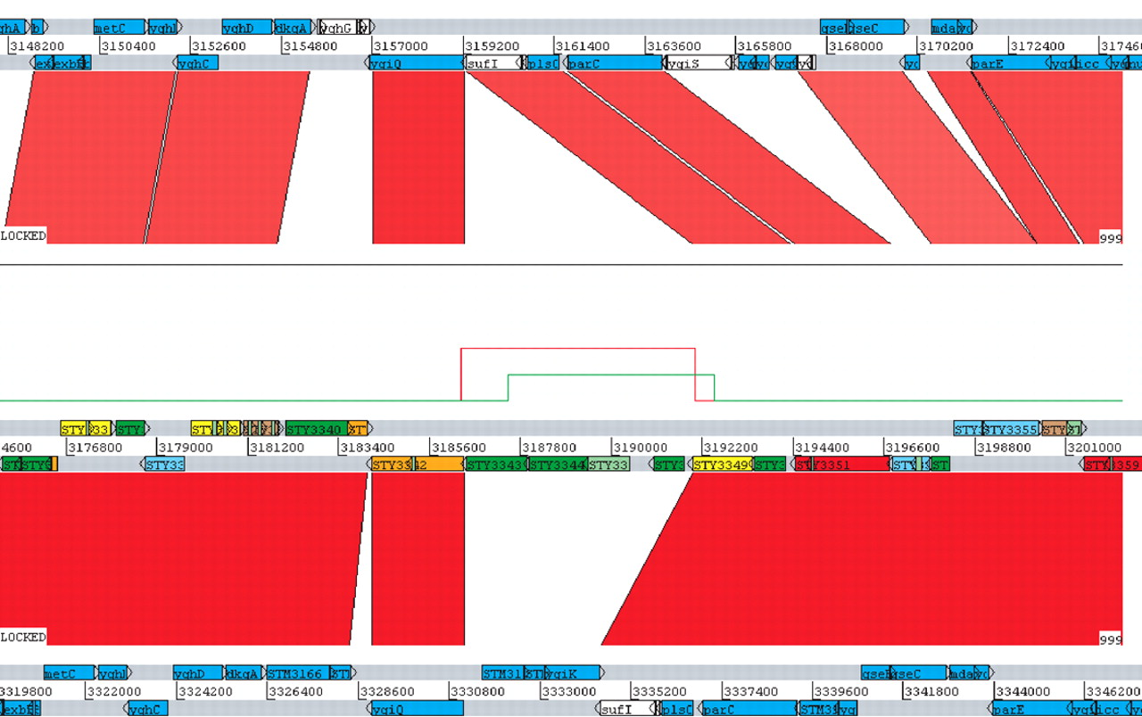
Fig. 3 ACT screenshot: BLASTN comparison between (from top to bottom): E.coli K12, S.typhi CT18, S.typhimurium LT2. ...
Notes:
Fig. 3 ACT screenshot: BLASTN comparison between (from top to bottom): E.coli K12, S.typhi CT18, S.typhimurium LT2. An example of a predicted putative horizontally transferred region in the genome of S.typhi is indicated with two peaks in the IVOM score plot (above S.typhi). This region seems to be absent in the other two genomes compared. The red and the green colored score plots represent IVOM predictions with optimized (HMM) and unoptimized boundaries respectively.
Unless provided in the caption above, the following copyright applies to the content of this slide: © 2006 The Author(s)This is an Open Access article distributed under the terms of the Creative Commons Attribution Non-Commercial License () which permits unrestricted non-commercial use, distribution, and reproduction in any medium, provided the original work is properly cited.

