Slide 1
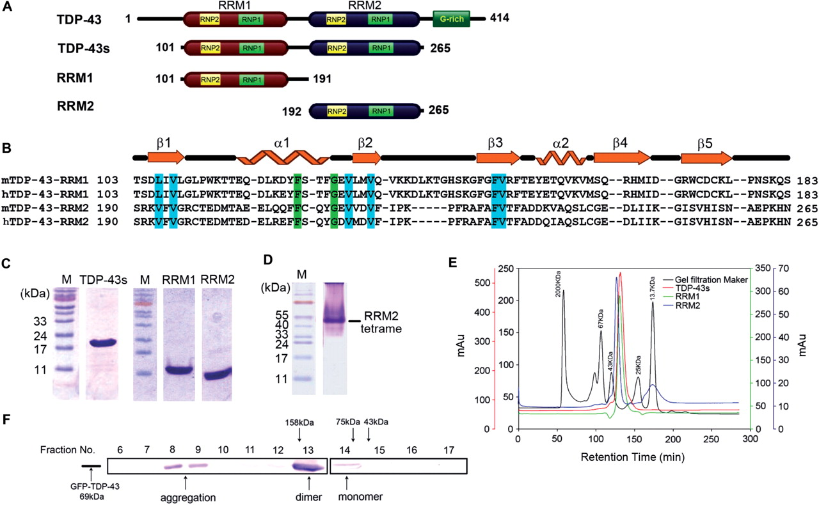
Figure 1. Domain structures and assembly of TDP-43 proteins. (A) TDP-43 has two RRM domains, RRM1 and RRM2, and a ...
Notes:
Figure 1. Domain structures and assembly of TDP-43 proteins. (A) TDP-43 has two RRM domains, RRM1 and RRM2, and a C-terminal glycine-rich domain. In this study, three truncated TDP-43 proteins were constructed: TDP-43s, RRM1 and RRM2. (B) Amino-acid sequences of mouse and human TDP-43 in the RRM1 and RRM2 domains. The secondary structures listed above the sequences are derived from the crystal structure of RRM2–DNA complex. (C) The purity of TDP-43 truncated proteins was assayed by 12.5% SDS–PAGE. (D) RRM2 appeared as a tetramer in the native 20% PAGE gel. (E) Gel filtration (Superdex 200) profiles of TDP-43 truncated proteins show that TDP-43s, RRM1 and RRM2 all had a molecular weight of ∼40 kDa, suggesting that the recombinant TDP-43s was a homodimer, and RRM1 and RRM2 were homotetramers. (F) The GFP-fused TDP-43, with a molecular weight of 69 kDa, was expressed in human 293T cells for size exclusion chromatography analysis. The fractionated cell extract eluted from a Superdex 200 column were blotted by TDP-43 antibodies. GFP-TDP-43 was mainly eluted with a size of a dimer. The molecular weight markers are: aldolase (158 kDa), conalbumin (75 kDa) and ovalbumin (43 kDa).
Unless provided in the caption above, the following copyright applies to the content of this slide: © 2009 The Author(s)This is an Open Access article distributed under the terms of the Creative Commons Attribution Non-Commercial License (http://creativecommons.org/licenses/by-nc/2.0/uk/) which permits unrestricted non-commercial use, distribution, and reproduction in any medium, provided the original work is properly cited.

Slide 2
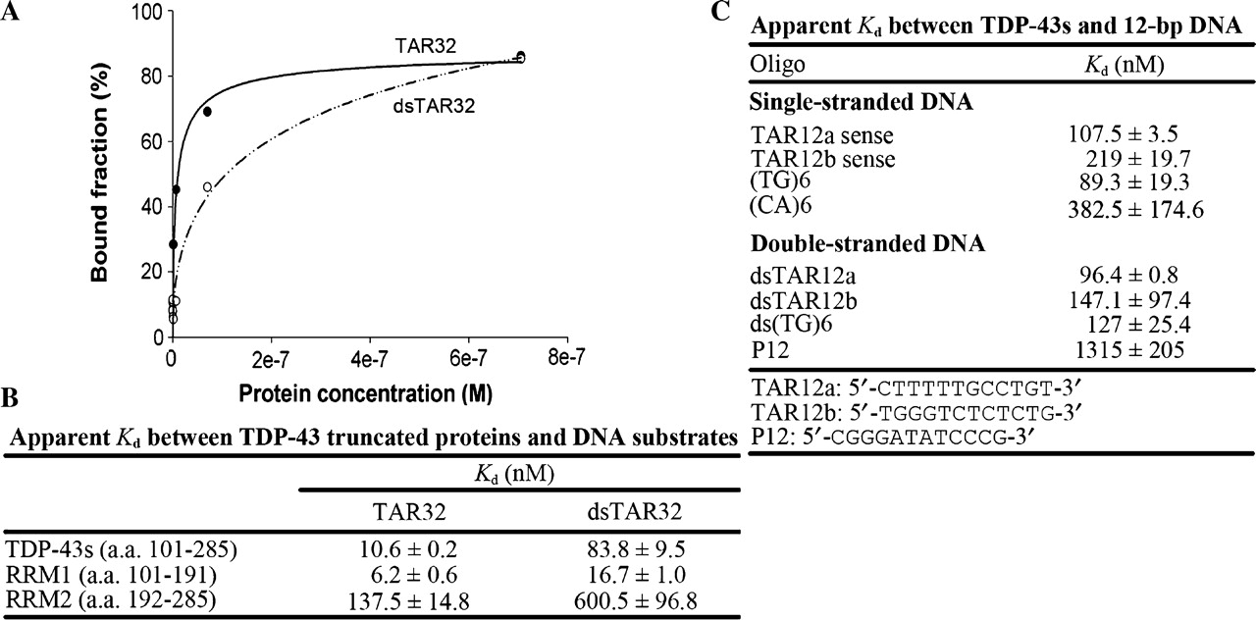
Figure 2. Binding affinities of TDP-43 truncated proteins and DNA, analyzed by nitrocellulose filter-binding assays. ...
Notes:
Figure 2. Binding affinities of TDP-43 truncated proteins and DNA, analyzed by nitrocellulose filter-binding assays. (A) TDP-43s bound to both single-stranded and double-stranded TAR DNA sequence (32-mer). The 5′-end 32P-labeled DNA (10 pmol) was incubated with 0.01–40 μM TDP-43s and the resultant protein–DNA complexes trapped in the nitrocellulose filters were quantified. (B) Summary of the apparent dissociation constants of TDP-43 truncated proteins and TAR 32-mer ssDNA and dsDNA. Both RRM1 and RRM2 domains were capable of DNA binding. (C) Summary of the apparent dissociation constants of TDP-43s and various 12-mer ssDNA and dsDNA. TDP-43s prefers to bind to TG-rich 12-mer DNAs with affinity at least one order higher than non-TG sequences.
Unless provided in the caption above, the following copyright applies to the content of this slide: © 2009 The Author(s)This is an Open Access article distributed under the terms of the Creative Commons Attribution Non-Commercial License (http://creativecommons.org/licenses/by-nc/2.0/uk/) which permits unrestricted non-commercial use, distribution, and reproduction in any medium, provided the original work is properly cited.

Slide 3
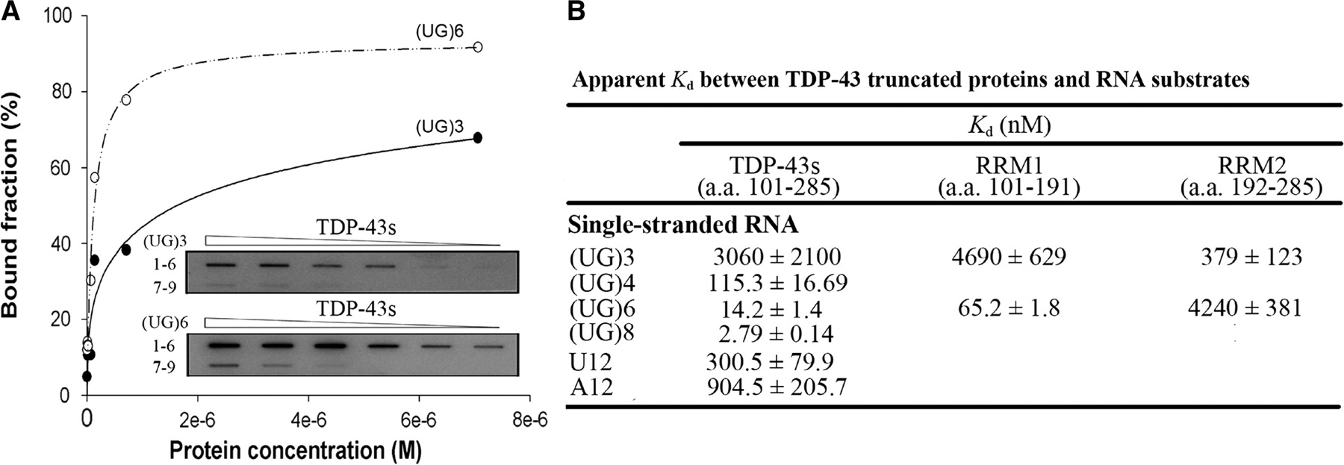
Figure 3. Binding affinities of TDP-43 truncated proteins and RNA, analyzed by nitrocellulose filter-binding assays. ...
Notes:
Figure 3. Binding affinities of TDP-43 truncated proteins and RNA, analyzed by nitrocellulose filter-binding assays. (A) TDP-43s bound to single-stranded RNA containing three and six UG repeats. (B) Summary of the apparent dissociation constants of TDP-43 truncated proteins and RNAs. TDP-43s prefers to bind UG-rich 12-mer ssRNA with affinity at least one order higher than RNA without any UG-repeats.
Unless provided in the caption above, the following copyright applies to the content of this slide: © 2009 The Author(s)This is an Open Access article distributed under the terms of the Creative Commons Attribution Non-Commercial License (http://creativecommons.org/licenses/by-nc/2.0/uk/) which permits unrestricted non-commercial use, distribution, and reproduction in any medium, provided the original work is properly cited.

Slide 4
Figure 4. Crystal structure of RRM2–DNA complex. (A) A ribbon model of RRM2 dimer bound to single-stranded DNAs. ...
Notes:
Figure 4. Crystal structure of RRM2–DNA complex. (A) A ribbon model of RRM2 dimer bound to single-stranded DNAs. Molecule a (in blue) is related to molecule b (in red) by a 2-fold crystallographic symmetry axis. DNA molecules are displayed as stick models. A classical RRM domain contains four β-strands (β2-β3-β1-β5) as marked by the rectangle on the top of the structure; however, TDP-43 RRM2 has an extra β4 strand next to β5. (B) A pair of hydrogen bonds are formed between the main-chain atoms of Asp247 (Asp247-O to Asp247-N), and a pair of hydrogen bonds are formed between Glu245 (Oε2) and Ile249 (N) between the two antiparallel β4 strands to stabilize the RRM2 dimeric structure. (C) The RRM2 domain (monomer a) also interacts with the neighboring 2-fold symmetry-related molecule (monomer e). This view is rotated ∼90 degrees vertically to that of panel A. (D) Four hydrogen bonds were formed between monomer a and e: Gln209 (Nε2) to Cys212 (O), and Glu208 (Oε1) to Cys (Sγ).
Unless provided in the caption above, the following copyright applies to the content of this slide: © 2009 The Author(s)This is an Open Access article distributed under the terms of the Creative Commons Attribution Non-Commercial License (http://creativecommons.org/licenses/by-nc/2.0/uk/) which permits unrestricted non-commercial use, distribution, and reproduction in any medium, provided the original work is properly cited.

Slide 5
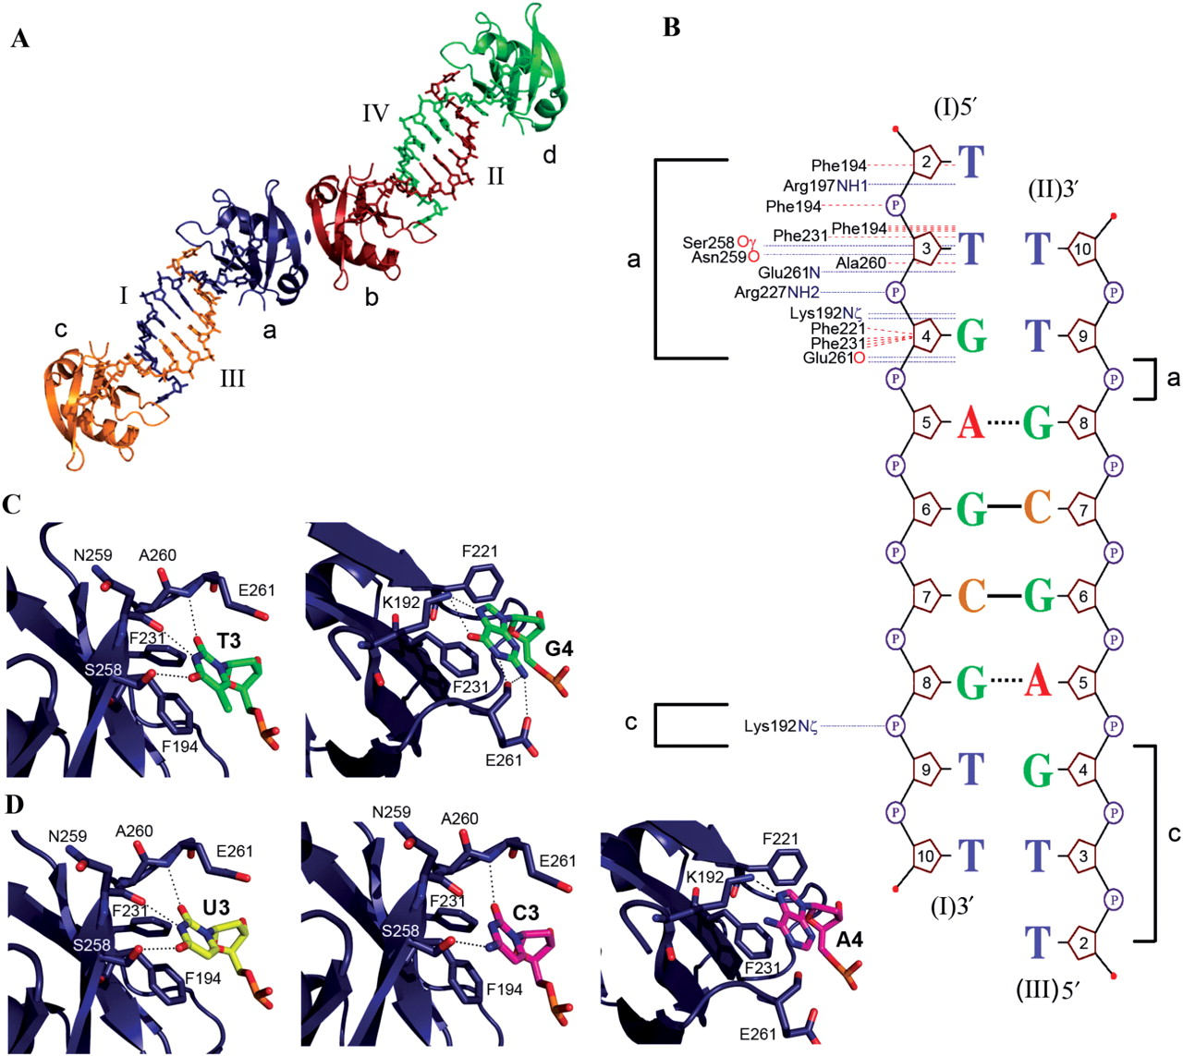
Figure 5. Interactions between TDP-43 RRM2 and DNA. (A) Single-stranded DNA bound to RRM2 formed a double-stranded-like ...
Notes:
Figure 5. Interactions between TDP-43 RRM2 and DNA. (A) Single-stranded DNA bound to RRM2 formed a double-stranded-like conformation, with the DNA bound to the neighboring RRM2 molecule. Four RRM2–DNA complexes are shown here to demonstrate the interactions between DNA strand I (bound to molecule a) and strand III (bound to molecule c). (B) Schematic diagrams of the detailed contacts between RRM2 and DNA. Hydrogen bonds are shown by blue dotted line, and non-bonded contacts are shown by red dotted line. Watson–Crick base pairs were formed between G6 and C7 (indicated by solid line) of strand I and III. (C) Extensive hydrogen-bond networks and non-bonded interactions are identified in the T3-binding pocket (left) and G4-binding pocket (right) in TDP-43 RRM2–DNA crystal structure The bases of T3 and G4 stack with Phe194 and Phe231, respectively. (D) A uracil (U3, left) and a cytosine (C3, middle) are modeled at the T3-binding pocket, whereas an adenine is modeled at the G4 pocket (A4, right).
Unless provided in the caption above, the following copyright applies to the content of this slide: © 2009 The Author(s)This is an Open Access article distributed under the terms of the Creative Commons Attribution Non-Commercial License (http://creativecommons.org/licenses/by-nc/2.0/uk/) which permits unrestricted non-commercial use, distribution, and reproduction in any medium, provided the original work is properly cited.

Slide 6
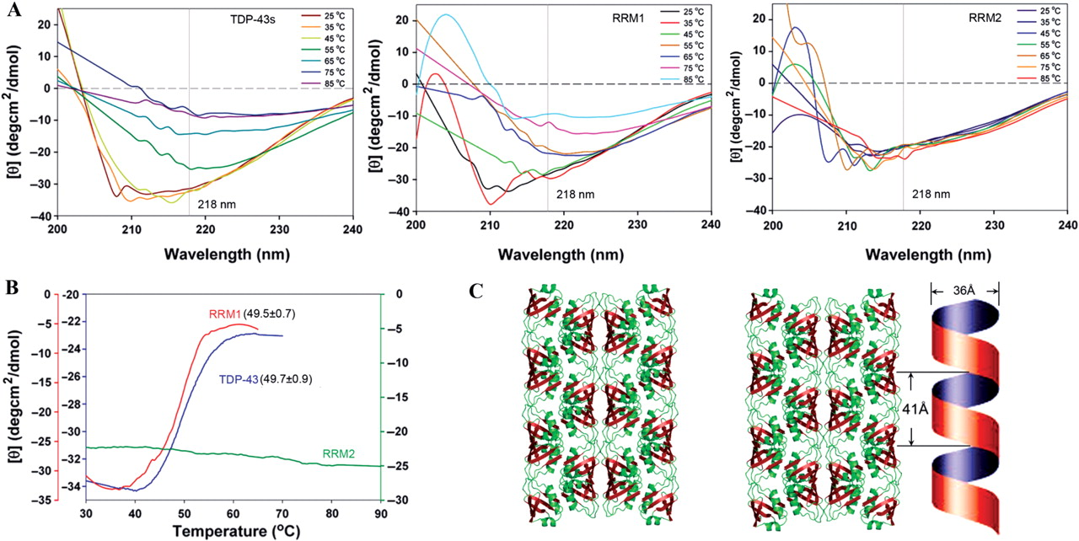
Figure 6. The RRM2 domain of TDP-43 forms a highly thermal-stable assembly as monitored by CD. (A) Thermal denaturation ...
Notes:
Figure 6. The RRM2 domain of TDP-43 forms a highly thermal-stable assembly as monitored by CD. (A) Thermal denaturation of TDP-43s, RRM1 and RRM2, was assayed by CD from 25 to 85°C in 200 mM NaCl at pH 7.0. (B) The melting point, monitored at a wavelength of 218 nm, was 49.7 ± 0.9°C for TDP-43s, and 49.5 ± 0.7°C for RRM1. RRM2 was not melted up to 85°C, suggesting that it was highly stable and had a melting point greater than 85°C. (C) The stereo view of the crystal packing of RRM2 shows that the RRM2 dimers interact with the neighboring dimers to generate a left-handed super-helix structure. For clarity, DNA molecules have been removed and two super helices packed side by side are shown here.
Unless provided in the caption above, the following copyright applies to the content of this slide: © 2009 The Author(s)This is an Open Access article distributed under the terms of the Creative Commons Attribution Non-Commercial License (http://creativecommons.org/licenses/by-nc/2.0/uk/) which permits unrestricted non-commercial use, distribution, and reproduction in any medium, provided the original work is properly cited.

Slide 7
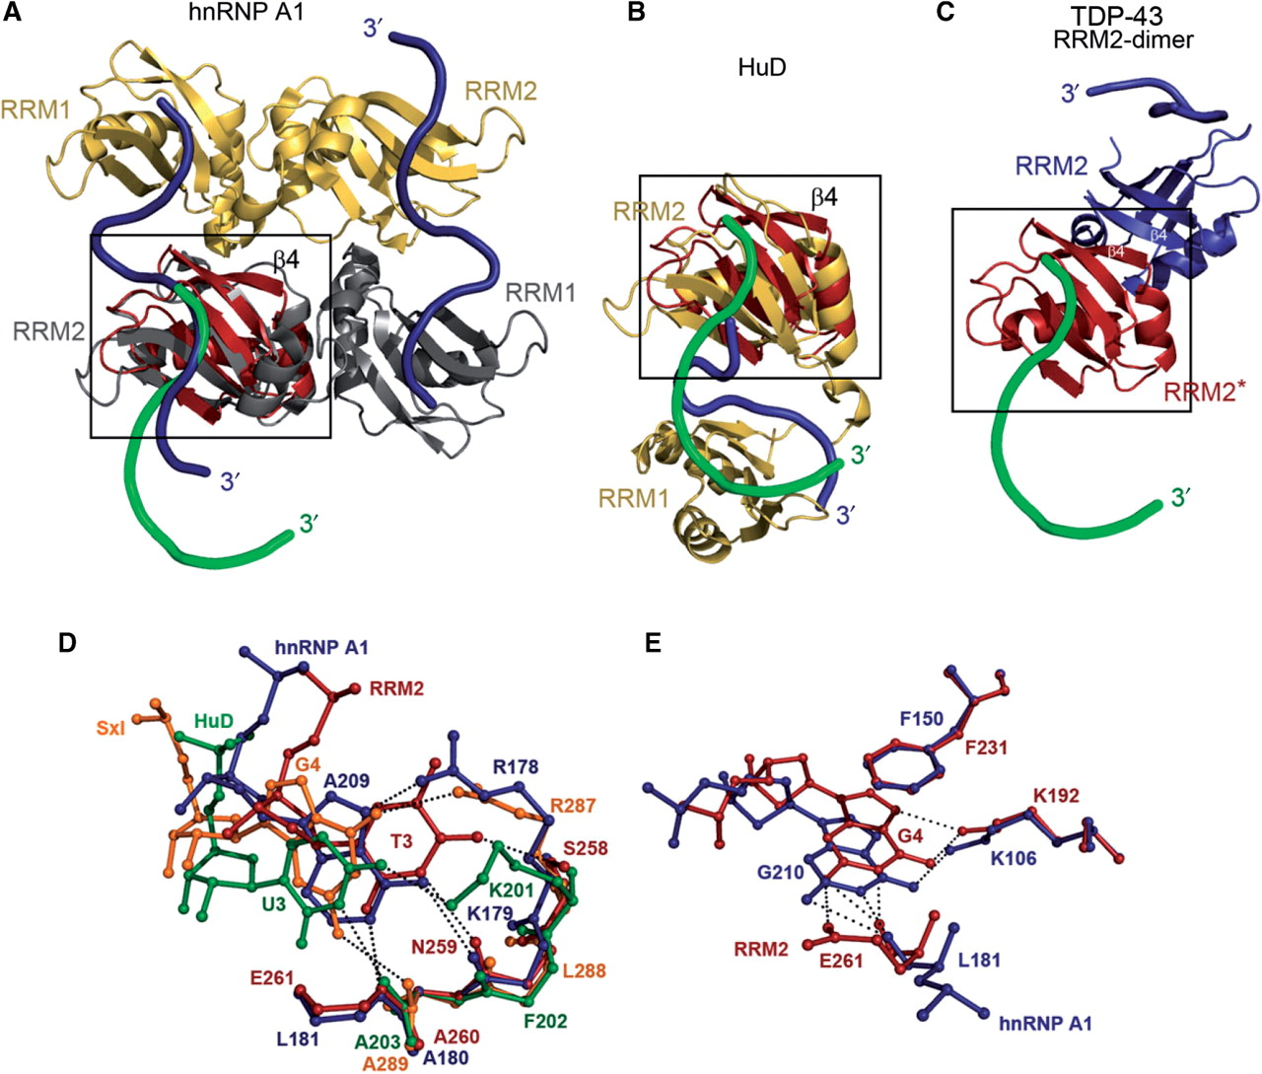
Figure 7. Comparison of RRM domain assembly between TDP-43, hnRNP A1 and HuD. (A) The RRM2 domain of TDP-43 (in red) ...
Notes:
Figure 7. Comparison of RRM domain assembly between TDP-43, hnRNP A1 and HuD. (A) The RRM2 domain of TDP-43 (in red) was superimposed onto the RRM2 of hnRNP A1. hnRNP A1 is a homodimer (in yellow and gray) bound to two strands of RNA (schematically displayed as a navy blue tube). The DNA bound to TDP-43 is displayed in green. (B) The RRM2 of TDP-43 (red) was superimposed onto the RRM2 of HuD (yellow). All the RRM2 domains in hnRNP A1, HuD and TDP-43 were fixed in the same orientation as marked by a black frame. (C) The dimeric interface in the TDP-43 RRM2 dimer is atypical, compared to those found in hnRNP A1 and HuD. (D) A similar T3-binding pocket was identified in several RRM proteins: TDP-43 in red (bound to T3); hnRNP A1 in navy blue (bound to A209); HuD in green (bound to U3); and Sxl in orange (bound to G4). (E) A similar G4 binding pocket in TDP-43 (in red) was only identified in hnRNP A1 (in navy blue, bound to G210). The PDB entry codes of the structures used in this figure are: 1U1O for hnRNP A1, 1FXL for HuD and 1B7F for Sxl.
Unless provided in the caption above, the following copyright applies to the content of this slide: © 2009 The Author(s)This is an Open Access article distributed under the terms of the Creative Commons Attribution Non-Commercial License (http://creativecommons.org/licenses/by-nc/2.0/uk/) which permits unrestricted non-commercial use, distribution, and reproduction in any medium, provided the original work is properly cited.

