Slide 1
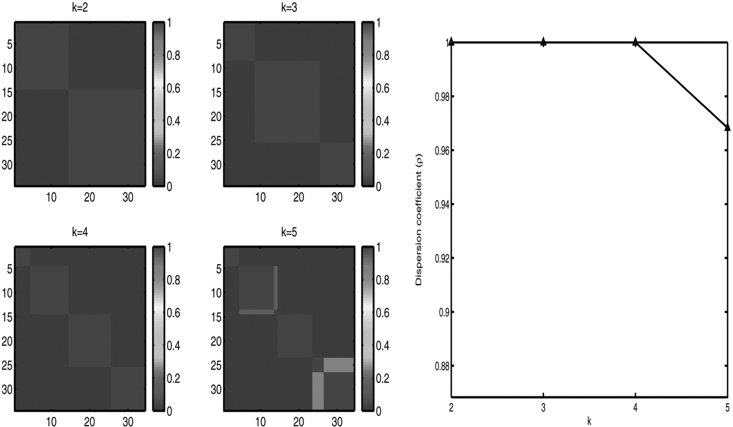
Fig. 1. CNS tumors clustering by SNMF/R with β = 0.01. (Left) The reordered consensus matrices on the CNS tumors ...
Notes:
Fig. 1. CNS tumors clustering by SNMF/R with β = 0.01. (Left) The reordered consensus matrices on the CNS tumors dataset. (Right) The corresponding dispersion coefficients. The dispersion coefficient drops when k increases from 4 to 5, indicating a four-cluster split of the data is more stable than a five-cluster split.
Unless provided in the caption above, the following copyright applies to the content of this slide: © The Author 2007. Published by Oxford University Press. All rights reserved. For Permissions, please email: journals.permissions@oxfordjournals.org

Slide 2
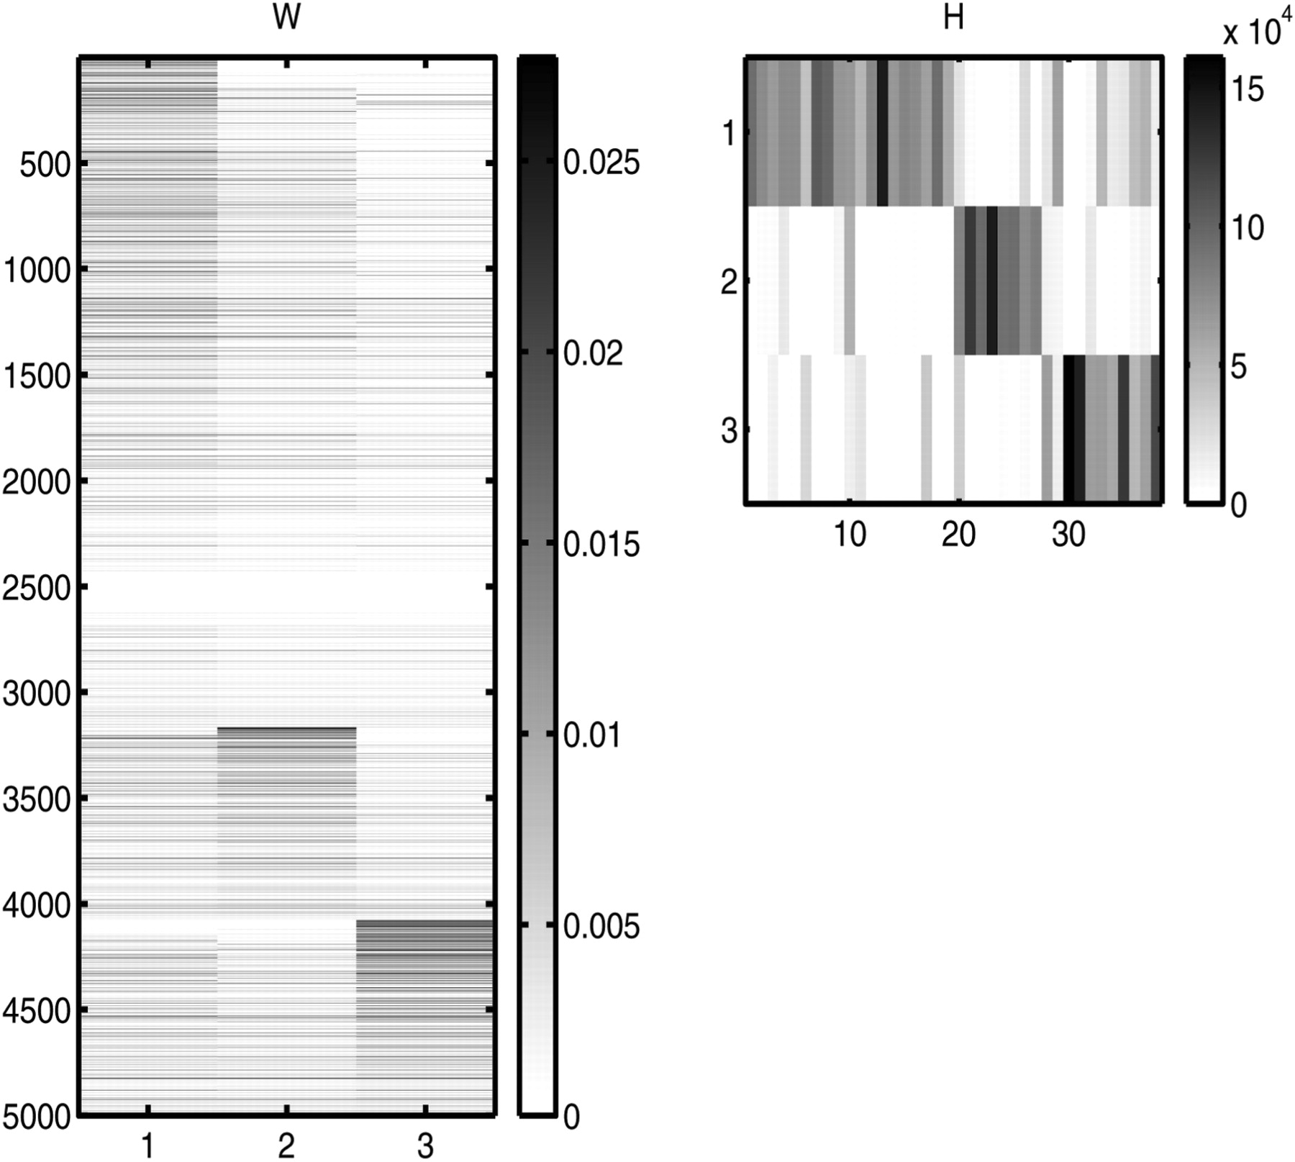
Fig. 2. W (basis matrix) and H (coefficient matrix) obtained from SNMF/R with β = 0.01 for the ALLAML leukemia ...
Notes:
Fig. 2. W (basis matrix) and H (coefficient matrix) obtained from SNMF/R with β = 0.01 for the ALLAML leukemia dataset (38 samples: 19 ALL-B, 8 ALL-T and 11 AML) with the 5000 most highly varying genes.
Unless provided in the caption above, the following copyright applies to the content of this slide: © The Author 2007. Published by Oxford University Press. All rights reserved. For Permissions, please email: journals.permissions@oxfordjournals.org

Slide 3
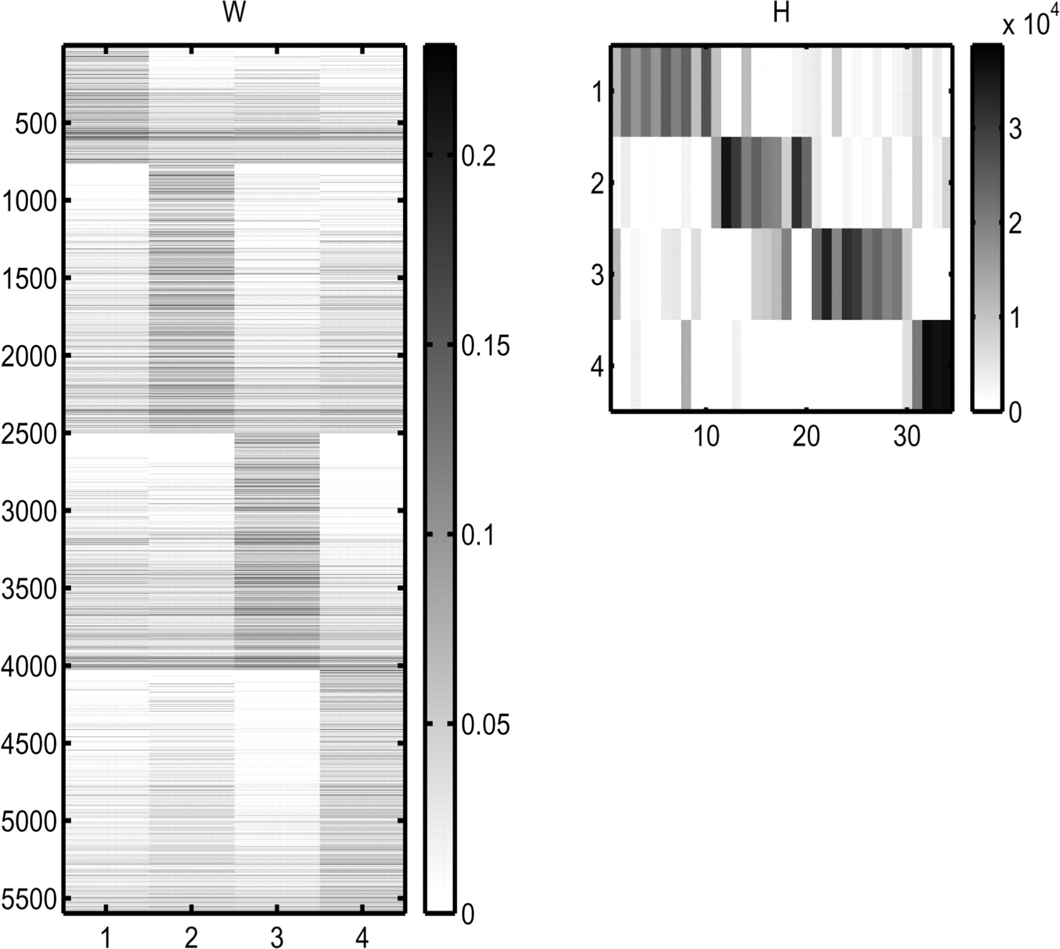
Fig. 3. W (basis matrix) and H (coefficient matrix) obtained from SNMF/R with β = 1.0 for the CNS tumor dataset (34 ...
Notes:
Fig. 3. W (basis matrix) and H (coefficient matrix) obtained from SNMF/R with β = 1.0 for the CNS tumor dataset (34 samples: 10 classic medulloblastomas, 10 malignant gliomas, 10 rhabdoids, 4 normal cerebella) with the 5597 genes.
Unless provided in the caption above, the following copyright applies to the content of this slide: © The Author 2007. Published by Oxford University Press. All rights reserved. For Permissions, please email: journals.permissions@oxfordjournals.org

