Slide 1
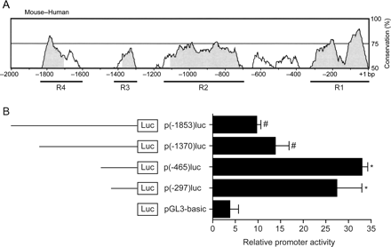
Figure 1 The conserved domains of the 5′ flanking region of the BMPER gene contain positive and negative acting ...
Notes:
Figure 1 The conserved domains of the 5′ flanking region of the BMPER gene contain positive and negative acting cis-elements. (A) Comparison of the human and mouse 5′ flanking region of the BMPER gene using mVISTA reveals four highly conserved regions (R1–R4) from −2000 bp to the translational start site. (B) Deletion analysis of the BMPER promoter in BAECs. Cells were transfected with the respective promoter construct, and luciferase activity was quantified. Values represent the mean ± SD of three independent experiments normalized to β-galactosidase (*P < 0.05 vs. pGL3-basic; #P < 0.05 vs. p(−465)luc).
Unless provided in the caption above, the following copyright applies to the content of this slide: Published on behalf of the European Society of Cardiology. All rights reserved. © The Author 2009. For permissions please email: journals.permissions@oxfordjournals.org.

Slide 2
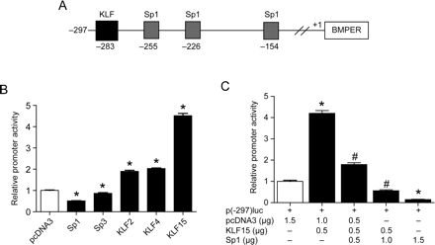
Figure 2 Members of the SP/KLF family regulate BMPER expression. (A) Schematic representation of the Sp1- and ...
Notes:
Figure 2 Members of the SP/KLF family regulate BMPER expression. (A) Schematic representation of the Sp1- and KLF-binding sites within the region −297 to 1 bp of the translational start site of the BMPER gene as analysed by in silico prediction software (www.genomatix.de). (B) Overexpression of KLF15 induces BMPER promoter activity in COS-7 cells. The p(−297)luc promoter construct was co-transfected with pcDNA3 (empty vector) or the expression plasmids encoding for Sp1, Sp3, KLF2, KLF4, and KLF15, respectively. The results represent the mean ± SD of three independent experiments (*P < 0.05 vs. pcDNA3). (C) Overexpression of Sp1 reverses KLF15- induced BMPER promoter activity in a dose-dependent fashion. The promoter construct p(−297)luc was co-transfected with KLF15 and increasing amounts of Sp1. The relative promoter activity was represented as the fold increase compared with the control (pcDNA3). The results represent the mean ± SD of three independent experiments (*P < 0.05 vs. pcDNA3; #P < 0.05 vs. p(−297)luc+KLF15).
Unless provided in the caption above, the following copyright applies to the content of this slide: Published on behalf of the European Society of Cardiology. All rights reserved. © The Author 2009. For permissions please email: journals.permissions@oxfordjournals.org.

Slide 3
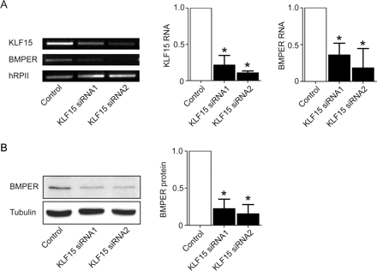
Figure 3 Lack of KLF15 results in reduced BMPER RNA and protein expression in HUVECs. Specific silencing of KLF15 by ...
Notes:
Figure 3 Lack of KLF15 results in reduced BMPER RNA and protein expression in HUVECs. Specific silencing of KLF15 by siRNA in endothelial cells resulted in decreased BMPER RNA (A) and protein (B) expression. (A) Two different siRNAs for KLF15 or control siRNA were transfected in HUVECs. After 48 h, RNA was prepared and reverse-transcribed. RT–PCR was performed with specific primers for KLF15, BMPER, and loading control hRPII. Panels to the right demonstrate the quantification of three independent experiments, one of which is shown on the left (*P < 0.05 vs. control). (B) Lack of KLF15 results in reduced BMPER protein expression at 72 h post-transfection. β-Tubulin served as the loading control. The right panel demonstrates the quantification of three independent experiments, one of which is shown at the left (*P < 0.05 vs. control).
Unless provided in the caption above, the following copyright applies to the content of this slide: Published on behalf of the European Society of Cardiology. All rights reserved. © The Author 2009. For permissions please email: journals.permissions@oxfordjournals.org.

Slide 4
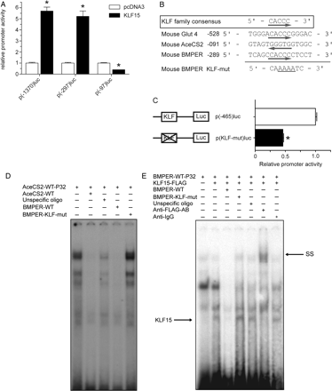
Figure 4 (A–C) KLF15 binds to the positive-acting KLF motif in the BMPER promoter. (A) The inducibility of the BMPER ...
Notes:
Figure 4 (A–C) KLF15 binds to the positive-acting KLF motif in the BMPER promoter. (A) The inducibility of the BMPER promoter by KLF15 depends on the region from −297 to −97 bp. Three deletion constructs of the BMPER promoter were co-transfected with KLF15 or pcDNA3 (empty vector). At 24 h after transfection, cells were harvested for luciferase assay. The results represent the mean ± SD of three independent experiments (*P < 0.05 vs. pcDNA3). (B) Alignment of KLF motifs in the AceCS2 gene, the Glut4 gene along with the wildtype and the mutated motif in the BMPER gene. (C) The KLF motif in the BMPER promoter at −284 bp is essential for maximal transcriptional activity. The p(−465)luc and the mutated p(KLF-mut)luc constructs were transiently transfected in COS-7 cells. At 24 h post-transfection, cells were harvested for luciferase assay. The results represent the mean ± SD of three independent experiments. Mutation of the KLF15 motif in the BMPER promoter reduced promoter activity to 45% of wildtype activity (*P < 0.05 vs. p(465)luc). (D and E) KLF15 binds specifically to the KLF motif in the BMPER promoter. (D) Nuclear extracts from C166 cells were incubated with the 32P-labelled KLF15-binding-site-derived oligonucleotide from the AceCS2 promoter (lane 1). Cold competition was performed using the same but unlabelled oligonucleotide (lane 2) or wildtype KLF15-binding-site-derived oligonucleotide from the BMPER promoter (lane 4). Mutated KLF15-binding oligonucleotide from the BMPER promoter did not compete for DNA-protein complex formation (lane 3). Incubation with an unrelated control oligonucleotide had no effect (lane 5). (E) Nuclear extracts from COS7 cells transfected with pcDNA3 (lane 1) or the FLAG-tagged KLF15 expression vector were used in binding the 32P-labelled BMPER oligonucleotide (lane 2). Cold competition was performed with an excess of unlabelled BMPER oligonucleotide BMPER-WT (lane 3). Incubation with mutated BMPER oligonucleotide BMPER-KLF-mut (lane 4) or unrelated control oligonucleotide (lane 5) had no effect on the formation of the three bands. SS studies were performed using an anti-FLAG antibody (lane 6) or an unspecific IgG antibody as control (lane 7).
Unless provided in the caption above, the following copyright applies to the content of this slide: Published on behalf of the European Society of Cardiology. All rights reserved. © The Author 2009. For permissions please email: journals.permissions@oxfordjournals.org.

Slide 5
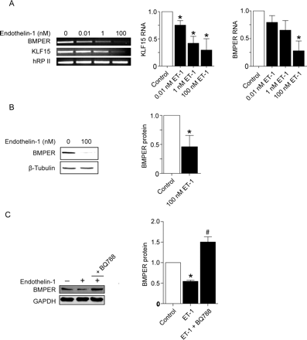
Figure 5 Endothelin-1 downregulates BMPER expression in endothelial cells. (A) Stimulation of HUVECs with the ...
Notes:
Figure 5 Endothelin-1 downregulates BMPER expression in endothelial cells. (A) Stimulation of HUVECs with the indicated concentrations of endothelin-1 for 48 h. RNA was prepared and reverse-transcribed for RT–PCR using specific primers for hBMPER, hKLF15, and hRPII as a control. One representative experiment out of three is shown. The panels to the right demonstrate the quantification of three independent experiments. (B) BMPER protein expression is reduced in HUVECs after stimulation with 100 nM endothelin-1. After 72 h stimulation with endothelin-1, cells were lysed, and western blot analysis for BMPER and β-tubulin (loading control) was performed. The right panel shows the quantification of three independent experiments (*P < 0.05 vs. control). (C) Co-incubation of selective ETB endothelin-1 receptor antagonist BQ788 blocks downregulation of BMPER expression by endothelin-1. After 72 h stimulation with endothelin-1 alone or in combination with BQ788 (2 µM), HUVECs were lysed and used for western blot analysis. GAPDH serves as loading control (*P < 0.05 vs. control).
Unless provided in the caption above, the following copyright applies to the content of this slide: Published on behalf of the European Society of Cardiology. All rights reserved. © The Author 2009. For permissions please email: journals.permissions@oxfordjournals.org.

