Slide 1
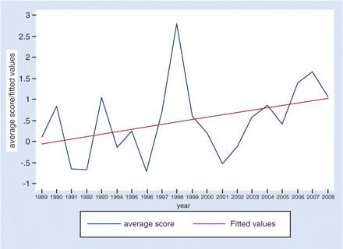
Fig. 1 Annual Average Confrontation–Friendship Score, 1989–2008. Source: Yan Xuetong, et al., Zhong Wai guanxi ...
Notes:
Fig. 1 Annual Average Confrontation–Friendship Score, 1989–2008. Source: Yan Xuetong, et al., Zhong Wai guanxi dingliang yuce (Quantitative Predictions of Sino-Foreign Relations) (Beijing: Shijie zhishi chubanshe, 2009), p. 39 (Table 1).
Unless provided in the caption above, the following copyright applies to the content of this slide: © The Author 2011. Published by Oxford University Press. All rights reserved. For permissions, please e-mail: journals.permissions@oup.com

Slide 2
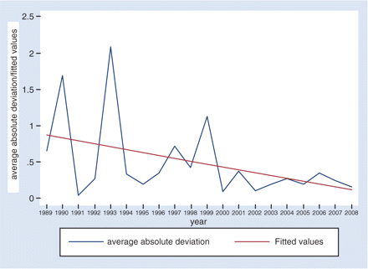
Fig. 2 Annual Confrontation–Friendship Score Average Absolute Deviation, 1989–2008. Source: Yan Xuetong, et al., ...
Notes:
Fig. 2 Annual Confrontation–Friendship Score Average Absolute Deviation, 1989–2008. Source: Yan Xuetong, et al., Zhong Wai guanxi dingliang yuce (Quantitative Predictions of Sino-Foreign Relations) (Beijing: Shijie zhishi chubanshe, 2009), p. 39 (Table 1).
Unless provided in the caption above, the following copyright applies to the content of this slide: © The Author 2011. Published by Oxford University Press. All rights reserved. For permissions, please e-mail: journals.permissions@oup.com

Slide 3
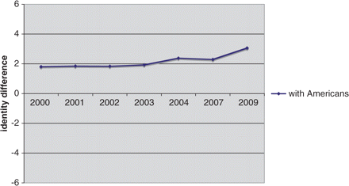
Fig. 3 Perceived Identity Difference Between Chinese and American People, as held by Chinese Respondents. Source: ...
Notes:
Fig. 3 Perceived Identity Difference Between Chinese and American People, as held by Chinese Respondents. Source: Beijing Area Study.41
Unless provided in the caption above, the following copyright applies to the content of this slide: © The Author 2011. Published by Oxford University Press. All rights reserved. For permissions, please e-mail: journals.permissions@oup.com

Slide 4
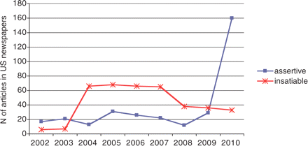
Fig. 4 Frequency Count of Articles Referring to ‘Insatiable’ and ‘Assertive’ within Five Words of ‘China’ in US ...
Notes:
Fig. 4 Frequency Count of Articles Referring to ‘Insatiable’ and ‘Assertive’ within Five Words of ‘China’ in US Newspapers and Wire Reports. Source: Lexisnexis.
Unless provided in the caption above, the following copyright applies to the content of this slide: © The Author 2011. Published by Oxford University Press. All rights reserved. For permissions, please e-mail: journals.permissions@oup.com

