Slide 1
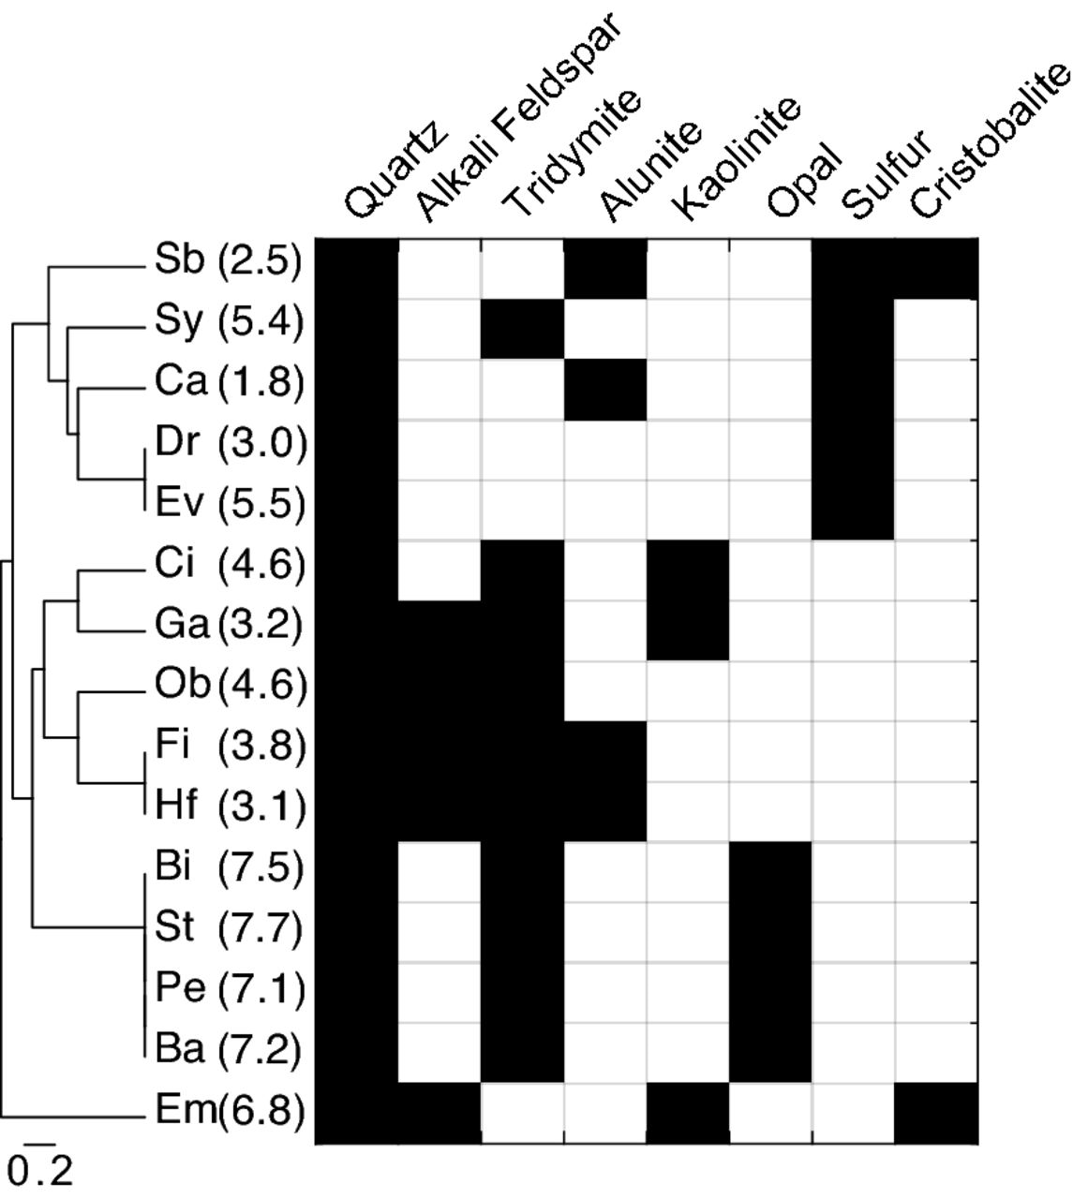
Figure 1. Sediment mineralogical distance dendrogram and corresponding mineralogical composition. UPGMA dendrogram of ...
Notes:
Figure 1. Sediment mineralogical distance dendrogram and corresponding mineralogical composition. UPGMA dendrogram of mineralogical compositional differences is shown on the left and spring pH is given next to each spring ID. The presence of each mineral constituent is indicated by a black rectangle. Scale shows Euclidean distance.
Unless provided in the caption above, the following copyright applies to the content of this slide: © FEMS 2016. All rights reserved. For permissions, please e-mail: journals.permissions@oup.com

Slide 2
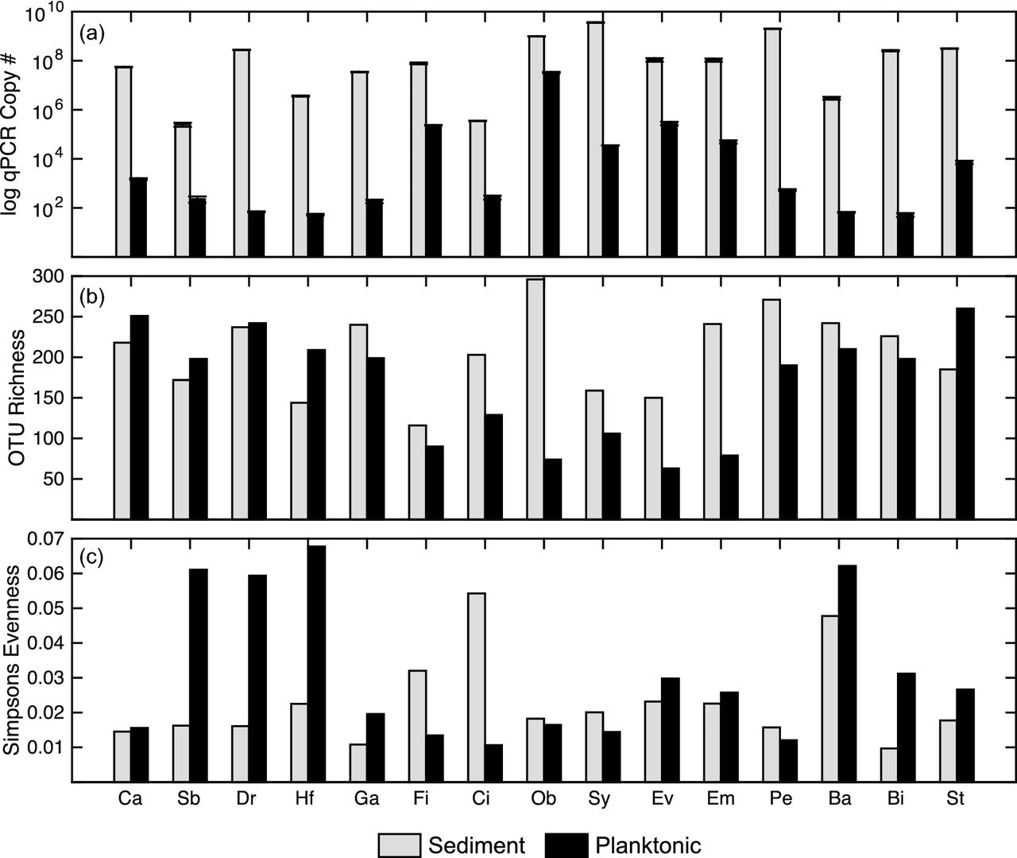
Figure 2. qPCR and community diversity measurements for each sample. (a) Sediment (gray) and planktonic (black) 16S ...
Notes:
Figure 2. qPCR and community diversity measurements for each sample. (a) Sediment (gray) and planktonic (black) 16S rRNA gene copies g−1 and ml−1, respectively. Standard error bars are overlaid for each bar. Springs are ordered from the lowest pH to the highest. (b) OTU richness and (c) community evenness for each spring sample, colored and ordered as in (a).
Unless provided in the caption above, the following copyright applies to the content of this slide: © FEMS 2016. All rights reserved. For permissions, please e-mail: journals.permissions@oup.com

Slide 3
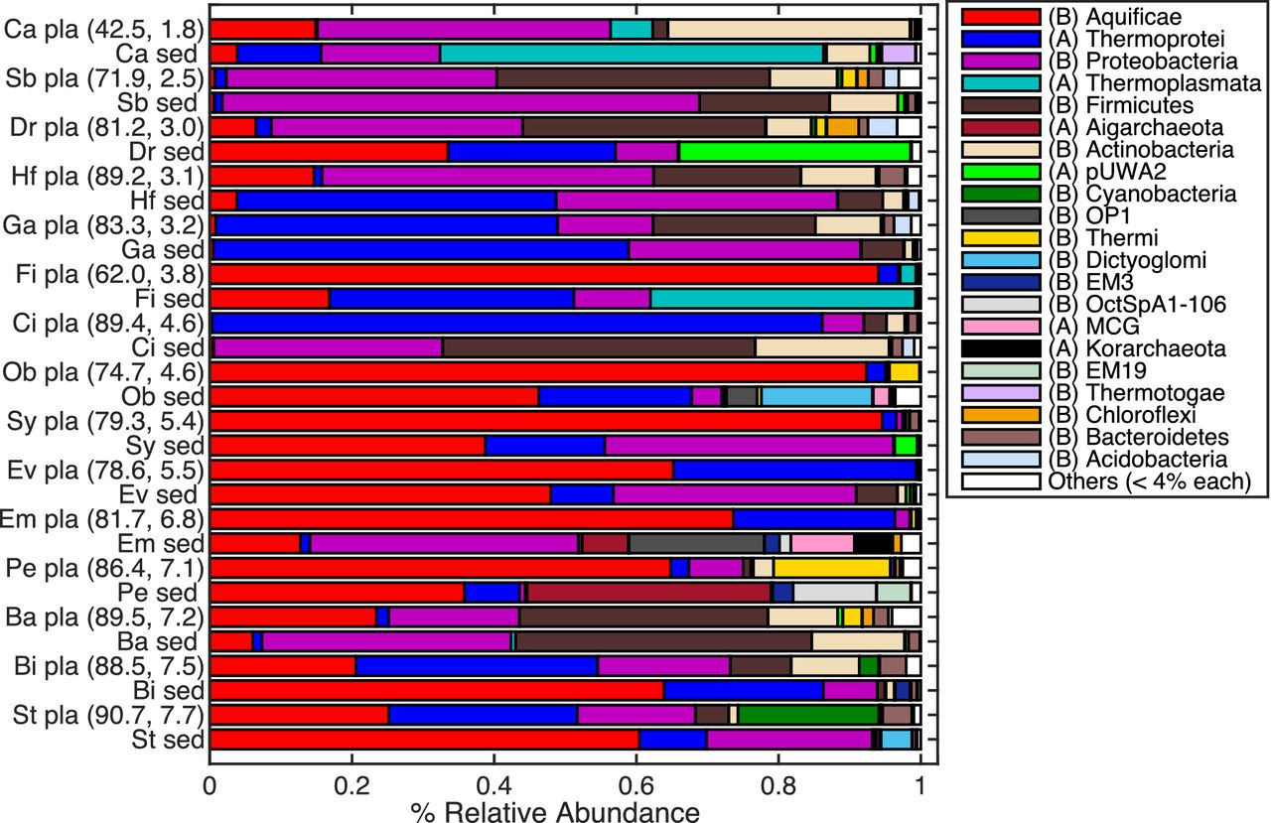
Figure 3. Community taxonomic composition at the phylum (Bacteria) or class (Archaea) level for each sample. Taxonomic ...
Notes:
Figure 3. Community taxonomic composition at the phylum (Bacteria) or class (Archaea) level for each sample. Taxonomic groups are only shown for those with >4% relative abundance in at least one sample. Domain (Archaea (A) /Bacteria (B)) of taxonomic group is given in parentheses in legend. Springs are listed from the lowest to the highest pH with planktonic communities, ‘pla’, followed by sediment communities, ‘sed’, for each spring.
Unless provided in the caption above, the following copyright applies to the content of this slide: © FEMS 2016. All rights reserved. For permissions, please e-mail: journals.permissions@oup.com

Slide 4
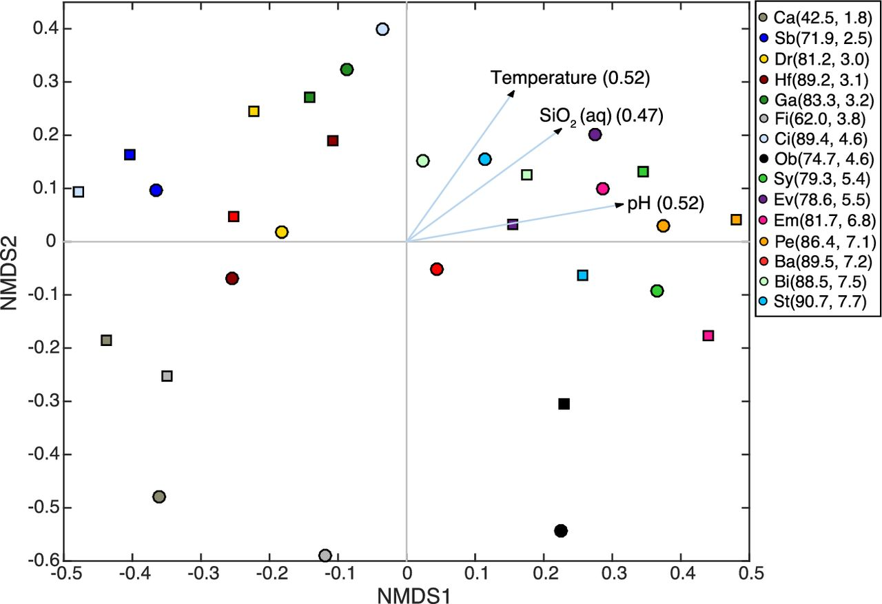
Figure 4. NMDS ordination plot showing community differences among samples and significantly correlated (P ≤ 0.05) ...
Notes:
Figure 4. NMDS ordination plot showing community differences among samples and significantly correlated (P ≤ 0.05) environmental parameters to the ordination. Planktonic communities are shown as circles and sediment communities as squares; each is colored by spring. Spring temperature and pH are given in the legend, respectively, next to the spring ID. Significantly correlated environmental parameters are given as arrows in the direction of highest correlation and with arrow length proportional to correlation strength (R2 in parentheses). DOC, although also significantly correlated to community composition was also significantly correlated to temperature and pH and is omitted from this plot.
Unless provided in the caption above, the following copyright applies to the content of this slide: © FEMS 2016. All rights reserved. For permissions, please e-mail: journals.permissions@oup.com

Slide 5
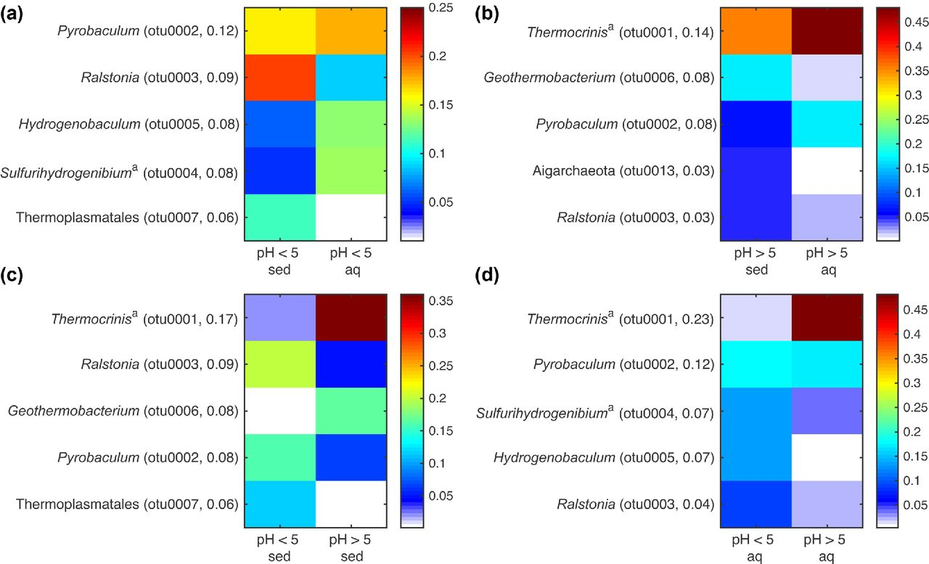
Figure 5. Relative abundance of OTUs that mostly contributed to sediment and aqueous community distance in pH < 5 and ...
Notes:
Figure 5. Relative abundance of OTUs that mostly contributed to sediment and aqueous community distance in pH 5 springs. The five OTUs that mostly contributed to community distances (by SIMPER analysis) are shown for each pairwise comparison. Taxonomic classification of each OTU is given on left (aDenotes manually annotated classification by BLAST search) followed by the OTU number and % contribution to distance in parentheses. Scale indicates each OTU's mean relative abundance in each category. Note that scales are not equivalent between plots to emphasize abundance differences for each comparison.
Unless provided in the caption above, the following copyright applies to the content of this slide: © FEMS 2016. All rights reserved. For permissions, please e-mail: journals.permissions@oup.com

