Slide 1
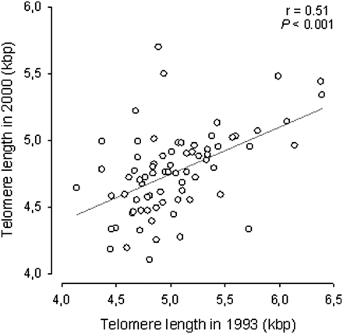
Figure 1. Relationship between leukocyte telomere length in 1993 and 2000 for 75 elderly men.
Notes:
Figure 1. Relationship between leukocyte telomere length in 1993 and 2000 for 75 elderly men.
Unless provided in the caption above, the following copyright applies to the content of this slide: © The Author 2010. Published by Oxford University Press on behalf of The Gerontological Society of America. All rights reserved. For permissions, please e-mail: journals.permissions@oup.com.

Slide 2
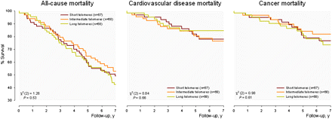
Figure 2. Kaplan–Meier analysis of survival according to the tertiles of leukocyte telomere length status in 203 Dutch ...
Notes:
Figure 2. Kaplan–Meier analysis of survival according to the tertiles of leukocyte telomere length status in 203 Dutch men. In log-rank overall tests, men with a shorter telomere length had similar survival rates as compared with men with a longer telomere length.
Unless provided in the caption above, the following copyright applies to the content of this slide: © The Author 2010. Published by Oxford University Press on behalf of The Gerontological Society of America. All rights reserved. For permissions, please e-mail: journals.permissions@oup.com.

