Slide 1
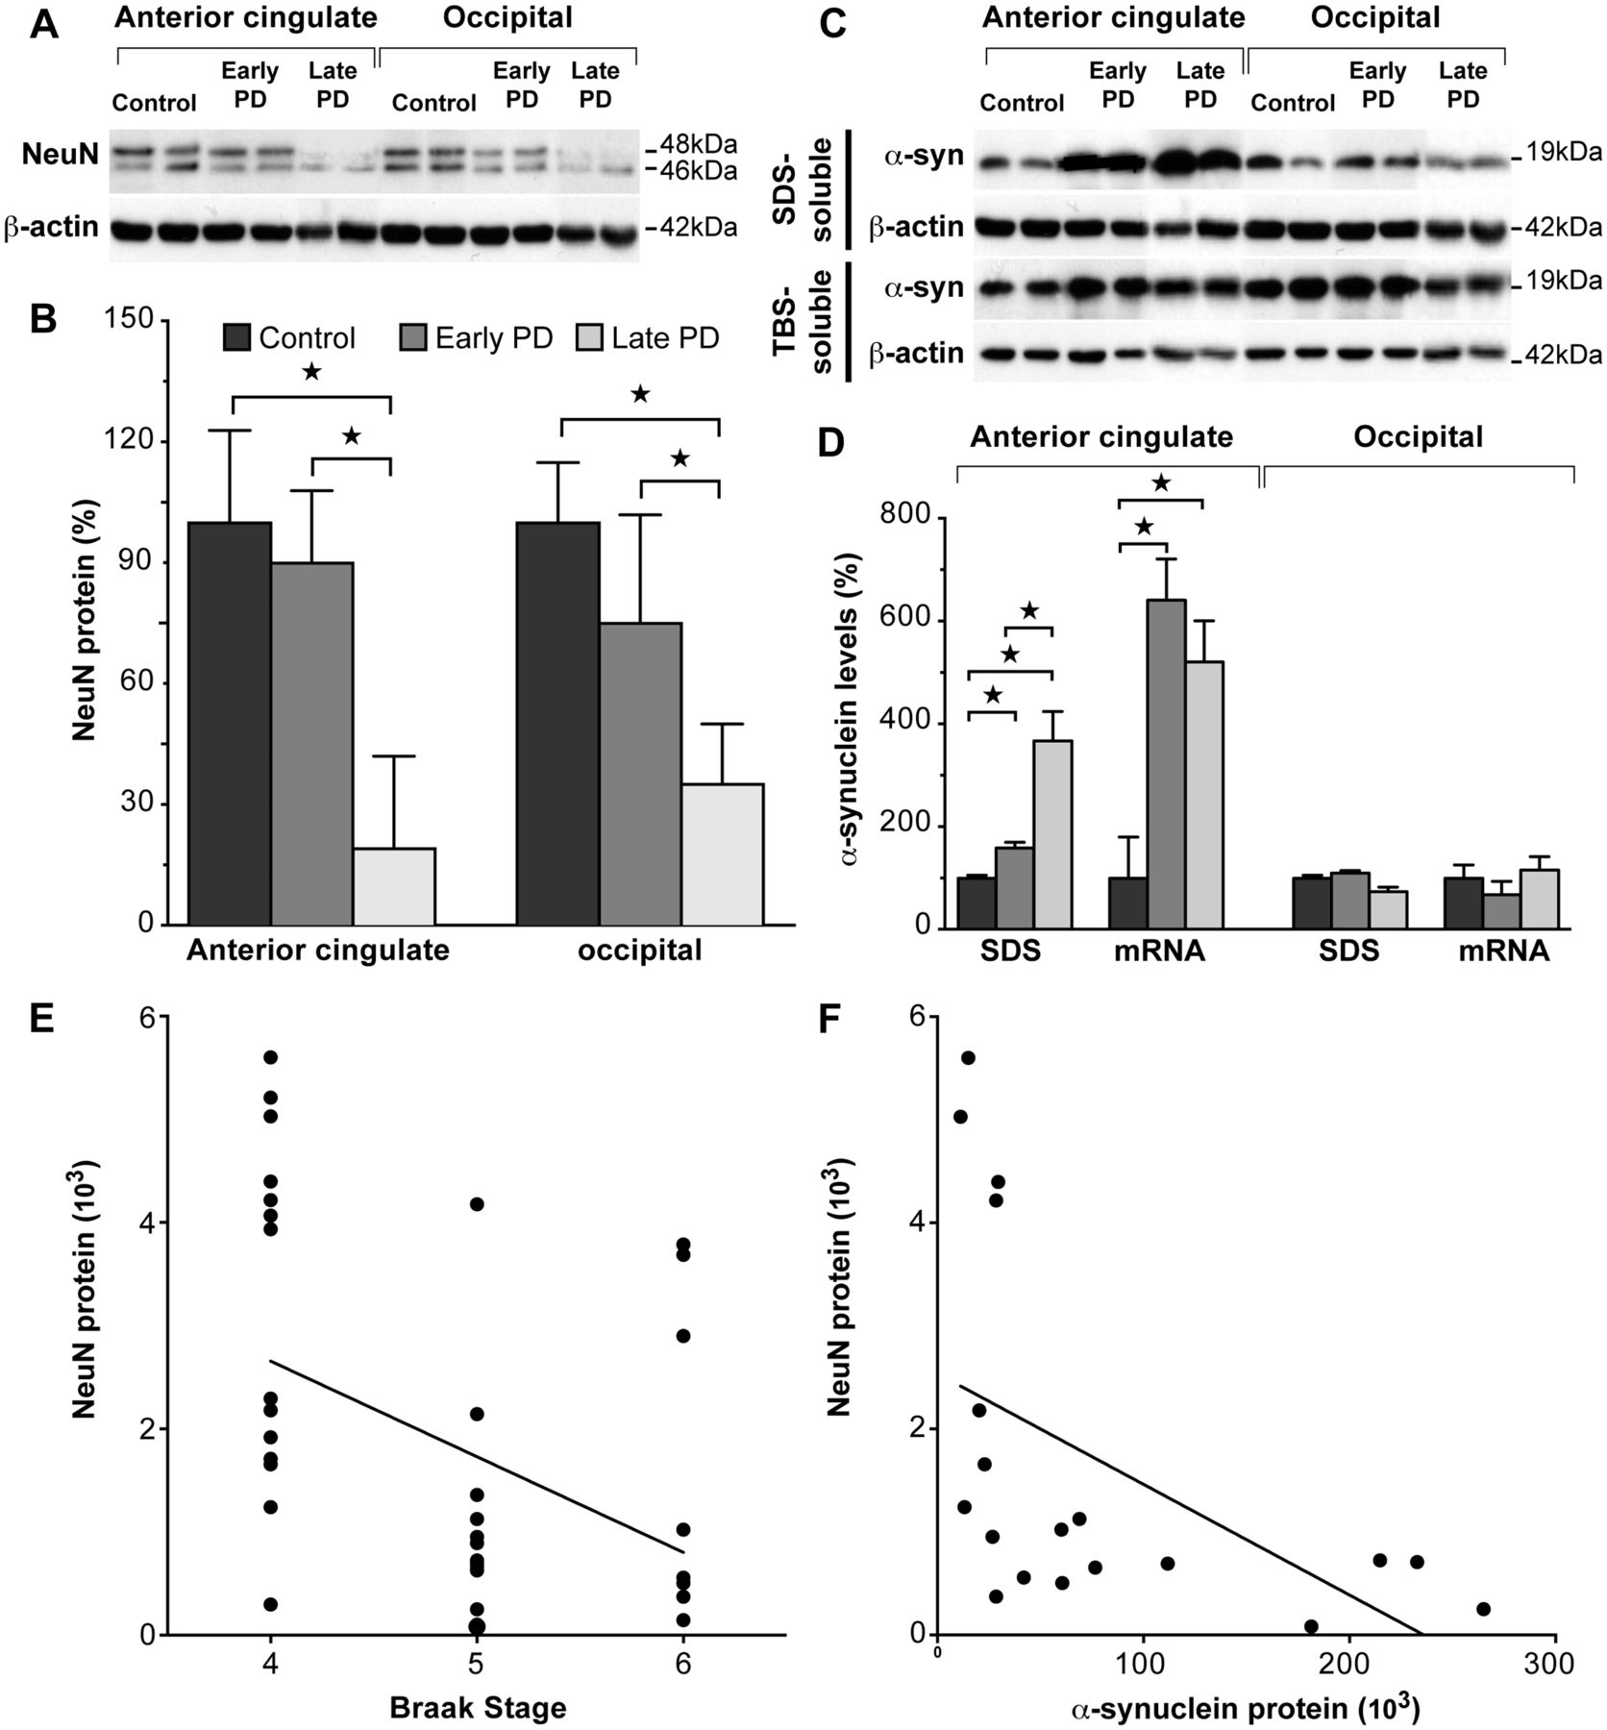
Figure 1 Characterization of neuron loss and α-synuclein changes in early and later stage sporadic Parkinson’s disease ...
Notes:
Figure 1 Characterization of neuron loss and α-synuclein changes in early and later stage sporadic Parkinson’s disease (PD). (A) Representative western blots of NeuN protein in control, early stage Parkinson’s disease and later stage Parkinson’s disease anterior cingulate and occipital cortices. (B) Quantitative western blot data of NeuN protein levels in control (n = 10), early stage Parkinson’s disease (n = 7) and later stage Parkinson’s disease (n = 12) cases. In early stage Parkinson’s disease anterior cingulate and occipital cortices, NeuN was not significantly different (P > 0.92), whereas NeuN was reduced in later stage Parkinson’s disease (P = 0.014). This confirms the lack of substantial cortical neuron loss in early stage Parkinson’s disease. ☆P < 0.05. (C) Representative western blots of SDS- and TBS-soluble α-synuclein protein in control, early stage Parkinson’s disease and later stage Parkinson’s disease anterior cingulate and occipital cortices. (D) Quantitative data of SDS-soluble α-synuclein protein and α-synuclein messenger RNA levels in control (n = 10), early stage Parkinson’s disease (n = 7) and later stage Parkinson’s disease (n = 12) cases. SDS-soluble α-synuclein was selectively increased in early stage Parkinson’s disease (P < 0.0001), and further increased in later stage Parkinson’s disease (P < 0.0001) anterior cingulate cortex, with unchanged levels in the occipital cortex. α-Synuclein messenger RNA was selectively increased to a similar extent in early stage Parkinson’s disease (P = 0.004) and later stage Parkinson’s disease (P = 0.004), with unchanged levels in the occipital cortex. These results confirm the regional selectivity of abnormal α-synuclein accumulation in early stage Parkinson’s disease. ☆P < 0.05. (E) Braak stage was significantly correlated with NeuN protein levels in all Parkinson’s disease samples (non-parametric Spearman’s rho = -0.47, P = 0.003), confirming the association of lower NeuN levels with the higher Braak stages of later stage Parkinson’s disease. (F) SDS-soluble α-synuclein protein levels were significantly correlated with NeuN levels (non-parametric Spearman’s rho = −0.69, P = 0.001) in Parkinson’s disease anterior cingulate cortex. This indicates that neuron loss associates with greater accumulation of membrane-associated α-synuclein in Parkinson’s disease anterior cingulate cortex.
Unless provided in the caption above, the following copyright applies to the content of this slide: © The Author (2014). Published by Oxford University Press on behalf of the Guarantors of Brain. All rights reserved. For Permissions, please email: journals.permissions@oup.com

Slide 2
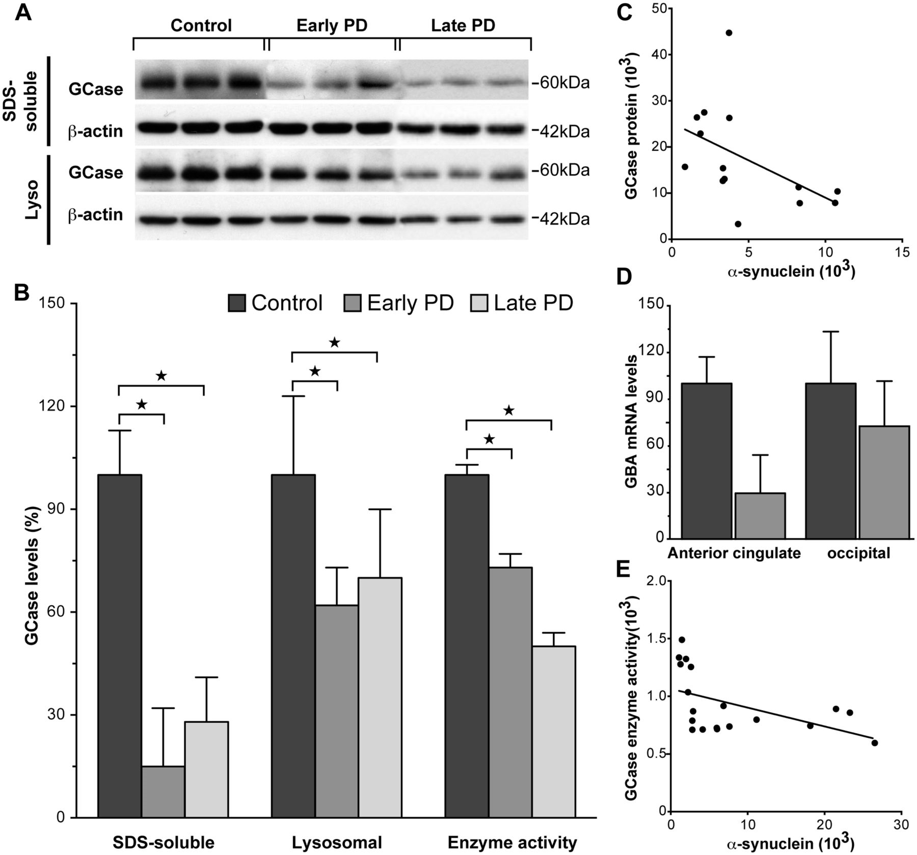
Figure 2 Glucocerebrosidase protein levels and enzyme activity were selectively reduced in regions that accumulate ...
Notes:
Figure 2 Glucocerebrosidase protein levels and enzyme activity were selectively reduced in regions that accumulate abnormal α-synuclein in sporadic Parkinson’s disease. (A) Representative western blots of SDS-soluble and lysosomal glucocerebrosidase (GCase) protein in control, early stage Parkinson’s disease and later stage Parkinson’s disease anterior cingulate cortex. (B) Quantitative data of SDS-soluble and lysosomal glucocerebrosidase protein and glucocerebrosidase enzyme activity in control (n = 10), early stage Parkinson’s disease (n = 7) and later stage Parkinson’s disease (n = 12) cases. There were selective reductions in SDS-soluble glucocerebrosidase (P = 0.006), lysosomal glucocerebrosidase (P = 0.013), and glucocerebrosidase enzyme activity (P = 0.003) in early stage Parkinson’s disease anterior cingulate cortex. There was no difference between early and later stage Parkinson’s disease anterior cingulate cortex for SDS-soluble glucocerebrosidase (P > 0.21), lysosomal glucocerebrosidase (P > 0.21), or glucocerebrosidase enzyme activity (P > 0.21). *P 0.25), the anterior cingulate cortex seemed to have less GBA1 messenger RNA. (E) The reduction in lysosomal glucocerebrosidase enzyme activity was significantly correlated with the increase in SDS-soluble α-synuclein protein in early and later stage Parkinson’s disease anterior cingulate cortex (non-parametric Spearman’s rho = −0.63, P = 0.005).
Unless provided in the caption above, the following copyright applies to the content of this slide: © The Author (2014). Published by Oxford University Press on behalf of the Guarantors of Brain. All rights reserved. For Permissions, please email: journals.permissions@oup.com

Slide 3
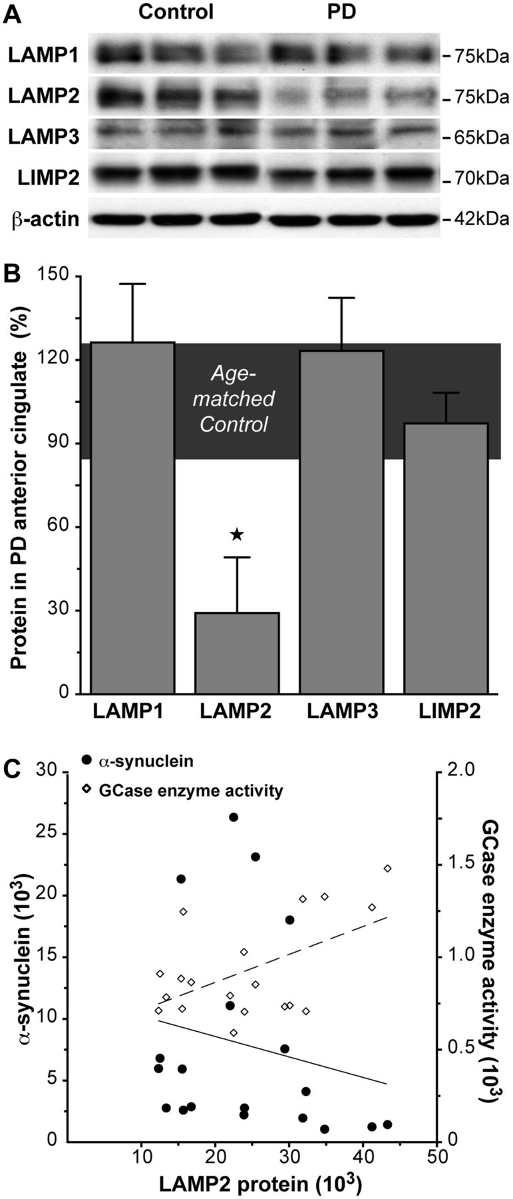
Figure 3 SDS-soluble lysosomal membrane protein LAMP2 levels were selectively reduced in association with reduced ...
Notes:
Figure 3 SDS-soluble lysosomal membrane protein LAMP2 levels were selectively reduced in association with reduced glucocerebrosidase (GCase) in regions that accumulate abnormal α-synuclein in early stage Parkinson’s disease (PD). (A) Representative western blots of SDS-soluble lysosomal membrane proteins LAMP1, LAMP2, LAMP3 and LIMP2 in control and early stage Parkinson’s disease anterior cingulate cortex. (B) Quantitative data of SDS-soluble lysosomal membrane proteins in control (n = 10; horizontal bar at 100 ± 15%) and early stage Parkinson’s disease (n = 7) anterior cingulate cortex showed no significant changes in LAMP1 (P = 0.12), LAMP3 (P = 0.76) and LIMP2 (P = 0.68), but a selective reduction of LAMP2 in early stage Parkinson’s disease (P = 0.005). *P < 0.05. (C) The reduction in SDS-soluble LAMP2 protein was negatively correlated with increased SDS-soluble α-synuclein (circles with unbroken line; non-parametric Spearman’s rho = −0.82, P = 0.023), and positively correlated with decreased glucocerebrosidase enzyme activity (diamonds with dashed line; non-parametric Spearman’s rho = 0.89, P = 0.007) in early stage Parkinson’s disease.
Unless provided in the caption above, the following copyright applies to the content of this slide: © The Author (2014). Published by Oxford University Press on behalf of the Guarantors of Brain. All rights reserved. For Permissions, please email: journals.permissions@oup.com

Slide 4
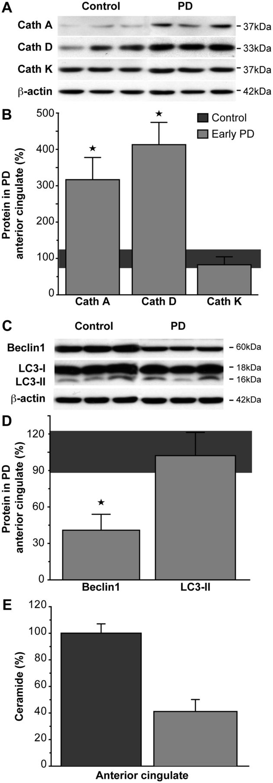
Figure 4 Chaperone-mediated autophagy- and macroautophagy-related proteins and total ceramide were selectively altered ...
Notes:
Figure 4 Chaperone-mediated autophagy- and macroautophagy-related proteins and total ceramide were selectively altered in regions that accumulate abnormal α-synuclein in early stage Parkinson’s disease. (A) Representative western blots of TBS-soluble lysosomal cathepsins (Cath) in control and early stage Parkinson’s disease anterior cingulate cortex. (B) Quantitative data of TBS-soluble lysosomal cathepsins in control (n = 10; horizontal bar at 100 ± 15%) and early stage Parkinson’s disease (n = 7) anterior cingulate cortex showed that the cathepsins related to the chaperone-mediated autophagic degradation of α-synuclein were significantly increased in early stage Parkinson’s disease (cathepsin A P = 0.004; cathepsin D P = 0.001), with no change to the GBA1-related cathepsin K levels (P = 0.41). *P < 0.05. (C) Representative western blots of SDS-soluble autophagosome marker proteins in control and early stage Parkinson’s disease anterior cingulate cortex. (D) Quantitative data of SDS-soluble autophagosome marker proteins in control (n = 10; horizontal bar at 100 ± 15%) and early stage Parkinson’s disease (n = 7) anterior cingulate cortex showed that beclin1 was significantly reduced in early stage Parkinson’s disease (P < 0.0001), while LC3-II levels remained within normal levels (P = 0.91). *P < 0.05. (E) Ceramide trended toward a selective reduction in early stage Parkinson’s disease anterior cingulate (P = 0.059). Data are presented as percentage changes in early stage Parkinson’s disease (n = 7) compared to controls (n = 10).
Unless provided in the caption above, the following copyright applies to the content of this slide: © The Author (2014). Published by Oxford University Press on behalf of the Guarantors of Brain. All rights reserved. For Permissions, please email: journals.permissions@oup.com

