Slide 1
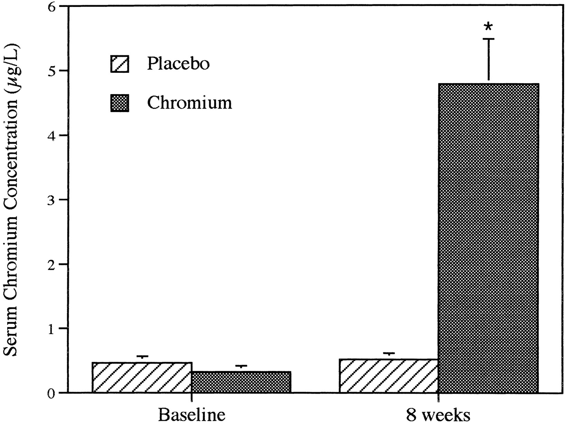
Figure 1. Mean (± SEM) serum chromium concentrations at baseline and after 8 weeks of chromium picolinate (1000 μg/d) ...
Notes:
Figure 1. Mean (± SEM) serum chromium concentrations at baseline and after 8 weeks of chromium picolinate (1000 μg/d) or placebo. * p < .0001.
Unless provided in the caption above, the following copyright applies to the content of this slide: The Gerontological Society of America

