Slide 1
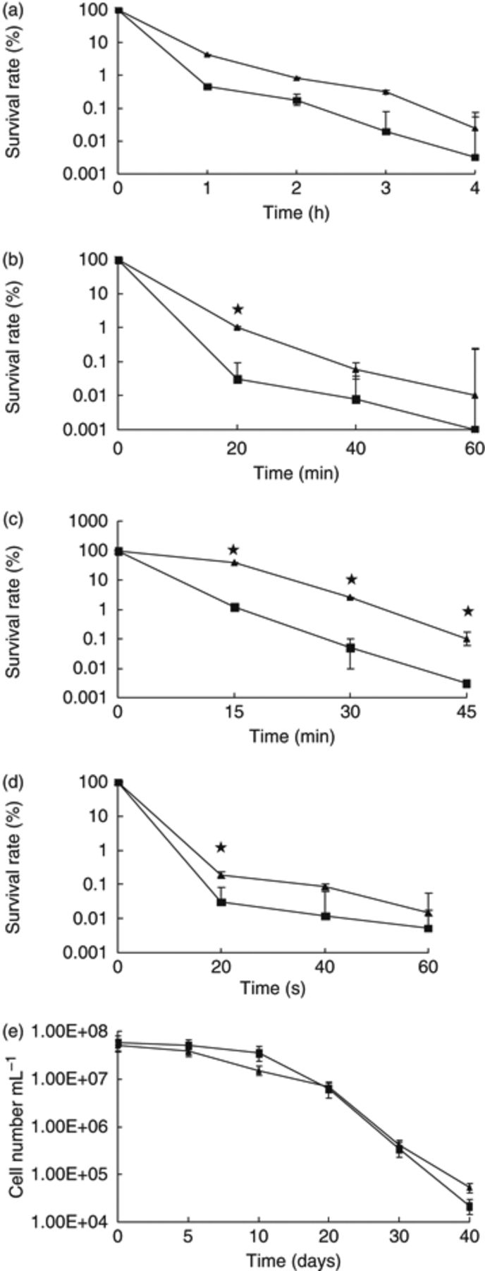
1 Survival of the rpoS mutant and wild-type cells of Vibrio anguillarum to different stresses. The survival ...
Notes:
1 Survival of the rpoS mutant and wild-type cells of Vibrio anguillarum to different stresses. The survival rates were determined as the percentage of viable plate counts at the indicated time points. Bar limits represent SD. *Significant differences (P<0.05) between the values of the rpoS mutant and wild-type cells of V. anguillarum. ▲, the wild-type strain; ▪, the mutant strain. (a) 2.4 M NaCl, (b) 5 mM of H2O2, (c) 45°C in ASW, (d) UV-irradiation, (e) starvation (4°C in ASW).
Unless provided in the caption above, the following copyright applies to the content of this slide: © 2009 Federation of European Microbiological Societies. Published by Blackwell Publishing Ltd. All rights reserved

