Slide 1
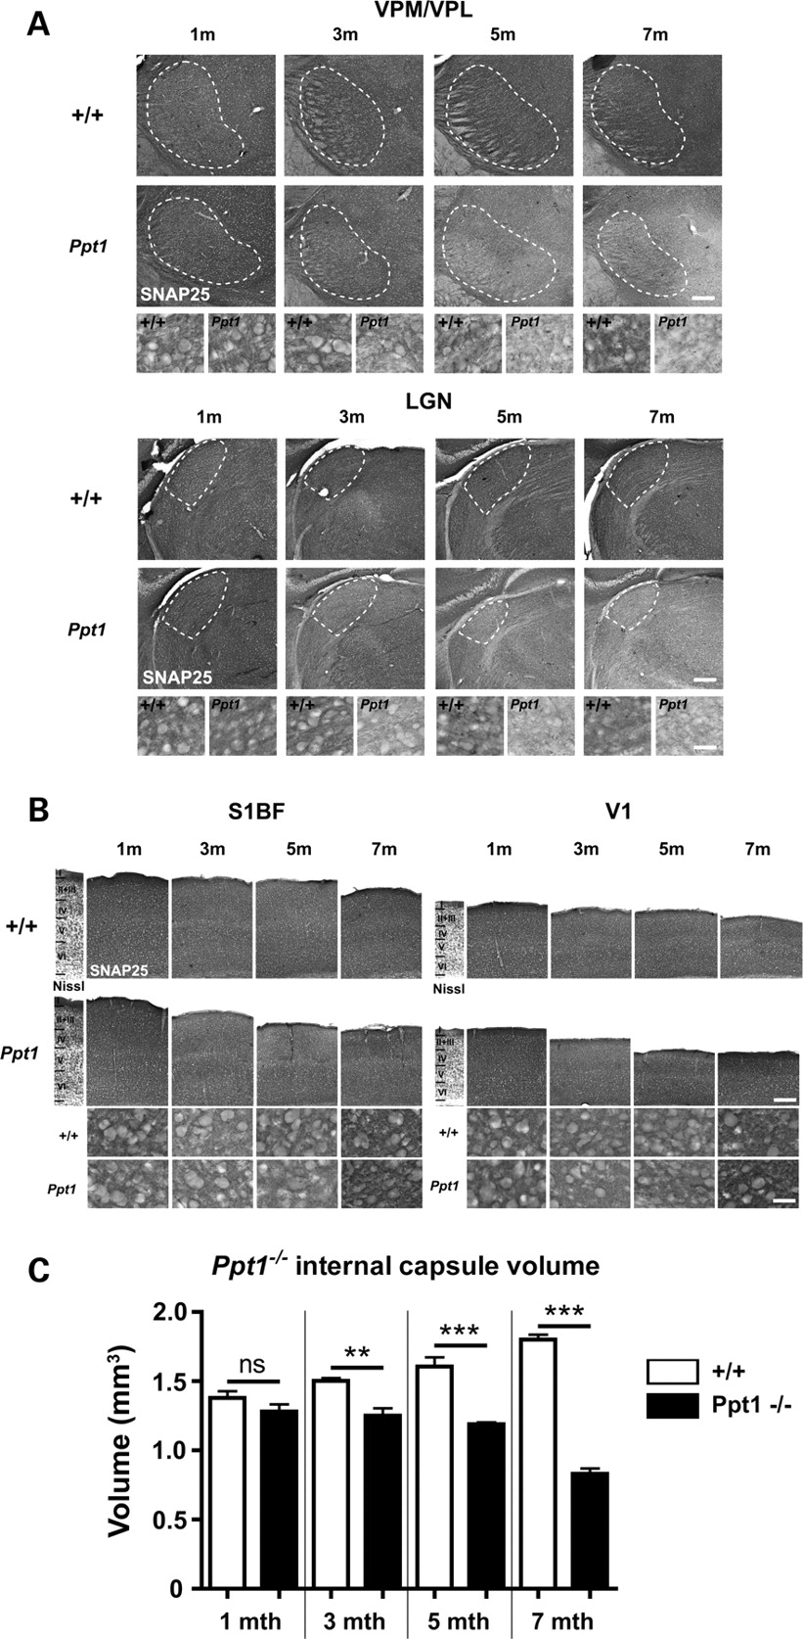
Figure 1. Effects upon SNAP25 expression in the visual and somatosensory system of Ppt1 deficient mice. (A) Changes in ...
Notes:
Figure 1. Effects upon SNAP25 expression in the visual and somatosensory system of Ppt1 deficient mice. (A) Changes in the distribution and intensity of staining for SNAP25 in the ventral posteromedial and ventral posterolateral (VPM/VPL) and dorsal lateral geniculate (LGNd) thalamic nuclei of 1, 3, 5 and 7-month-old Ppt1 deficient mice ( Ppt1 ) and controls (+/+). Immunohistochemical staining for SNAP 25 within individual thalamic nuclei reveals similar levels of immunoreactivity in the VPM/VPL and LGNd of Ppt1 deficient mice and control mice at 1 month of age. However, levels of SNAP25 were markedly reduced in the thalamus of Ppt1 deficient mice from 3 months of age and continued to decrease with increased age in these mutant mice, as revealed in more detail at higher magnification. The boundaries of thalamic nuclei are indicated by white dashed lines. (B) SNAP25 immunoreactivity in the cortex was noticeably decreased by 3 months of age, but subsequently increased in intensity over time compared with age-matched control mice (+/+). Laminar boundaries are indicated by roman numerals on a Nissl-stained section through the same region of cortex. (C) Stereological survey of internal capsule volume in control and Ppt1−/− tissue at different stages of disease progression. The volume of the internal capsule was significantly reduced in Ppt1−/− mice versus controls from 3 months of age onwards. This reduction increased with time to reach a 40% difference between Ppt1 deficient mice and age matched controls at 7 months of age. (mean ± SEM; ** P < 0.01; *** P 3 mice per genotype. Scale bar = 200 µm in ( A and B ); 30 µm in higher magnification views.
Unless provided in the caption above, the following copyright applies to the content of this slide: © 2009 The Author(s).This is an Open Access article distributed under the terms of the Creative Commons Attribution Non-Commercial License (http://creativecommons.org/licenses/by-nc/2.0/uk/) which permits unrestricted non-commercial use, distribution, and reproduction in any medium, provided the original work is properly cited.

Slide 2
Figure 2. Representative fluorescent western blots of protein expression levels of Pttg1, VDAC1 and tubulin loading ...
Notes:
Figure 2. Representative fluorescent western blots of protein expression levels of Pttg1, VDAC1 and tubulin loading control in the thalamus of Ppt1−/− mice (−/−) and littermate controls (+/+) at 1, 3, 5 and 7 months.
Unless provided in the caption above, the following copyright applies to the content of this slide: © 2009 The Author(s).This is an Open Access article distributed under the terms of the Creative Commons Attribution Non-Commercial License (http://creativecommons.org/licenses/by-nc/2.0/uk/) which permits unrestricted non-commercial use, distribution, and reproduction in any medium, provided the original work is properly cited.

Slide 3
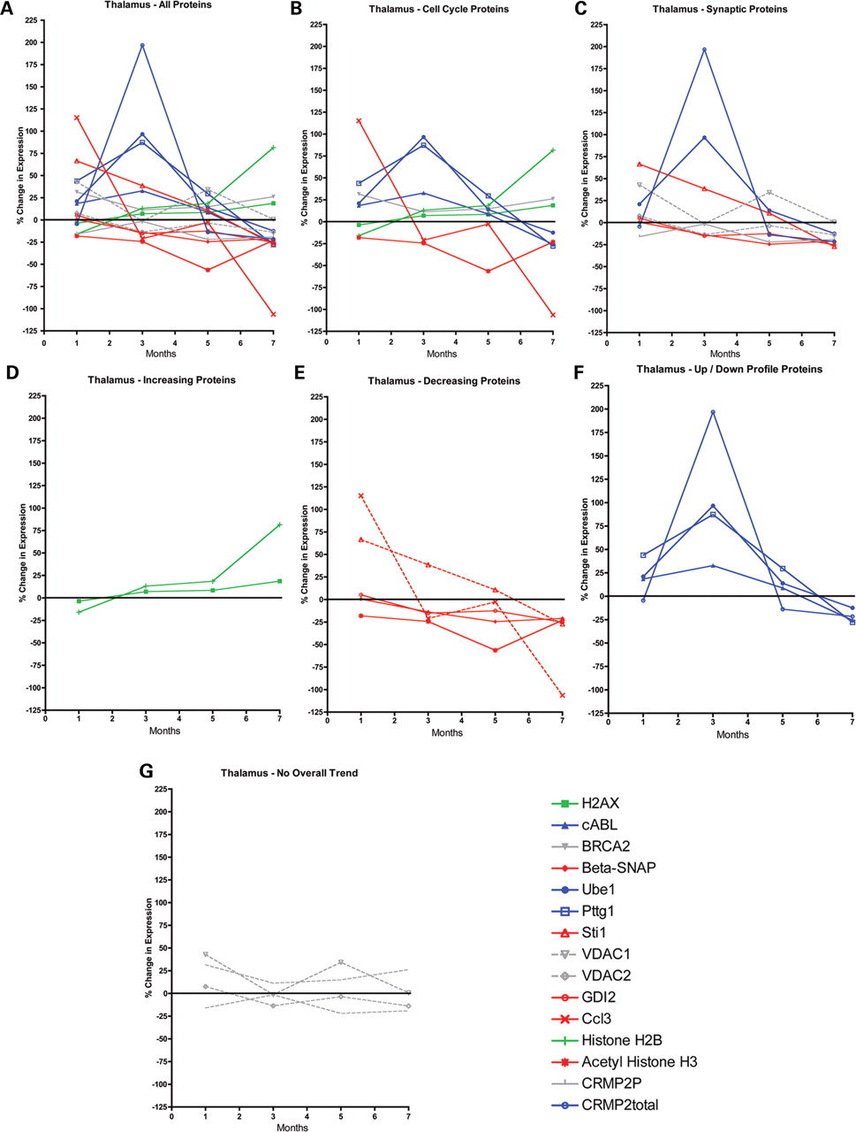
Figure 3. Temporal progression of protein expression changes in the thalamus of Ppt1^{−/−} mice. ( A ) ...
Notes:
Figure 3. Temporal progression of protein expression changes in the thalamus of Ppt1−/− mice. ( A ) Temporal progression of expression profiles for all 15 proteins examined. This graph is included to illustrate the overall complexity of expression changes observed. Data for individual proteins is shown more clearly on the subsequent graphs. ( B ) Graph of cell cycle proteins only [data extracted from (A)]. ( C ) Graph of synaptic proteins only [data extracted from (A)]. ( D – G ) Graphs showing expression levels for proteins conforming to a ‘increasing’ profile (D), ‘decreasing’ profile (E), ‘up-down’ profile (F) or ‘no overall trend’ profile (G). Profiles were determined by the patterns of change in expression following initial measurements in 1-month-old mice, not by the initial direction of change. Note how proteins conforming to the ‘up-down’ profile reach their peak in 3-month-old mice. All data normalized to control tubulin levels.
Unless provided in the caption above, the following copyright applies to the content of this slide: © 2009 The Author(s).This is an Open Access article distributed under the terms of the Creative Commons Attribution Non-Commercial License (http://creativecommons.org/licenses/by-nc/2.0/uk/) which permits unrestricted non-commercial use, distribution, and reproduction in any medium, provided the original work is properly cited.

Slide 4
Figure 4. Representative fluorescent western blots of protein expression levels of Pttg1, VDAC1 and tubulin loading ...
Notes:
Figure 4. Representative fluorescent western blots of protein expression levels of Pttg1, VDAC1 and tubulin loading control in the cortex of Ppt1−/− mice (−/−) and littermate controls (+/+) at 1, 3, 5 and 7 months.
Unless provided in the caption above, the following copyright applies to the content of this slide: © 2009 The Author(s).This is an Open Access article distributed under the terms of the Creative Commons Attribution Non-Commercial License (http://creativecommons.org/licenses/by-nc/2.0/uk/) which permits unrestricted non-commercial use, distribution, and reproduction in any medium, provided the original work is properly cited.

Slide 5
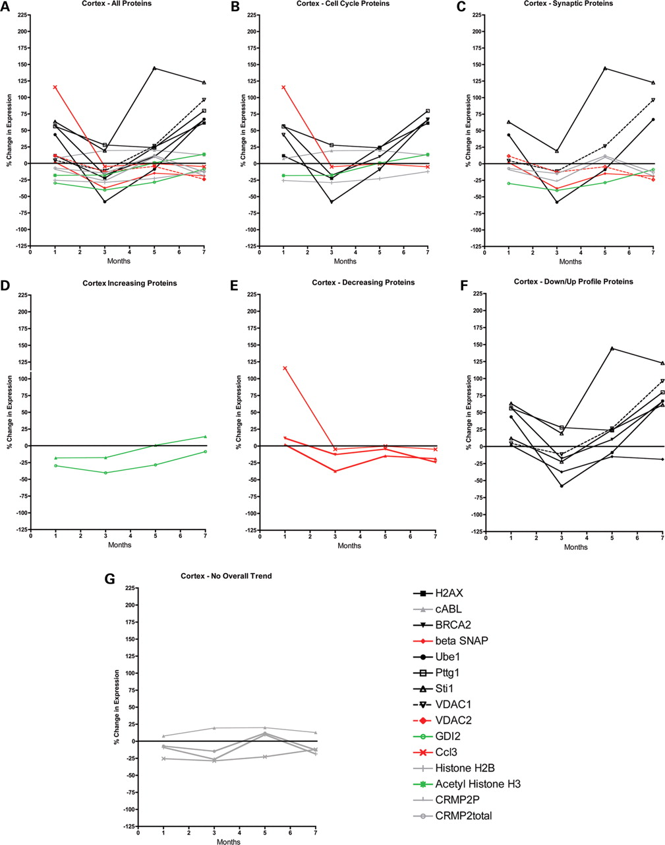
Figure 5. Temporal progression of protein expression changes in the cortex of Ppt1^{−/−} mice. ( A ) Temporal ...
Notes:
Figure 5. Temporal progression of protein expression changes in the cortex of Ppt1−/− mice. ( A ) Temporal progression of expression profiles for all 15 proteins examined. This graph is included to illustrate the overall complexity of expression changes observed. Data for individual proteins is shown more clearly on the subsequent graphs. ( B ) Graph of cell cycle proteins only [data extracted from (A)]. ( C ) Graph of synaptic proteins only [data extracted from (A)]. ( D – G ) Graphs showing expression levels for proteins conforming to a ‘increasing’ profile (D), ‘decreasing’ profile (E), ‘down-up’ profile (F) or ‘no overall trend’ profile (G). Profiles were determined by the patterns of change in expression following initial measurements in 1-month-old mice, not by the initial direction of change. Note how proteins conforming to the ‘down-up’ profile reach their peak in 3-month-old mice. All data normalized to control tubulin levels.
Unless provided in the caption above, the following copyright applies to the content of this slide: © 2009 The Author(s).This is an Open Access article distributed under the terms of the Creative Commons Attribution Non-Commercial License (http://creativecommons.org/licenses/by-nc/2.0/uk/) which permits unrestricted non-commercial use, distribution, and reproduction in any medium, provided the original work is properly cited.

Slide 6
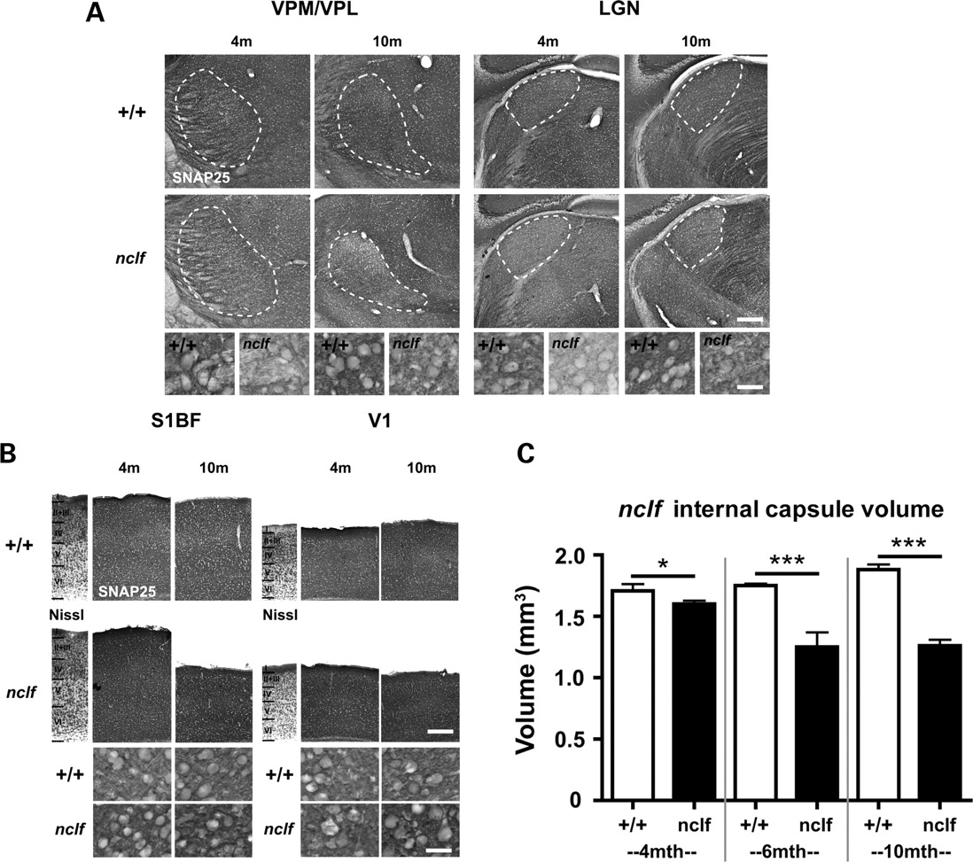
Figure 6. Synaptic and axonal pathology in early-symptomatic Cln6^{nclf} mice (A) Changes in the distribution ...
Notes:
Figure 6. Synaptic and axonal pathology in early-symptomatic Cln6nclf mice (A) Changes in the distribution and intensity of staining for SNAP25 in the ventral posteromedial and ventral posterolateral (VPM/VPL) and dorsal lateral geniculate (LGN) thalamic nuclei of 4 and 10-month-old Cln6nclf deficient mice ( nclf ) and controls (+/+). SNAP25 immunoreactivity was markedly reduced in the thalamus of Cln6nclf mice at 4 months of age and was decreased further at 10 months of age in Cln6nclf mice, as revealed in more detail at higher magnification. The boundaries of thalamic nuclei are indicated by white dashed lines. (B) SNAP25 immunoreactivity was already elevated compared with controls (+/+) at 4 months of age, and was subsequently more intense in Cln6nclf mice at 10 months of age. Laminar boundaries are indicated by roman numerals on a Nissl-stained section through the same region of cortex. (C) Stereological survey of internal capsule volume in control and Cln6nclf tissue at different stages of disease progression. The volume of the internal capsule was significantly reduced in Cln6nclf mice versus controls from 4 months of age onwards. This reduction increased with time to reach a 40% difference between Cln6nclf mice and age-matched controls at 10 months of age. (mean ± SEM; ** P < 0.01; *** P 3 mice per genotype. Scale bar = 200 µm in ( A and B ); 30 µm in higher magnification views.
Unless provided in the caption above, the following copyright applies to the content of this slide: © 2009 The Author(s).This is an Open Access article distributed under the terms of the Creative Commons Attribution Non-Commercial License (http://creativecommons.org/licenses/by-nc/2.0/uk/) which permits unrestricted non-commercial use, distribution, and reproduction in any medium, provided the original work is properly cited.

Slide 7
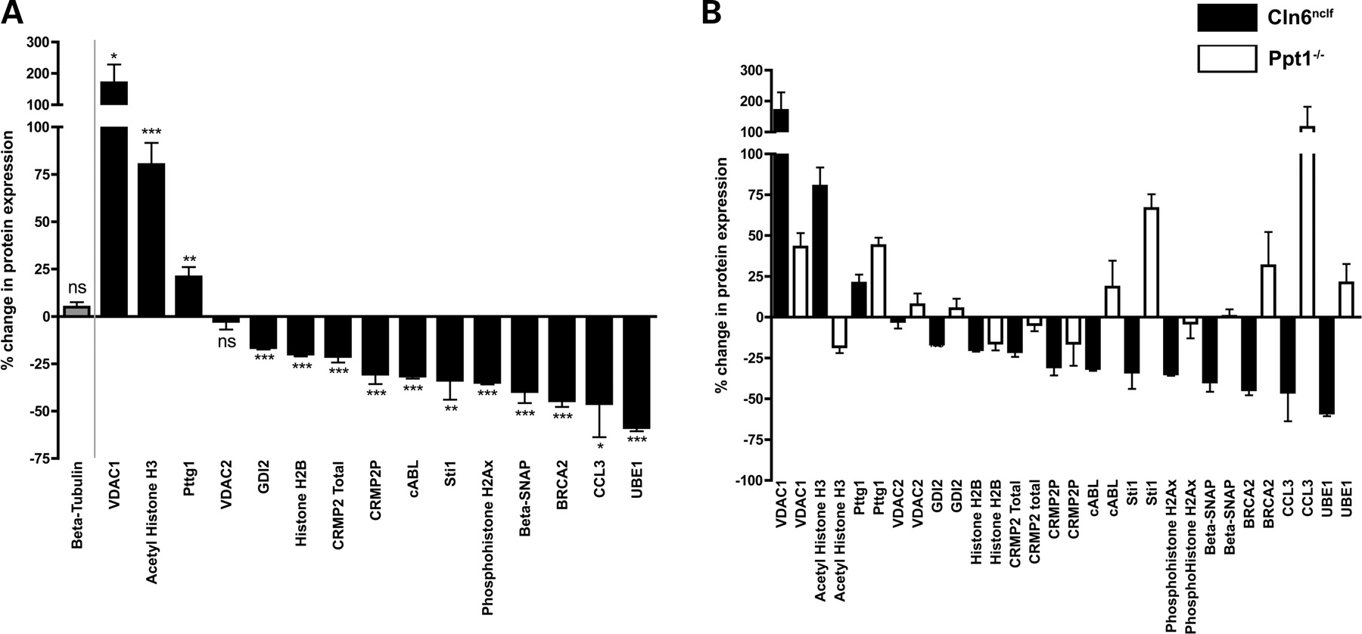
Figure 7. Protein expression changes in the thalamus of early-symptomatic (3 month old) Cln6^{nclf} mice ...
Notes:
Figure 7. Protein expression changes in the thalamus of early-symptomatic (3 month old) Cln6nclf mice compared with early-symptomatic (1 month old) Ppt1−/− mice reveal VDAC1 and Pttg1 as potential biomarkers of axonal and synaptic vulnerability. ( A ) Bar chart showing percentage changes in expression levels for all 15 proteins examined in Cln6nclf mice (as well as tubulin control levels), compared with wild-type littermate controls. Statistical values were calculated using unpaired t -tests on raw arbitrary fluorescence values from Cln6nclf mice compared with wild-type littermate controls. Note that all but one of the experimental proteins (VDAC2) had significant changes in expression levels in the Cln6nclf mice. ( B ) Bar chart showing expression levels (normalized to tubulin) for all 15 proteins examined. Black bars show data from Cln6nclf mice and white bars show data from Ppt1−/− mice (mean ± SEM; n = 3 mice per genotype/protein). Note the distinct expression profiles between the two groups of mice: only 5 out of the 15 proteins examined showed expression changes consistently changing in the same direction. Two of the proteins examined, however, showed robust increases in expression levels in both mouse models (VDAC1 and Pttg1). Expression data for CRMP2 total and CRMP2P in Cln6nclf mice are the same as those previously published in ( 62 ).
Unless provided in the caption above, the following copyright applies to the content of this slide: © 2009 The Author(s).This is an Open Access article distributed under the terms of the Creative Commons Attribution Non-Commercial License (http://creativecommons.org/licenses/by-nc/2.0/uk/) which permits unrestricted non-commercial use, distribution, and reproduction in any medium, provided the original work is properly cited.

Slide 8
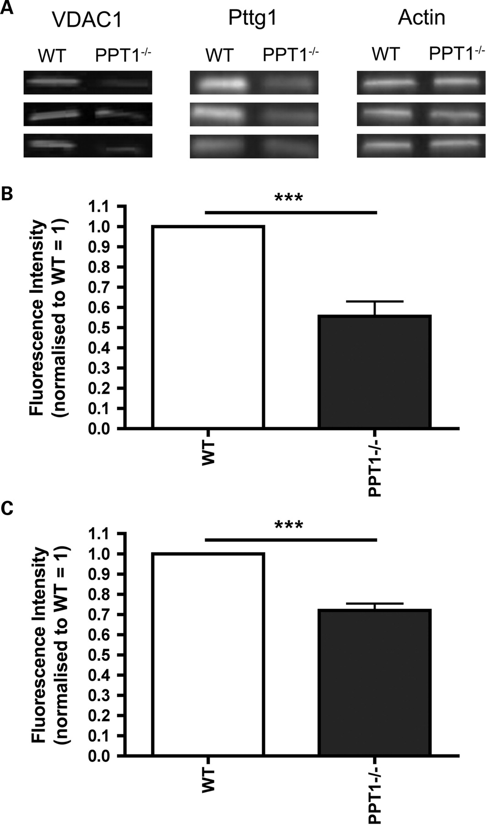
Figure 8. VDAC1 and Pttg1 protein expression changes were also detectable in peripherally accessible muscle tissue ...
Notes:
Figure 8. VDAC1 and Pttg1 protein expression changes were also detectable in peripherally accessible muscle tissue from 1-month-old Ppt1−/− mice. ( A ) Bands from quantitative fluorescent western blots showing significantly reduced expression levels of both VDAC1 and Pttg1 in 1-month-old Ppt1−/− mice (example blots from three separate animals are shown to illustrate variability between samples). Actin is shown as a loading control. ( B ) Bar chart showing a significant reduction in VDAC1 levels in muscle tissue from 1-month-old Ppt1−/− mice (*** P < 0.001, Mann–Whitney test, n = 4 mice per genotype). ( C ) Bar chart showing a significant reduction in Pttg1 levels in muscle tissue from 1-month-old Ppt1−/− mice (*** P < 0.001, Mann–Whitney test, n = 4 mice per genotype).
Unless provided in the caption above, the following copyright applies to the content of this slide: © 2009 The Author(s).This is an Open Access article distributed under the terms of the Creative Commons Attribution Non-Commercial License (http://creativecommons.org/licenses/by-nc/2.0/uk/) which permits unrestricted non-commercial use, distribution, and reproduction in any medium, provided the original work is properly cited.

