Slide 1
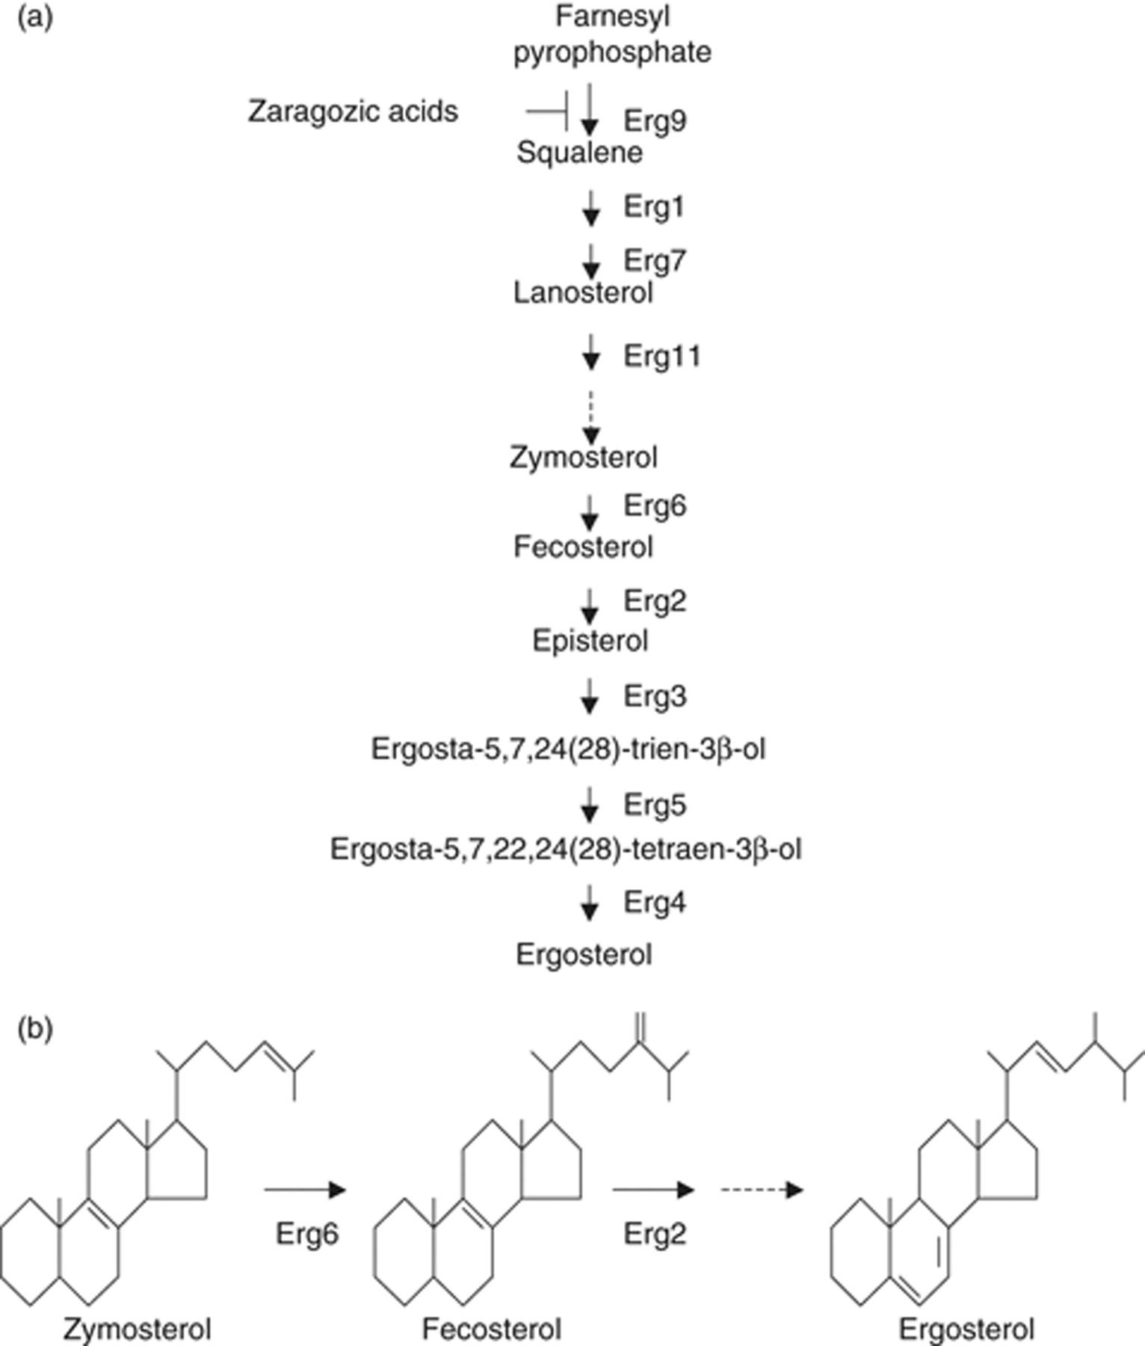
1 Sterols in yeast. (a) Sterol synthesis pathway in yeast. For details, see the text. (b) Structures of ...
Notes:
1 Sterols in yeast. (a) Sterol synthesis pathway in yeast. For details, see the text. (b) Structures of zymosterol, fecosterol, and ergosterol. For details, see Discussion.
Unless provided in the caption above, the following copyright applies to the content of this slide: © 2009 Federation of European Microbiological Societies. Published by Blackwell Publishing Ltd. All rights reserved

Slide 2
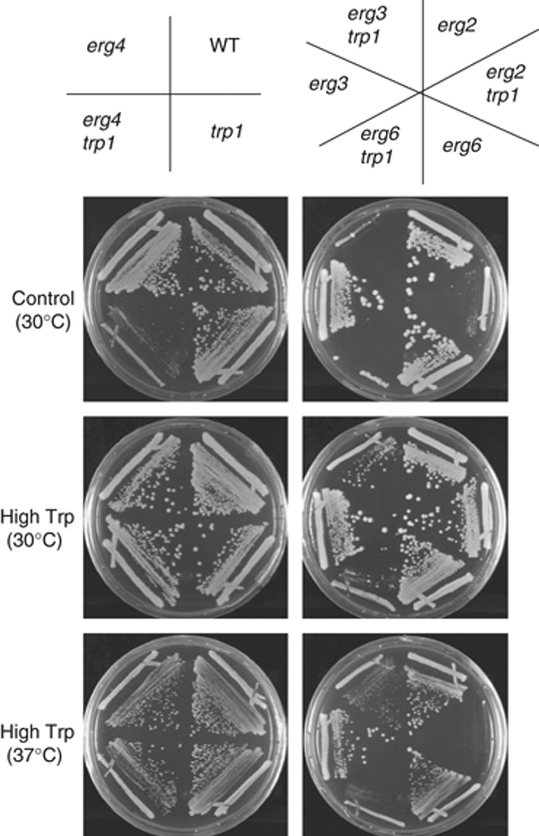
2 Growth defects of tryptophan auxotrophic erg mutant strains. ergΔ strains show a severe synthetic growth ...
Notes:
2 Growth defects of tryptophan auxotrophic erg mutant strains. ergΔ strains show a severe synthetic growth defect with trp1. Cells were incubated on YPAD plates with or without 200 μg mL−1 of additional tryptophan at 30 or 37°C for 3 (left plates) or 4 (right plates) days. The following TRP1 strains were used: wild type (WT, SCU734), erg2Δ (SCU719), erg6Δ (SCU730), erg3Δ (SCU725), and erg4Δ (SCU727). The following trp1 strains were used: trp1 (SCU733), erg2Δtrp1 (SCU809), erg6Δtrp1 (SCU816), erg3Δtrp1 (SCU811), and erg4Δtrp1 (SCU813).
Unless provided in the caption above, the following copyright applies to the content of this slide: © 2009 Federation of European Microbiological Societies. Published by Blackwell Publishing Ltd. All rights reserved

Slide 3
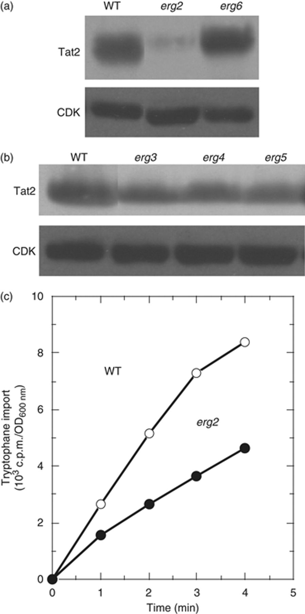
3 Tat2 levels and tryptophan uptake decrease in erg2Δ cells. (a and b) Tat2 protein levels in erg mutants. ...
Notes:
3 Tat2 levels and tryptophan uptake decrease in erg2Δ cells. (a and b) Tat2 protein levels in erg mutants. Cells of wild-type (SCU734), erg2Δ (SCU720), erg6Δ (SCU730), erg3Δ (SCU725), erg4Δ (SCU443), and erg5Δ (SCU729) strains harboring the plasmid pHA2-TAT2 (pSCU301) were used. Protein levels of HA-tagged Tat2 were examined by Western blotting using anti-HA antibody. CDK was used as the loading control. (c) Decrease in tryptophan uptake in erg2Δ cells. Tryptophan uptake activity was measured using strains SCU734 (wild type) and SCU720 (erg2Δ) as described in Materials and methods. WT, wild type.
Unless provided in the caption above, the following copyright applies to the content of this slide: © 2009 Federation of European Microbiological Societies. Published by Blackwell Publishing Ltd. All rights reserved

Slide 4
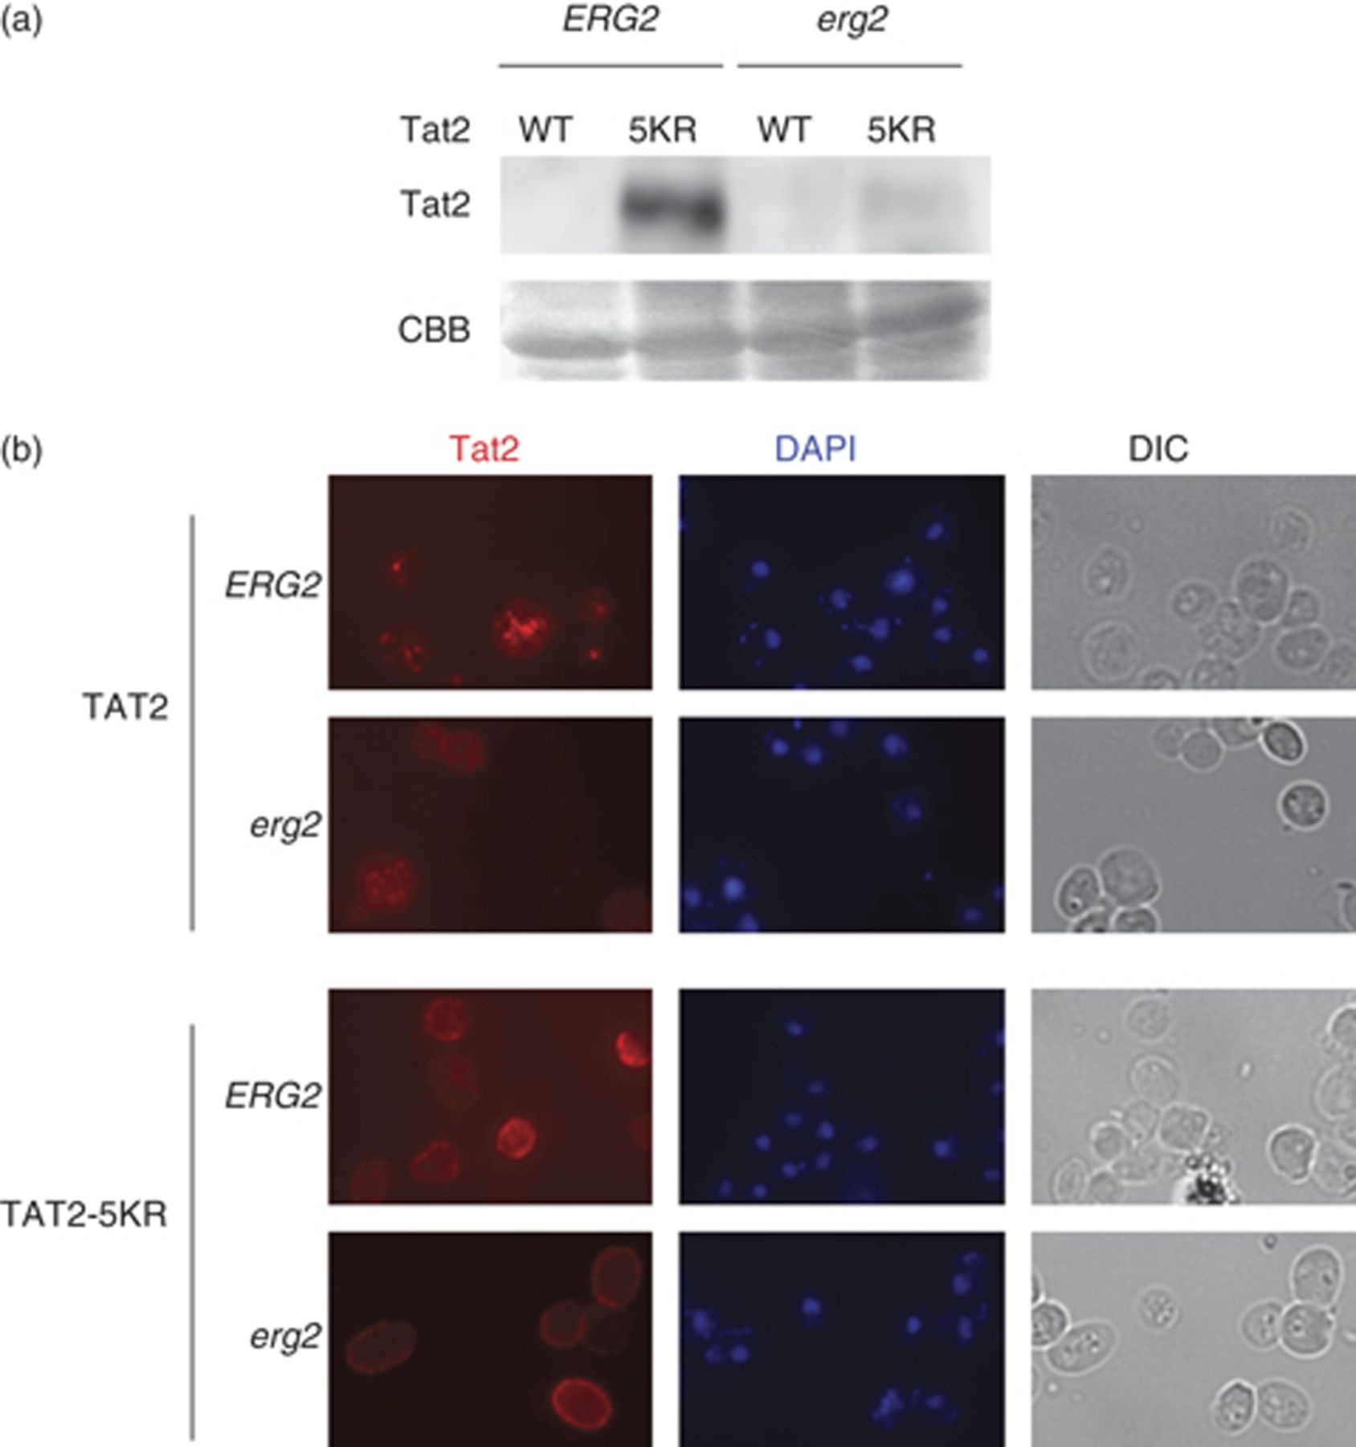
4 Effects of the inhibition of Tat2 ubiquitination in erg2Δ cells. (a) Inhibition of Tat2 ubiquitination in ...
Notes:
4 Effects of the inhibition of Tat2 ubiquitination in erg2Δ cells. (a) Inhibition of Tat2 ubiquitination in erg2Δ cells suppresses Tat2 degradation. SCU734 (wild type) and SCU720 (erg2Δ) cells harboring the plasmid pHA-TAT2 (pSCU301) or pHA-TAT2-5KR (pSCU425) were used. Protein levels of HA-tagged Tat2 were examined by Western blotting using an anti-HA antibody. Coomassie brilliant blue (CBB)-stained proteins were used as the loading control. Note that immunoblotting signals were detected more rapidly as compared with those in Fig. 3a, because the Tat2-5KR signal in the wild-type strain was remarkably strong (see Fig. 5). (b) Inhibition of Tat2 ubiquitination in erg2Δ cells promotes Tat2 targeting to the plasma membrane. SCU734 (wild type) and SCU720 (erg2Δ) cells harboring the plasmid pHA-TAT2 (pSCU301) or pHA-TAT2-5KR (pSCU425) were observed with Cy3-stained Tat2 (red) and DAPI-stained DNA (blue) signals. Nomarski images (DIC) were also recorded. Note that the exposure time of the images was not equal in each sample. WT, wild type.
Unless provided in the caption above, the following copyright applies to the content of this slide: © 2009 Federation of European Microbiological Societies. Published by Blackwell Publishing Ltd. All rights reserved

Slide 5
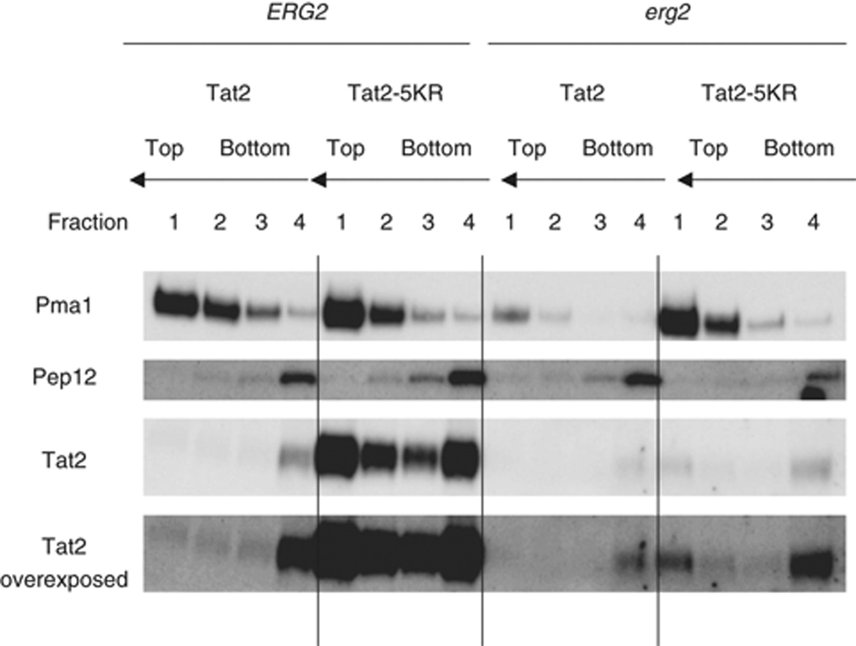
5 Effect of erg2 deletion on raft- and bulk lipid-associated Tat2. Detergent-insoluble membrane fractions ...
Notes:
5 Effect of erg2 deletion on raft- and bulk lipid-associated Tat2. Detergent-insoluble membrane fractions (Fraction 1) were isolated from wild-type (SCU734) and erg2 (SCU720) cells harboring the plasmid pHA2-TAT2 (pSCU301) or pHA2-TAT2-5KR (pSCU425). HA-tagged Tat2 in each fraction was detected using Western blotting. Pma1 and Pep12 were used as raft- and bulk lipid-associated protein markers, respectively.
Unless provided in the caption above, the following copyright applies to the content of this slide: © 2009 Federation of European Microbiological Societies. Published by Blackwell Publishing Ltd. All rights reserved

Slide 6
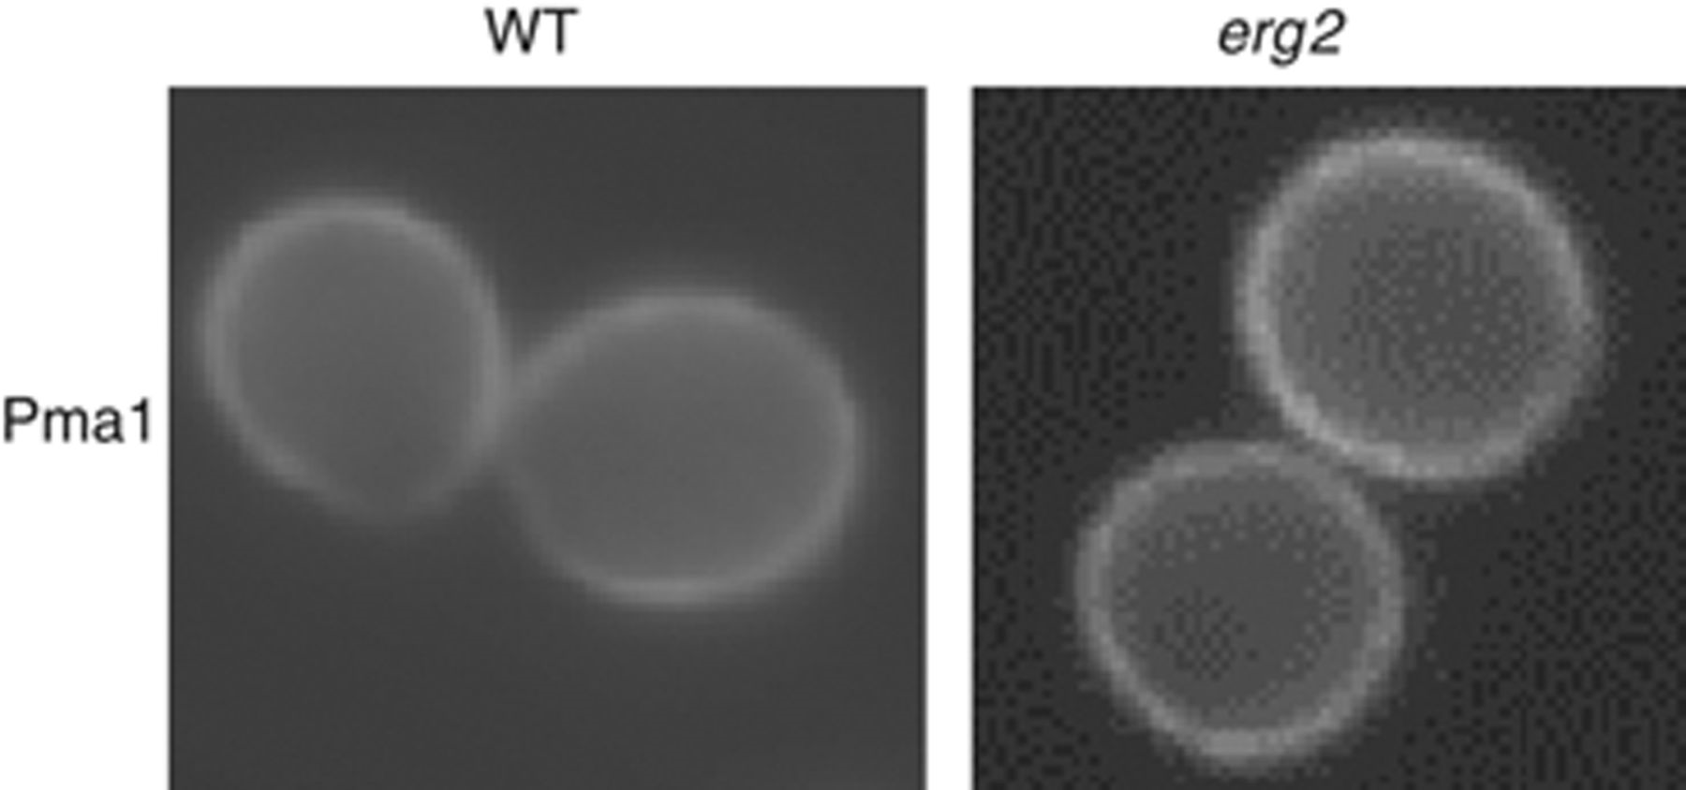
6 Pma1 is localized in the plasma membrane in erg2Δ cells. Pma1 distribution in SCU734 (wild type) and SCU720 ...
Notes:
6 Pma1 is localized in the plasma membrane in erg2Δ cells. Pma1 distribution in SCU734 (wild type) and SCU720 (erg2Δ) cells were visualized using anti-Pma1 primary and Cy3-stained secondary antibodies. WT, wild type.
Unless provided in the caption above, the following copyright applies to the content of this slide: © 2009 Federation of European Microbiological Societies. Published by Blackwell Publishing Ltd. All rights reserved

Slide 7
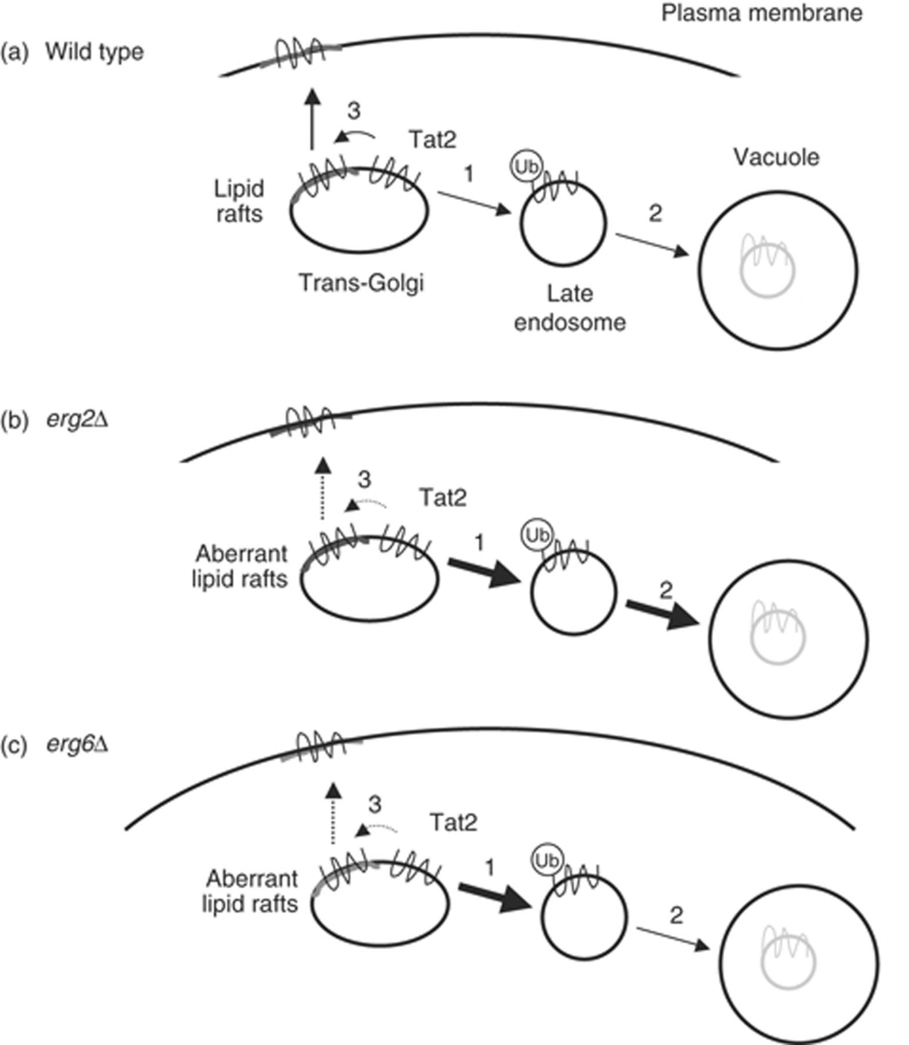
7 Model for Tat2 sorting in erg mutant cells. (a–c) Tat2 sorting in wild-type, erg2Δ, and erg6Δ cells. Tat2 is ...
Notes:
7 Model for Tat2 sorting in erg mutant cells. (a–c) Tat2 sorting in wild-type, erg2Δ, and erg6Δ cells. Tat2 is attacked by the ubiquitin ligase Rsp5 in nonlipid rafts in the trans-Golgi to be transported to the late endosome (1), and some proteins are further sorted to the vacuole (2). Nonubiquitinated Tat2 is translocated to lipid rafts to be sorted to the plasma membrane (3). Plasma membrane sorting of Tat2 is impeded in both mutants, but vacuolar sorting is promoted in erg2Δ cells but not in erg6Δ cells. See text for further details.
Unless provided in the caption above, the following copyright applies to the content of this slide: © 2009 Federation of European Microbiological Societies. Published by Blackwell Publishing Ltd. All rights reserved

