Slide 1
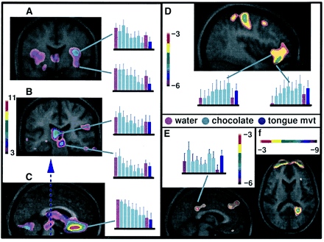
Fig. 3 Cortical regions demonstrating significant rCBF correlations with affective rating for question (ii). ...
Notes:
Fig. 3 Cortical regions demonstrating significant rCBF correlations with affective rating for question (ii). Regression analyses were used to correlate rCBF from averaged PET data (Choc 1 minus Choc 7) with affective ratings taken immediately after these scans (see Methods). Correlations are shown as t statistic images superimposed on corresponding averaged MRI scans. The t statistic ranges for each set of images are coded by colour bars, one in each box. Bar graphs represent normalized CBF in an 8 mm radius surrounding the peak. The y-axis corresponds to normalized activity and the bars along the x-axis represent scans. The three colours represent scan type and correspond to the coloured bars in Fig. 2. Each bar graph corresponds to activations indicated by a turquoise line. (A) Coronal section taken at y = 1 showing the decrease in rCBF in the primary gustatory area (bilaterally in the anterior insula/frontal operculum and in the right ventral insula). (B) Coronal section taken at y = –26 showing decreases in rCBF in the left thalamus and medial midbrain (possibly corresponding to the ventral tegmental area). (C) Sagittal section taken at x = –1 showing decreases in rCBF in the subcallosal region, thalamus and midbrain. (D) Sagittal section taken at x = 42 showing the increase in rCBF in the right caudolateral orbitofrontal cortex. Activation is also evident in the motor and premotor areas. (E) Sagittal section taken at x = 8 showing an increase in rCBF in the posterior cingulate gyrus (peak at 8, –30, 45) in subtraction analysis Choc 1 – water-post (see Table 3 and Results section). This was the only region where CBF was consistently greater in affective scans regardless of valence, compared with the neutral chocolate scan (Choc 4) and the two water baseline scans (water-pre and water-post). (F) Horizontal section at z = 12 showing an increase in rCBF in the retrosplenial cortex (area 30) that correlated with affective rating (ii) but not the affective rating (i) when scan order was covaried out of the regression analysis (see Results and Methods).
Unless provided in the caption above, the following copyright applies to the content of this slide: © Oxford University Press 2001

Slide 2
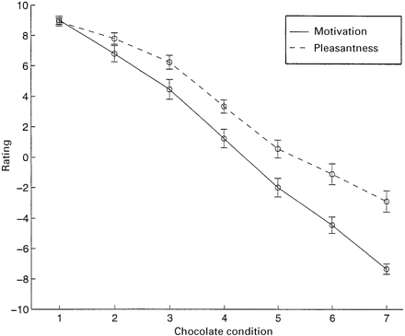
Fig. 4 Average affective rating to questions (i) and (ii) across the seven chocolate conditions. Dotted line depicts ...
Notes:
Fig. 4 Average affective rating to questions (i) and (ii) across the seven chocolate conditions. Dotted line depicts ratings to question (i) (Pleasantness) and the solid line represents ratings to question (ii) (Motivation). Error bars represent the standard error of the mean. Ratings correspond to the rating scale shown in Fig. 1. Repeated measures ANOVA revealed a significant interaction, indicating that the slopes of the two lines are different (see Results).
Unless provided in the caption above, the following copyright applies to the content of this slide: © Oxford University Press 2001

Slide 3
Fig. 2 Pictorial representation of protocol. Purple bars represent water PET scans and turquoise bars represent ...
Notes:
Fig. 2 Pictorial representation of protocol. Purple bars represent water PET scans and turquoise bars represent chocolate PET scans. The tongue movement scan is represented by a blue bar. Interscan intervals consist of a feeding period and a rest period. The amount of chocolate eaten to produce the required decreases in affective ratings obtained from questions (i) and (ii) decreased gradually as the experiment progressed. This is depicted by the shrinking feed periods. Colour-coded bar graphs in Fig. 3 correspond to the colour scheme used here.
Unless provided in the caption above, the following copyright applies to the content of this slide: © Oxford University Press 2001

Slide 4
Fig. 1 Rating scale. Subjects used the rating scale to respond to two questions following ingestion of each piece of ...
Notes:
Fig. 1 Rating scale. Subjects used the rating scale to respond to two questions following ingestion of each piece of chocolate: (i) How pleasant or unpleasant was the piece of chocolate you just ate? (ii) How much would you like or not like another piece of chocolate?
Unless provided in the caption above, the following copyright applies to the content of this slide: © Oxford University Press 2001

