Slide 1
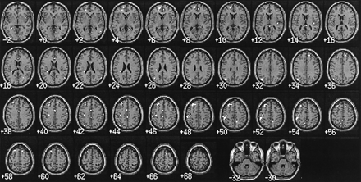
Fig. 3 Intentional minus unintentional violation of social norms. Comparison of the intentional and ...
Notes:
Fig. 3 Intentional minus unintentional violation of social norms. Comparison of the intentional and unintentional violation of social norms conditions, with a height threshold set to P < 0.001 (uncorrected) and an extent threshold set to P < 0.05. Activations data are superimposed onto the canonical template of SPM99 in the axial plane. z coordinates in the Talairach and Tournoux space are given (cf. Table 2).
Unless provided in the caption above, the following copyright applies to the content of this slide:

Slide 2
Fig. 4 Unintentional minus intentional violation of social norms. Comparison of the unintentional and ...
Notes:
Fig. 4 Unintentional minus intentional violation of social norms. Comparison of the unintentional and intentional violation of social norms conditions, with a height threshold set to P < 0.001 (uncorrected) and an extent threshold set to P < 0.05. Activations data are superimposed onto the canonical template of SPM99 in the sagittal plane. x coordinates in the Talairach and Tournoux space are given (cf. Table 2).
Unless provided in the caption above, the following copyright applies to the content of this slide:

Slide 3
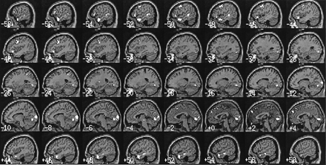
Fig. 2 Unintentional violation of social norms minus normal social behaviour. Comparison of the unintentional ...
Notes:
Fig. 2 Unintentional violation of social norms minus normal social behaviour. Comparison of the unintentional violation of social norms (embarrassment) and normal behaviour conditions, with a height threshold set to P < 0.001 (uncorrected) and an extent threshold set to P < 0.05. Activations data are superimposed onto the canonical template of SPM99 in the sagittal plane. x coordinates in the Talairach and Tournoux space are given (cf. Table 1).
Unless provided in the caption above, the following copyright applies to the content of this slide:

Slide 4
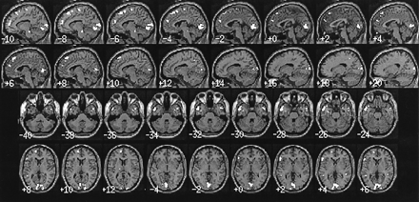
Fig. 1 Intentional violation of social norms minus normal social behaviour. Comparison of the intentional ...
Notes:
Fig. 1 Intentional violation of social norms minus normal social behaviour. Comparison of the intentional violation of social norms and normal behaviour conditions, with a height threshold set to P < 0.001 (uncorrected) and an extent threshold set to P < 0.05. Activations data are superimposed onto the canonical template of SPM99 in the sagittal (two top rows) and axial (two bottom rows) planes. x and z coordinates (for the sagittal and axial planes respectively) in the Talairach and Tournoux space are given (cf. Table 1).
Unless provided in the caption above, the following copyright applies to the content of this slide:

