Slide 1
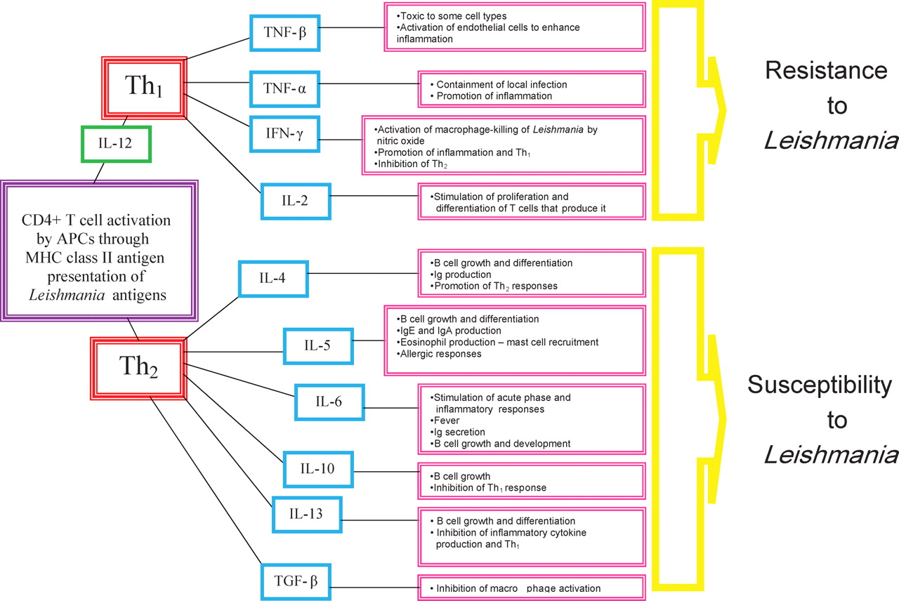
Figure 1. Antagonistic Th₁ and Th₂ responses that confer either resistance or susceptibility to ...
Notes:
Figure 1. Antagonistic Th1 and Th2 responses that confer either resistance or susceptibility to Leishmania. APC, antigen-presenting cell; Th, T-helper cell; IL, interleukin; TGF-β, transforming growth factor; TFN-α/β, tumour necrosis factor-α/β; IFN-γ, interferon-gamma; Ig, immunoglobulin.
Unless provided in the caption above, the following copyright applies to the content of this slide: © 2009 The Author(s)This is an Open Access article distributed under the terms of the Creative Commons Attribution Non-Commercial License (http://creativecommons.org/licenses/by-nc/2.0/uk/) which permits unrestricted non-commercial use, distribution, and reproduction in any medium, provided the original work is properly cited.

Slide 2
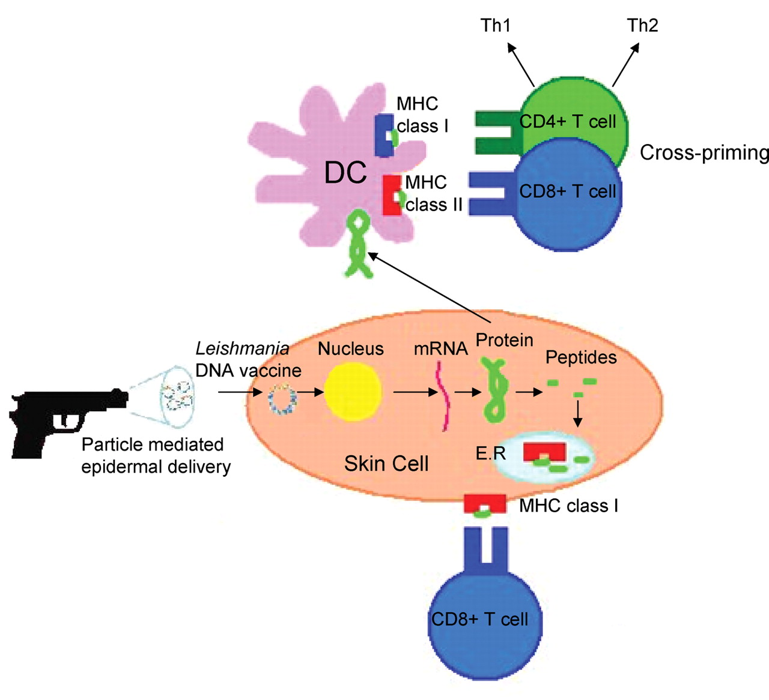
Figure 2. Possible immune mechanisms induced by particle-mediated epidermal delivery of a Leishmania DNA vaccine ...
Notes:
Figure 2. Possible immune mechanisms induced by particle-mediated epidermal delivery of a Leishmania DNA vaccine (adapted from Encke et al.44).
Unless provided in the caption above, the following copyright applies to the content of this slide: © 2009 The Author(s)This is an Open Access article distributed under the terms of the Creative Commons Attribution Non-Commercial License (http://creativecommons.org/licenses/by-nc/2.0/uk/) which permits unrestricted non-commercial use, distribution, and reproduction in any medium, provided the original work is properly cited.

