Slide 1
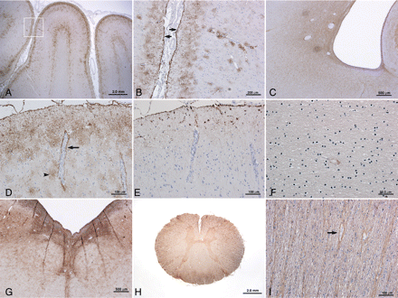
Fig. 1 AQP4 immunoreactivity (IR) in normal CNS tissues. (A) AQP4 is concentrated at the glia limitans externa, ...
Notes:
Fig. 1 AQP4 immunoreactivity (IR) in normal CNS tissues. (A) AQP4 is concentrated at the glia limitans externa, throughout the cerebral cortex and at the grey–white junction. (B) Higher magnification of boxed region in A demonstrates intense AQP4 at the glia limitans (arrows) and a rosette pattern of staining in the underlying cortex. (C) AQP4 is concentrated in the subependymal region. (D) AQP4 is intense at the abluminal surface of penetrating cortical blood vessels in a rim pattern (arrow) and at astrocytic foot processes abutting vessels in a rosette pattern (arrowhead). (E) GFAP is concentrated at the glia limitans and astrocyte cell body, but does not label astrocytic endfeet associated with small to medium sized vessels. (F) AQP4 is minimal in normal cerebral white matter, apart from occasional penetrating capillaries. (G) AQP4 is intense at the floor of the fourth ventricle. (H) Spinal cord white and grey matter show moderate diffuse AQP4. (I) Optic nerve shows diffuse mesh-like and vasculocentric (arrow) AQP4 IR. A–D, F–I, AQP4 Immunohistochemistry (IHC); E, GFAP IHC.
Unless provided in the caption above, the following copyright applies to the content of this slide: © The Author (2007). Published by Oxford University Press on behalf of the Guarantors of Brain. All rights reserved. For Permissions, please email: journals.permissions@oxfordjournals.org

Slide 2
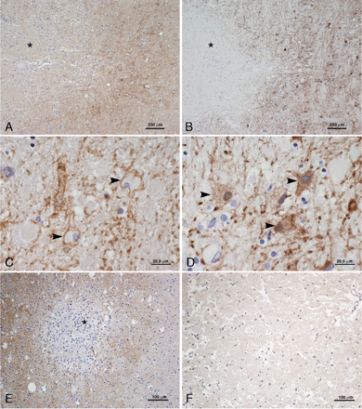
Fig. 2 AQP4 immunoreactivity (IR) in early acute (A–D) and subacute (E–F) infarcts. (A) The early acute infarct ...
Notes:
Fig. 2 AQP4 immunoreactivity (IR) in early acute (A–D) and subacute (E–F) infarcts. (A) The early acute infarct demonstrates loss of AQP4 in the necrotic centre (*), with increased IR in the periphery. (B) With GFAP, there is a similar pattern and distribution of IR, absent in the necrotic centre (*), and increased at the periphery. (C) Higher magnification of the infarct periphery in A demonstrates increased AQP4 outlining the cytoplasmic surface of reactive astrocytes (arrowheads). (D) Higher magnification of the infarct periphery in B demonstrates GFAP is similarly increased in reactive astrocytes, but concentrated in cell bodies (arrowheads). (E) The subacute infarct also demonstrates increased AQP4 IR in the periphery, with relative lack of AQP4 IR in macrophage-rich necrotic areas (*). (F) There is absence of AQP4 in the necrotic zone. A, C, E, F, AQP4 IHC; B, D, GFAP IHC.
Unless provided in the caption above, the following copyright applies to the content of this slide: © The Author (2007). Published by Oxford University Press on behalf of the Guarantors of Brain. All rights reserved. For Permissions, please email: journals.permissions@oxfordjournals.org

Slide 3
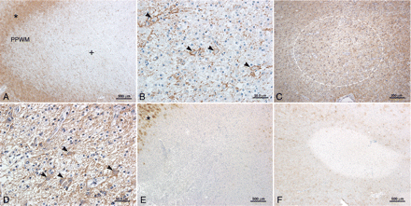
Fig. 3 Stage-dependent pattern of AQP4 immunoreactivity (IR) in active (A, B), early remyelinated (C, D) and ...
Notes:
Fig. 3 Stage-dependent pattern of AQP4 immunoreactivity (IR) in active (A, B), early remyelinated (C, D) and inactive (E, F) MS lesions. (A) An active MS lesion demonstrates increased AQP4 IR that is marked in the adjacent cortical grey matter (*) and periplaque white matter (PPWM), and moderate in the lesion centre (+). (B) Higher magnification of the active lesion centre demonstrates AQP4 outlining the cytoplasmic surface of reactive astrocytes (arrowheads) and their processes. (C) An early remyelinated MS lesion (circle) shows diffuse increase in AQP4 extending throughout the lesion, and surrounding PPWM. (D) AQP4 stains the cytoplasmic surface of reactive astrocytes (arrowheads) in an early remyelinated lesion. (E–F). Inactive MS lesions from an acute case (E) and a chronic case (F) show complete loss of AQP4; (*) indicates normal grey matter AQP4 IR. A–F, AQP4 IHC.
Unless provided in the caption above, the following copyright applies to the content of this slide: © The Author (2007). Published by Oxford University Press on behalf of the Guarantors of Brain. All rights reserved. For Permissions, please email: journals.permissions@oxfordjournals.org

Slide 4
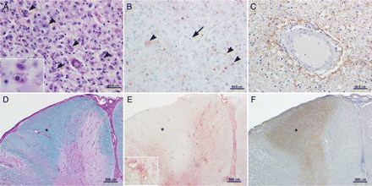
Fig. 4 AQP4 immunoreactivity (IR) in acute pattern II MS (A–C) and NMO (D–F) lesions. (A) Numerous macrophages ...
Notes:
Fig. 4 AQP4 immunoreactivity (IR) in acute pattern II MS (A–C) and NMO (D–F) lesions. (A) Numerous macrophages containing myelin debris are dispersed throughout the active lesion (arrowheads and inset; LFB/PAS). (B) C9neo antigen is present within macrophages (arrowheads), but absent around blood vessels (arrow). (C) Higher magnification reveals AQP4 IR is prominent in a rosette pattern surrounding a penetrating blood vessel in the lesion. (D) In NMO, there is extensive demyelination involving both grey and white matter (LFB/PAS); *indicates preserved myelin in the PPWM. (E) C9neo is deposited in a vasculocentric rim and rosette pattern (inset) within the active lesions, but not in the PPWM. (F) The lesions lack AQP4, which is retained in the PPWM (*) and grey matter. A, D, LFB/PAS; B, E, C9neo IHC; C, F, AQP4 IHC.
Unless provided in the caption above, the following copyright applies to the content of this slide: © The Author (2007). Published by Oxford University Press on behalf of the Guarantors of Brain. All rights reserved. For Permissions, please email: journals.permissions@oxfordjournals.org

Slide 5
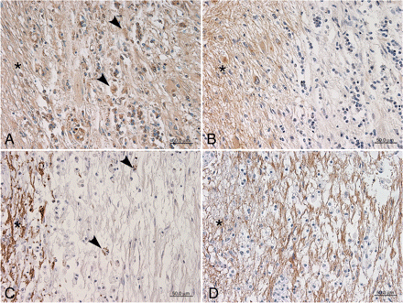
Fig. 5 Comparison of AQP4 immunoreactivity (IR) in active NMO (A, B) and MS (C, D) optic nerve lesions. (A) Active ...
Notes:
Fig. 5 Comparison of AQP4 immunoreactivity (IR) in active NMO (A, B) and MS (C, D) optic nerve lesions. (A) Active demyelination with macrophages containing MOG-immunoreactive myelin debris (arrowheads), adjacent to PPWM (*). (B) AQP4 is lost in the active lesion, but retained in the PPWM (*). (C) Active demyelination with macrophages containing PLP-immunoreactive myelin debris (arrowheads), adjacent to PPWM (*). (D) AQP4 IR is increased in both the active lesion and PPWM (*). A, MOG IHC; B, D, AQP4 IHC; C, PLP IHC.
Unless provided in the caption above, the following copyright applies to the content of this slide: © The Author (2007). Published by Oxford University Press on behalf of the Guarantors of Brain. All rights reserved. For Permissions, please email: journals.permissions@oxfordjournals.org

Slide 6
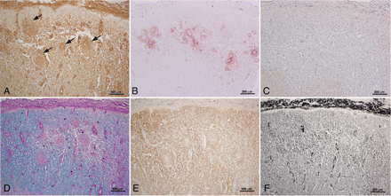
Fig. 6 Spinal cord AQP4 loss in inflammatory NMO foci lacking demyelination. (A–B) Immune complexes (IgG, A; C9neo, ...
Notes:
Fig. 6 Spinal cord AQP4 loss in inflammatory NMO foci lacking demyelination. (A–B) Immune complexes (IgG, A; C9neo, B) are deposited in a rosette pattern surrounding thickened, hyalinized vessels (arrows). (C–F) The lesion is characterized by complete loss of AQP4 IR (C; note residual AQP4 in grey matter at lower left), with preservation of myelin (D, LFB/PAS; E, MOG) and axons (F, Bielschowsky).
Unless provided in the caption above, the following copyright applies to the content of this slide: © The Author (2007). Published by Oxford University Press on behalf of the Guarantors of Brain. All rights reserved. For Permissions, please email: journals.permissions@oxfordjournals.org

Slide 7
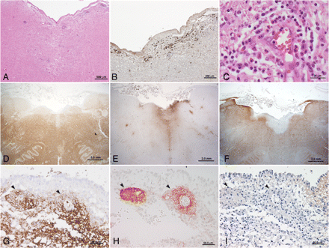
Fig. 7 Medullary floor of the fourth ventricle AQP4 loss in inflammatory NMO foci lacking demyelination. (A–C) ...
Notes:
Fig. 7 Medullary floor of the fourth ventricle AQP4 loss in inflammatory NMO foci lacking demyelination. (A–C) Patchy perivascular inflammatory infiltrate and parenchymal rarefaction are noted at low power (A, H & E). Major components of the inflammatory infiltrates include plasma cells (B, CD138), and eosinophils (C, H & E), but macrophages are scarce. (D–F) There is myelin preservation (D, MOG), while IgM is prominent in subventricular zones. (E, IgM). Note that AQP4 loss is most profound in region of IgM deposition (F, AQP4). (G–I) In the area postrema: subependymal vessels (arrowheads) show a rosette pattern of staining for IgM (G), C9neo (H) and loss of AQP4 (I).
Unless provided in the caption above, the following copyright applies to the content of this slide: © The Author (2007). Published by Oxford University Press on behalf of the Guarantors of Brain. All rights reserved. For Permissions, please email: journals.permissions@oxfordjournals.org

Slide 8
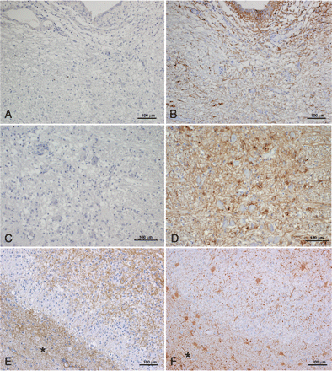
Fig. 8 AQP4 and astrocytes in NMO and MS. (A–D) There is loss of AQP4 in the medullary subependyma (A) and raphe ...
Notes:
Fig. 8 AQP4 and astrocytes in NMO and MS. (A–D) There is loss of AQP4 in the medullary subependyma (A) and raphe (C), despite astrogliosis associated with the presence of GFAP immunoreactive astrocytes (B, D). (E–F) Early MS lesion shows increased AQP4 (E) in the PPWM (*), the expanding macrophage rich border and lesion centre. With GFAP (F), a similar increased distribution associated with multiple reactive astrocytes is noted. *PPWM. A, C, E, AQP4 IHC; B, D, F, GFAP IHC.
Unless provided in the caption above, the following copyright applies to the content of this slide: © The Author (2007). Published by Oxford University Press on behalf of the Guarantors of Brain. All rights reserved. For Permissions, please email: journals.permissions@oxfordjournals.org

