Slide 1
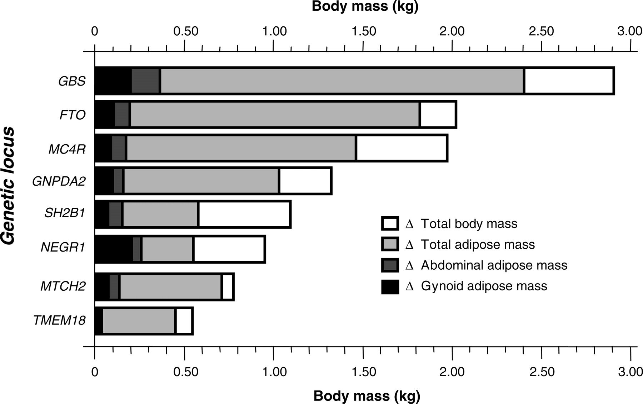
Figure 1. Differences in weight (kg) and total, abdominal and gynoid adipose mass (kg) between major and minor allele ...
Notes:
Figure 1. Differences in weight (kg) and total, abdominal and gynoid adipose mass (kg) between major and minor allele homozygotes at each of the seven nominally associated loci (P < 0.1) and between the first and fifth quintiles of the genetic burden score. Data are adjusted for age and sex (n = 2206). As described in the results, nominal gene–sex interactions were observed for total and abdominal adipose mass at the MC4R locus.
Unless provided in the caption above, the following copyright applies to the content of this slide: © 2009 The Author(s)This is an Open Access article distributed under the terms of the Creative Commons Attribution Non-Commercial License (http://creativecommons.org/licenses/by-nc/2.0/uk/) which permits unrestricted non-commercial use, distribution, and reproduction in any medium, provided the original work is properly cited.

Slide 2
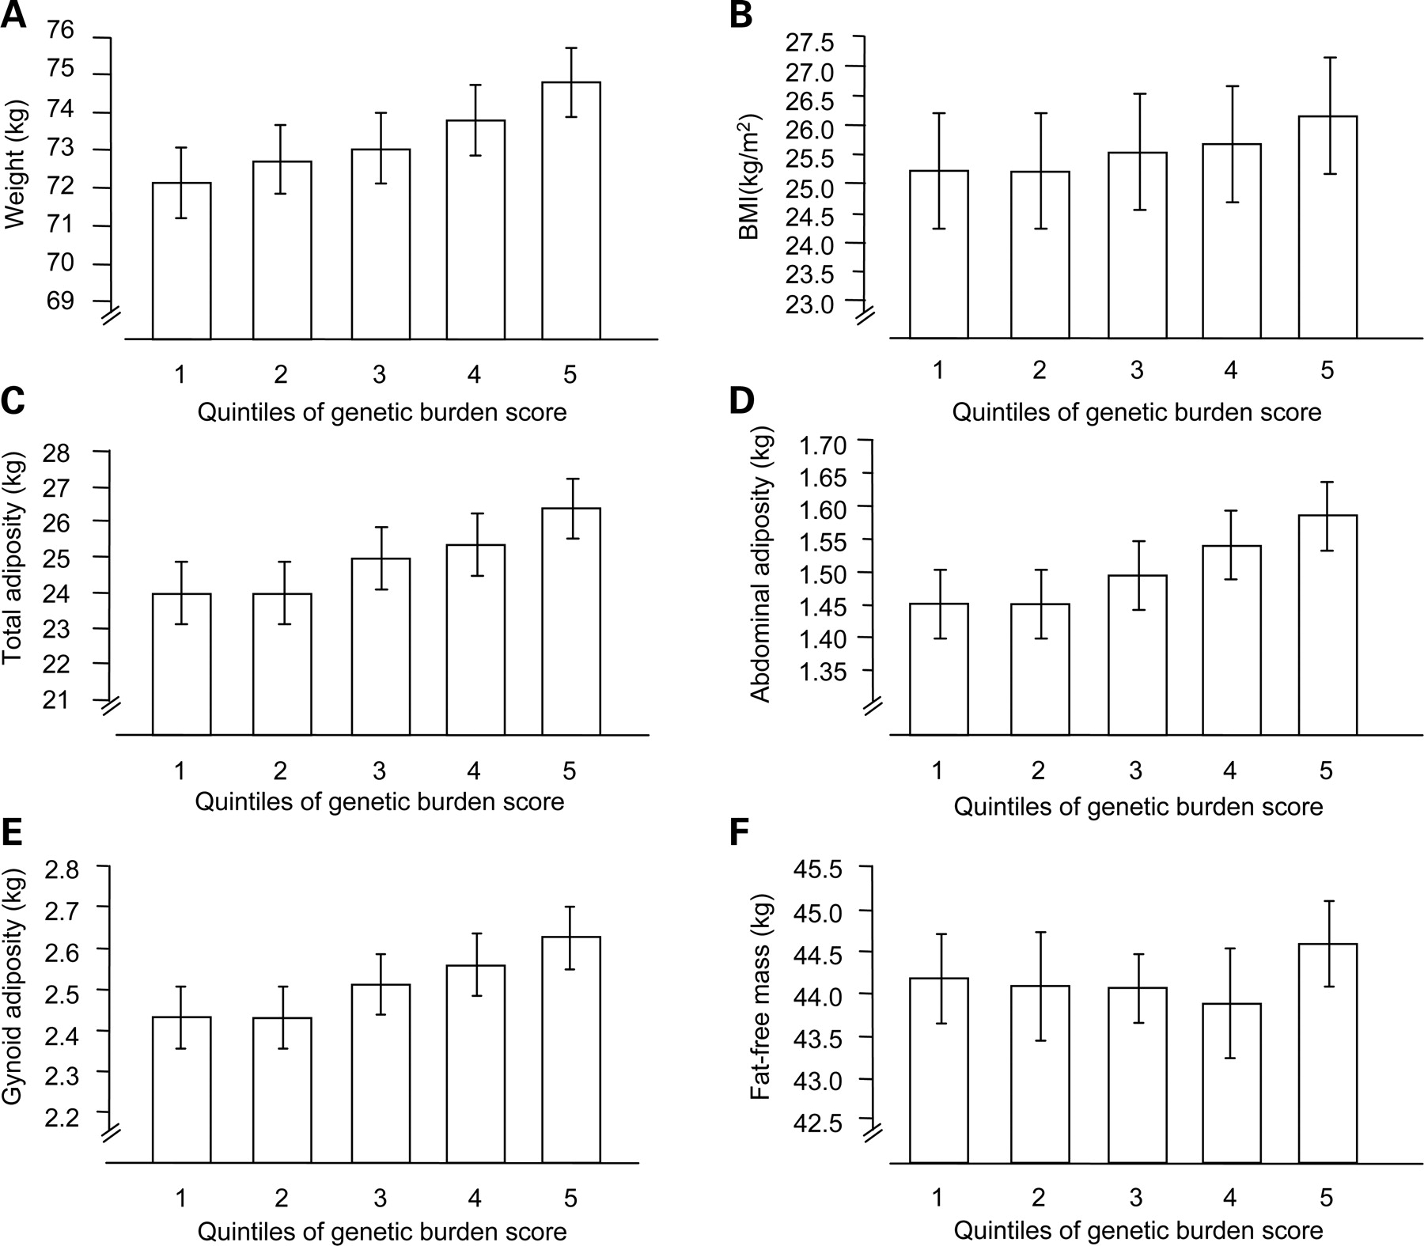
Figure 2. Associations between the genetic burden score (expressed in quintiles) and obesity indices. Error bars are ...
Notes:
Figure 2. Associations between the genetic burden score (expressed in quintiles) and obesity indices. Error bars are 95% confidence intervals. P-values are derived from linear regression models adjusted for age and sex. (A) P = 2.32 × 10−5; (B) P = 3.69 × 10−6; (C) P = 0.0001; (D) P = 0.0004; (E) P = 0.0002; (F) P = 0.099).
Unless provided in the caption above, the following copyright applies to the content of this slide: © 2009 The Author(s)This is an Open Access article distributed under the terms of the Creative Commons Attribution Non-Commercial License (http://creativecommons.org/licenses/by-nc/2.0/uk/) which permits unrestricted non-commercial use, distribution, and reproduction in any medium, provided the original work is properly cited.

Slide 3
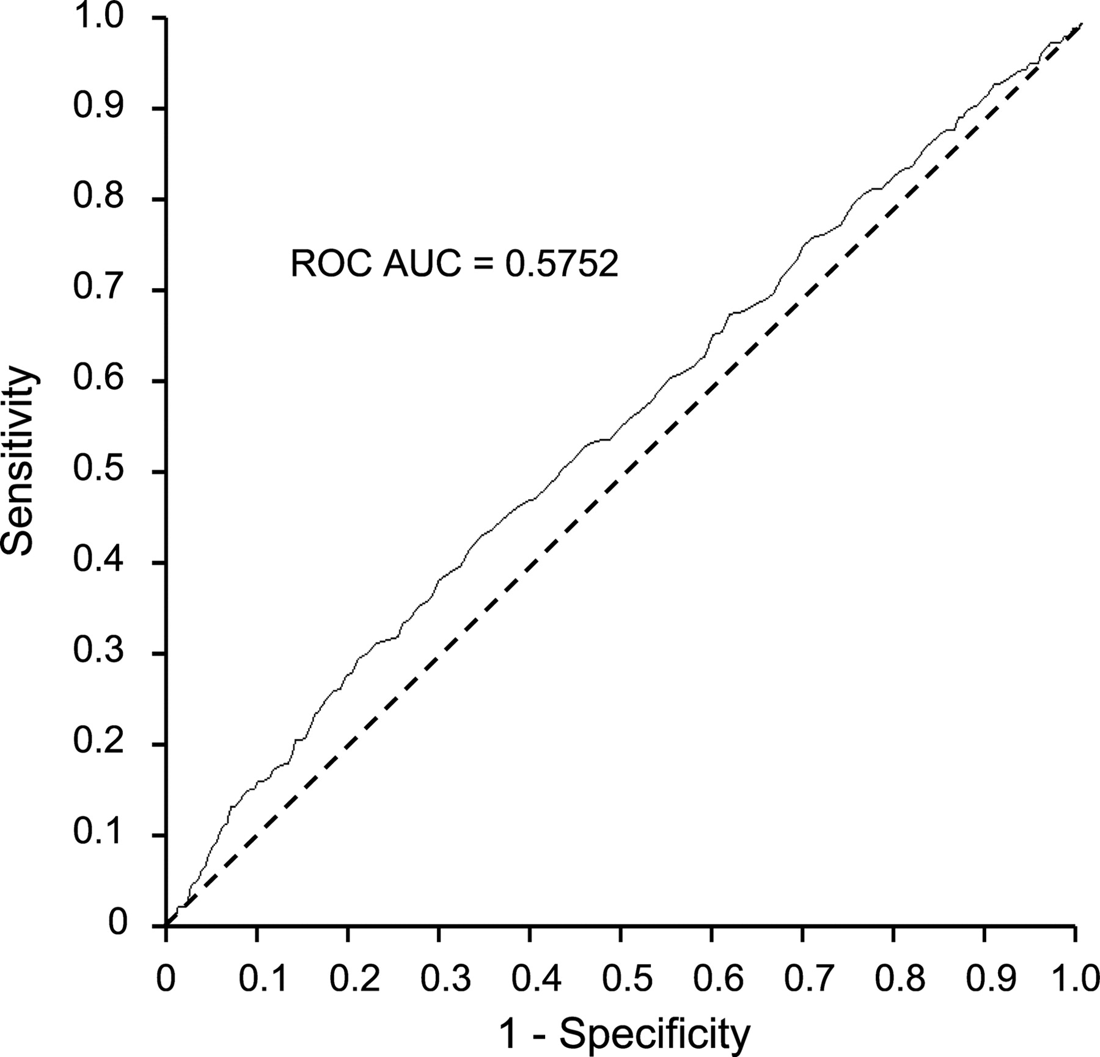
Figure 3. Unadjusted receiver-operating characteristic curve showing the combined ability of the genetic burden score ...
Notes:
Figure 3. Unadjusted receiver-operating characteristic curve showing the combined ability of the genetic burden score to discriminate between 353 obese (BMI >30 kg/m2) and 1370 normal weight (BMI 18.5–24.9 kg/m2) individuals.
Unless provided in the caption above, the following copyright applies to the content of this slide: © 2009 The Author(s)This is an Open Access article distributed under the terms of the Creative Commons Attribution Non-Commercial License (http://creativecommons.org/licenses/by-nc/2.0/uk/) which permits unrestricted non-commercial use, distribution, and reproduction in any medium, provided the original work is properly cited.

