Slide 1
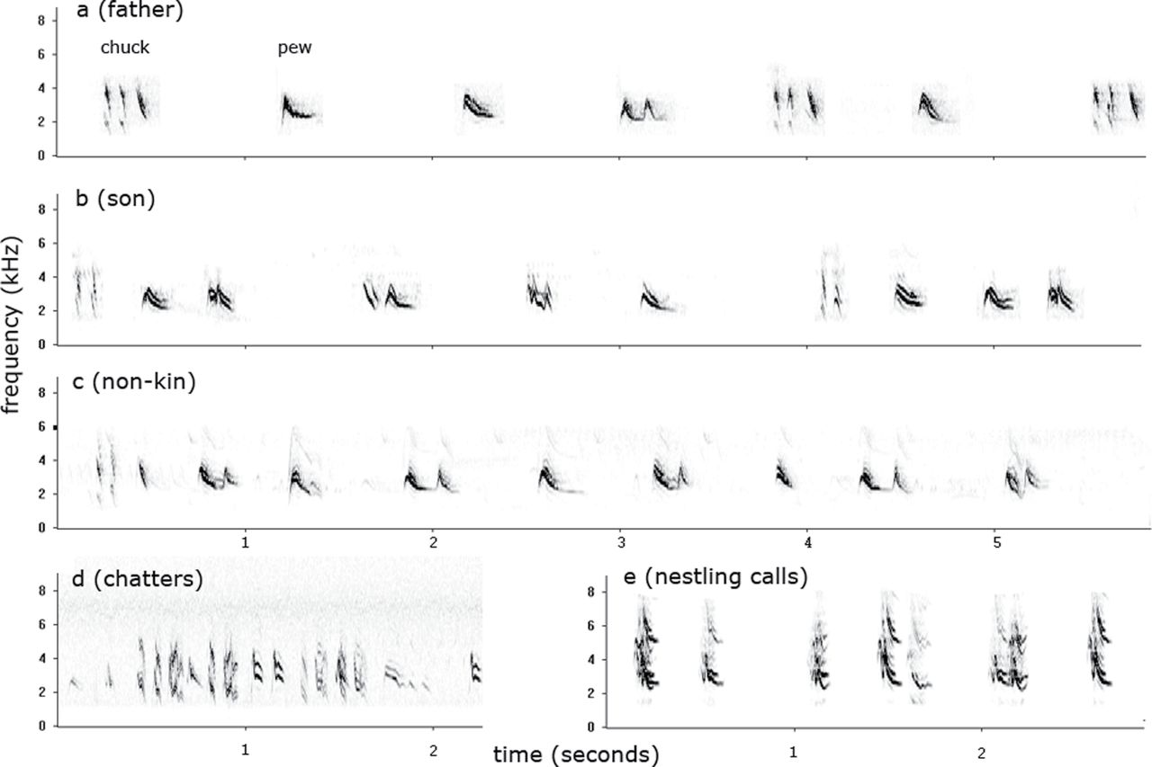
Figure 1 Examples of western bluebird vocalizations: dawn song from (a) father, (b) son, (c) another male not related ...
Notes:
Figure 1 Examples of western bluebird vocalizations: dawn song from (a) father, (b) son, (c) another male not related to either (a) or (b), (d) burst of chatter calls, and (e) begging calls of a single nestling, recorded on day 15.
Unless provided in the caption above, the following copyright applies to the content of this slide: © The Author 2013. Published by Oxford University Press on behalf of the International Society for Behavioral Ecology. All rights reserved. For permissions, please e-mail: journals.permissions@oup.com

Slide 2
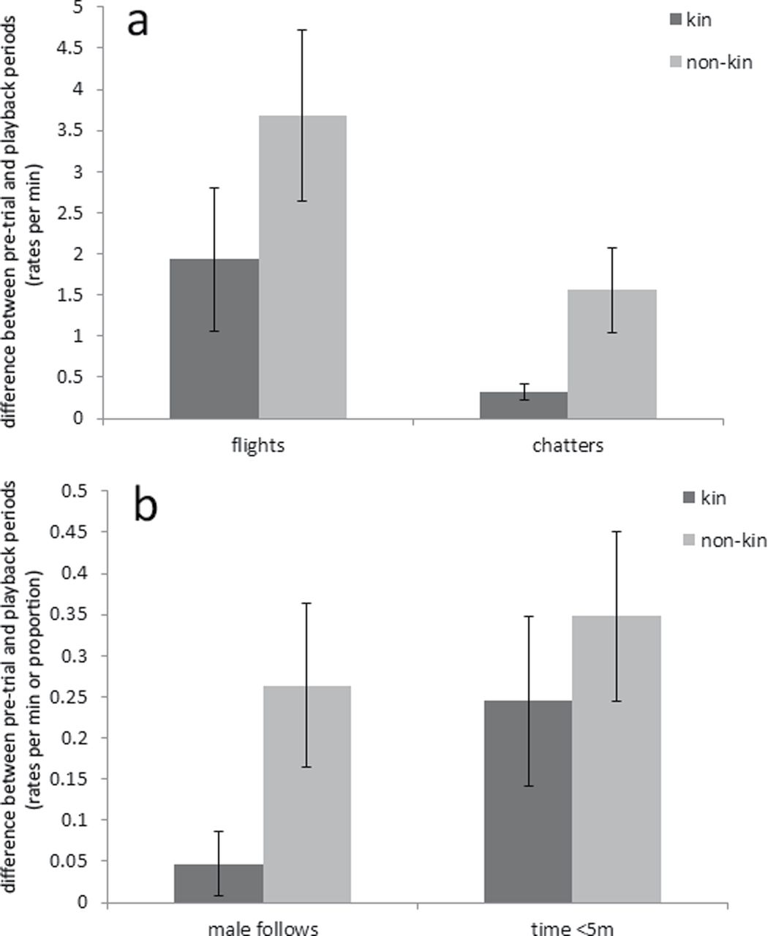
Figure 2 (a) Difference between pretrial and playback periods in rates of flights and chatters. (b) Difference between ...
Notes:
Figure 2 (a) Difference between pretrial and playback periods in rates of flights and chatters. (b) Difference between the pretrial and playback in rates of male “follows” and proportion of time spent within 5 m. Error bars are 1 SE.
Unless provided in the caption above, the following copyright applies to the content of this slide: © The Author 2013. Published by Oxford University Press on behalf of the International Society for Behavioral Ecology. All rights reserved. For permissions, please e-mail: journals.permissions@oup.com

