Slide 1
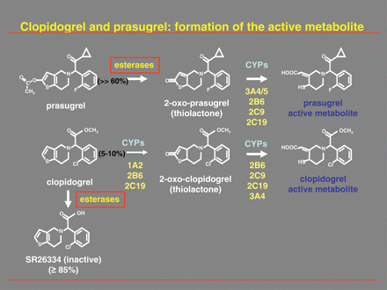
Figure 1 Formation of the active metabolites of clopidogrel and prasugrel.
Notes:
Figure 1 Formation of the active metabolites of clopidogrel and prasugrel.
Unless provided in the caption above, the following copyright applies to the content of this slide: Published on behalf of the European Society of Cardiology. All rights reserved. © The Author 2010. For permissions please email: journals.permissions@oxfordjournals.org

