Slide 1
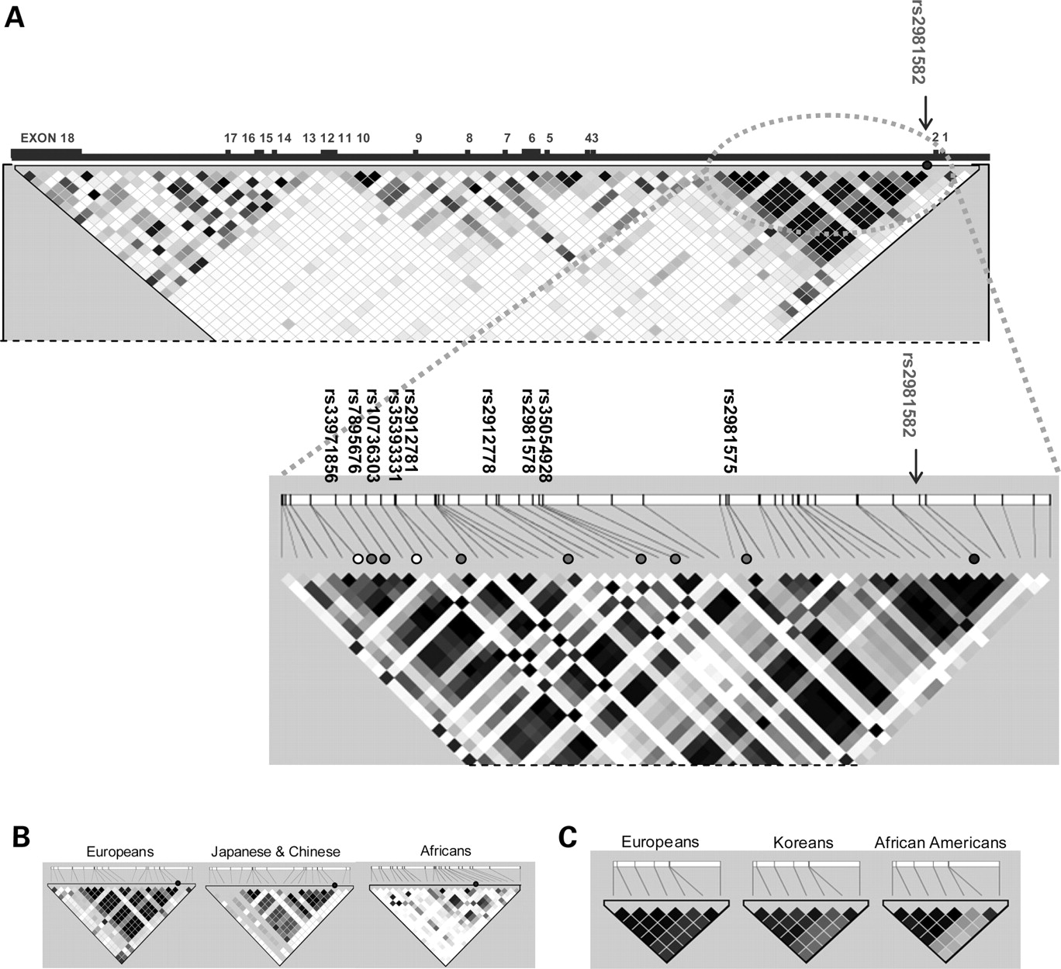
Figure 1. Diagram of FGFR2 and linkage disequilibrium blocks containing candidate SNPs. ( A ) The upper diagram is a ...
Notes:
Figure 1. Diagram of FGFR2 and linkage disequilibrium blocks containing candidate SNPs. ( A ) The upper diagram is a map of the whole FGFR2 gene viewed relative to common (MAF >5%) SNPs in HapMap CEU. The lower diagram is a map of the 25 kb region of linkage derived from the resequence data. The most strongly associated tagSNP is rs2981582. The positions of remaining candidate SNPs are labeled with filled circles on the map with relative chromosomal positions indicated on the bar. The two variants that could not be genotyped are labeled with open circles. ( B ) 25 kb LD blocks in HapMap CEU, JPT+CHB and YRI populations. ( C ) LD block of the seven candidate-SNPs in study populations SEARCH, Seoul Breast Cancer Project and MEC-African Americans (MEC-AA).
Unless provided in the caption above, the following copyright applies to the content of this slide: © The Author 2009. Published by Oxford University Press. All rights reserved. For Permissions, please email: journals.permissions@oxfordjournals.org

Slide 2
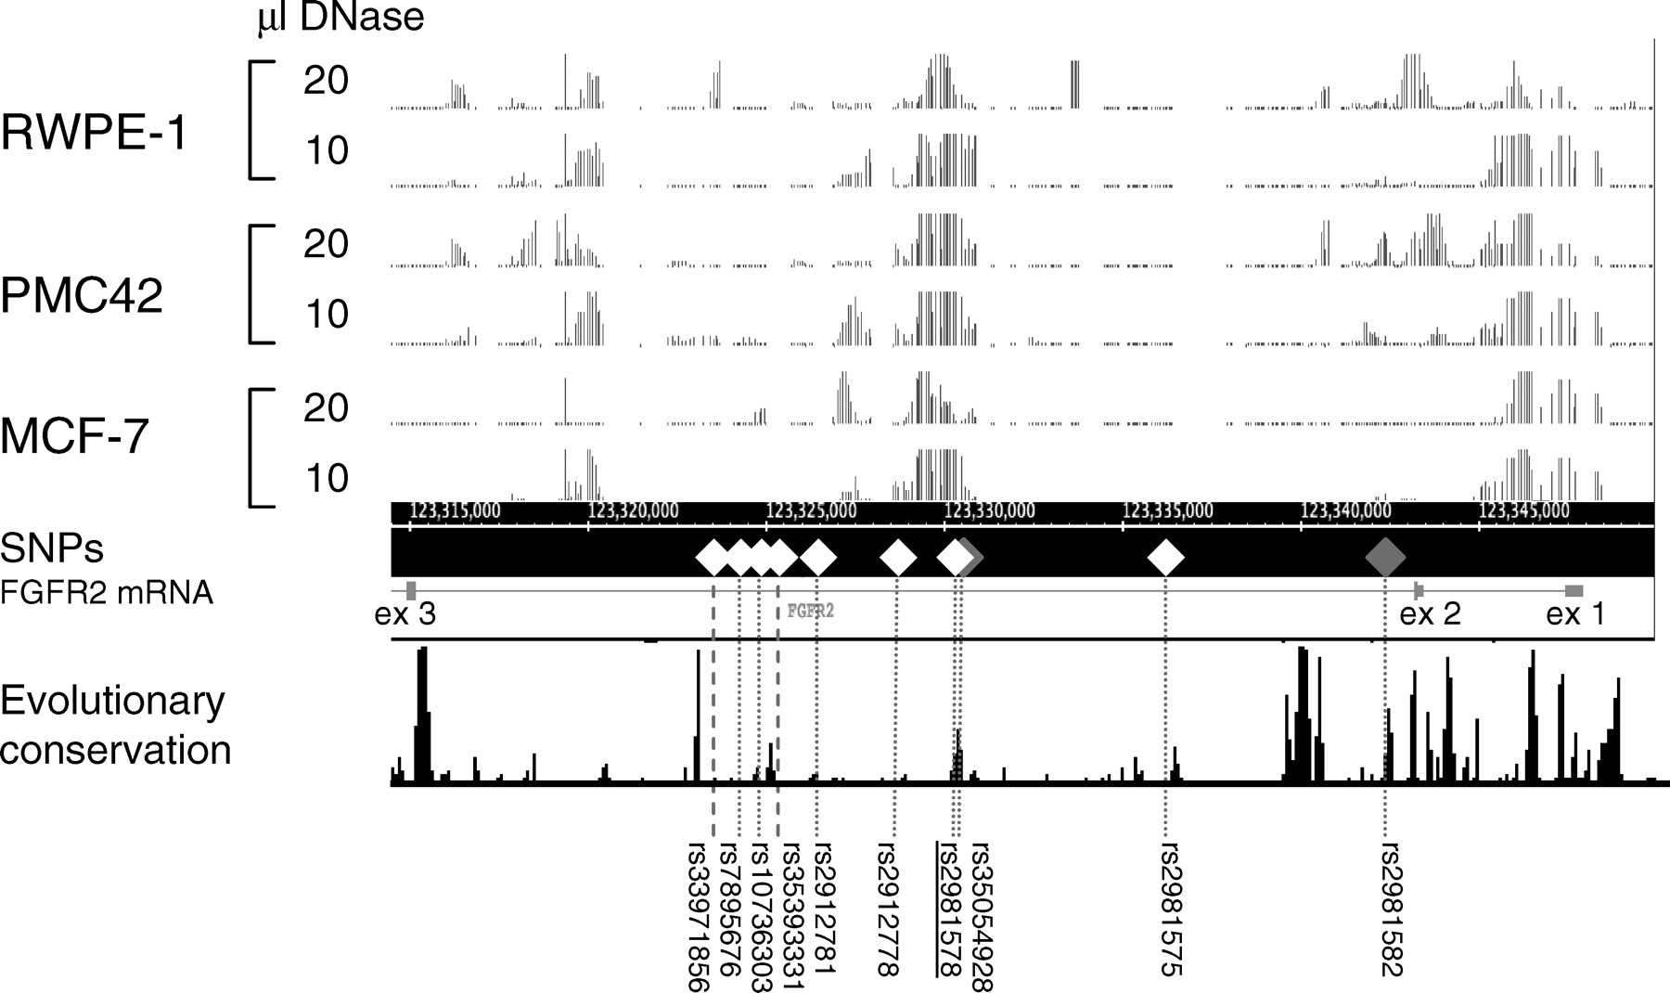
Figure 2. DNase I hypersensitivity profiles of the genomic region of FGFR2 covering exons 1–3. Profiles for the two ...
Notes:
Figure 2. DNase I hypersensitivity profiles of the genomic region of FGFR2 covering exons 1–3. Profiles for the two breast (PMC42 and MCF-7) and one prostate (RWPE-1) cell line were generated using two different concentrations of DNase I. The ACME ( 45 ) algorithm was used to generate the plots with a 95% cut-off and a sliding window of 500 bp. Grey diamonds indicate SNPs that were excluded on the basis of the likelihood ratio test. Two SNPs that could not be genotyped are indicated by the thick dotted line. Mammalian conservation of 17 species was taken from the UCSC genome browser ( 28 ).
Unless provided in the caption above, the following copyright applies to the content of this slide: © The Author 2009. Published by Oxford University Press. All rights reserved. For Permissions, please email: journals.permissions@oxfordjournals.org

