Slide 1
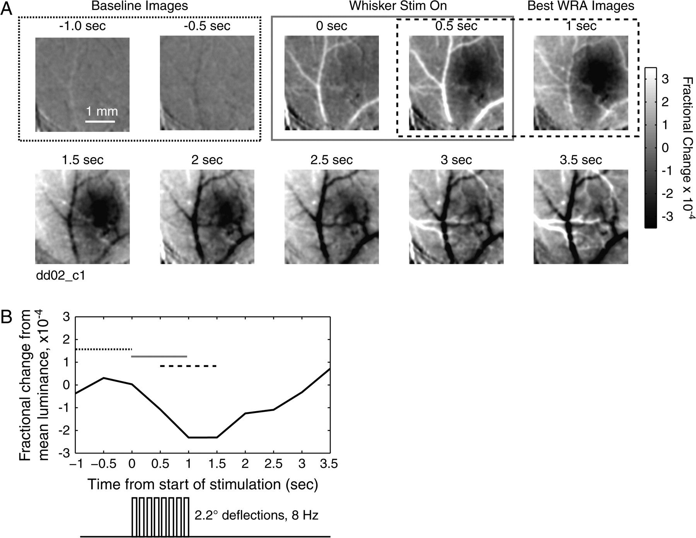
Figure 1. Whisker-evoked intrinsic signal in S1. (A) Stimulation consists of one second of baseline (outlined in dotted ...
Notes:
Figure 1. Whisker-evoked intrinsic signal in S1. (A) Stimulation consists of one second of baseline (outlined in dotted line), followed by one second of 8-Hz stimulation of the C1 whisker (gray line). Each image is an average over 0.5 s, and divided by the average image obtained during the baseline period (−1 to 0 s). The fractional change is indicated in gray scale, with black denoting a decrease in reflectance, white an increase. The images of the barrel least disrupted by blood vessels are found between 0.5 and 1.5 s after the start of stimulation (in dashed line box). Caudal is to the right, medial up. (B) Average reflectance over the entire image. Mean reflectance of during the baseline second is subtracted out. Dotted bar denotes baseline frames, gray time of whisker stimulation and dashed line the time over which the images are averaged for analysis. Note the dip in reflectance following stimulation and the subsequent rebound.
Unless provided in the caption above, the following copyright applies to the content of this slide: © The Author 2008. Published by Oxford University Press. All rights reserved. For permissions, please e-mail: journals.permissions@oxfordjournals.org

Slide 2
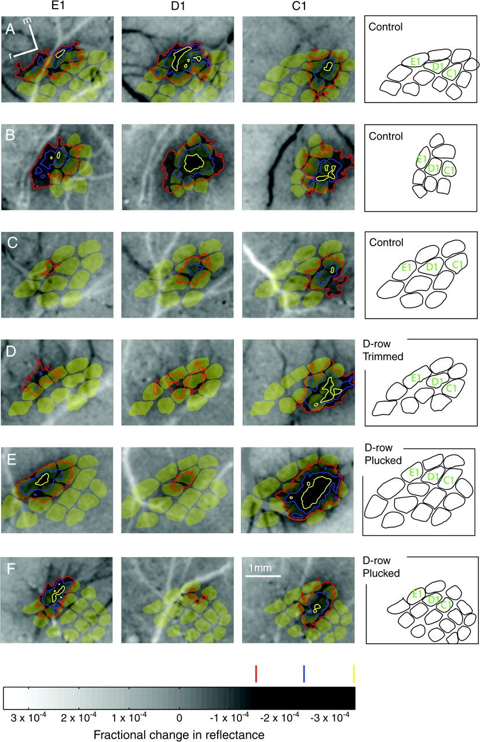
Figure 2. Example WRAs in control and D-row plucked rats. Each panel shows a gray scale image of whisker-evoked changes ...
Notes:
Figure 2. Example WRAs in control and D-row plucked rats. Each panel shows a gray scale image of whisker-evoked changes in luminance, relative to baseline (darker values denote decreased reflectance and increased neural activity). Dark and light streaks are blood vessels. WRAs are indicated by the different colored contours, which enclose areas of progressively stronger intrinsic signal, as shown on gray scale bar at bottom. Red indicates the lowest threshold for whisker-evoked intrinsic signal (pixel values −1.5 × 10−4), and yellow the highest threshold (−3.5 × 10−4). Contours with intermediate thresholds were calculated for analysis (e.g., Fig. 3), but are not shown here. WRAs are overlaid on anatomical barrel maps measured from CO-stained histological sections in the same animal (shown in yellow). See Supplementary Figure 1 for unobstructed versions of the intrinsic signal images. (A–C) Three representative control animals. m, medial. r, rostral. (D) Representative rat that had the D-row of whiskers trimmed. (E, F) Two representative rats that had the D-row plucked.
Unless provided in the caption above, the following copyright applies to the content of this slide: © The Author 2008. Published by Oxford University Press. All rights reserved. For permissions, please e-mail: journals.permissions@oxfordjournals.org

Slide 3
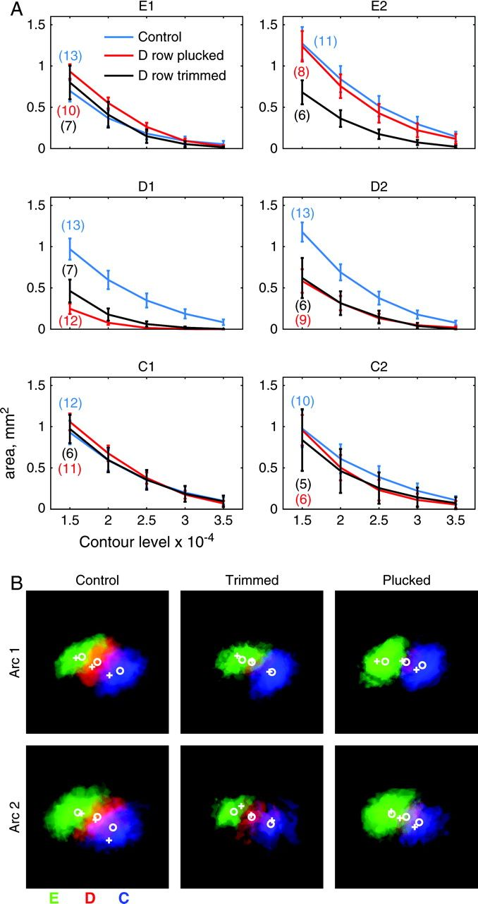
Figure 3. Quantitative effects of whisker deprivation on WRAs. (A) Mean WRA area as a function of contour threshold. ...
Notes:
Figure 3. Quantitative effects of whisker deprivation on WRAs. (A) Mean WRA area as a function of contour threshold. Blue, control rats; Red, D-row plucked, black, D-row trimmed. Bars show standard error. (B) Overlay of averaged WRAs for C1, D1, and E1 whiskers (top row) and C2, D2, and E2 whiskers (bottom row), from control (left), D-trimmed (center) and D-plucked (right) animals. WRAs from each animal were aligned at their centers and rotated to align the anatomically determined D-row axis before averaging. The average spacing of the anatomical barrel centers was used to arrange the WRAs. E row is green, D is red, and C is blue. Color mixtures indicate areas of overlap. Deprivation reduced average D-row WRAs in size and intensity. White circles indicate average centers of WRAs, white crosses indicate averaged centers of barrel columns.
Unless provided in the caption above, the following copyright applies to the content of this slide: © The Author 2008. Published by Oxford University Press. All rights reserved. For permissions, please e-mail: journals.permissions@oxfordjournals.org

Slide 4
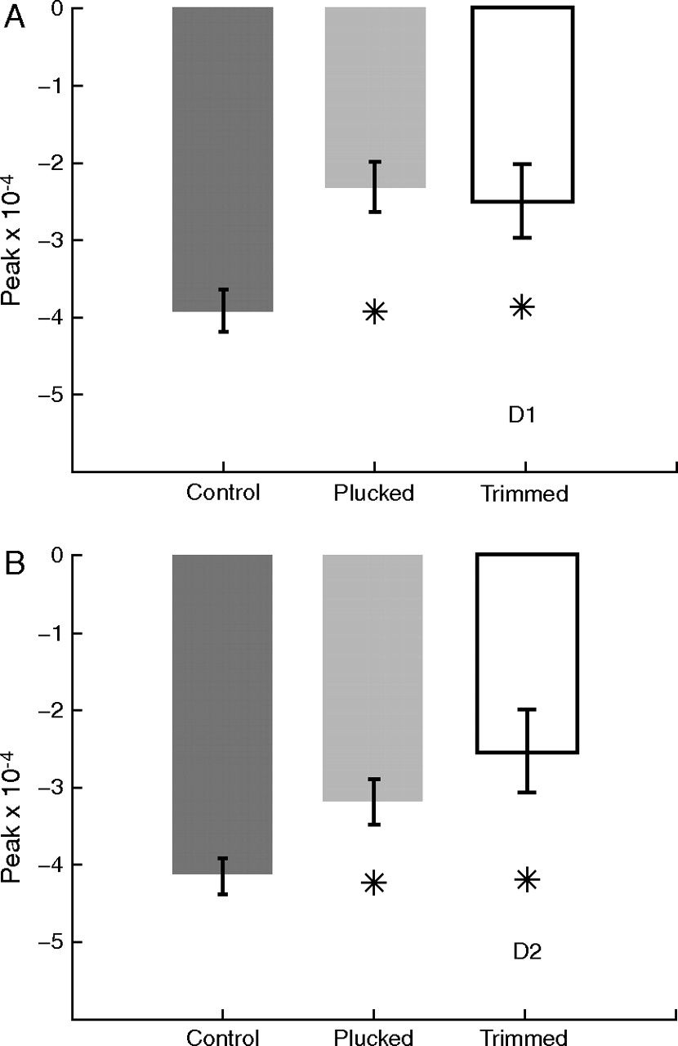
Figure 4. Effect of deprivation on peak magnitude of WRAs. (A) Average peak reflectance within the D1 WRA for control, ...
Notes:
Figure 4. Effect of deprivation on peak magnitude of WRAs. (A) Average peak reflectance within the D1 WRA for control, D-row plucked and D-row trimmed animals. Asterisks denote significant differences (P < 0.05, 2-tailed t-test) from control animals. Reduced peak reflectance in D-deprived rats indicates reduced whisker-evoked neural activity. (B) Average peak reflectance for D2 WRAs. Conventions as in (A).
Unless provided in the caption above, the following copyright applies to the content of this slide: © The Author 2008. Published by Oxford University Press. All rights reserved. For permissions, please e-mail: journals.permissions@oxfordjournals.org

Slide 5
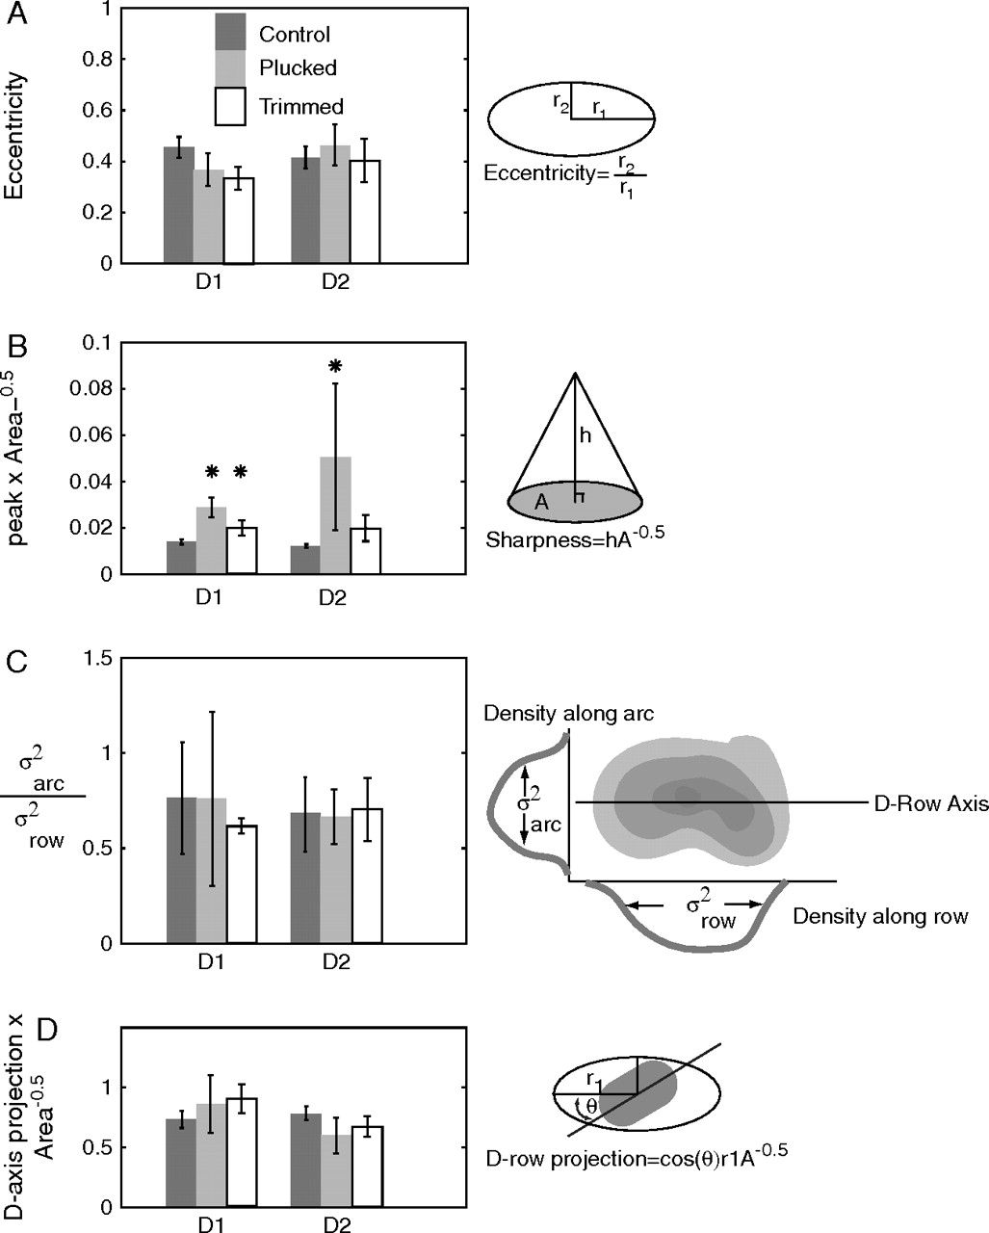
Figure 5. Effects of deprivation on shape of deprived WRAs. (A) Eccentricity of D1 (left) and D2 (right) WRAs. ...
Notes:
Figure 5. Effects of deprivation on shape of deprived WRAs. (A) Eccentricity of D1 (left) and D2 (right) WRAs. Eccentricity is the ratio of smallest to largest principle components, with 0 corresponding to a line, and 1 to a circle. There are no significant differences between the control D1 and D2 WRAs and the plucked and trimmed WRAs. (B) Ratio of the WRA peak to the square root of the area within the −1.5 × 10−4 threshold. An increase in this ratio implies a “steepening” of the WRA. There is a significant increase in this ratio relative to controls in plucked D1 and D2 WRAs, and in trimmed D1 WRAs. There were no significant changes in the spared WRAs relative to controls (not shown). (C) Ratio of the projection of the inner product of the anatomically determined D-row axis and the long axis of the WRA eccentricity to the square root of area. A decrease in this ratio implied that there is disproportionally more shrinkage along the D-row axis. There is no significant difference between control and deprived D-row WRAs. (D) Ratio of the spread of the WRA along the arc axis to the spread along the row axis. Increase indicates more contraction along the row than the arcs. There is no significant change in this ratio between control and D-row plucked and trimmed WRAs in the D-row or for other WRAs (data not shown). (E) Difference between the angle of the largest principal component of the D1 (left) and D2 (right) WRAs and the axis of the D-row determined from layer 4 CO staining for control, plucked, and trimmed animals.
Unless provided in the caption above, the following copyright applies to the content of this slide: © The Author 2008. Published by Oxford University Press. All rights reserved. For permissions, please e-mail: journals.permissions@oxfordjournals.org

Slide 6
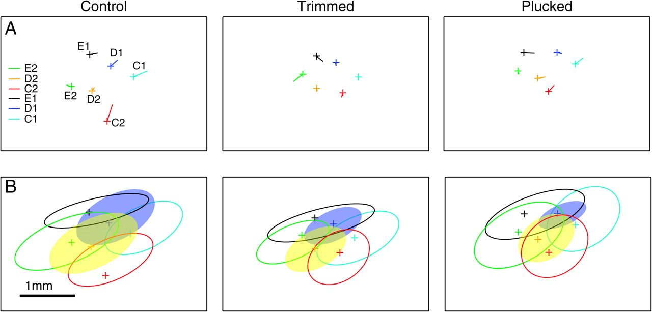
Figure 6. Effects of deprivation on position of WRAs. (A) Error between center of the −1.5 × 10⁻⁴ contour ...
Notes:
Figure 6. Effects of deprivation on position of WRAs. (A) Error between center of the −1.5 × 10−4 contour and center of anatomically defined barrel. Crosses show barrel centers, lines from centers show direction and magnitude of the mismatch between anatomy and imaging. (B) Average WRAs represented by ellipsoids with average area and eccentricity of WRAs. Crosses show location of barrels centers. Left, average of control animals, center, trimmed animals, and right, plucked animals. The 3 conditions have similar average maps, except for the shrinkage of the D-row WRAs in the deprived row.
Unless provided in the caption above, the following copyright applies to the content of this slide: © The Author 2008. Published by Oxford University Press. All rights reserved. For permissions, please e-mail: journals.permissions@oxfordjournals.org

Slide 7
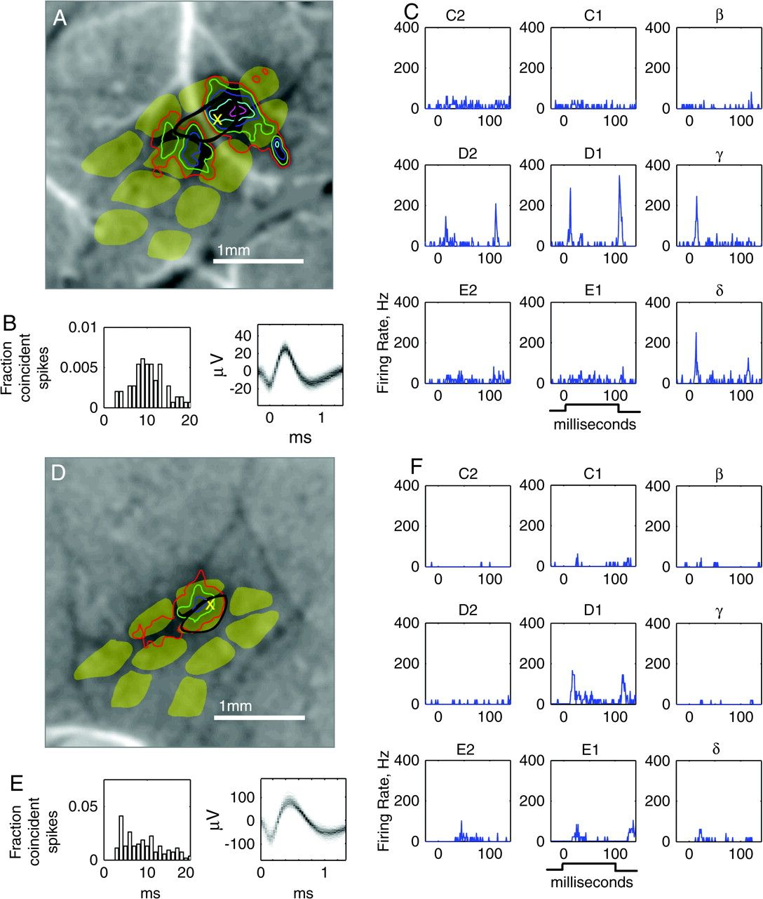
Figure 7. Representative single-unit recordings in L2/3 of the D1 column in control and deprived rats. (A–C) L2/3 ...
Notes:
Figure 7. Representative single-unit recordings in L2/3 of the D1 column in control and deprived rats. (A–C) L2/3 single unit in the D1 column of a control rat (depth: 586 μm below the pia). (D–F) L2/3 single unit in the D1 column of a D-row plucked rat (depth: 512 μm below pia). (A, D) Location of recording sites (X) relative to barrel outlines from CO-stained sections, and to D1 WRA used to target the recording penetration (contours, same thresholds as in Fig. 2). Background, D1-evoked intrinsic signal image. (B, E) Single-unit isolation shown by ISI histogram (left) and spike waveform density plot (right). (C, F) Nine-whisker tuning curve showing responses to 100-ms ramp–hold–return deflections (deflection onset: 0 ms). On- and off-responses are clearly visible. Each PSTH is mean of 50 sweeps.
Unless provided in the caption above, the following copyright applies to the content of this slide: © The Author 2008. Published by Oxford University Press. All rights reserved. For permissions, please e-mail: journals.permissions@oxfordjournals.org

Slide 8
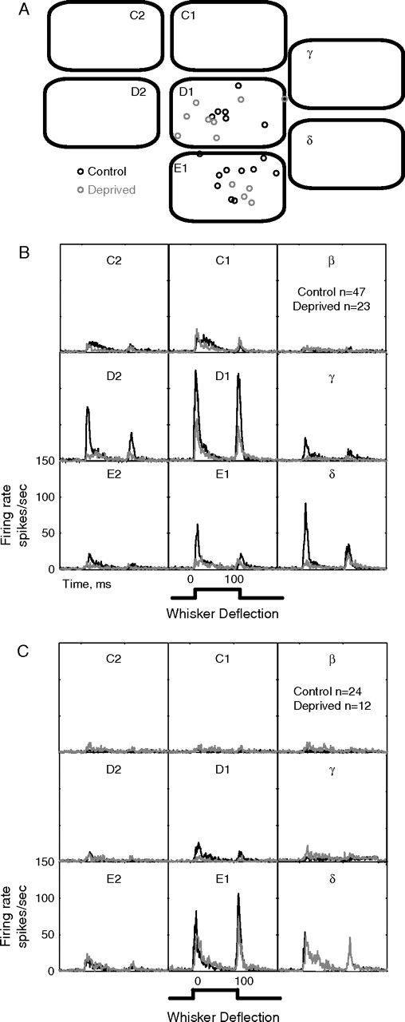
Figure 8. Effect of deprivation on population average whisker responses in D1 and E1 columns. (A) Location of all ...
Notes:
Figure 8. Effect of deprivation on population average whisker responses in D1 and E1 columns. (A) Location of all recording penetrations in D1 and E1 columns in control (n = 7) and D-row deprived (n = 6) rats, relative to normalized anatomical barrel boundaries. (B) Population average PSTHs for whisker responses of all single units recorded in L2/3 of the D1 whisker column. Instantaneous firing rate is calculated for each 1-ms time bin. Black, control rats. Gray, deprived rats. (C) Population average PSTHs for whisker responses for all single units recorded in L2/3 of the E1 whisker column.
Unless provided in the caption above, the following copyright applies to the content of this slide: © The Author 2008. Published by Oxford University Press. All rights reserved. For permissions, please e-mail: journals.permissions@oxfordjournals.org

Slide 9
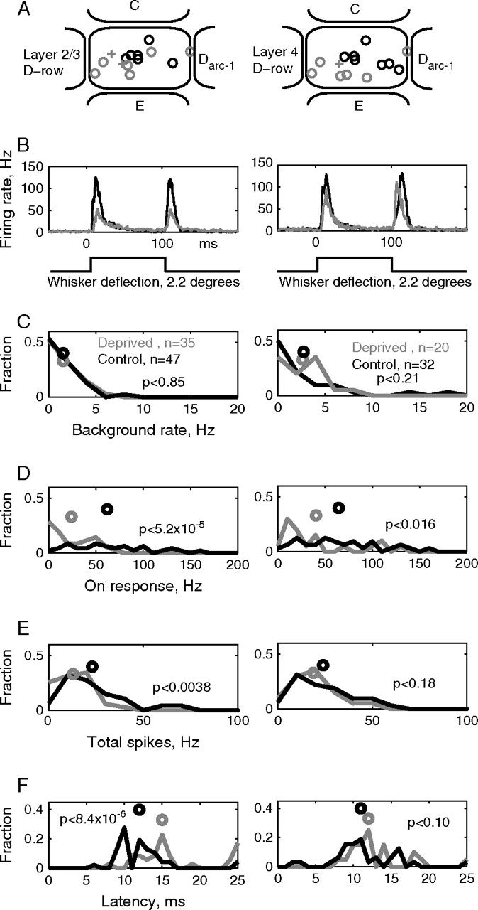
Figure 9. Single-unit responses to deprived D1 and D2 whiskers measured in their home columns. (A) Location of all ...
Notes:
Figure 9. Single-unit responses to deprived D1 and D2 whiskers measured in their home columns. (A) Location of all recording penetrations in D1 and D2 columns in control (n = 7) and deprived (n = 7) rats, relative to normalized column boundaries. Circles, D1 penetrations; +, D2 penetrations. Black, control cases. Gray, deprived cases. (B) Population average PSTHs of principal whisker responses, for all L2/3 (left) and L4 (right) units, in D1 and D2 columns. The left column includes data for units in D1 columns from Figure 8B. (C) Spontaneous firing rate distribution and means. (D) Magnitude of ON response (5–25 ms after onset of whisker deflection) to principal whisker deflection. Circles show mean. (E) Magnitude of total response to principal whisker deflection (5–130 ms after deflection onset). (F) Onset latency of principal whisker responses for all single units in D1 and D2 columns. Circles, median latency. All statistics are results of Mann–Whitney U test.
Unless provided in the caption above, the following copyright applies to the content of this slide: © The Author 2008. Published by Oxford University Press. All rights reserved. For permissions, please e-mail: journals.permissions@oxfordjournals.org

Slide 10
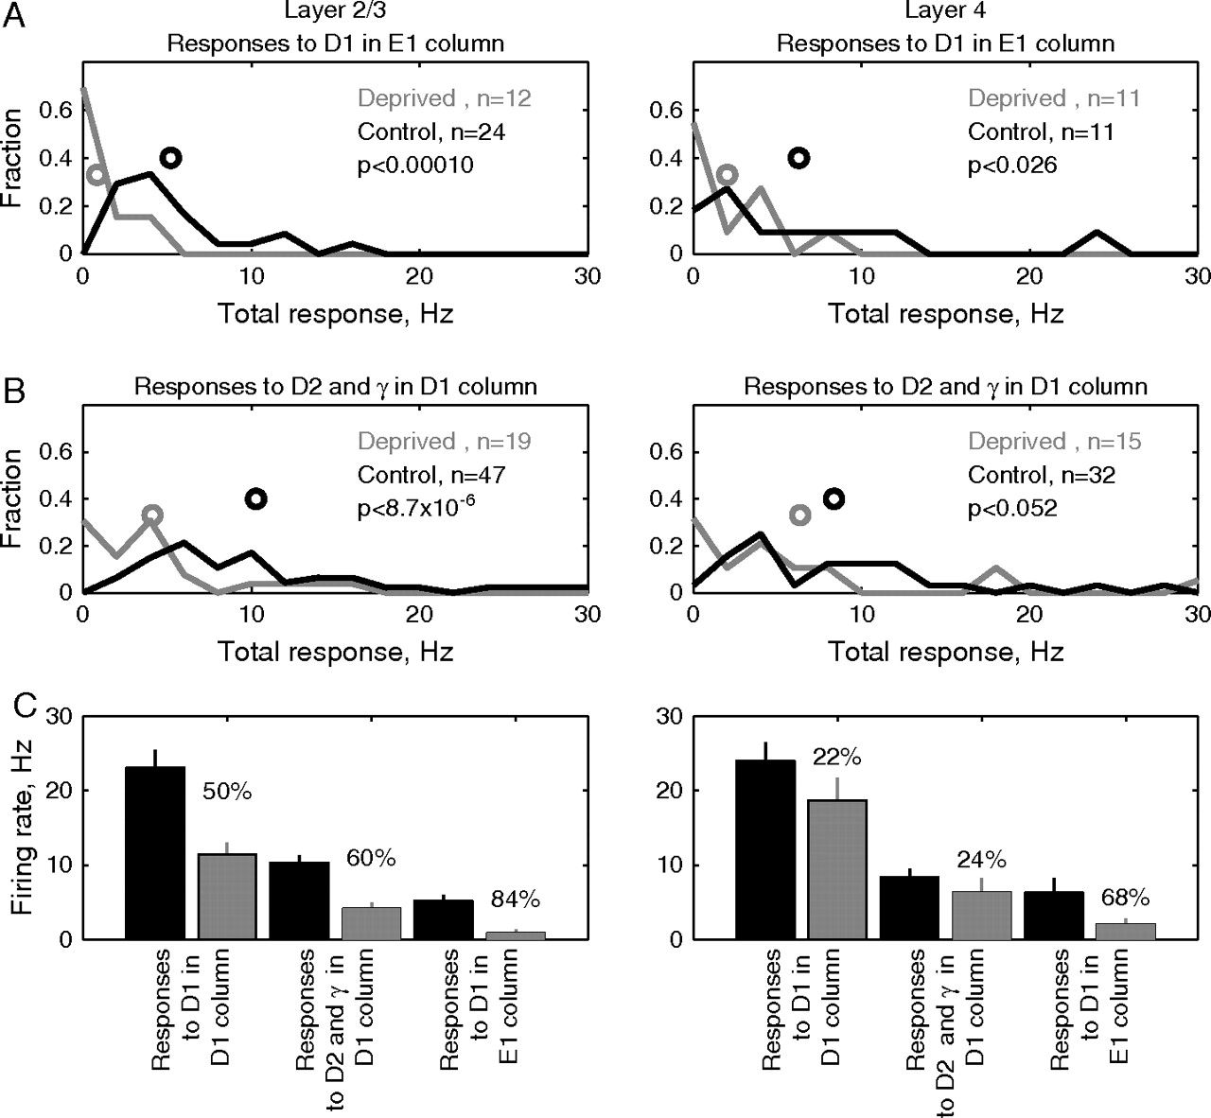
Figure 10. Single-unit responses to deprived whiskers measured in surrounding columns. (A) Total responses to the D1 ...
Notes:
Figure 10. Single-unit responses to deprived whiskers measured in surrounding columns. (A) Total responses to the D1 whisker measured for single units in the E1 column. Recording penetration locations are shown as circles in the E1 column in Figure 8A. ON-responses (5–25 ms after deflection onset) to the E1 whisker measured for single units in the E1 column. Recording penetration locations are shown as circles in the E1 column in Figure 8A. (B) Total responses to D2 and gamma whiskers in D1 column. (C) Mean total response magnitude for deprived D1, D2, and gamma whiskers in different cortical columns. Left, response to D1 whisker in its home, D1 column (from Fig. 9). Middle, mean response to D2 and gamma whiskers in the deprived D1 column. Right, response to D1 whisker in the spared E1 column. Percentages represent the magnitude of response reduction in deprived animals, relative to the control animals.
Unless provided in the caption above, the following copyright applies to the content of this slide: © The Author 2008. Published by Oxford University Press. All rights reserved. For permissions, please e-mail: journals.permissions@oxfordjournals.org

Slide 11
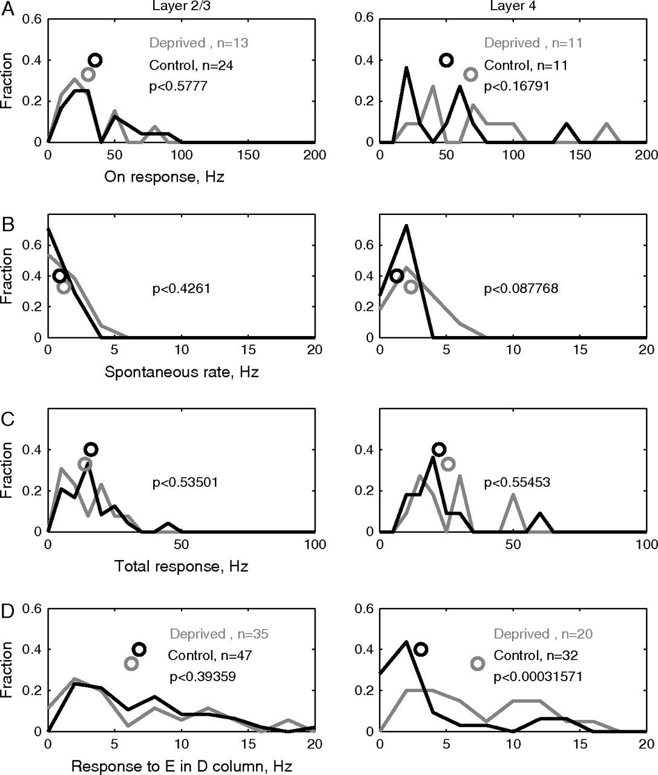
Figure 11. Single-unit responses to the spared E1 whisker. (A) ON-responses to the E1 whisker measured for single units ...
Notes:
Figure 11. Single-unit responses to the spared E1 whisker. (A) ON-responses to the E1 whisker measured for single units in the E1 column. Recording penetration locations are shown as circles in the E1 column in Figure 8A. (B) Spontaneous firing rate for single units in the E1 column. (C) Total responses (5–130 ms after deflection onset) to E1 deflection for single units in the E1 column. (D) Total responses to E1 whisker deflection for single units in the D1 column). Recording site locations are shown in Figure 8A (D1 sites).
Unless provided in the caption above, the following copyright applies to the content of this slide: © The Author 2008. Published by Oxford University Press. All rights reserved. For permissions, please e-mail: journals.permissions@oxfordjournals.org

