Slide 1
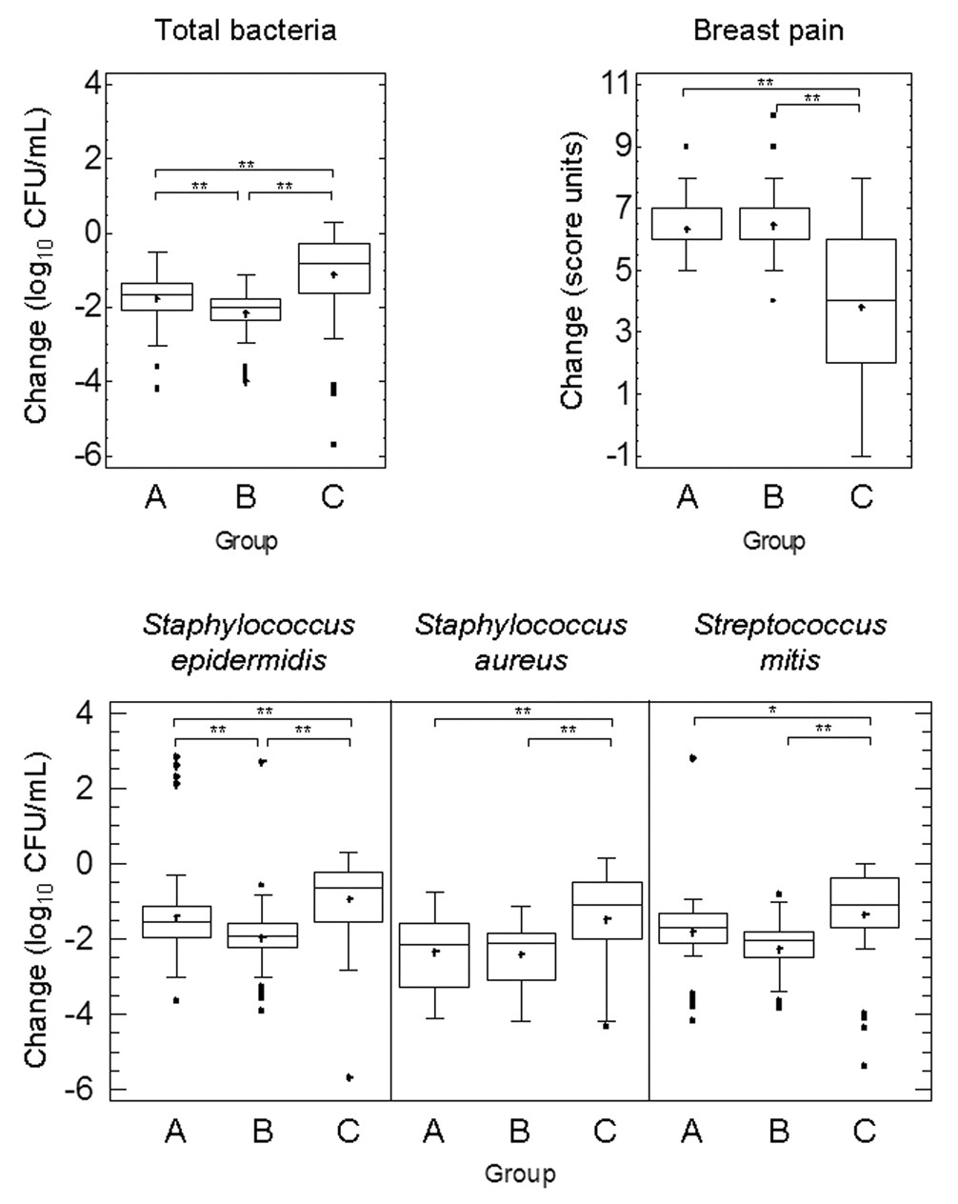
Figure 1. Box and whisker plots showing changes in bacterial count (total, Staphylococcus epidermidis, Staphylococcus ...
Notes:
Figure 1. Box and whisker plots showing changes in bacterial count (total, Staphylococcus epidermidis, Staphylococcus aureus, and Streptococcus mitis) of breast milk samples and changes in breast pain score reported by the participants after probiotic (Lactobacillus fermentum CECT5716 in group A and Lactobacillus salivarius CECT5713 in group B) or antibiotic (group C) treatment. Differences in the changes experienced for each group were evaluated with nonparametric multiple comparison tests and are shown with horizontal lines inside each graph (*P < .01; **P < .001). The horizontal line in the middle of each box represents the median, while the top and bottom borders of the box represent the 75% and 25% percentiles, respectively. The mean is represented as a cross, and the outliers as individual points outside the boxes. Breast pain score ranged from 0 (extremely painful) to 10 (no pain).
Unless provided in the caption above, the following copyright applies to the content of this slide: © 2010 by the Infectious Diseases Society of America

Slide 2
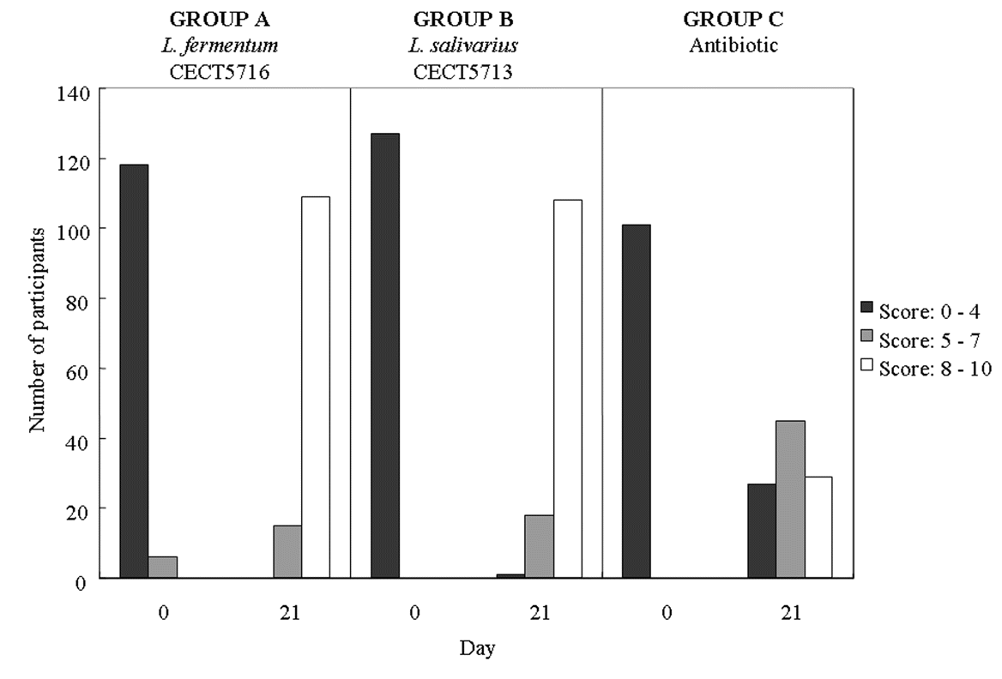
Figure 2. Distribution of breast pain scores reported by participants at the beginning (day 0) and at the end (day 21) ...
Notes:
Figure 2. Distribution of breast pain scores reported by participants at the beginning (day 0) and at the end (day 21) of the trial in the probiotic groups (group A, Lactobacillus fermentum CECT5716; and group B, Lactobacillus salivarius CECT5713) and in the antibiotic group (group C). Breast pain categories were 0–4, extremely painful; 5–7, discomfort; and 8–10, no pain.
Unless provided in the caption above, the following copyright applies to the content of this slide: © 2010 by the Infectious Diseases Society of America

Slide 3
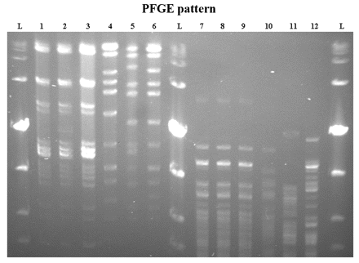
Figure 3. Banding patterns determined by pulsed-field gel electrophoresis (PFGE) of SmaI-digested genomic DNA from ...
Notes:
Figure 3. Banding patterns determined by pulsed-field gel electrophoresis (PFGE) of SmaI-digested genomic DNA from Lactobacillus salivarius CECT5713 (lane 1), 2 milk isolates that hybridized with the L. salivarius probe in the colony hybridization assay (lanes 2 and 3), L. salivarius CECT4062 (lane 4 ), L. salivarius CECT4063 (lane 5 ), L. salivarius DSM 20492 (lane 6), Lactobacillus fermentum CECT5716 (lane 7), 2 milk isolates that hybridized with the L. fermentum probe in the hybridization assay (lanes 8 and 9), L. fermentum CECT285 (lane 10), L. fermentum CECT4007 (lane 11), and L. fermentum LMG 8900 (lane 12 ). Lane L represents the Low Range PFG standard (New England BioLabs).
Unless provided in the caption above, the following copyright applies to the content of this slide: © 2010 by the Infectious Diseases Society of America

Slide 4
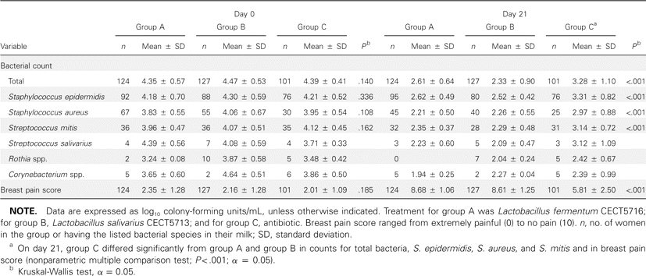
Table 1. Bacterial Counts from Breast Milk and Breast Pain Score at the Beginning (Day 0) and the End (Day 21) of the ...
Notes:
Table 1. Bacterial Counts from Breast Milk and Breast Pain Score at the Beginning (Day 0) and the End (Day 21) of the Trial
Unless provided in the caption above, the following copyright applies to the content of this slide: © 2010 by the Infectious Diseases Society of America

Slide 5
Table 2. Reduction in Bacterial Counts in Breast Milk and Change in Breast Pain Score from Day 0 to Day 21, according ...
Notes:
Table 2. Reduction in Bacterial Counts in Breast Milk and Change in Breast Pain Score from Day 0 to Day 21, according to the Antibiotic Prescribed to Group C Women
Unless provided in the caption above, the following copyright applies to the content of this slide: © 2010 by the Infectious Diseases Society of America

Slide 6
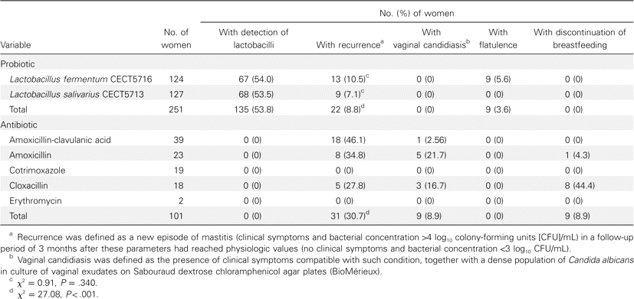
Table 3. Additional Outcomes of the Study of Treatment of Infectious Mastitis during Lactation
Notes:
Table 3. Additional Outcomes of the Study of Treatment of Infectious Mastitis during Lactation
Unless provided in the caption above, the following copyright applies to the content of this slide: © 2010 by the Infectious Diseases Society of America

