Slide 1
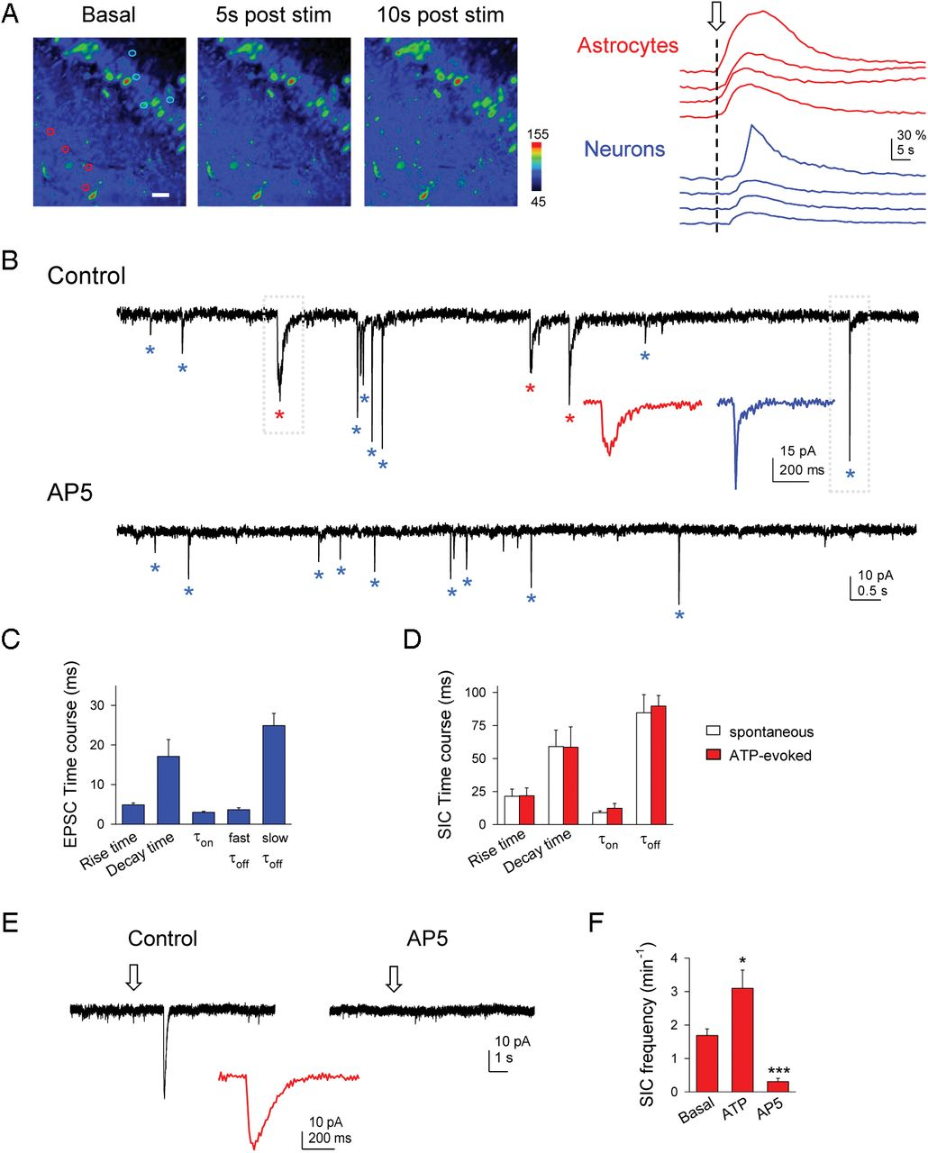
Figure 3. Human astrocytes release glutamate that activates NMDA receptors in postsynaptic neurons. (A) Left: ...
Notes:
Figure 3. Human astrocytes release glutamate that activates NMDA receptors in postsynaptic neurons. (A) Left: fluorescence images of a fluo-4-loaded hippocampal slice showing Ca2+ levels before (basal) and after (5 and 10 s) ATP application. Right: ATP application (arrow) evoked Ca2+ elevations in astrocytes (red traces corresponding to astrocytes marked with red circles in A) and delayed Ca2+ elevations in neurons (blue traces corresponding to neurons marked with blue circles in A). Scale bar 30 µm. (B) Whole-cell currents from a human neuron showing spontaneous SICs (red asterisks; expanded at bottom) and mEPSCs (blue asterisks; expanded at bottom) in control and in the presence of 50 µM AP5. Note that SICs were absent in AP5. (C) Time course parameters of mEPSCs recorded in human neurons (n ≥ 18 for each bar from 5 neurons). mEPSCs decay time courses were fitted to 2 exponential functions with 2 time constants (fast and slow τ). (D) Time course parameters of spontaneous and ATP-evoked SICs (n ≥ 35 for each bar from 6 neurons). (E) Whole currents from human neurons. ATP application (arrows) evoked a SIC (expanded at bottom) in control but not in AP5. (F) Mean frequency of neuronal SICs in control, after ATP, and in AP5 (n ≥ 5 neurons for each bar). Results from hippocampal and cortical neurons were similar and pooled together. Error bars indicate SEM. *P < 0.05, ***P < 0.001.
Unless provided in the caption above, the following copyright applies to the content of this slide: © The Author 2012. Published by Oxford University Press. All rights reserved. For Permissions, please e-mail: journals.permissions@oup.com

Slide 2
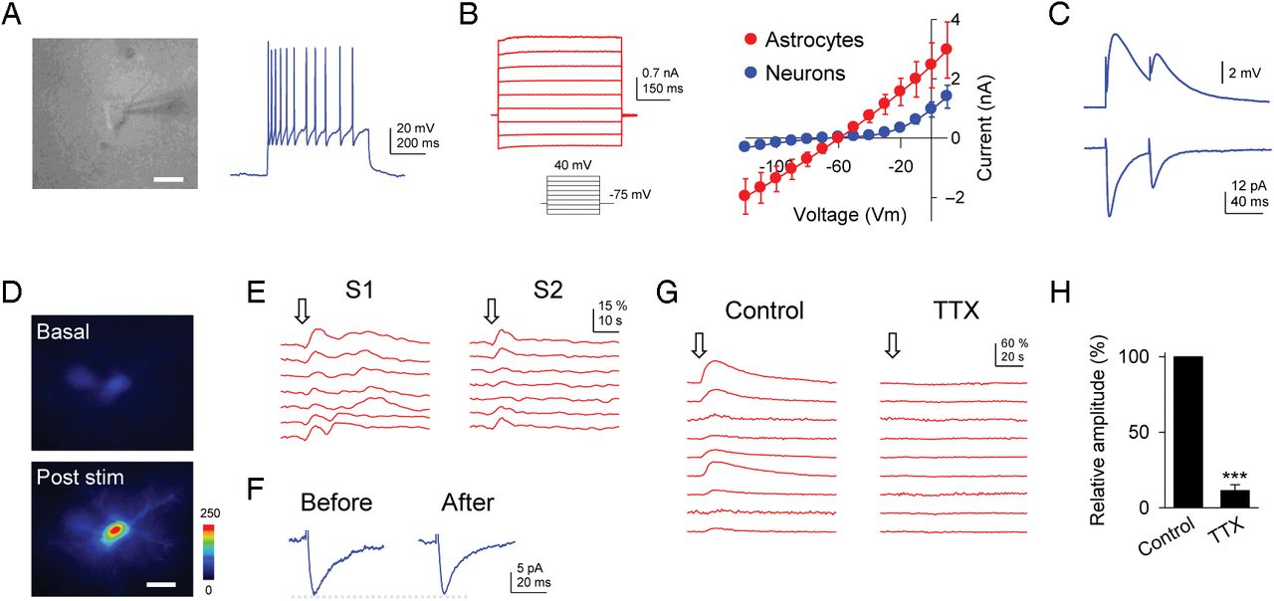
Figure 2. Human astrocytes respond with Ca²⁺ elevations to synaptic activity. (A) Depolarization of recorded ...
Notes:
Figure 2. Human astrocytes respond with Ca2+ elevations to synaptic activity. (A) Depolarization of recorded neurons (left) elicits action potential firing (right). Scale bar 15 µm. (B) Typical passive electrophysiological responses of astrocytes to voltage pulses, and I-V relationships of neurons and astrocytes (n ≥ 5 cells for each bar). (C) Representative traces of evoked EPSPs (top) and EPSCs (bottom) in recorded neurons by electrical stimulation. (D) Representative fluorescence images of Ca2+ levels of a patch-clamped astrocyte filled with fluo-4 before and after a train (30 Hz, 5 s) of axonal stimulation. Scale bar 10 µm. (E) Astrocyte Ca2+ responses in 7 astrocytes elicited by 2 consecutive trains of electrical stimulation (30 Hz, 5 s; S1, S2; arrows). (F) Representative traces of evoked EPSCs in recorded neurons before and after a train of electrical stimulation (30 Hz, 5 s). (G) Astrocyte Ca2+ responses of 9 astrocytes to trains of electrical stimulation (arrows) before (Control) and after perfusion with TTX. (H) Relative changes from control recordings of astrocyte Ca2+ signal evoked by electrical stimulation in the presence TTX (1 µM; n = 14 astrocytes from 4 slices). Error bars indicate SEM. ***P < 0.001.
Unless provided in the caption above, the following copyright applies to the content of this slide: © The Author 2012. Published by Oxford University Press. All rights reserved. For Permissions, please e-mail: journals.permissions@oup.com

Slide 3
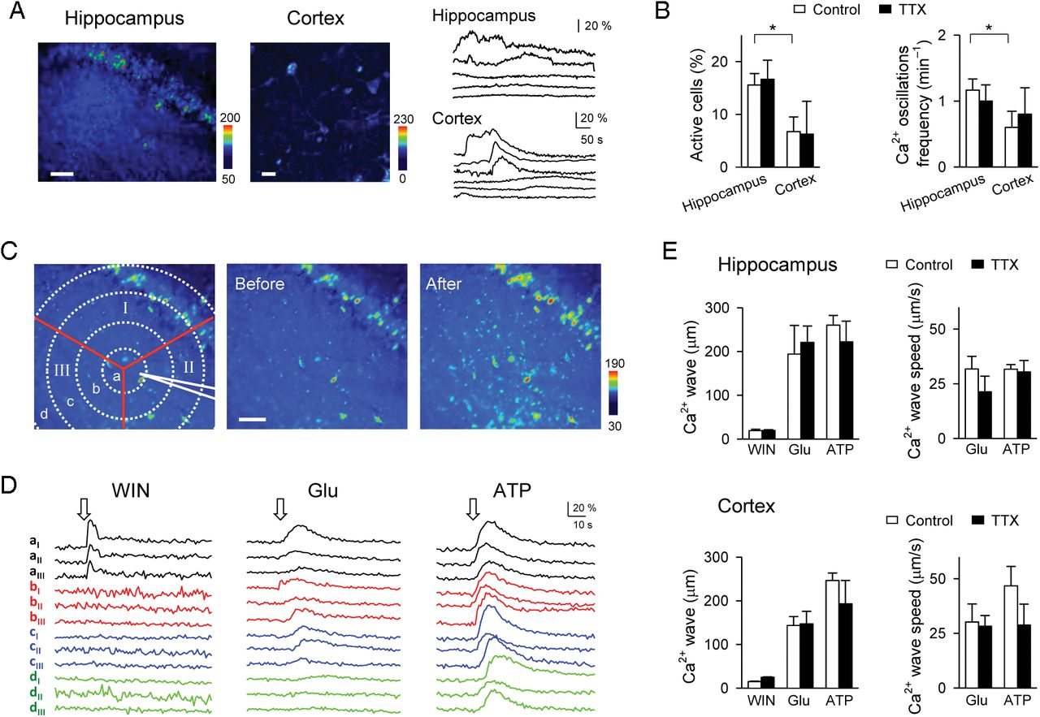
Figure 1. Ca²⁺ signal in human astrocytes in situ. (A) Pseudocolor images of fluo-4-filled hippocampal and ...
Notes:
Figure 1. Ca2+ signal in human astrocytes in situ. (A) Pseudocolor images of fluo-4-filled hippocampal and cortical slices, and representative Ca2+ levels showing spontaneous Ca2+ elevations from hippocampal and cortical astrocytes. Scale bar: 60 µm (left), 40 µm (right). (B) Relative number of active astrocytes and oscillation frequency in control and TTX (n = 46 and 39 astrocytes for the hippocampus and the cortex, respectively; n ≥ 6 slices for each bar). (C) Fluorescence images of a fluo-4-loaded hippocampal slice depicting the experimental arrangement (left), and Ca2+ levels 10 s before and after ATP application. Scale bar 60 µm. (D) Astrocyte Ca2+ responses (at the regions shown in C) to 2 s application of WIN (300 µM), glutamate (0.8 mM), or ATP (20 mM). (E) Astrocyte Ca2+ wave extension and speed in control and TTX (n ≥ 4 slices for each bar). Error bars indicate SEM. *P < 0.05.
Unless provided in the caption above, the following copyright applies to the content of this slide: © The Author 2012. Published by Oxford University Press. All rights reserved. For Permissions, please e-mail: journals.permissions@oup.com

