Slide 1
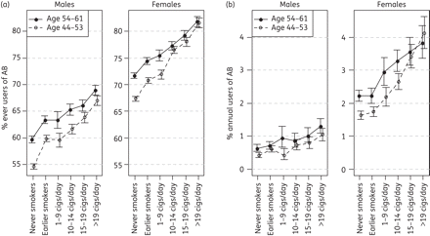
Figure 1. Prevalence of individuals prescribed antibacterials (AB) in the period 2004–09 by gender, age and smoking ...
Notes:
Figure 1. Prevalence of individuals prescribed antibacterials (AB) in the period 2004–09 by gender, age and smoking category. (a) At least one prescription (ever users); (b) at least one prescription each year (annual users). cigs, cigarettes.
Unless provided in the caption above, the following copyright applies to the content of this slide: © The Author 2011. Published by Oxford University Press on behalf of the British Society for Antimicrobial Chemotherapy. All rights reserved. For Permissions, please e-mail: journals.permissions@oup.com

Slide 2
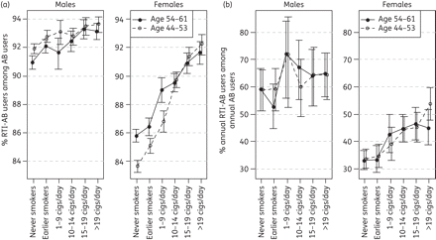
Figure 2. Proportions of RTI-AB users among users of antibacterials (AB users) in the period 2004–09 by gender, age and ...
Notes:
Figure 2. Proportions of RTI-AB users among users of antibacterials (AB users) in the period 2004–09 by gender, age and smoking category. (a) At least one prescription (ever users); (b) at least one prescription each year (annual users). cigs, cigarettes.
Unless provided in the caption above, the following copyright applies to the content of this slide: © The Author 2011. Published by Oxford University Press on behalf of the British Society for Antimicrobial Chemotherapy. All rights reserved. For Permissions, please e-mail: journals.permissions@oup.com

Slide 3
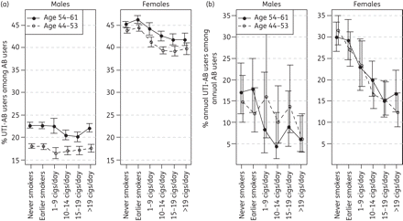
Figure 3. Proportions of UTI-AB users among users of antibacterials (AB users) in the period 2004–09 by gender, age and ...
Notes:
Figure 3. Proportions of UTI-AB users among users of antibacterials (AB users) in the period 2004–09 by gender, age and smoking category. (a) At least one prescription (ever users); (b) at least one prescription each year (annual users). cigs, cigarettes.
Unless provided in the caption above, the following copyright applies to the content of this slide: © The Author 2011. Published by Oxford University Press on behalf of the British Society for Antimicrobial Chemotherapy. All rights reserved. For Permissions, please e-mail: journals.permissions@oup.com

Slide 4
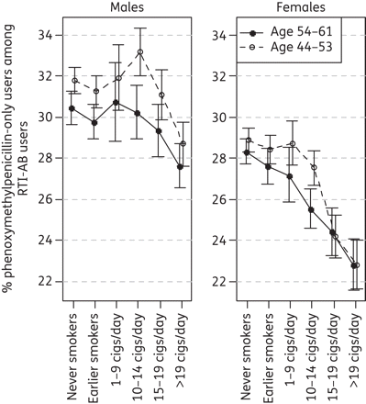
Figure 4. Proportions of users of phenoxymethylpenicillin only among RTI-AB users in the period 2004–09 by gender, age ...
Notes:
Figure 4. Proportions of users of phenoxymethylpenicillin only among RTI-AB users in the period 2004–09 by gender, age and smoking category. cigs, cigarettes.
Unless provided in the caption above, the following copyright applies to the content of this slide: © The Author 2011. Published by Oxford University Press on behalf of the British Society for Antimicrobial Chemotherapy. All rights reserved. For Permissions, please e-mail: journals.permissions@oup.com

