Slide 1
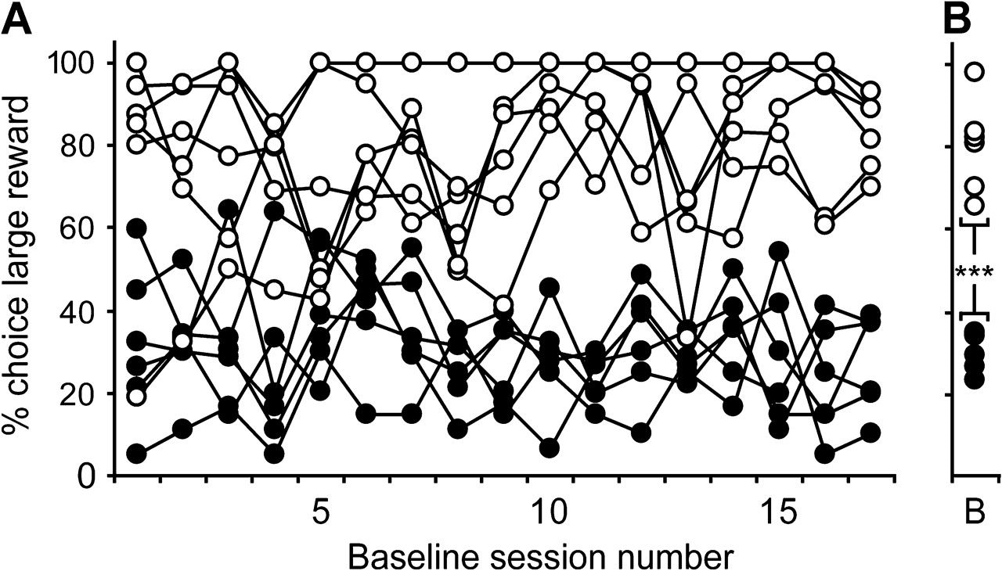
Figure 1. Temporally stable differences in impulsive choice between rats. (A) The level of impulsive choice (100 − % ...
Notes:
Figure 1. Temporally stable differences in impulsive choice between rats. (A) The level of impulsive choice (100 − % choice large reward) of LI (white circles) and HI rats (black circles) across 17 baseline sessions. (B) LI and HI rats differed in their average percentage choice for large reward calculated from 17 baseline sessions (B = baseline). ***P < 0.0001.
Unless provided in the caption above, the following copyright applies to the content of this slide: © The Author 2009. Published by Oxford University Press. All rights reserved. For permissions, please e-mail: journals.permissions@oxfordjournals.org

Slide 2
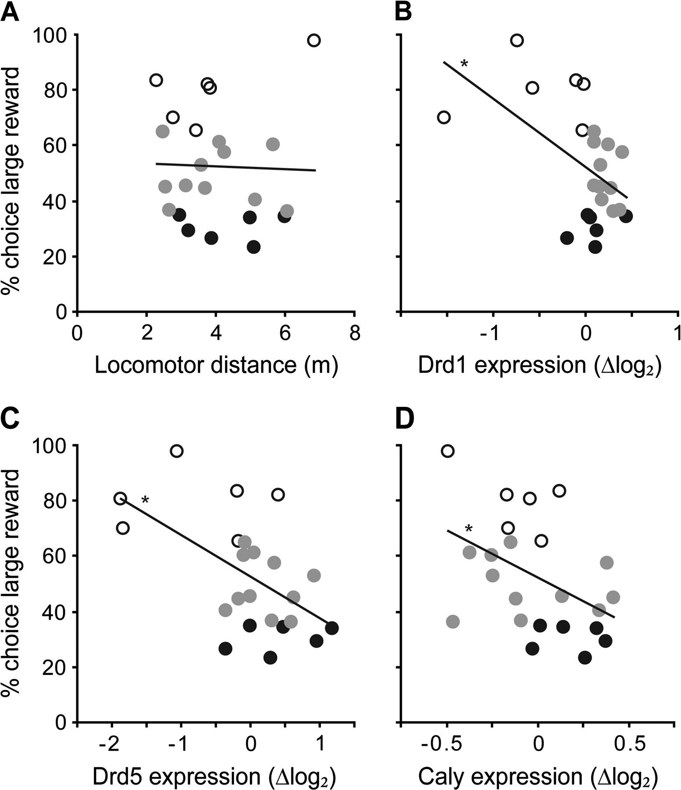
Figure 2. Scatter plots of correlations between the level of impulsive choice (100 − % choice large reward) and (A) the ...
Notes:
Figure 2. Scatter plots of correlations between the level of impulsive choice (100 − % choice large reward) and (A) the level of locomotor activity as measured as distance moved and the level of expression in the mPFC of (B) Drd1, (C) Drd5, and (D) Caly. Normalized levels of gene expression are displayed as deviation from the group mean expression level (GEnorm; log2 scale). *P < 0.05. Colors of the circles represent LI (white circles), HI rats (black circles), and intermediate impulsive rats (gray circles).
Unless provided in the caption above, the following copyright applies to the content of this slide: © The Author 2009. Published by Oxford University Press. All rights reserved. For permissions, please e-mail: journals.permissions@oxfordjournals.org

Slide 3
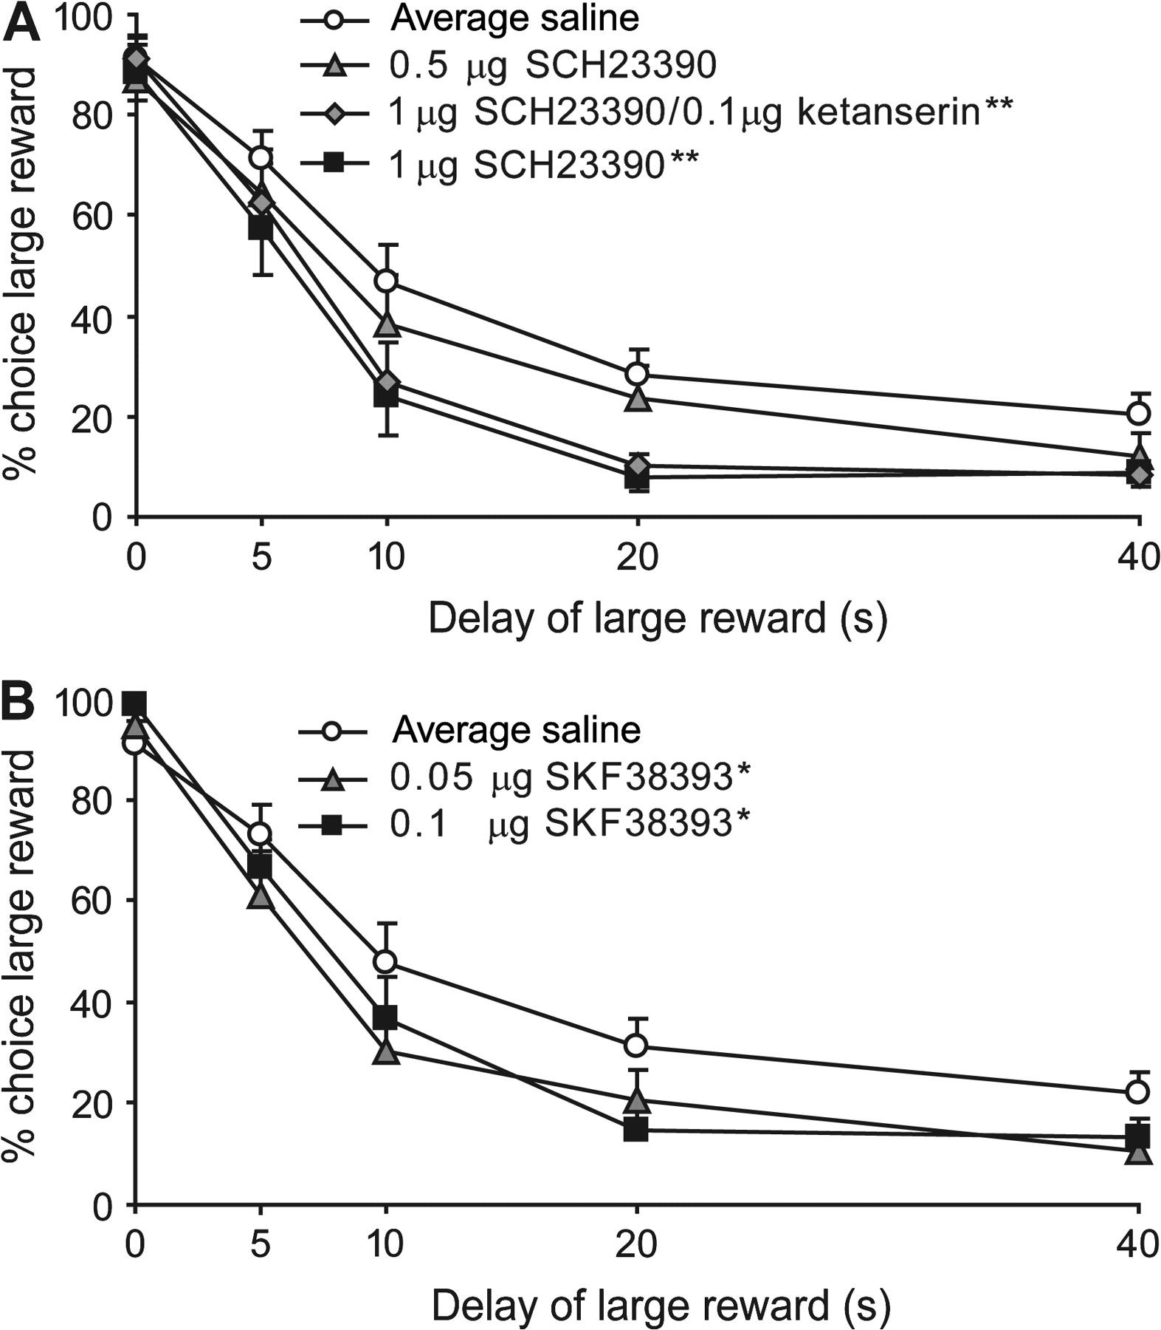
Figure 3. Agonist and antagonist infusions of D₁/D₅ receptors in the mPFC increased impulsive ...
Notes:
Figure 3. Agonist and antagonist infusions of D1/D5 receptors in the mPFC increased impulsive choice. (A) SCH 23390 increased impulsive choice (decreased % choice large reward) compared with saline, an effect that was not blocked by coinfusion of ketanserin. (B) SKF 38393 increased impulsive choice compared with saline. *P < 0.05, **P < 0.01 compared with saline. Data are expressed as mean ± standard error of the mean.
Unless provided in the caption above, the following copyright applies to the content of this slide: © The Author 2009. Published by Oxford University Press. All rights reserved. For permissions, please e-mail: journals.permissions@oxfordjournals.org

