Slide 1
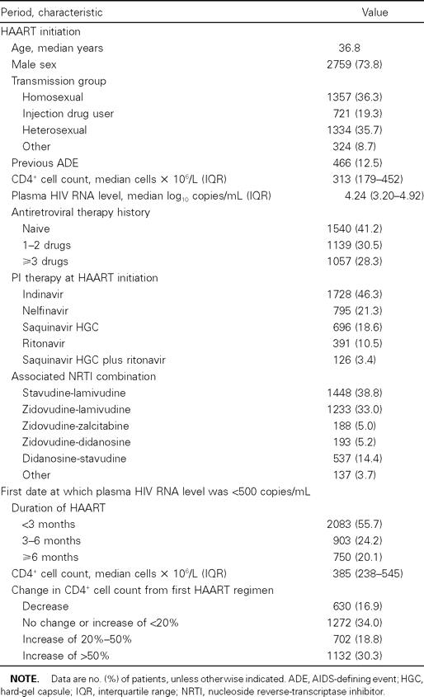
Table 1 Characteristics of 3736 patients in a study of midterm clinical and immunologic outcome of HIV infection ...
Notes:
Table 1 Characteristics of 3736 patients in a study of midterm clinical and immunologic outcome of HIV infection after initial virus load undetectability during HAART.
Unless provided in the caption above, the following copyright applies to the content of this slide: © 2003 by the Infectious Diseases Society of America

Slide 2
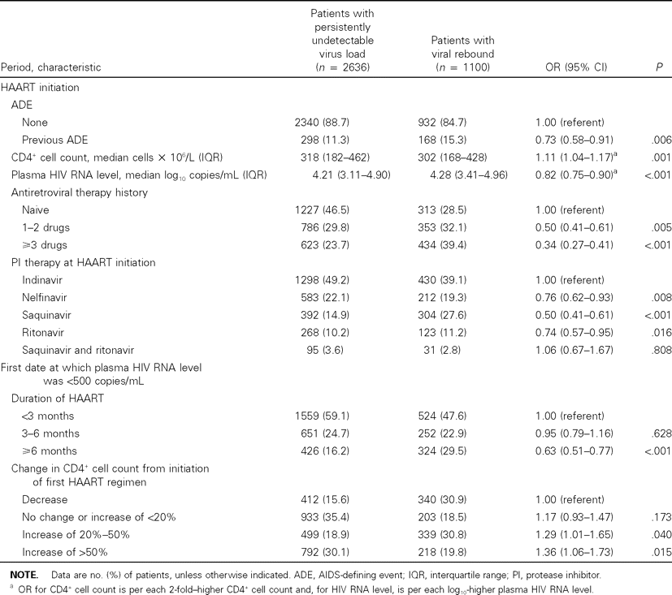
Table 2 Characteristics of patients with and without persistently undetectable virus load during the year after ...
Notes:
Table 2 Characteristics of patients with and without persistently undetectable virus load during the year after initial virus load undetectability during HAART and multivariate analysis of factors related to persistent undetectability, adjusted for age, transmission group, and associated nucleoside reverse-transcriptase inhibitor (NRTI) combination.
Unless provided in the caption above, the following copyright applies to the content of this slide: © 2003 by the Infectious Diseases Society of America

Slide 3
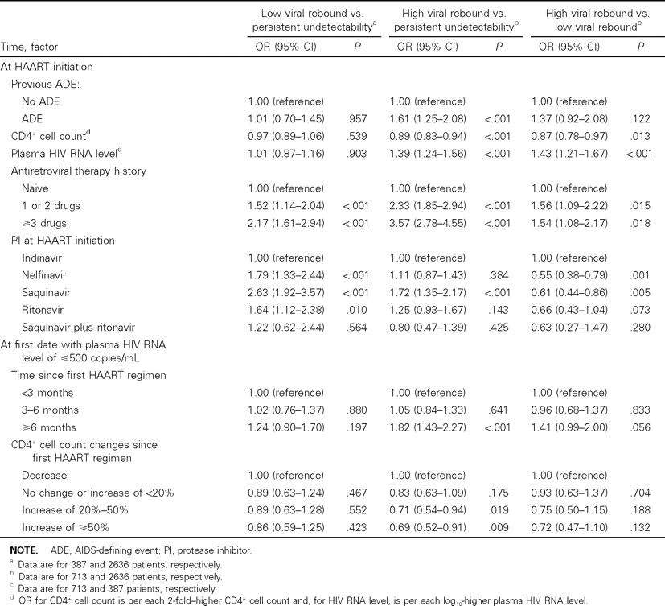
Table 3 Factors associated on multivariate analyses with 2 levels of viral rebound during the year after initial ...
Notes:
Table 3 Factors associated on multivariate analyses with 2 levels of viral rebound during the year after initial virus load undetectability during HAART, adjusted for age, transmission group, and associated nucleoside reverse-transcriptase inhibitor (NRTI) combination.
Unless provided in the caption above, the following copyright applies to the content of this slide: © 2003 by the Infectious Diseases Society of America

Slide 4
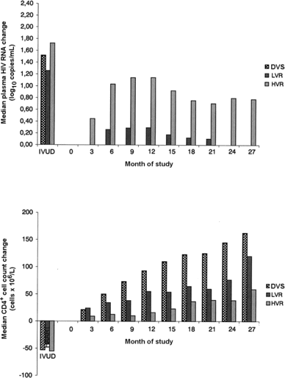
Figure 1 Changes in median plasma HIV RNA levels (top) and median CD4⁺ cell counts (bottom), compared with ...
Notes:
Figure 1 Changes in median plasma HIV RNA levels (top) and median CD4+ cell counts (bottom), compared with the values from the date of initial virus load undetectability (IVUD) during HAART, according to the 3 categories of antiretroviral efficacy in the year after initial undetectability. DVS, durable viral suppression; HVR, high viral rebound; LVR, low viral rebound.
Unless provided in the caption above, the following copyright applies to the content of this slide: © 2003 by the Infectious Diseases Society of America

Slide 5
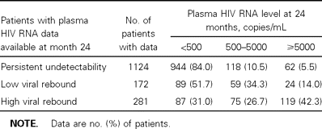
Table 4 Plasma HIV RNA values after a follow-up of 24 months, according to the 3 categories of antiretroviral ...
Notes:
Table 4 Plasma HIV RNA values after a follow-up of 24 months, according to the 3 categories of antiretroviral efficacy during the year after initial virus load undetectability during HAART.
Unless provided in the caption above, the following copyright applies to the content of this slide: © 2003 by the Infectious Diseases Society of America

Slide 6
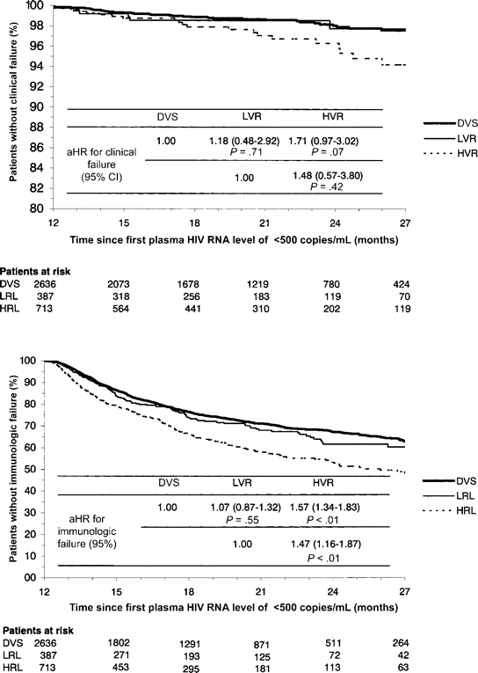
Figure 2 Kaplan-Meier curves of the probabilities of no clinical failure (top) or immunological failure (bottom), ...
Notes:
Figure 2 Kaplan-Meier curves of the probabilities of no clinical failure (top) or immunological failure (bottom), according to the 3 categories of antiretroviral efficacy after initial virus load undetectability during HAART. aHR, adjusted hazard ratio; DVS, durable viral suppression; HVR, high viral rebound; LVR, low viral rebound.
Unless provided in the caption above, the following copyright applies to the content of this slide: © 2003 by the Infectious Diseases Society of America

