Slide 1
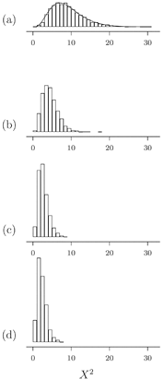
Figure 1 Type II error in the X² compositional homogeneity test Bars show distributions of the statistic ...
Notes:
Figure 1 Type II error in the X2 compositional homogeneity test Bars show distributions of the statistic X2 for the composition X2 test generated by simulation of DNA sequences on a four-taxon tree with equal branch lengths. Simulations used the Jukes-Cantor model of evolution Jukes and Cantor, 1969. (a) Branch lengths were set to expected 10.0 mutations per site, effectively making the sequences unrelated. The curve is X2df = 9 (b) Same as (a), but half of the sites were held invariant in the simulation. (c) Branch lengths were set to expected 0.1 mutations per site, with all sites free to vary. (d) Same as (c), but half of the sites were held invariant. Note that an observed X2 statistic of 10 would not reject compositional homogeneity based on the X2 curve, but that same statistic would be significant using the simulation histograms.
Unless provided in the caption above, the following copyright applies to the content of this slide: © 2004 Society of Systematic BiologistsThis article is published and distributed under the terms of the Oxford University Press, Standard Journals Publication Model (https://academic.oup.com/journals/pages/open_access/funder_policies/chorus/standard_publication_model)

Slide 2
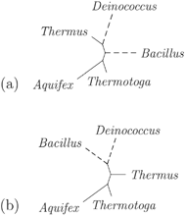
Figure 2 Compositional attraction in bacterial 16S sequences. The branches leading to the two mesophiles are indicated ...
Notes:
Figure 2 Compositional attraction in bacterial 16S sequences. The branches leading to the two mesophiles are indicated by dashed lines. (a) Based on other evidence (see text), this can be considered the correct tree. (b) The tree obtained with most phylogenetic methods, the “attract” tree.
Unless provided in the caption above, the following copyright applies to the content of this slide: © 2004 Society of Systematic BiologistsThis article is published and distributed under the terms of the Oxford University Press, Standard Journals Publication Model (https://academic.oup.com/journals/pages/open_access/funder_policies/chorus/standard_publication_model)

Slide 3
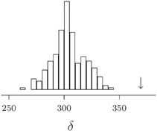
Figure 3 Goldman-Cox test for the homogeneous model. The ML tree under a homogeneous GTR + Γ model (Fig. 2b) was ...
Notes:
Figure 3 Goldman-Cox test for the homogeneous model. The ML tree under a homogeneous GTR + Γ model (Fig. 2b) was tested. The statistic δ is the difference between the optimized log likelihood and the unconstrained or multinomial log likelihood of the data. The arrow shows the position of δ for the original data. The bars are a null distribution generated by 200 simulations on the ML tree, each followed by optimization of branch lengths and model parameters. Because the statistic for the original data is well outside of the null distribution, the ML tree fails this test (P < 0.005), showing that this homogeneous model does not adequately describe the data
Unless provided in the caption above, the following copyright applies to the content of this slide: © 2004 Society of Systematic BiologistsThis article is published and distributed under the terms of the Oxford University Press, Standard Journals Publication Model (https://academic.oup.com/journals/pages/open_access/funder_policies/chorus/standard_publication_model)

Slide 4
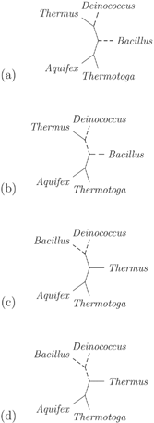
Figure 4 Arrangement of composition parameters on the trees. Dashed lines show the arrangement of the composition for ...
Notes:
Figure 4 Arrangement of composition parameters on the trees. Dashed lines show the arrangement of the composition for the mesophiles, solid lines show the arrangement of the composition for the thermophiles (a and b) This is the true topology, with two plausible arrangements of the two composition vectors. (a) The arrangement shown in Figure 2, and of the arrangements shown here is the ML arrangement. (c and d) Same as (a) and (b), for the attract tree.
Unless provided in the caption above, the following copyright applies to the content of this slide: © 2004 Society of Systematic BiologistsThis article is published and distributed under the terms of the Oxford University Press, Standard Journals Publication Model (https://academic.oup.com/journals/pages/open_access/funder_policies/chorus/standard_publication_model)

Slide 5
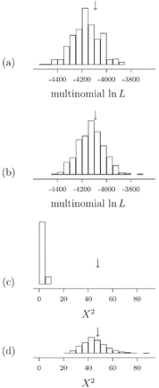
Figure 5 Posterior predictive distributions from bacterial 16S. Arrows show the test quantity from the original data. ...
Notes:
Figure 5 Posterior predictive distributions from bacterial 16S. Arrows show the test quantity from the original data. Panels (a) and (b) show a model fit test using the unconstrained or multinomial likelihood. Panel (a) shows the test quantity generated by simulations using the homogeneous model Panel (b) shows the test quantity for the two-part heterogeneous model. Using this test quantity, because the test quantity from the original data falls within both of the distributions, it appears that both models fit the data. Panels (c) and (d) show a model fit test using X2 as the test quantity. Panel (c) shows the test quantity for simulations using the homogeneous model and shows marked lack of model fit. Panel (d) shows the test quantity for simulations under the two-part heterogeneous model, which fits the data
Unless provided in the caption above, the following copyright applies to the content of this slide: © 2004 Society of Systematic BiologistsThis article is published and distributed under the terms of the Oxford University Press, Standard Journals Publication Model (https://academic.oup.com/journals/pages/open_access/funder_policies/chorus/standard_publication_model)

Slide 6
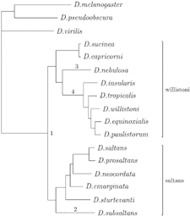
Figure 6 Rooting the Drosophila saltans and willistoni groups. Modified from Tarrío et al. (2000), Figure 1. The ...
Notes:
Figure 6 Rooting the Drosophila saltans and willistoni groups. Modified from Tarrío et al. (2000), Figure 1. The outgroup is D. melanogaster, D. pseudoobscura, and D. virilis. Four different roots, attachment points of the outgroup to the ingroup, indicated by 1 to 4, were found by various methods. Roots 1 to 3 were noted in Tarrío et al. (2000), and root 4 is from the present study. The preferred root is as shown, root 1
Unless provided in the caption above, the following copyright applies to the content of this slide: © 2004 Society of Systematic BiologistsThis article is published and distributed under the terms of the Oxford University Press, Standard Journals Publication Model (https://academic.oup.com/journals/pages/open_access/funder_policies/chorus/standard_publication_model)

Slide 7
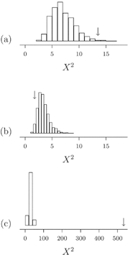
Figure 7 Bayesian model composition fit assessed using posterior predictive simulation. The model used separate GTR ...
Notes:
Figure 7 Bayesian model composition fit assessed using posterior predictive simulation. The model used separate GTR rate matrix, composition, and among-site rate heterogeneity in each of the 3 codon positions, homogeneous over the tree. Bars show the distribution of X2 in the posterior predictive simulation (a) for the first codon position, (b) the second codon position, and (c) for the third codon position. Arrows show the realized X2 for the original data for each codon position
Unless provided in the caption above, the following copyright applies to the content of this slide: © 2004 Society of Systematic BiologistsThis article is published and distributed under the terms of the Oxford University Press, Standard Journals Publication Model (https://academic.oup.com/journals/pages/open_access/funder_policies/chorus/standard_publication_model)

Slide 8
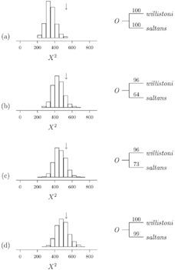
Figure 8 Bayesian composition fit tests where the composition differs over the tree. The model used separate GTR rate ...
Notes:
Figure 8 Bayesian composition fit tests where the composition differs over the tree. The model used separate GTR rate matrix, composition, and among-site rate heterogeneity in each of the three codon positions. For the third codon position only, composition was accommodated with (a) two, (b) three, (c) four, and (d) five vectors of composition parameters. Left panels show posterior predictive simulation results using the composition X2 statistic, where the statistic for the original data is shown with an arrow. Tail area probabilities pt for these analyses are 0.002, 0.077, 0.137, and 0.256, for panels (a), (b), (c), and (d), respectively. Panels on the right show percent posterior probability support for outgroup rooting position 1. The posterior probability of the split to the outgroup was 100% in all cases.
Unless provided in the caption above, the following copyright applies to the content of this slide: © 2004 Society of Systematic BiologistsThis article is published and distributed under the terms of the Oxford University Press, Standard Journals Publication Model (https://academic.oup.com/journals/pages/open_access/funder_policies/chorus/standard_publication_model)

