Slide 1
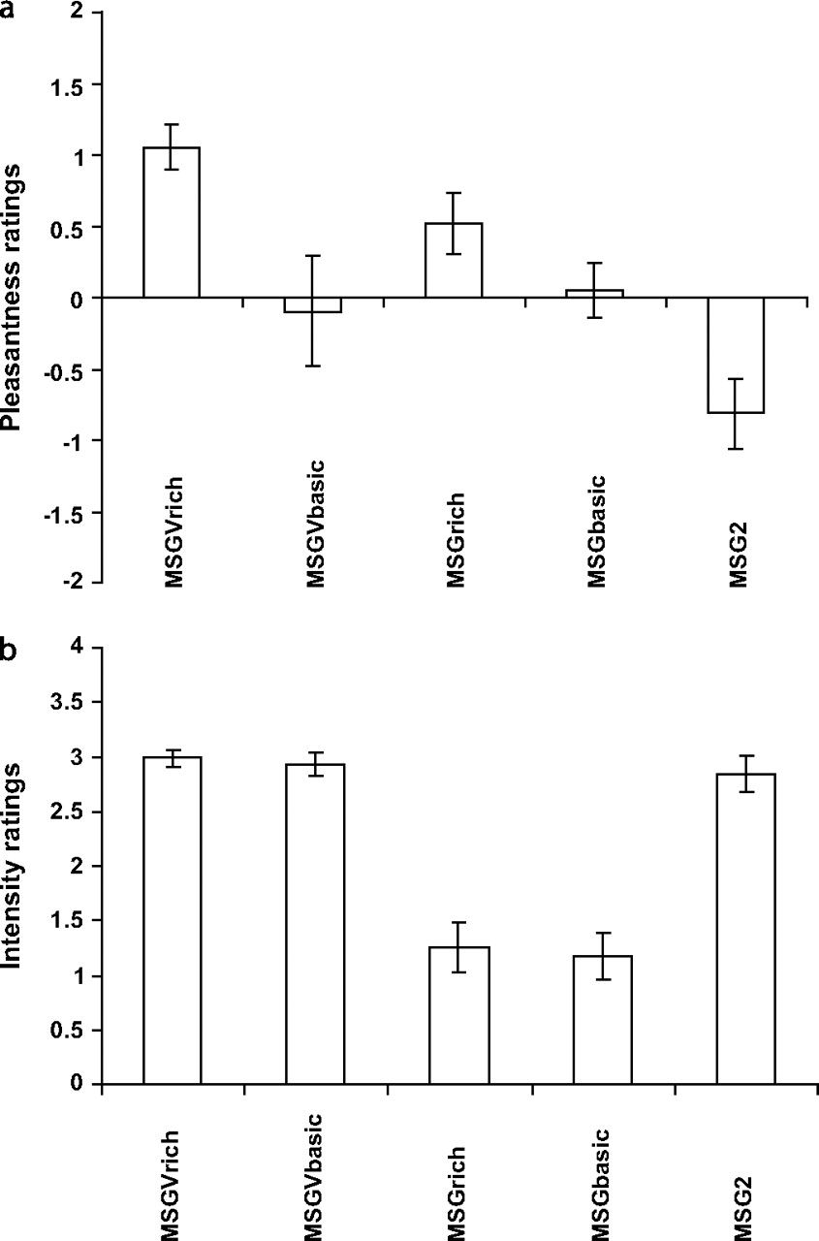
Figure 1. The ratings of pleasantness (a) and intensity (b) for the taste and flavor stimuli (means ± SEM). For ...
Notes:
Figure 1. The ratings of pleasantness (a) and intensity (b) for the taste and flavor stimuli (means ± SEM). For abbreviations see Table 1. The taste stimulus MSG was rated as significantly more pleasant when labeled “rich and delicious taste” than when labeled “monosodium glutamate.” Similarly, the flavor stimulus MSGV was rated as significantly more pleasant when labeled “rich and delicious flavor” than when labeled “boiled vegetable water.” In contrast to the effects on the pleasantness ratings, the labels did not produce significant differences in the intensity ratings for the taste and flavor stimuli. These findings provide clear evidence that the cognitive labels were modulating the perceived pleasantness, but not the intensity of the taste and flavor. The more concentrated taste stimulus MSG2 was rated as significantly less pleasant and more intense than the identically labeled taste stimulus MSGbasic. In this case, the labels were identical (“monosodium glutamate”), and this provides evidence that the perceived taste reflected also the properties of the stimuli (low vs. high concentration).
Unless provided in the caption above, the following copyright applies to the content of this slide: © The Author 2007. Published by Oxford University Press. All rights reserved. For permissions, please e-mail: journals.permissions@oxfordjournals.org

Slide 2
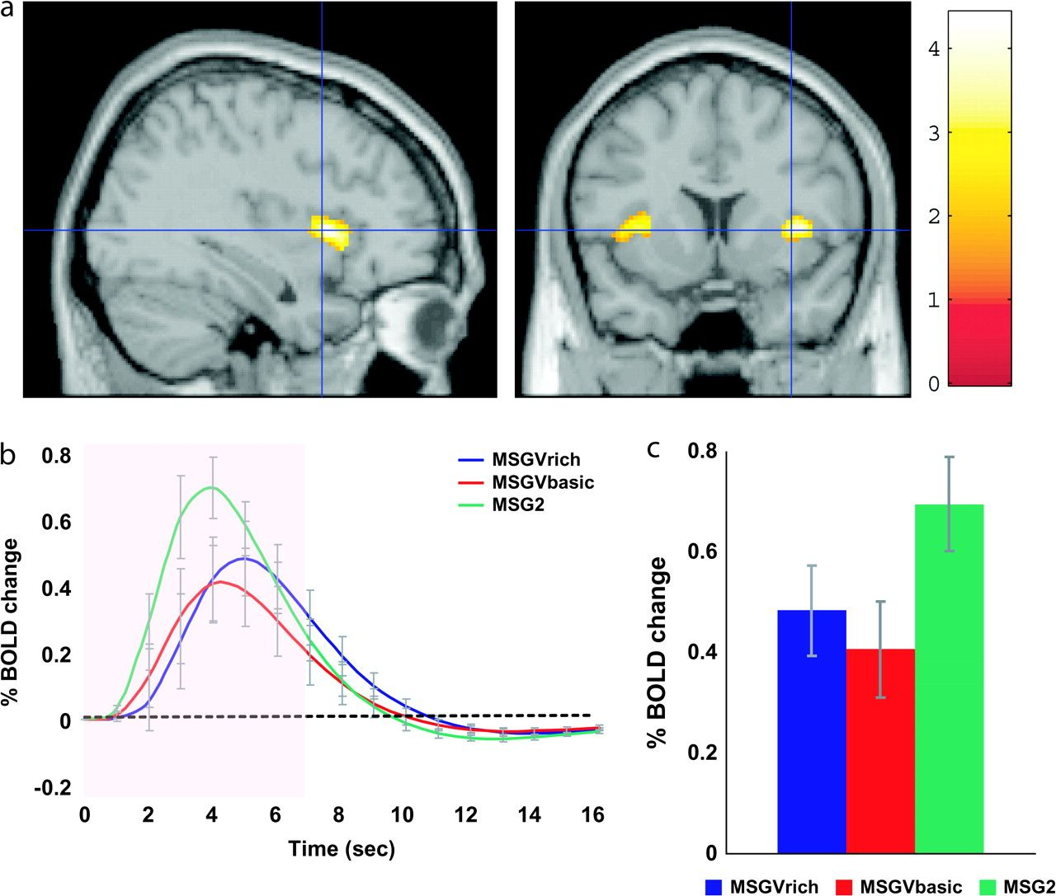
Figure 2. Insular taste cortex. (a) A conjunction analysis of the activations produced by the taste of MSG (from the ...
Notes:
Figure 2. Insular taste cortex. (a) A conjunction analysis of the activations produced by the taste of MSG (from the conditions MSGrich-rinse and MSGbasic-rinse) shows the location of the insular primary taste cortex [34 16 4]. Subtraction of the tasteless control was performed, as this is a better control than subtracting effects produced by water, for there are neurons tuned to water in the primary taste cortex (Yaxley et al. 1990), and water relative to a tasteless control activates the human primary taste cortex (de Araujo et al. 2003b). (b) The time course of the BOLD signals for the conditions MSGVrich, MSGVbasic, and MSG2 in the insular taste cortex. (c) The peak values of the BOLD signal (mean across subjects ± SEM) were not different in this region for the flavor stimulus under the different labels (MSGVrich vs. MSGVbasic), but the effect of the more concentrated solution (MSG2) was larger (LSD post hoc tests both P < 0.05 following a significant ANOVA F2,22 = 4.63, P = 0.021).
Unless provided in the caption above, the following copyright applies to the content of this slide: © The Author 2007. Published by Oxford University Press. All rights reserved. For permissions, please e-mail: journals.permissions@oxfordjournals.org

Slide 3
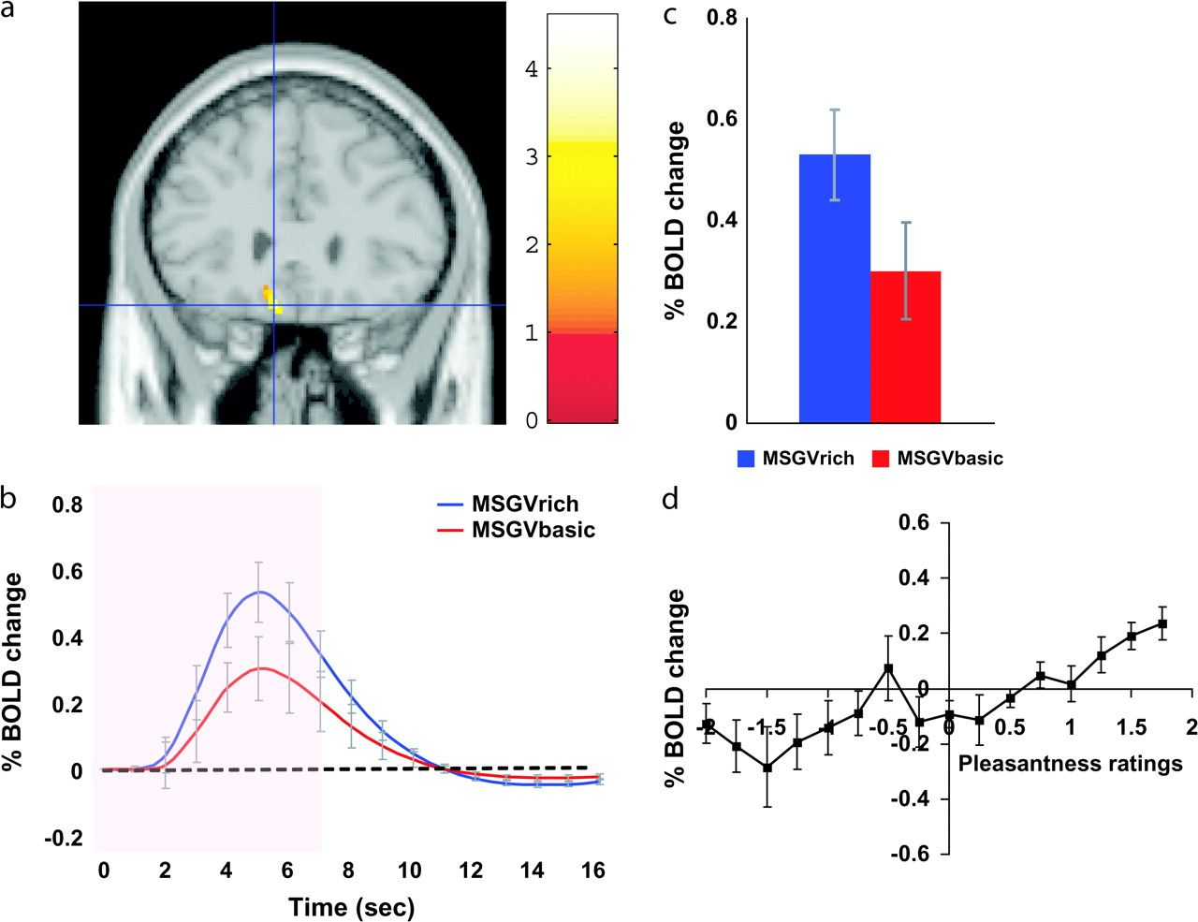
Figure 3. (a) The medial orbitofrontal cortex was more strongly activated when the flavor stimulus was labeled “rich ...
Notes:
Figure 3. (a) The medial orbitofrontal cortex was more strongly activated when the flavor stimulus was labeled “rich and delicious flavor” (MSGVrich) than when it was labeled “boiled vegetable water” (MSGVbasic) ([−8 28 −20]). (b) The time course of the BOLD signals for the 2 conditions. (c) The peak values of the BOLD signal (mean across subjects ± SEM) were significantly different (t = 3.06, df = 11, P = 0.01). (d) The BOLD signal in the medial orbitofrontal cortex was correlated with the subjective pleasantness ratings of taste and flavor, as shown by the SPM analysis (Table 2), and as illustrated in (d) (mean across subjects ± SEM, r = 0.86, P < 0.001).
Unless provided in the caption above, the following copyright applies to the content of this slide: © The Author 2007. Published by Oxford University Press. All rights reserved. For permissions, please e-mail: journals.permissions@oxfordjournals.org

Slide 4
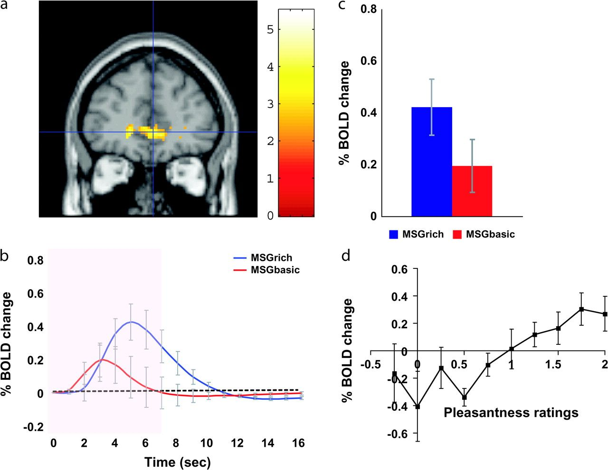
Figure 4. (a) The pregenual cingulate cortex was more strongly activated when the taste stimulus was labeled “rich and ...
Notes:
Figure 4. (a) The pregenual cingulate cortex was more strongly activated when the taste stimulus was labeled “rich and delicious taste” (MSGrich) than when it was labeled “monosodium glutamate” (MSGbasic) ([0 46 2] z = 2.78 P = 0.05). (b) The time course of the BOLD signals for the 2 conditions. (c) The peak values of the BOLD signal (mean across subjects ± SEM) were significantly different (t = 3.02, df = 11, P = 0.01). (d) The BOLD signal in the pregenual cingulate cortex was correlated with the subjective pleasantness ratings of taste, as shown by the SPM analysis (Table 2), and as illustrated in (d) (mean across subjects ± SEM, r = 0.84, P = 0.002).
Unless provided in the caption above, the following copyright applies to the content of this slide: © The Author 2007. Published by Oxford University Press. All rights reserved. For permissions, please e-mail: journals.permissions@oxfordjournals.org

Slide 5
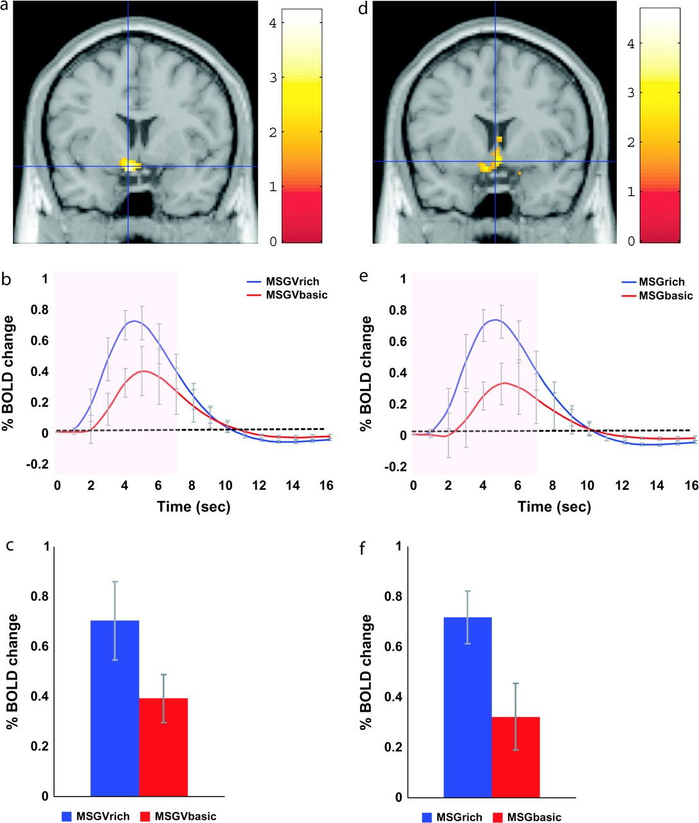
Figure 5. Ventral striatum. (a) The ventral striatum was significantly more activated by the flavor stimulus MSGV when ...
Notes:
Figure 5. Ventral striatum. (a) The ventral striatum was significantly more activated by the flavor stimulus MSGV when labeled “rich and delicious flavor” than when labeled “boiled vegetable water” [−6 6 −14]. As shown in Table 2, the activations in this region were also correlated with the pleasantness ratings. (b) The time course of the BOLD signals for the 2 conditions. (c) The peak values of the BOLD signal (mean across subjects ± SEM) were significantly different (t = 2.71, df = 11, P = 0.02). (d) The ventral striatum was significantly more activated by the taste stimulus MSG when labeled “rich and delicious taste” than when labeled “monosodium glutamate” [2 12 −10]. As shown in Table 2, the activations in this region were also correlated with the pleasantness ratings. (e) The time course of the BOLD signals for the 2 conditions. (f) The peak values of the BOLD signal (mean across subjects ± SEM) were significantly different (t = 3.14, df = 11, P = 0.001).
Unless provided in the caption above, the following copyright applies to the content of this slide: © The Author 2007. Published by Oxford University Press. All rights reserved. For permissions, please e-mail: journals.permissions@oxfordjournals.org

