Slide 1
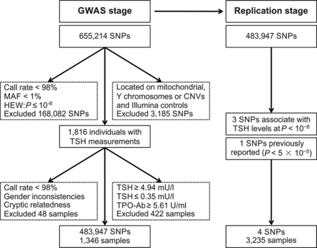
Figure 1. Flowchart for quality filtering in the two-stage GWAS for serum TSH levels. In the initial GWAS stage, ...
Notes:
Figure 1. Flowchart for quality filtering in the two-stage GWAS for serum TSH levels. In the initial GWAS stage, quality filtering was performed on SNPs and samples before analysis to ensure robust association tests. Of the 655 214 markers assayed, the Y-chromosome and mitochondrial SNPs, CNV-related markers, and Illumina controls were excluded (n = 3185), leaving 652 029 SNPs for further analysis. We further excluded SNPs with a low call rate (< 98%), an MAF < 1% within the population, or a significant deviation from Hardy-Weinberg equilibrium (P ≤ 10−6). Samples were excluded if they had a high missing call rate (<98%), gender inconsistencies, cryptic relatedness, abnormal TSH (TSH ≥4.94 or ≤0.35 mU/l) or high TPO-Ab (TPO-Ab ≥5.61 U/ml). In the replication study, three SNPs associated with TSH (P < 10−6) were selected as candidate loci for replication. Additionally, one SNP that was previously reported to be associated with TSH was also chosen for genotyping in the replication samples.
Unless provided in the caption above, the following copyright applies to the content of this slide: © The Author 2014. Published by Oxford University Press. All rights reserved. For Permissions, please email: journals.permissions@oup.com

Slide 2
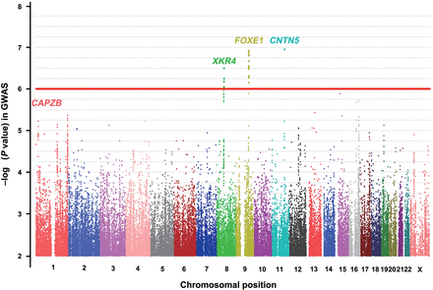
Figure 2. Manhattan plots of the SNPs associated with serum TSH levels in the GWAS data. Manhattan plots of ...
Notes:
Figure 2. Manhattan plots of the SNPs associated with serum TSH levels in the GWAS data. Manhattan plots of associations between SNPs and TSH levels. Typed and imputed SNPs (P < 10−2) are represented on the X-axis, organized by chromosome. On the Y-axis, statistical significance is expressed as -log10P values. The red horizontal line represents the discovery cohorts (1346 subjects) threshold P-value of 10−6.
Unless provided in the caption above, the following copyright applies to the content of this slide: © The Author 2014. Published by Oxford University Press. All rights reserved. For Permissions, please email: journals.permissions@oup.com

Slide 3
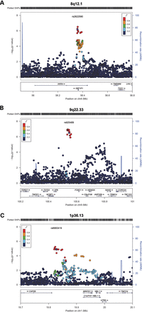
Figure 3. Regional plots of association results at 8p12.1, 9q22.33 and 1p36.13. Regional plots of association results ...
Notes:
Figure 3. Regional plots of association results at 8p12.1, 9q22.33 and 1p36.13. Regional plots of association results in the GWAS samples at 8p12.1 (A), 9q22.33 (B) and 1p36.13 (C). The color of each SNP spot, ranging from red to blue, reflects the magnitude of the r2 between the SNP spot and the candidate SNP (purple circle) within each candidate locus for serum TSH levels. Genetic recombination rates, estimated using the 1000 Genomes ASN samples, are plotted in the background in cyan. The vertical axis represents the -log10P-value. Physical positions are based on NCBI build 36/hg19 of the human genome.
Unless provided in the caption above, the following copyright applies to the content of this slide: © The Author 2014. Published by Oxford University Press. All rights reserved. For Permissions, please email: journals.permissions@oup.com

Slide 4
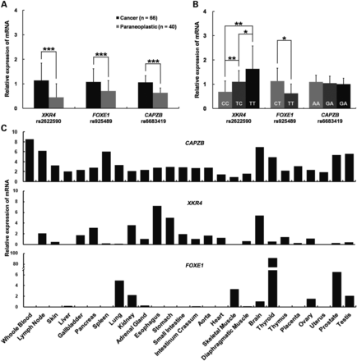
Figure 4. The expression analyses of the candidate genes XKR4, FOXE1 and CAPZB at 1p36.13, 8p12.1 and 9q22.33. (A) The ...
Notes:
Figure 4. The expression analyses of the candidate genes XKR4, FOXE1 and CAPZB at 1p36.13, 8p12.1 and 9q22.33. (A) The mRNA levels of XKR4, FOXE1 and CAPZB in the tumor tissues (n = 66) and adjacent normal thyroid tissues (n = 40) of patients with PTC. Data are shown as means ± SD. The mRNA levels of XKR4, FOXE1 and CAPZB are normalized to that of GAPDH. (B) The correlation of XKR4, FOXE1 and CAPZB mRNA levels in PTC tumor tissues with the genotypes of rs2622590 in XKR4 (CC, n = 14; TC, n = 34; TT, n = 18), rs925489 near FOXE1 (TT, n = 59; CT, n = 7) and rs6683419 near CAPZB (AA, n = 28; GA, n = 30; GG, n = 8), respectively (normalized to GAPDH). (C) The expression patterns of CAPZB, XKR4 and FOXE1 in human tissues resolved by real-time PCR. *P < 0.05; **P < 0.01; ***P < 0.001. Error bars, ±SD.
Unless provided in the caption above, the following copyright applies to the content of this slide: © The Author 2014. Published by Oxford University Press. All rights reserved. For Permissions, please email: journals.permissions@oup.com

Slide 5
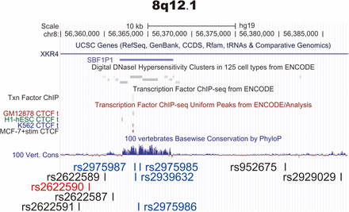
Figure 5. The epigenetic analysis of XKR4 at 8q12.1 from the ENCODE database. Rs2622590 shows no DNase I ...
Notes:
Figure 5. The epigenetic analysis of XKR4 at 8q12.1 from the ENCODE database. Rs2622590 shows no DNase I hypersensitivity and does not bind any transcription factors. However, a ∼5 kb fragment near to rs2622590, which contained four TSH strongly associated SNPs (rs2975987, rs2939632, rs2975986 and rs2975985), was conserved from zebrafish to human. The data from ENCODE manifested a ∼35 kb LD block in the 8q12.1 region containing rs2975987, rs2939632, rs2975986 and rs29759854 (blue SNPs) were located in a DNaseI hypersensitivity clusters, which were in complete LD with rs2622590 (r2 > 0.97 in the 1000 Genomes ASN samples). SNPs in red font are candidate SNPs in our study. SNPs in black font are in high LD with candidate SNPs (r2 > 0.8 in the 1000 Genomes ASN samples).
Unless provided in the caption above, the following copyright applies to the content of this slide: © The Author 2014. Published by Oxford University Press. All rights reserved. For Permissions, please email: journals.permissions@oup.com

