Slide 1
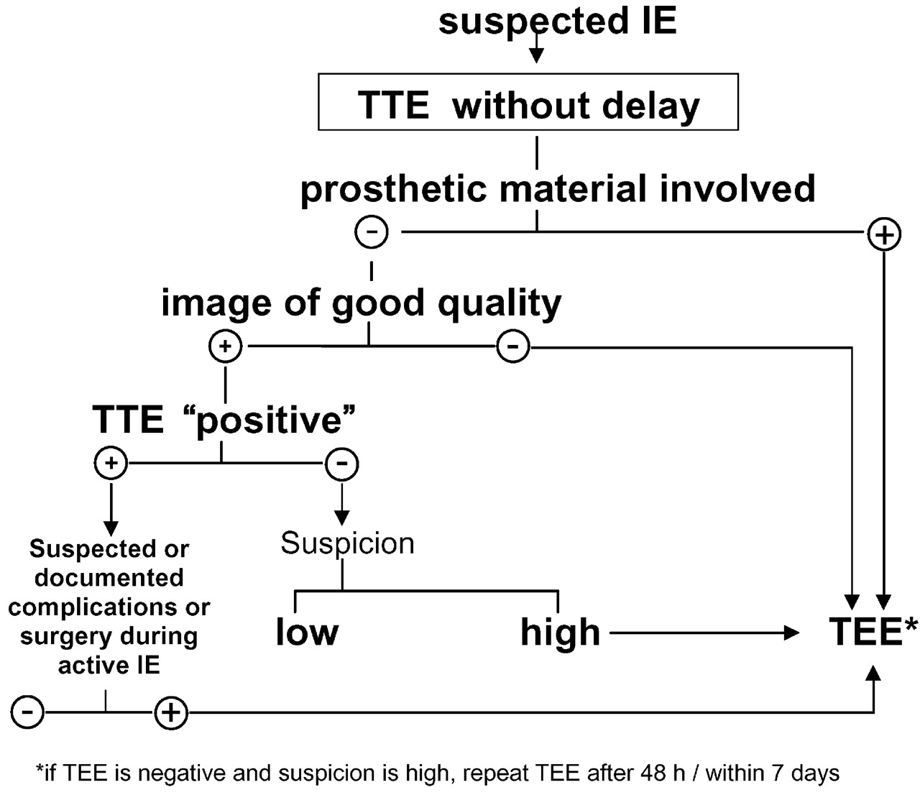
Fig. 1 Algorithm for the use of transthoracic (TTE) and transoesophageal echocardiography (TEE) in suspected IE. ...
Notes:
Fig. 1 Algorithm for the use of transthoracic (TTE) and transoesophageal echocardiography (TEE) in suspected IE. N.B. TTE “positive” indicates finding typical of IE (e.g. fresh vegetation or abscess formation)
Unless provided in the caption above, the following copyright applies to the content of this slide: The European Society of Cardiology

