Slide 1
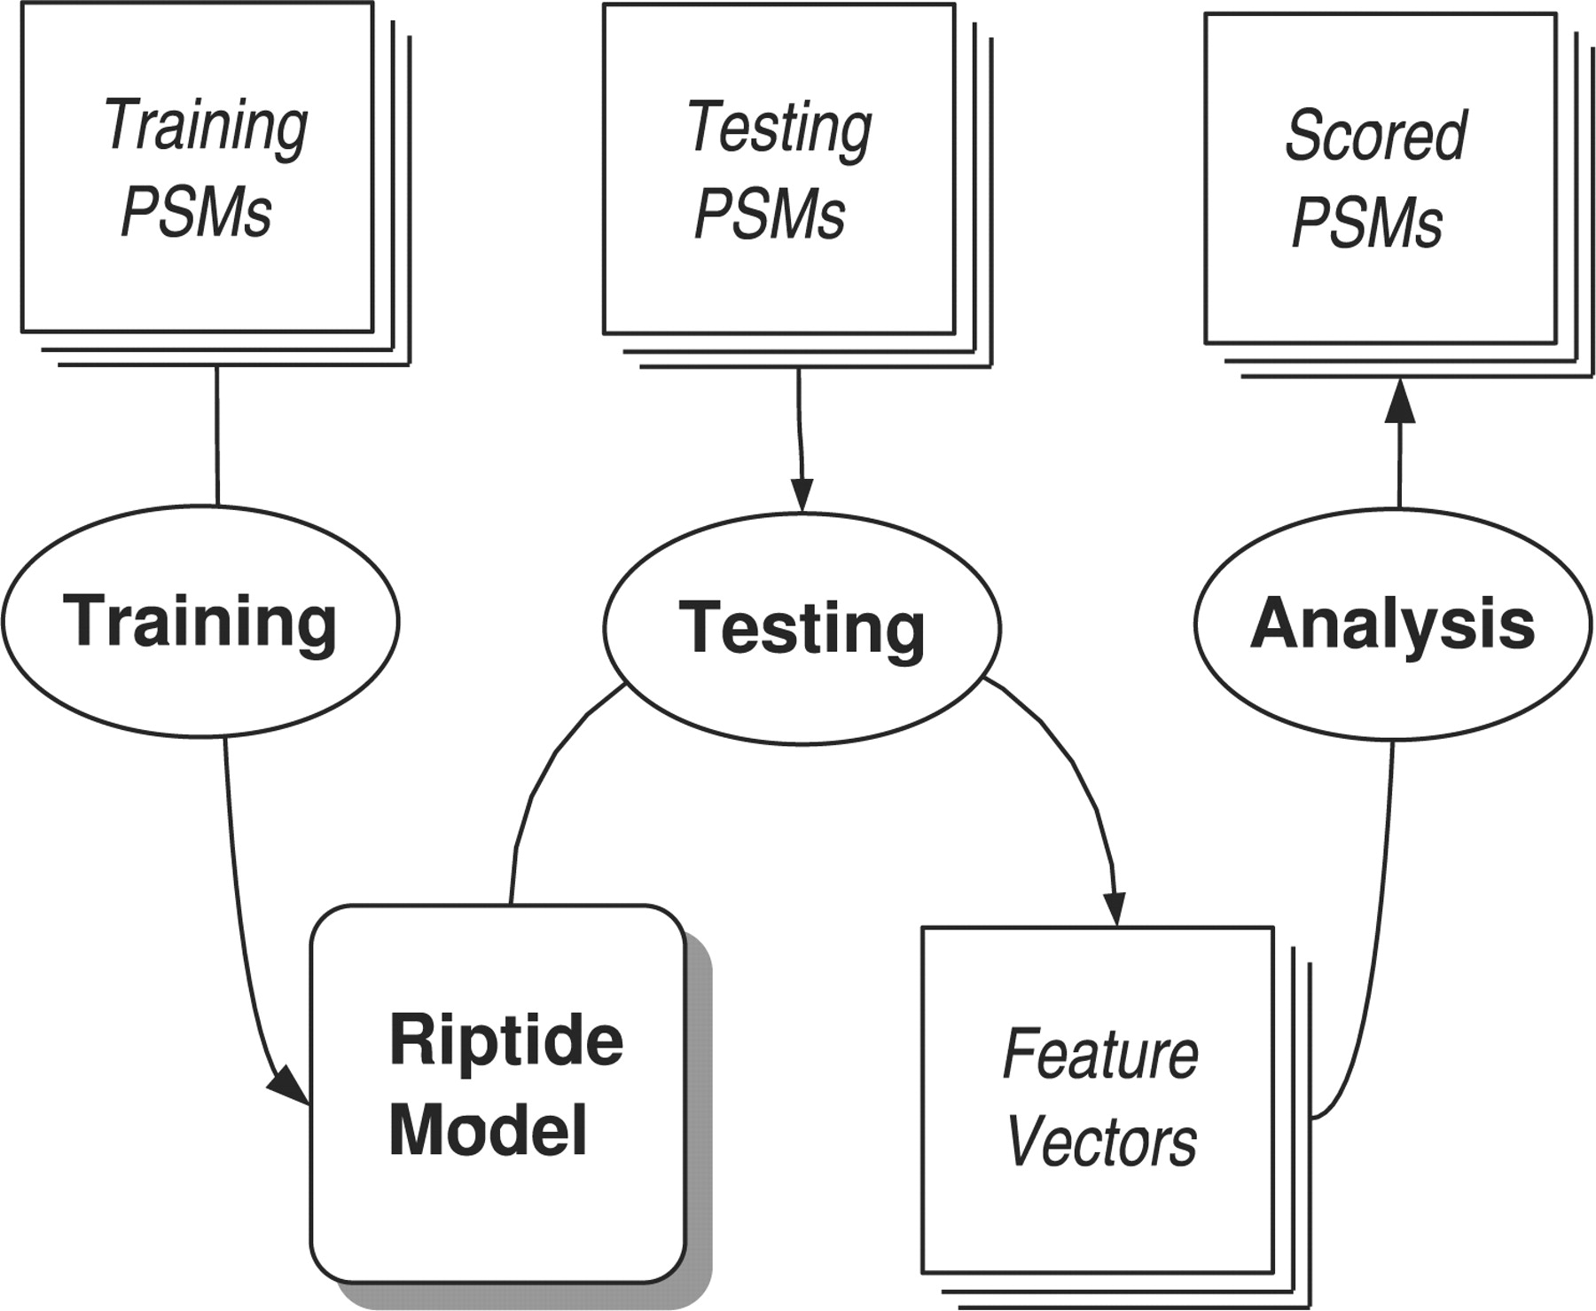
Fig. 1. Experimental overview. We start with a collection of high-confidence PSMs. These training PSMs are used to ...
Notes:
Fig. 1. Experimental overview. We start with a collection of high-confidence PSMs. These training PSMs are used to train the Riptide model, which consists of a collection of DBNs that model the probability distributions governing peptide fragment ion intensities. Riptide is used to evaluate testing PSMs to produce a vector of features for each PSM, each feature related to a probability assigned to the PSM by one of the Riptide DBNs. Finally, these feature vectors can be analyzed by additional algorithms (such as SVMs) to produce scores for the test PSMs.
Unless provided in the caption above, the following copyright applies to the content of this slide: © 2008 The Author(s)This is an Open Access article distributed under the terms of the Creative Commons Attribution Non-Commercial License (http://creativecommons.org/licenses/by-nc/2.0/uk/) which permits unrestricted non-commercial use, distribution, and reproduction in any medium, provided the original work is properly cited.

Slide 2
Fig. 2. Riptide overview. The process of training and evaluating Riptide consists of two main stages. (A) The process ...
Notes:
Fig. 2. Riptide overview. The process of training and evaluating Riptide consists of two main stages. (A) The process begins with high-confidence PSMs (positive PSMs, top). Each of the spectra for these positive PSMs is also associated with a randomly generated peptide to create a set of negative PSMs (bottom). These two classes of PSMs are used to train a set of DBNs, one positive and one negative for each ion series. (B) The trained DBNs are then used to evaluate testing PSMs, yielding for each PSM and each type of DBN a pair of probabilities (positive and negative) as well as the ratio between them, a log odds ratio. Thus, each of the testing PSMs is represented as a vector of scalar values, three values for each DBN. These vectors are then used during testing as input to either an SVM or the Percolator algorithm (Section 4).
Unless provided in the caption above, the following copyright applies to the content of this slide: © 2008 The Author(s)This is an Open Access article distributed under the terms of the Creative Commons Attribution Non-Commercial License (http://creativecommons.org/licenses/by-nc/2.0/uk/) which permits unrestricted non-commercial use, distribution, and reproduction in any medium, provided the original work is properly cited.

Slide 3
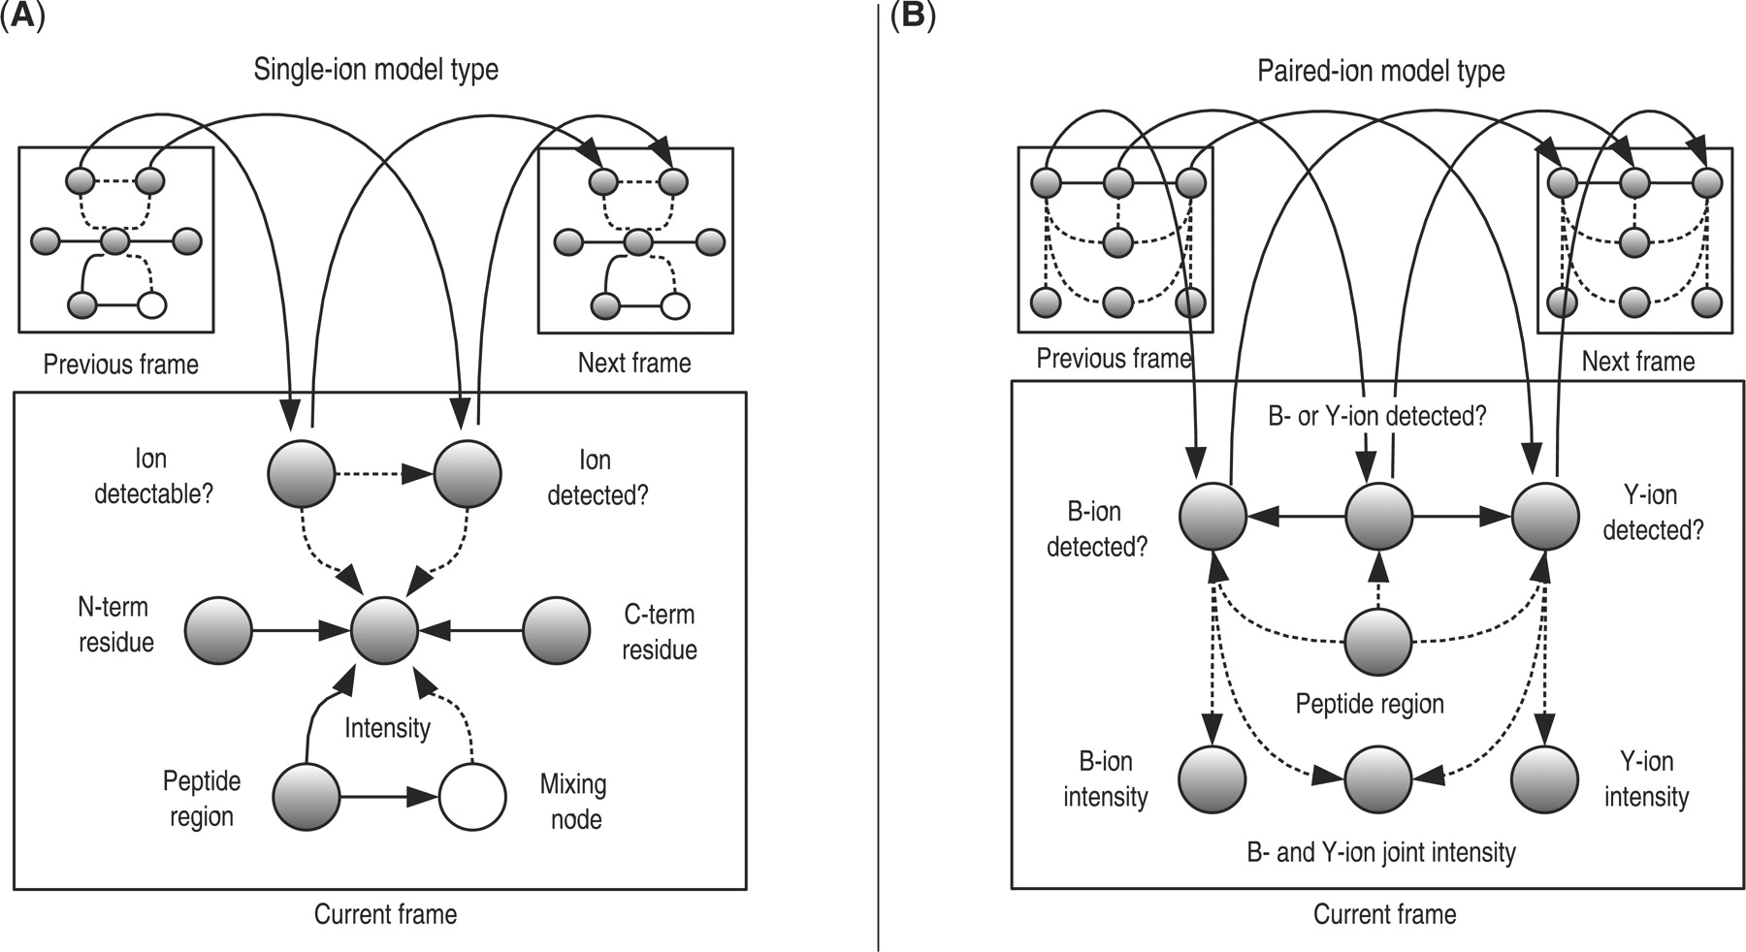
Fig. 3. The two types of Riptide DBNs. The first class of DBNs (A) models distributions of ion fragment intensities ...
Notes:
Fig. 3. The two types of Riptide DBNs. The first class of DBNs (A) models distributions of ion fragment intensities individually, conditioning on the amino acids flanking the cleavage site that fragments to produce that particular ion. The second class of DBNs (B) models the distributions of ion fragment intensities in pairs, incorporating dependencies between related ions that result from fragmentation at the same site. Observed nodes are shaded gray; hidden nodes are not shaded. The nodes at the top of each center frame are connected to identical nodes in previous and subsequent frames. Solid lines indicate conditional dependencies, while dashed lines indicate a switching parent relationship, a special form of conditional dependency.
Unless provided in the caption above, the following copyright applies to the content of this slide: © 2008 The Author(s)This is an Open Access article distributed under the terms of the Creative Commons Attribution Non-Commercial License (http://creativecommons.org/licenses/by-nc/2.0/uk/) which permits unrestricted non-commercial use, distribution, and reproduction in any medium, provided the original work is properly cited.

Slide 4
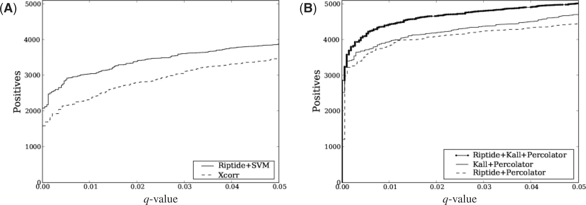
Fig. 4. Positive peptide identifications as a function of q -value (a measure of FDR). The Riptide scoring function ...
Notes:
Fig. 4. Positive peptide identifications as a function of q -value (a measure of FDR). The Riptide scoring function is compared with the SEQUEST scoring function Xcorr, to test the utility of the SVM normalized discriminant score function (A). In addition, the Riptide DBN feature vectors are used as input to the algorithm Percolator (Käll et al., 2007), and are compared with the original Percolator features (B).
Unless provided in the caption above, the following copyright applies to the content of this slide: © 2008 The Author(s)This is an Open Access article distributed under the terms of the Creative Commons Attribution Non-Commercial License (http://creativecommons.org/licenses/by-nc/2.0/uk/) which permits unrestricted non-commercial use, distribution, and reproduction in any medium, provided the original work is properly cited.

Slide 5
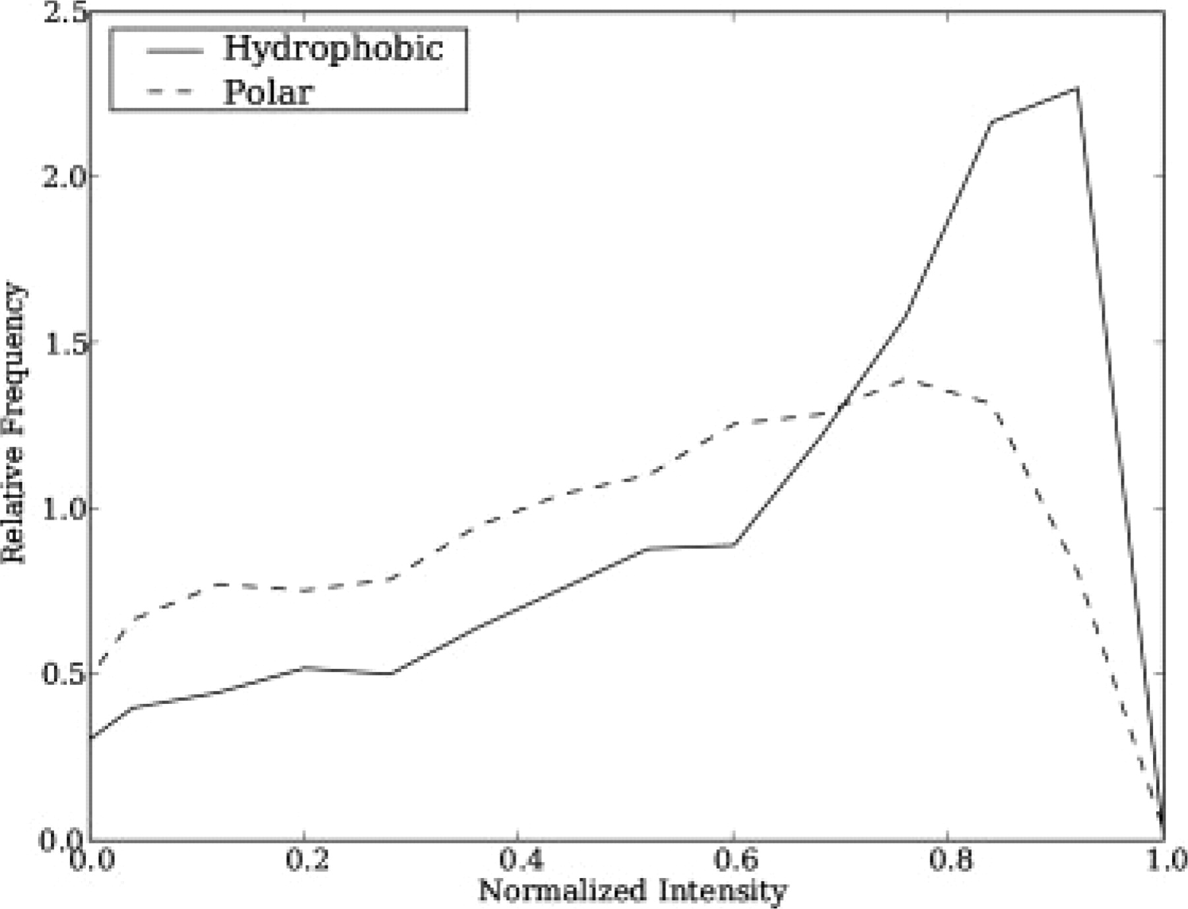
Fig. 5. Distribution of a-ion intensities from fragmentation at sites C-term to hydrophobic or polar residues. ...
Notes:
Fig. 5. Distribution of a-ion intensities from fragmentation at sites C-term to hydrophobic or polar residues. Difference is significant at P ≪ 0.0001.
Unless provided in the caption above, the following copyright applies to the content of this slide: © 2008 The Author(s)This is an Open Access article distributed under the terms of the Creative Commons Attribution Non-Commercial License (http://creativecommons.org/licenses/by-nc/2.0/uk/) which permits unrestricted non-commercial use, distribution, and reproduction in any medium, provided the original work is properly cited.

Slide 6
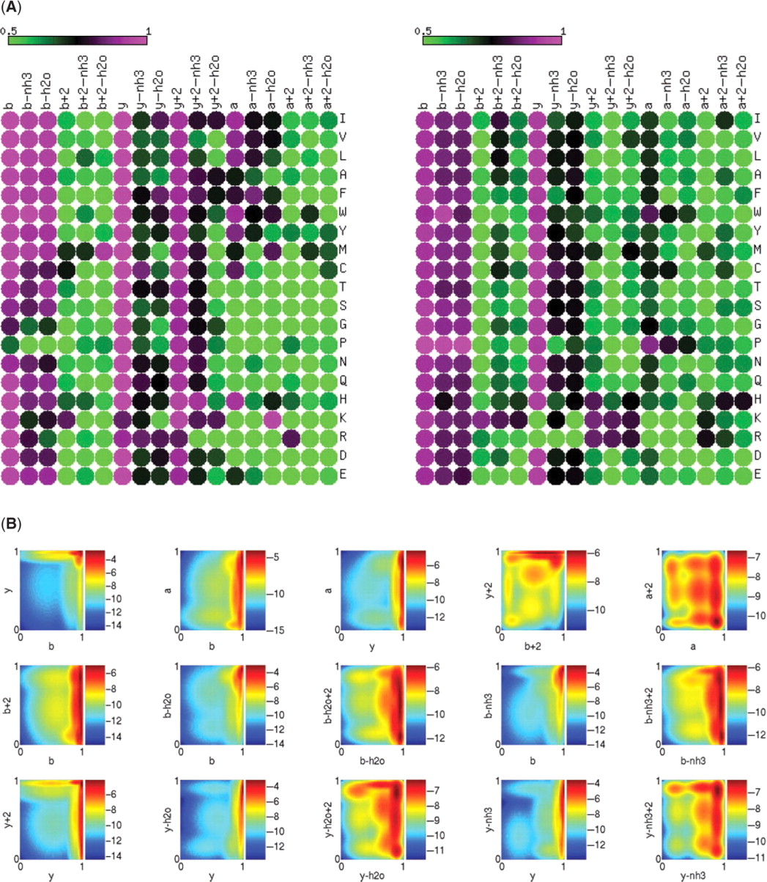
Fig. 6. Learned parameters of the Riptide model. (A) Displays the mean peak intensities for different residues and ...
Notes:
Fig. 6. Learned parameters of the Riptide model. (A) Displays the mean peak intensities for different residues and ion types learned using the Riptide single-ion models. Each cell shows the mean normalized intensity value for a particular ion series and flanking residue. For the left heat map, residues designated are those to the left of the amide bond fragmented to produce ions of that type (i.e. the amide bond is itself C-term to the residue), while for the right heat map, the residues designated are those to the right of the fragmented amide bond (i.e. the amide bond is itself N-term to the residue). The top image was created using matrix2png (Pavlidis and Noble, 2003). (B) Displays the 2D Gaussian distributions of peak intensities for pairs of ions learned using the Riptide paired-ion models. Each plot shows the joint distribution of ion intensities resulting from the same amide bond cleavage; thus, for example, points on the b/y plot corresponds to bi/yn−i pairs, for a peptide of length n. The color bar scale indicates natural log probability.
Unless provided in the caption above, the following copyright applies to the content of this slide: © 2008 The Author(s)This is an Open Access article distributed under the terms of the Creative Commons Attribution Non-Commercial License (http://creativecommons.org/licenses/by-nc/2.0/uk/) which permits unrestricted non-commercial use, distribution, and reproduction in any medium, provided the original work is properly cited.

