Slide 1
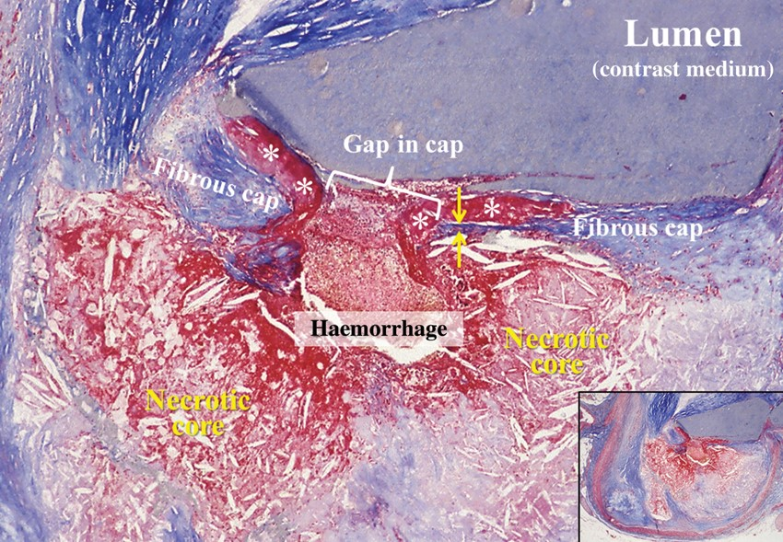
Figure 1 Cross-sectioned coronary artery showing a ruptured thin-cap fibroatheroma. The fibrous cap is very thin near ...
Notes:
Figure 1 Cross-sectioned coronary artery showing a ruptured thin-cap fibroatheroma. The fibrous cap is very thin near the rupture site (between arrows) and a non-obstructive mural thrombus (asterisks) is bordering the gap in the disrupted cap. A haemorrhage has penetrated from the lumen through the gap into the lipid-rich necrotic core in which the characteristic cholesterol clefts are clearly seen. The lumen contains contrast medium injected postmortem. Overview in inset. Trichrome, staining collagen blue, and thrombus and haemorrhage red.
Unless provided in the caption above, the following copyright applies to the content of this slide: Published on behalf of the European Society of Cardiology. All rights reserved. © The Author 2013. For permissions please email: journals.permissions@oup.com

Slide 2
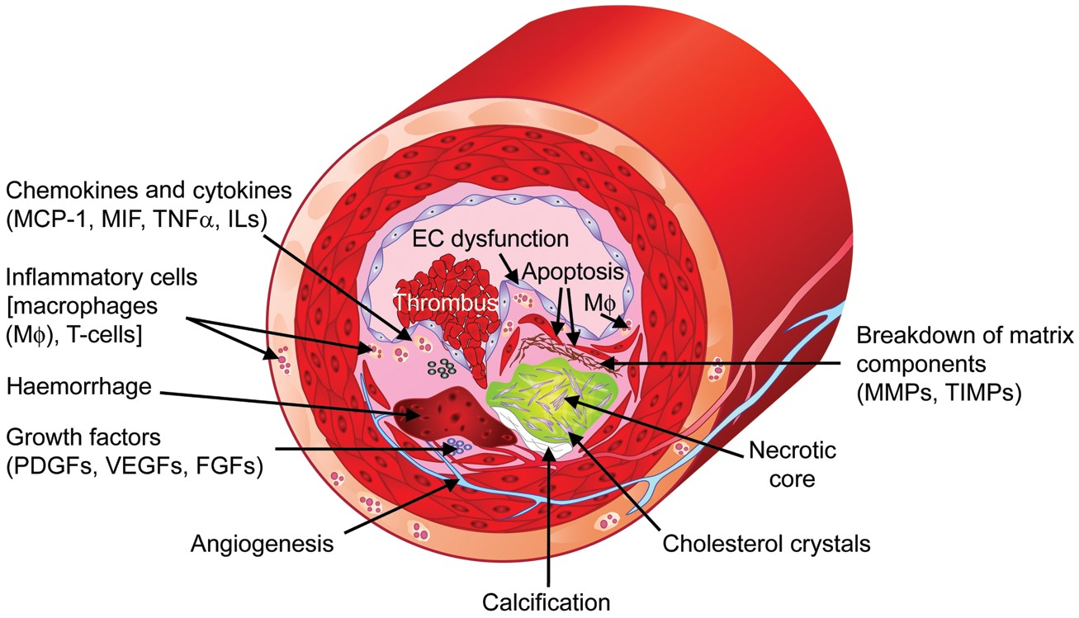
Figure 2 Factors contributing to the formation of vulnerable plaques. MCP-1, monocyte chemotactic protein-1; MIF, ...
Notes:
Figure 2 Factors contributing to the formation of vulnerable plaques. MCP-1, monocyte chemotactic protein-1; MIF, migration inhibitory factor; TNFα, tumour necrosis factor-α; ILs, interleukins; MMPs, matrix metalloproteinases; TIMPs, tissue inhibitors of metalloproteinases; PDGFs, platelet-derived growth factors; VEGFs, vascular endothelial growth factors; FGFs, fibroblast growth factors; Mφ, macrophages.
Unless provided in the caption above, the following copyright applies to the content of this slide: Published on behalf of the European Society of Cardiology. All rights reserved. © The Author 2013. For permissions please email: journals.permissions@oup.com

Slide 3
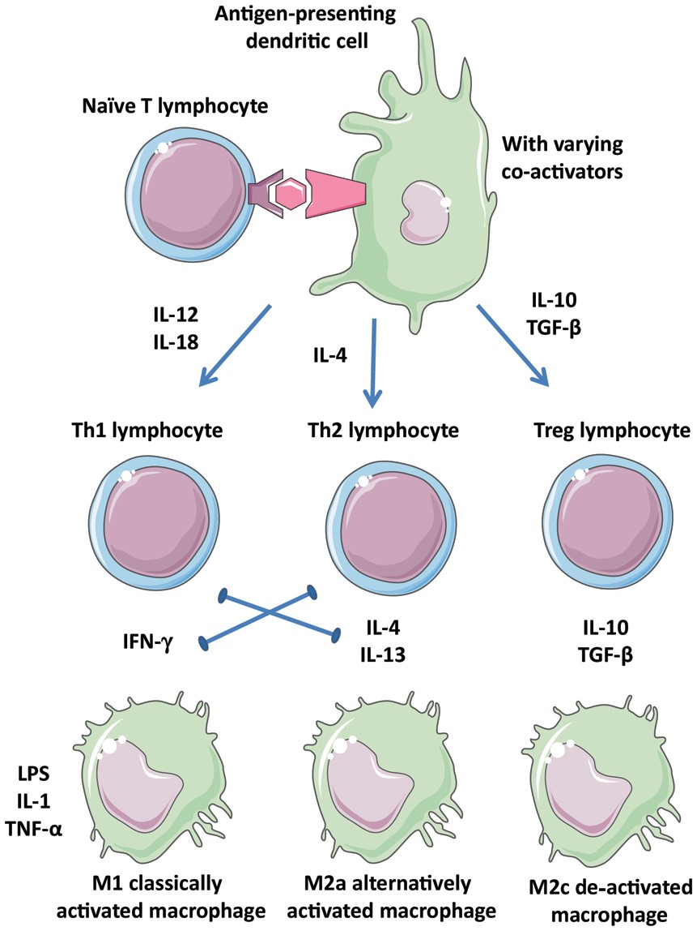
Figure 3 Diverse leucocyte populations in atherosclerotic plaques. Depending on the context of antigen presentation ...
Notes:
Figure 3 Diverse leucocyte populations in atherosclerotic plaques. Depending on the context of antigen presentation including the cytokine environment, naïve T-cells and macrophages may adopt several phenotypes that are more or less inflammatory. Polarization of the environment is promoted by the positive and negative interactions indicated. Th1, Th2, Treg: T-cell subtypes; M1, M2a, M2c: macrophage subtypes.
Unless provided in the caption above, the following copyright applies to the content of this slide: Published on behalf of the European Society of Cardiology. All rights reserved. © The Author 2013. For permissions please email: journals.permissions@oup.com

Slide 4
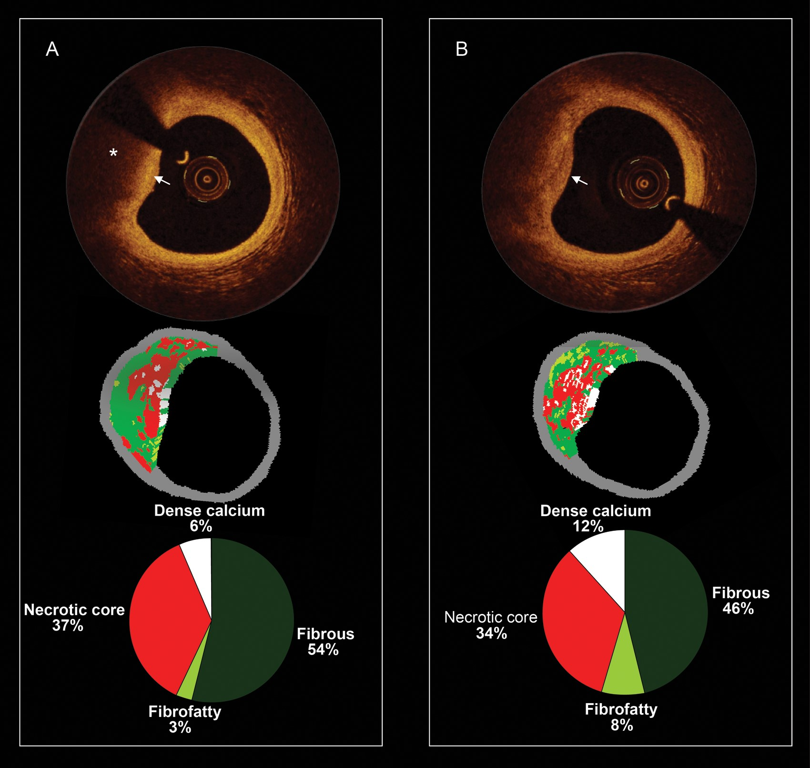
Figure 4 Serial and corresponding virtual histology and optical coherence tomography. (A) The baseline optical ...
Notes:
Figure 4 Serial and corresponding virtual histology and optical coherence tomography. (A) The baseline optical coherence tomography frame (top), the corresponding virtual histology frame (mid), and the quantification of the virtual histology tissue types (bottom). The optical coherence tomography frame shows from 8 to 12 o'clock a fibroatheroma which is composed of a fibrous cap (white arrow) and a necrotic core (asterisk). The corresponding virtual histology frames show also a fibroatheroma (necrotic core-rich plaque in red colour). In (B), the patient was reimaged at 1 year and some plaque changes have been observed. In the optical coherence tomography frame, the fibrous cap became thinner (please note that at baseline, the signal rich area overlying the necrotic core was wider).
Unless provided in the caption above, the following copyright applies to the content of this slide: Published on behalf of the European Society of Cardiology. All rights reserved. © The Author 2013. For permissions please email: journals.permissions@oup.com

