Slide 1
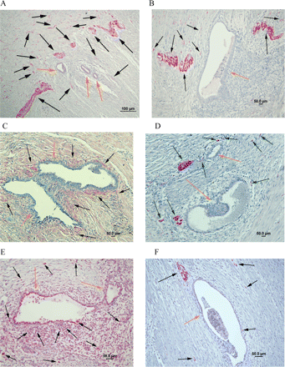
Figure 1 Nerve fibres in DIE.
Notes:
Figure 1 Nerve fibres in DIE. Permanent fast red chromogen has been used throughout unless noted. (A) A rectal lesion stained with PGP9.5, thick nerve trunks in the adjacent fibromuscular tissue (magnification ×100). (B) A rectal lesion stained with NF (magnification ×200). (C) A uterosacral ligament lesion stained with NGF (magnification ×200). (D) A rectal lesion stained with NGFRp75 (magnification ×200). (E) A peritoneal sidewall lesion stained with Trk-A (magnification ×200). (F) A peritoneal sidewall lesion stained with CGRP (magnification ×200). (G) A cul de sac lesion stained with SP (magnification ×200). (H) A rectal lesion stained with VAChT (magnification ×200). (I) A cul de sac lesion stained with VIP (magnification ×200). (J) A peritoneal sidewall lesion stained with NPY (magnification ×100). (K) A rectal lesion stained with PGP9.5, high densities of nerve fibres in rectal lesion (magnification ×200). (L) A uterosacral ligament lesion stained with PGP9.5 and CD34 (magnification ×200). The nerve fibres were intensely stained red (permanent fast red chromogen) and blood vessels were stained brown (DAB chromogen). Scale bars represent 100 µm in A, J and K; and 50 µm in B–I, L. Black arrows represent nerve fibres; deep orange arrows represent endometriotic glands; yellow arrows represent rectal mucosa epithelia; green arrows represent blood vessels.
Unless provided in the caption above, the following copyright applies to the content of this slide: © The Author 2009. Published by Oxford University Press on behalf of the European Society of Human Reproduction and Embryology. All rights reserved. For Permissions, please email: journals.permissions@oxfordjournals.org

Slide 2
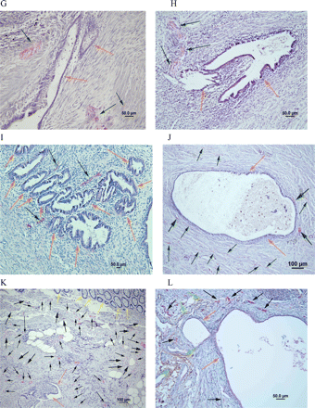
Figure 1 Nerve fibres in DIE.
Notes:
Figure 1 Nerve fibres in DIE. Permanent fast red chromogen has been used throughout unless noted. (A) A rectal lesion stained with PGP9.5, thick nerve trunks in the adjacent fibromuscular tissue (magnification ×100). (B) A rectal lesion stained with NF (magnification ×200). (C) A uterosacral ligament lesion stained with NGF (magnification ×200). (D) A rectal lesion stained with NGFRp75 (magnification ×200). (E) A peritoneal sidewall lesion stained with Trk-A (magnification ×200). (F) A peritoneal sidewall lesion stained with CGRP (magnification ×200). (G) A cul de sac lesion stained with SP (magnification ×200). (H) A rectal lesion stained with VAChT (magnification ×200). (I) A cul de sac lesion stained with VIP (magnification ×200). (J) A peritoneal sidewall lesion stained with NPY (magnification ×100). (K) A rectal lesion stained with PGP9.5, high densities of nerve fibres in rectal lesion (magnification ×200). (L) A uterosacral ligament lesion stained with PGP9.5 and CD34 (magnification ×200). The nerve fibres were intensely stained red (permanent fast red chromogen) and blood vessels were stained brown (DAB chromogen). Scale bars represent 100 µm in A, J and K; and 50 µm in B–I, L. Black arrows represent nerve fibres; deep orange arrows represent endometriotic glands; yellow arrows represent rectal mucosa epithelia; green arrows represent blood vessels.
Unless provided in the caption above, the following copyright applies to the content of this slide: © The Author 2009. Published by Oxford University Press on behalf of the European Society of Human Reproduction and Embryology. All rights reserved. For Permissions, please email: journals.permissions@oxfordjournals.org

Slide 3
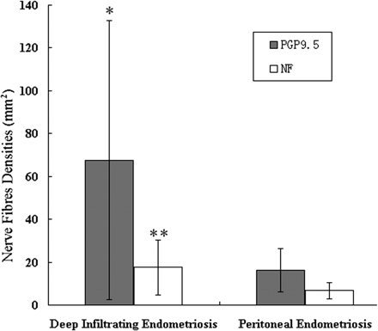
Figure 2 Densities of nerve fibres (mean ± SD) in DIE and superficial peritoneal endometriosis.
Notes:
Figure 2 Densities of nerve fibres (mean ± SD) in DIE and superficial peritoneal endometriosis. The density of nerve fibres stained with PGP9.5 in DIE was significantly greater than that in superficial peritoneal endometriosis (*P &lt; 0.01). The density of nerve fibres stained with NF in DIE was also significantly greater than that in superficial peritoneal endometriosis (**P &lt; 0.01).
Unless provided in the caption above, the following copyright applies to the content of this slide: © The Author 2009. Published by Oxford University Press on behalf of the European Society of Human Reproduction and Embryology. All rights reserved. For Permissions, please email: journals.permissions@oxfordjournals.org

Slide 4
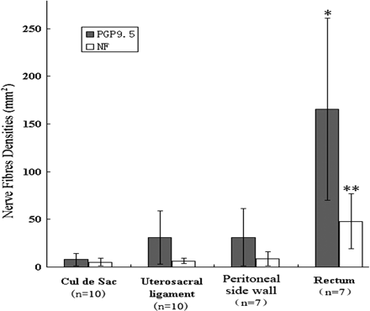
Figure 3 The densities of nerve fibres (mean ± SD) stained with PGP9.5 and NF in uterosacral ligament, cul de sac, ...
Notes:
Figure 3 The densities of nerve fibres (mean ± SD) stained with PGP9.5 and NF in uterosacral ligament, cul de sac, peritoneal side wall and rectal lesions of DIE. The densities of nerve fibres were highest in rectal lesions (*P &lt; 0.001; **P &lt; 0.001). There was no statistical difference in nerve fibre density between cul de sac, uterosacral ligament and pelvic side wall lesions (P &gt; 0.05).
Unless provided in the caption above, the following copyright applies to the content of this slide: © The Author 2009. Published by Oxford University Press on behalf of the European Society of Human Reproduction and Embryology. All rights reserved. For Permissions, please email: journals.permissions@oxfordjournals.org

Slide 5
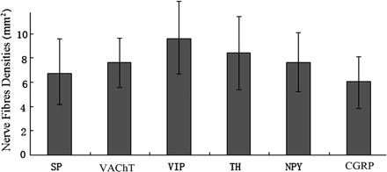
Figure 4 Densities of nerve fibres (mean ± SD) expressing different neural markers (stained with SP, VAChT, VIP, TH, ...
Notes:
Figure 4 Densities of nerve fibres (mean ± SD) expressing different neural markers (stained with SP, VAChT, VIP, TH, NPY and CGRP). There were no significant differences in the densities of these nerve fibres (P &gt; 0.05).
Unless provided in the caption above, the following copyright applies to the content of this slide: © The Author 2009. Published by Oxford University Press on behalf of the European Society of Human Reproduction and Embryology. All rights reserved. For Permissions, please email: journals.permissions@oxfordjournals.org

