Slide 1
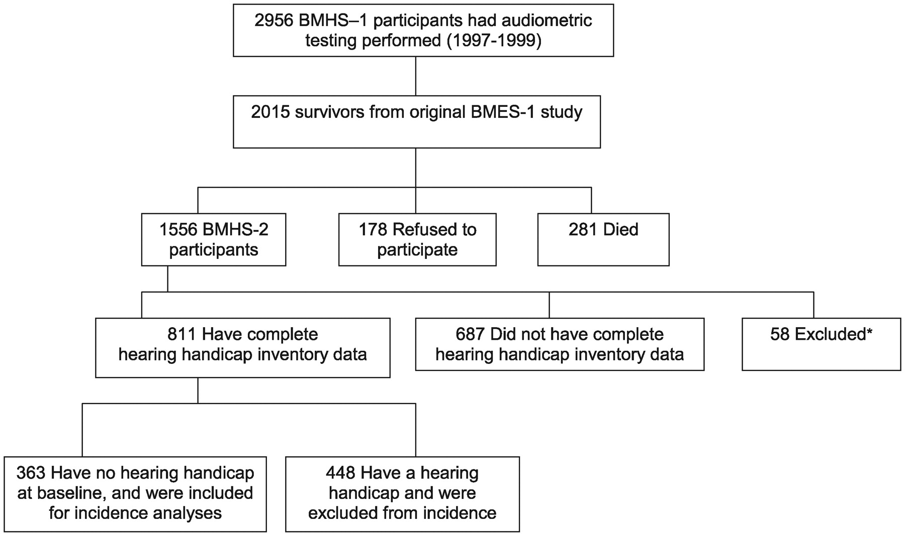
Figure 1. Participation in the Blue Mountains Hearing Study from 1997–99 to 2002–04. The asterisk indicates ...
Notes:
Figure 1. Participation in the Blue Mountains Hearing Study from 1997–99 to 2002–04. The asterisk indicates participants excluded on the basis that they had either conductive hearing loss and/or childhood hearing loss.
Unless provided in the caption above, the following copyright applies to the content of this slide: © The Author 2012. Published by Oxford University Press on behalf of the British Geriatrics Society. All rights reserved. For Permissions, please email: journals.permissions@oup.com

