Slide 1
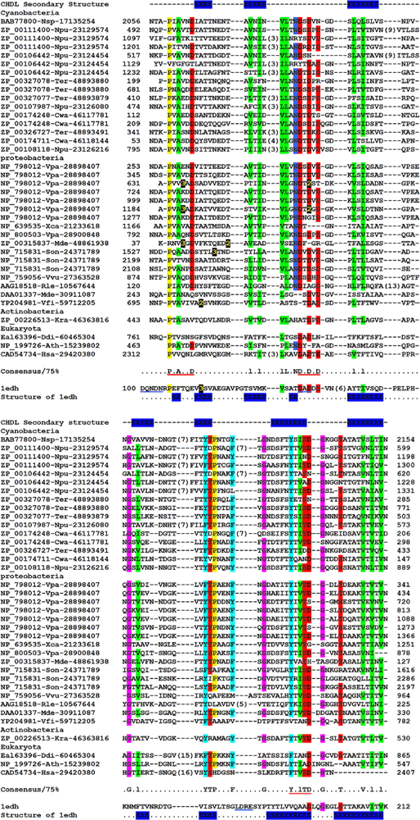
1 Multiple sequence alignment of the cadherin-like domain (CHDL). The alignment was constructed by the T-Coffee ...
Notes:
1 Multiple sequence alignment of the cadherin-like domain (CHDL). The alignment was constructed by the T-Coffee program [10] with minimal manual adjustment on the basis of PSI-BLAST [9] search results. The alignment was colored by the Chroma program [11]. The yellow numbers on dark background and the black numbers in the alignment all indicate the lengths of variable inserts in respective protein sequences. The secondary structure of the CHDL domain predicted by the PSIPRED [13] and the JPRED2 [14] programs is labeled above the alignment with E representing β-strand. The sequence of the cadherin domain (PDB entry: 1edh) [26] was carefully aligned with the CHDL domain sequence based on the alignment results querying the sequence (residues 2055–2154) of the hypothetical protein alr0276 (BAB77800) from Nostoc sp. PCC 7120 and the sequence (residues 999–1088) of a putative RTX toxin (NP_798012) from V. parahaemolyticus using the 3D-PSSM folding prediction program [15]. The secondary structure of the cadherin domain (PDB entry: 1edh) is also labeled below the 1edh sequence as a control. Cadherin specific motifs DxD, LDRE and DxNDN are underlined in the 1edh sequence. The conserved motifs PxAxxD, DxDxD and YT-V/I-S/T-D in the CHDL domain are also underlined. The protein sequences are denoted by GenBank Accession Nos. followed by species abbreviation and GenBank gi number. The species abbreviations are: Nsp –Nostoc sp. PCC 7120; Npu –N. punctiforme PCC 73102; Ter –Trichodesmium erythraeum; Cwa –C. watsonii; Vpr –V. parahaemolyticus; Mde –M. degradans; Vvu –V. vulnificus; Son –S. oneidensis; Xca –Xanthomonas campestris; Kra –K. radiotolerans; Rlg –Rhizobium leguminosarum bv. Trifolii; Vfi –V. fischeri ES114; Ddi –Dictyostelium discoideum; Ath –A. thaliana; Hsa –Homo sapiens.
Unless provided in the caption above, the following copyright applies to the content of this slide: © 2005 Federation of European Microbiological Societies

Slide 2
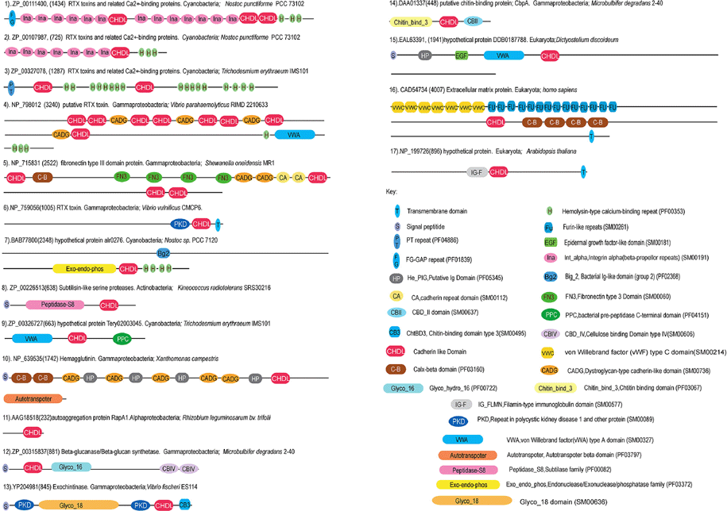
2 Domain organization of proteins containing the CHDL domain. Full names and accession numbers of the proteins ...
Notes:
2 Domain organization of proteins containing the CHDL domain. Full names and accession numbers of the proteins are listed. The domain architectures were drawn approximately to scale. The key identifies all the domains in the figure and also includes the SMART or Pfam accession number describing each domain.
Unless provided in the caption above, the following copyright applies to the content of this slide: © 2005 Federation of European Microbiological Societies

