Slide 1
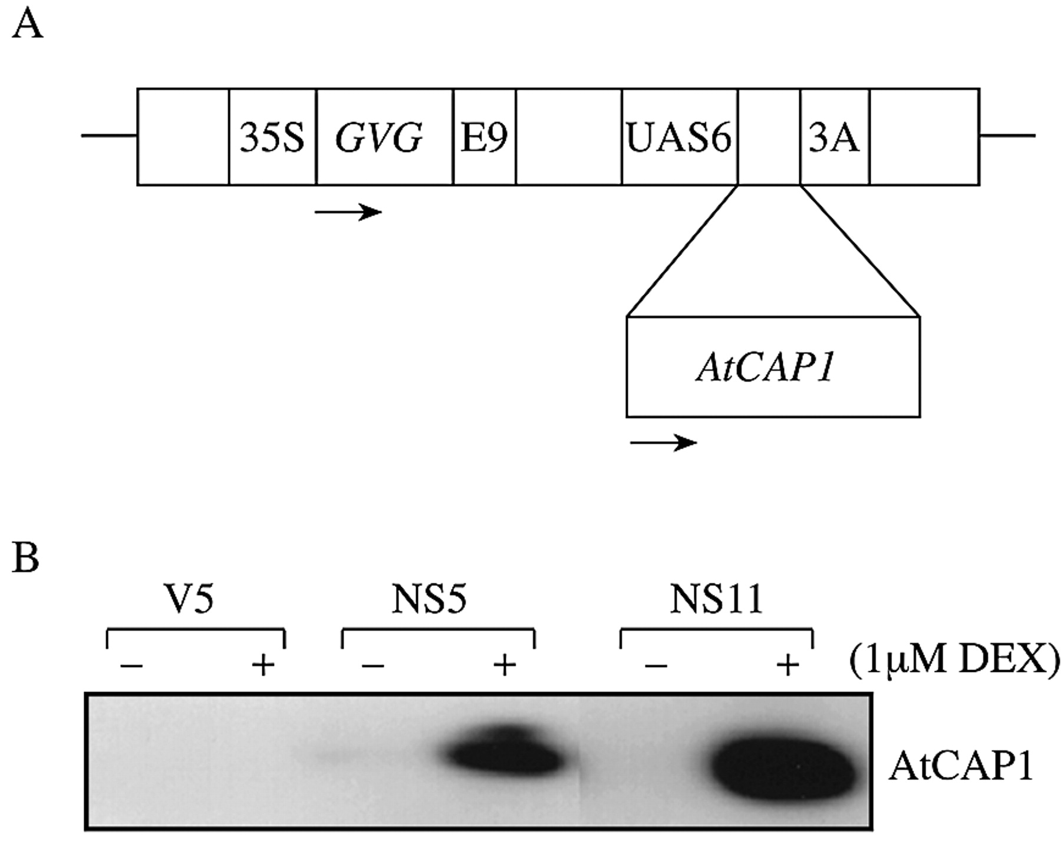
Fig. 1. Expression of AtCAP1 in transgenic tobacco lines following DEX treatment. A, Schematic representation ...
Notes:
Fig. 1. Expression of AtCAP1 in transgenic tobacco lines following DEX treatment. A, Schematic representation of the glucocorticoid‐inducible construct. 35S, Cauliflower mosaic virus 35S promoter; GVG, chimeric GVG transcription factor; E9, pea rbcS‐E9 poly A addition sequences; UAS6, six copies of the DNA binding sites for GAL4; AtCAP1, AtCAP1 coding sequence; 3A, pea rbc‐3A poly A addition sequence. Arrows indicate direction of transcription. B, Protein gel blot detection of AtCAP1. Tobacco plants were grown on MS plates for 7 d and then treated with DEX (1 µm) for 10 d. Protein was extracted from shoot tissues and 20 µg protein per line was loaded in duplicate gels. Results of tobacco empty‐vector line (V5) and transgenic plants over‐expressing AtCAP1 (NS6 and NS11) are shown.
Unless provided in the caption above, the following copyright applies to the content of this slide:

Slide 2
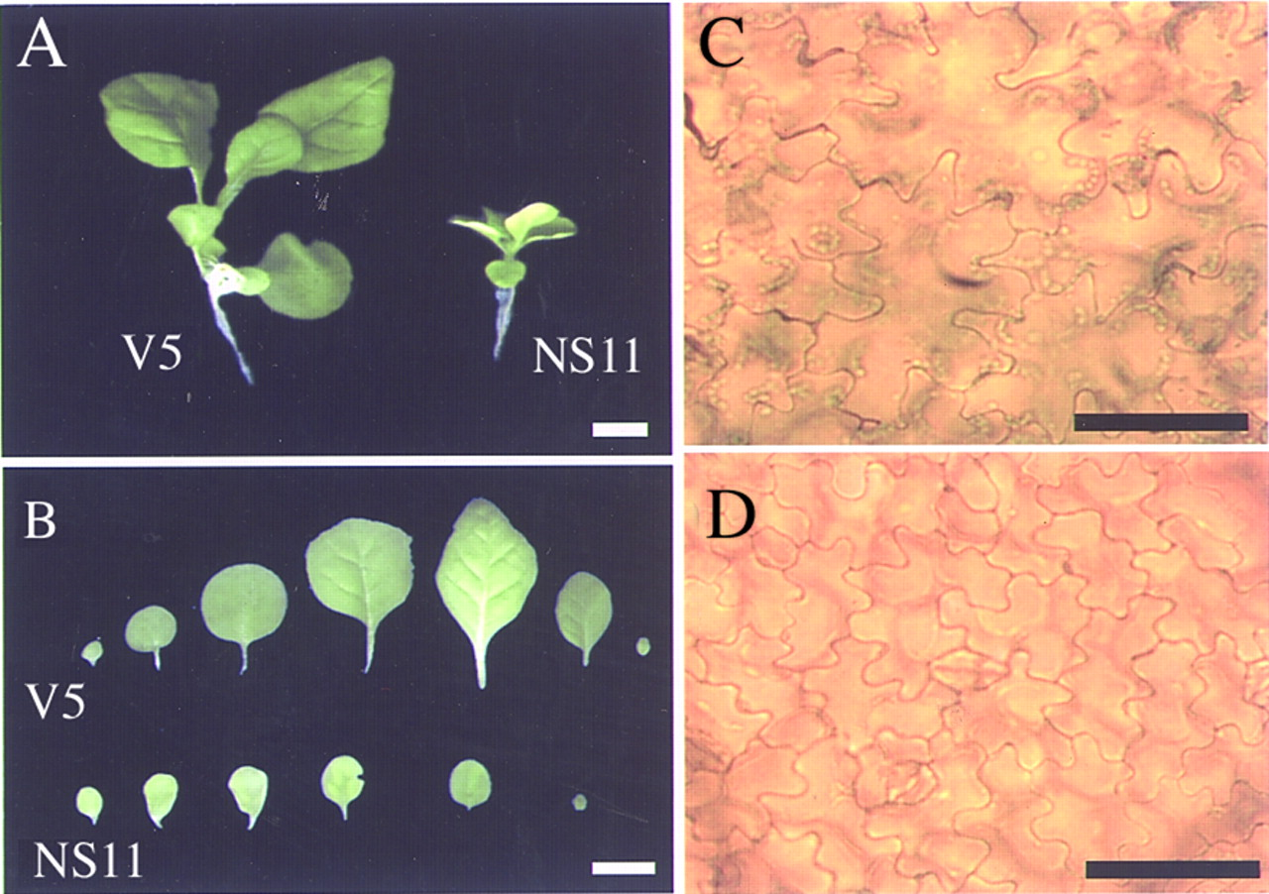
Fig. 2. Anatomical comparison of transgenic tobacco plants over‐expressing AtCAP1. A, Plants grown on ...
Notes:
Fig. 2. Anatomical comparison of transgenic tobacco plants over‐expressing AtCAP1. A, Plants grown on DEX‐free medium for 7 d were transferred to a 1 µm DEX medium and grown for 7 d. B, Leaves of the empty‐vector line (V5) and transgenic tobacco plants (NS11). The leaves in each row are, from left to right, the cotyledon and leaves. Epidermal cells of the third leaf of empty‐vector line (V5) (C) and of transgenic tobacco plants over‐expressing AtCAP1 (NS11) (D) shown in B. Bar = 100 µm.
Unless provided in the caption above, the following copyright applies to the content of this slide:

