Slide 1
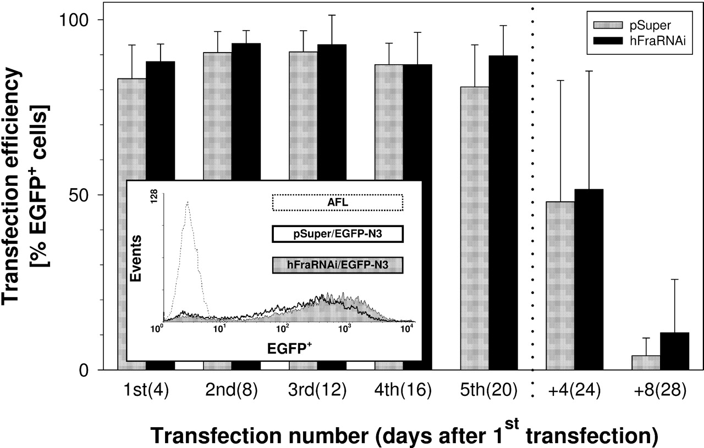
Figure 1. Transfection efficiency and stabilization of plasmid expression. HeLa cells were co-transfected by ...
Notes:
Figure 1. Transfection efficiency and stabilization of plasmid expression. HeLa cells were co-transfected by electroporation with vector EGFP-N3 in combination with either vectors pSUPER or hFraRNAi (15–22.5 µg of each plasmid). After 4 days, the fluorescence was determined by flow cytometry (excitation 488, 530 nm band pass filter) and served as a measure of the transfection efficiency. The transfection efficiency (mean±SD; n=4–9) was estimated from the percentage of EGFP+ per total cells. Transfection and analysis were repeated four times. Thereafter, cells were further cultivated for another 4 or 8 days (+4, +8) without transfection. The time period (days) after the first transfection is given in parenthesis. Representative examples of the flow cytometry analyses with the vector-transfected cells and the autofluorescence (AFL) of untransfected cells are shown in the insert.
Unless provided in the caption above, the following copyright applies to the content of this slide: Human Molecular Genetics, Vol. 13, No. 23 © Oxford University Press 2004; all rights reserved

Slide 2
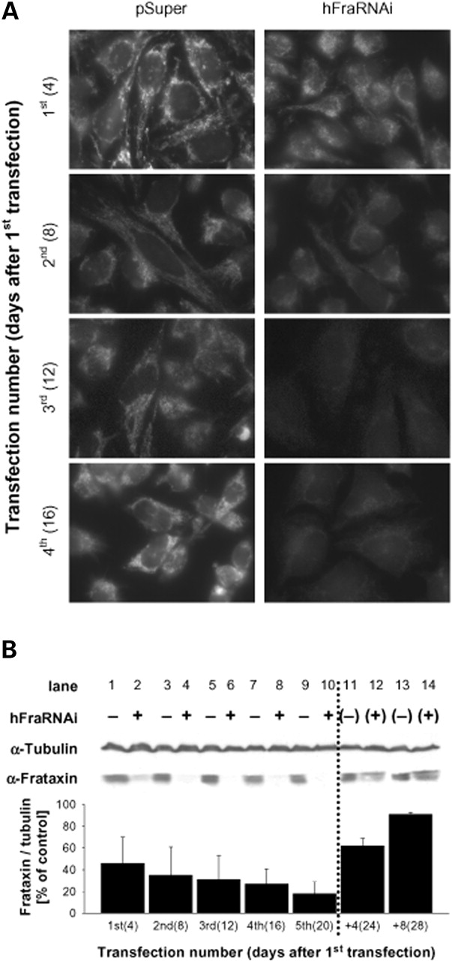
Figure 2. Depletion of frataxin by siRNA. (A) HeLa cells were repeatedly transfected with the vectors as ...
Notes:
Figure 2. Depletion of frataxin by siRNA. (A) HeLa cells were repeatedly transfected with the vectors as described in Figure 1. Human frataxin was visualized by indirect immunofluorescence 4 days after each transfection. In contrast to cells transfected with control vector pSUPER, frataxin staining disappeared almost completely after two rounds of transfection with vector hFraRNAi. (B) Cell lysates from (A) were analysed by SDS–PAGE and immunostaining for frataxin and tubulin (mean±SD; n=3–6). After normalization of frataxin levels to the amounts of tubulin, the levels of residual frataxin in HeLa cells transfected with vector hFraRNAi (+) were expressed relative to frataxin/tubulin present in pSUPER-transfected control cells (−).
Unless provided in the caption above, the following copyright applies to the content of this slide: Human Molecular Genetics, Vol. 13, No. 23 © Oxford University Press 2004; all rights reserved

Slide 3
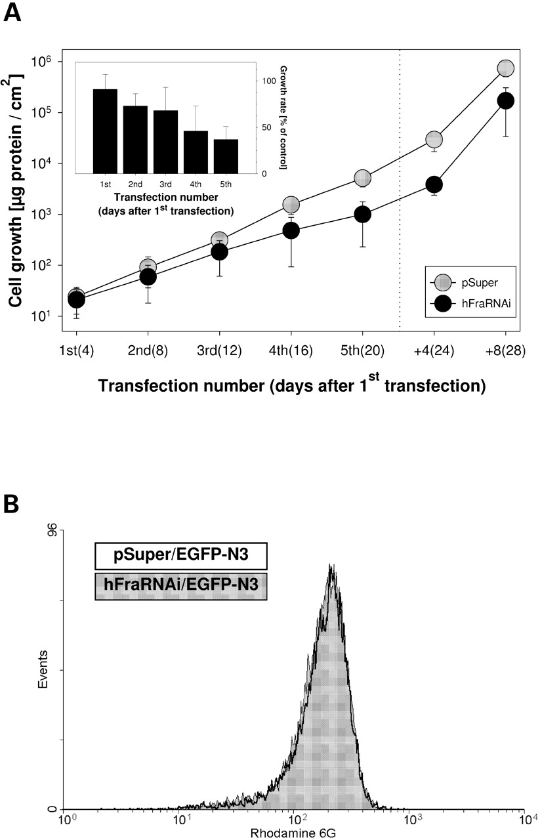
Figure 3. Impaired cell growth upon frataxin depletion. (A) Growth of HeLa cells transfected with the vectors ...
Notes:
Figure 3. Impaired cell growth upon frataxin depletion. (A) Growth of HeLa cells transfected with the vectors as described in Figure 1. Cells were harvested every 4th day after electroporation and their protein content (mean±SD; n=3–9) was determined as a measure for cell growth. Error bars are only indicated, if larger than the circles. The growth rates were >2-fold reduced upon frataxin depletion (insert). (B) The mitochondrial membrane potentials of frataxin-depleted (grey) or control (open) HeLa cells were determined by rhodamine 6G (R6G)-staining and flow cytometry. R6G fluorescence of both representative examples obtained after the third transfection (i.e. after 12 days of frataxin depletion) displayed a congruent unimodal distribution, indicating an equivalent viability of both frataxin-deficient and control cells.
Unless provided in the caption above, the following copyright applies to the content of this slide: Human Molecular Genetics, Vol. 13, No. 23 © Oxford University Press 2004; all rights reserved

Slide 4
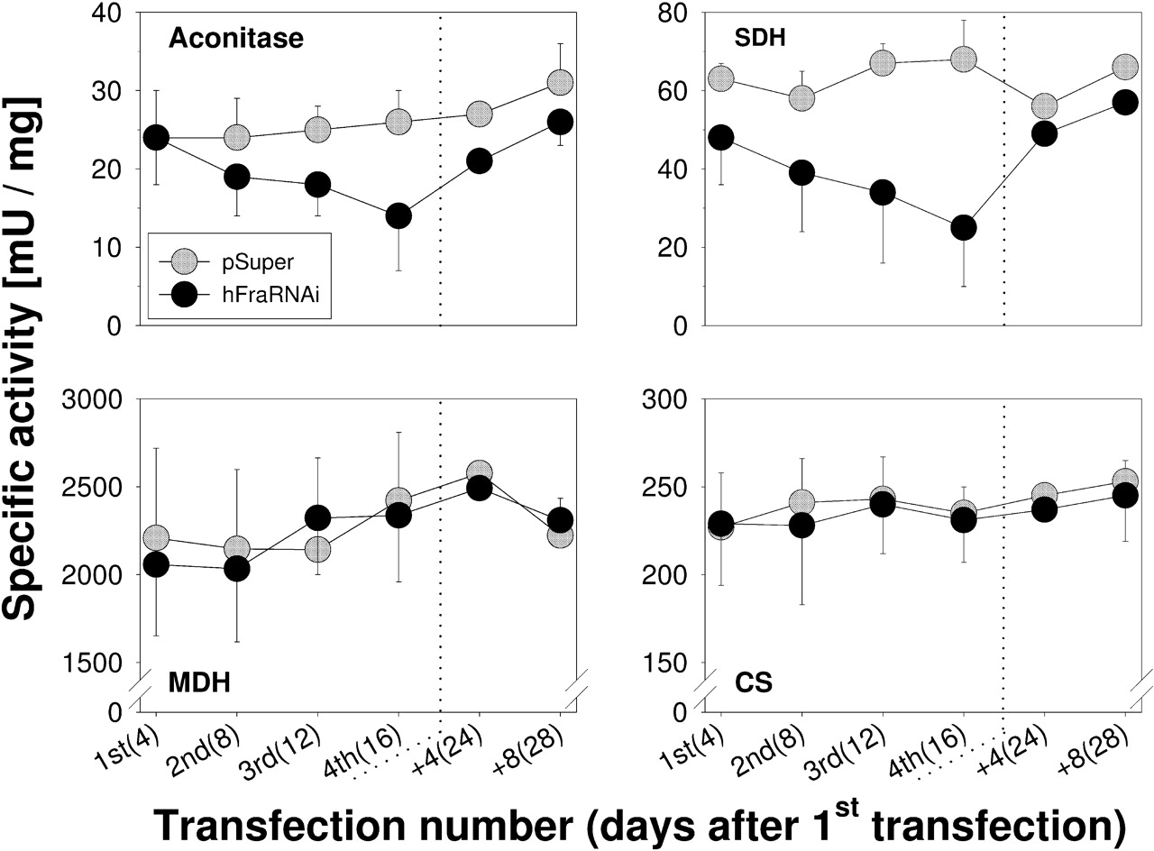
Figure 4. Defects in mitochondrial Fe/S proteins upon frataxin depletion. Specific activities (mean±SD; ...
Notes:
Figure 4. Defects in mitochondrial Fe/S proteins upon frataxin depletion. Specific activities (mean±SD; n=3–6) of the mitochondrial ISC-containing enzymes aconitase and succinate dehydrogenase (SDH) and of the non-ISC-containing enzymes malate dehydrogenase (MDH) and citrate synthase (CS) were measured in lysates of HeLa cells transfected as described in Figure 1.
Unless provided in the caption above, the following copyright applies to the content of this slide: Human Molecular Genetics, Vol. 13, No. 23 © Oxford University Press 2004; all rights reserved

Slide 5
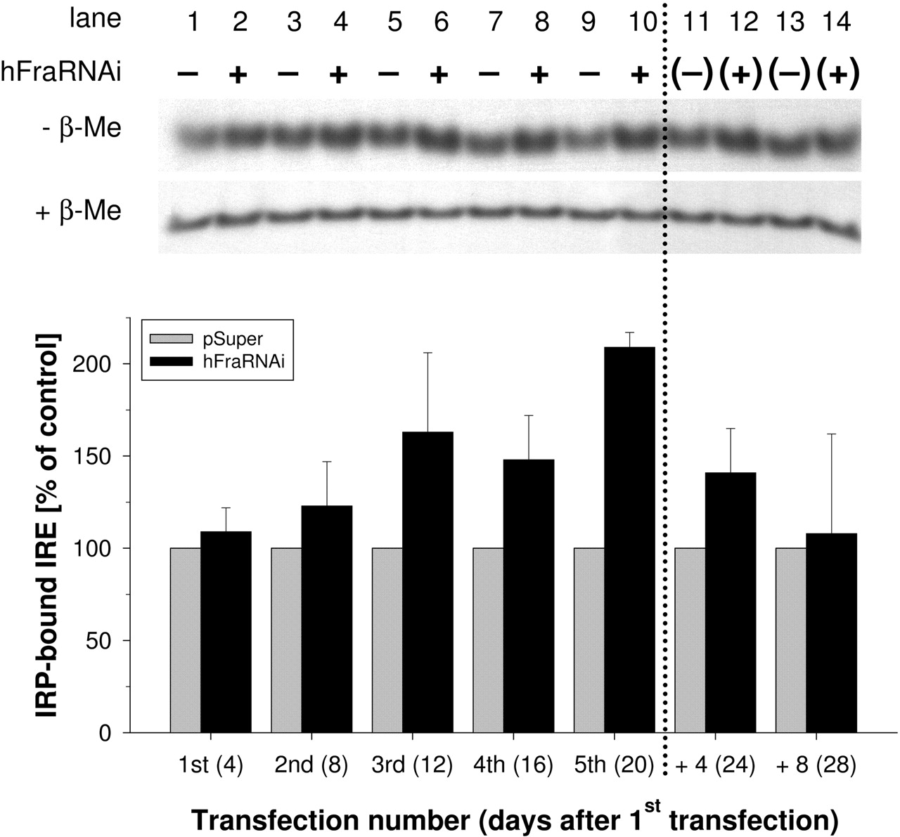
Figure 5. Increased binding activity of IRP to IRE upon frataxin depletion. Extracts derived from HeLa cells ...
Notes:
Figure 5. Increased binding activity of IRP to IRE upon frataxin depletion. Extracts derived from HeLa cells transfected as described in Figure 1 were analysed for total binding activity of IRP to 32P-labelled IRE (mean±SD; n=3–10). After native gel electrophoresis, binding of [α-32P]CTP-labelled IREs of human ferritin mRNA to IRP was visualized by autoradiography and normalized to the maximal binding capacity of β-mercaptoethanol-treated (β-ME) IRP. Finally, the amount of IRP-bound IRE in samples from frataxin-deficient HeLa cells (+) was expressed relatively to the amount of IRP-bound IRE in the corresponding control cells (−).
Unless provided in the caption above, the following copyright applies to the content of this slide: Human Molecular Genetics, Vol. 13, No. 23 © Oxford University Press 2004; all rights reserved

Slide 6
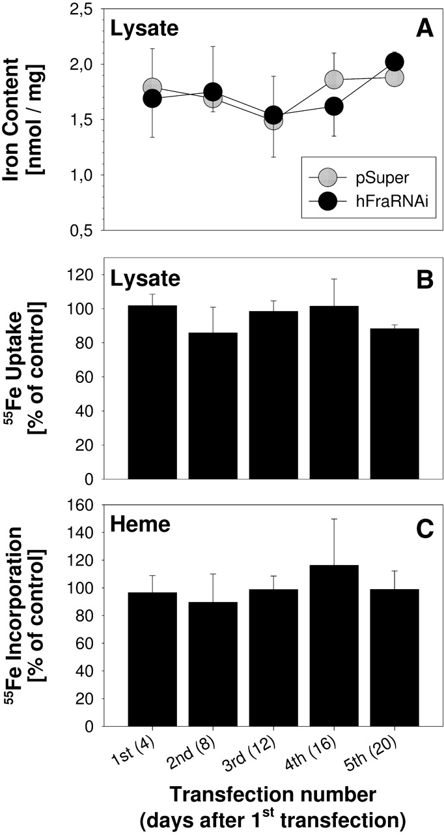
Figure 6. No alterations in cellular iron content, uptake of non-transferrin-bound iron and heme formation ...
Notes:
Figure 6. No alterations in cellular iron content, uptake of non-transferrin-bound iron and heme formation upon frataxin depletion. (A) The total iron content of cell extracts (mean±SD; n=3–6) obtained from HeLa cells transfected as described in Figure 1 was spectrophotometrically determined at the time points indicated, using the iron-sensitive chelator Nitro-PAPS. (B, C) Iron uptake and heme formation were examined by incubating the cells with 1 µCi 55Fe per ml culture medium for 18 h every 4th day after electroporation. The 55Fe content of cell lysates served as a measure for the uptake of non-transferrin-bound iron (B). The 55Fe content of butyl acetate extracts reflects iron incorporation into heme (C). Data were normalized to culture density (see Materials and Methods), and results for the frataxin-depleted cells (mean±SD) were expressed relative to the respective controls.
Unless provided in the caption above, the following copyright applies to the content of this slide: Human Molecular Genetics, Vol. 13, No. 23 © Oxford University Press 2004; all rights reserved

