Slide 1
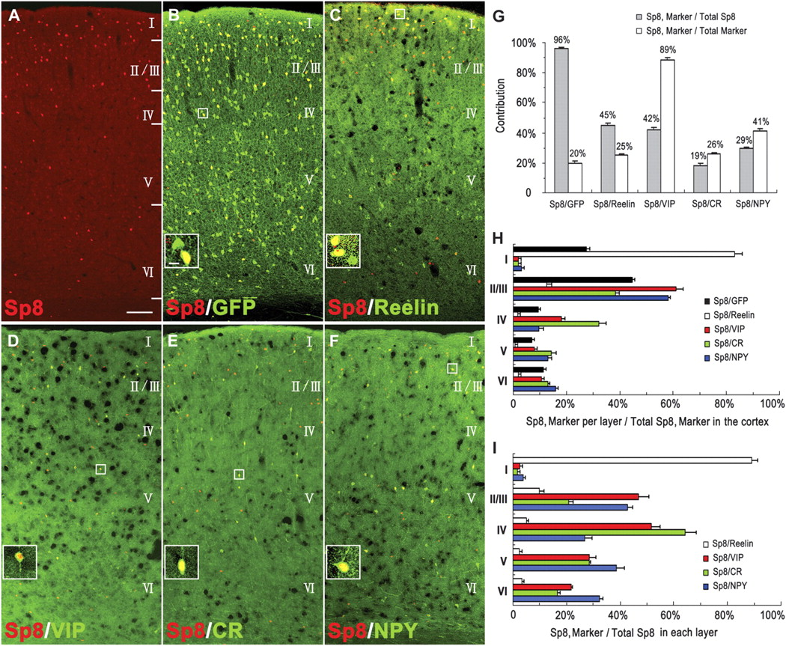
Figure 1. Sp8 labels a specific population of cortical interneurons. Images are taken from coronal sections of mouse ...
Notes:
Figure 1. Sp8 labels a specific population of cortical interneurons. Images are taken from coronal sections of mouse primary somatosensory cortex at P28. (A–B) Sp8/GFP double immunostaining in the section of Dlx5/6-CIE; Z/EG mice reveals that nearly all Sp8+ cells are GFP+ cortical interneurons. (C–F) Sp8 labels some of Reelin+ (C), VIP+ (D), CR+ (E), and NPY+ (F) cortical interneurons. (G) Quantification of the percentage of Sp8+ cells that express GFP in Dlx5/6-CIE; Z/EG mice or subtype-specific cortical interneuron markers in wild-type mice and the percentage of GFP+ interneurons or specific cortical interneuron subtypes that express Sp8. (H) The layer distribution of subtype-specific Sp8+ cortical interneurons. (I) The percentage of Sp8+ cells that express subtype-specific cortical interneuron markers in each layer. Error bars are standard error of the mean. Scale bars are 100 μm (A–F) and 10 μm (inserts).
Unless provided in the caption above, the following copyright applies to the content of this slide: © The Author 2011. Published by Oxford University Press. All rights reserved. For permissions, please e-mail: journals.permissions@oup.com

Slide 2
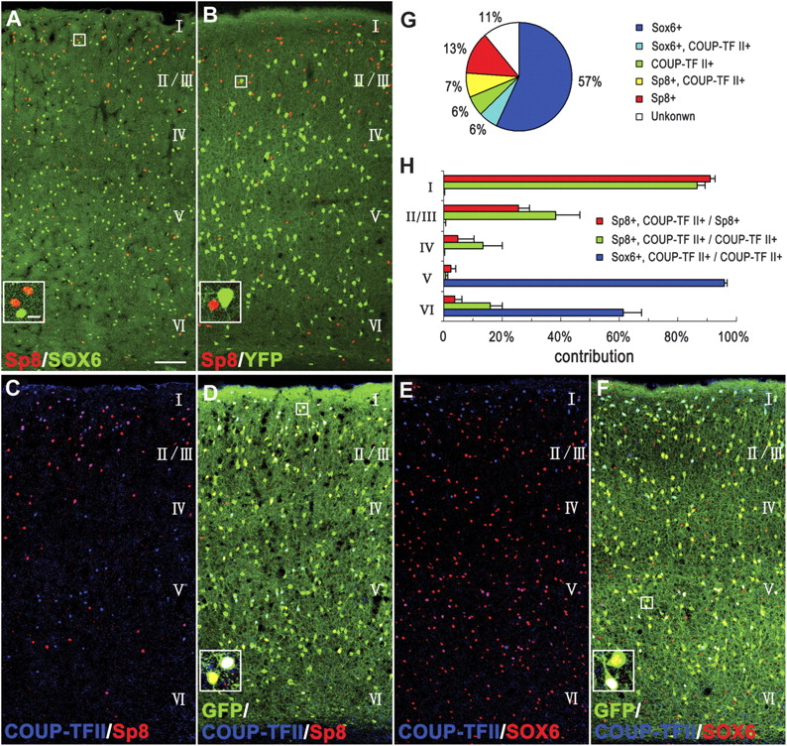
Figure 2. Classification of cortical interneurons using the Sp8, Sox6, and COUP-TFII transcription factors. Images are ...
Notes:
Figure 2. Classification of cortical interneurons using the Sp8, Sox6, and COUP-TFII transcription factors. Images are taken from coronal sections of mouse primary somatosensory cortex at P28. (A) Sp8+ cells do not express Sox6. (B) Sp8 is not expressed in MGE-derived interneurons labeled with YFP in the cortex of Nkx2.1-cre; R26R-YFP mice. (C–F) Sp8+/COUP-TFII+/GFP+ cells are mainly in superficial layers, whereas Sox6+/COUP-TFII+/GFP+ cells are mainly in deep layers in Dlx5/6-CIE; Z/EG mice. (G) Classification of cortical interneurons using the transcription factors Sp8, Sox6, and COUP-TFII. (H) The layer distribution of transcription factor–labeled cortical interneurons. Error bars are standard error of the mean. Scale bars are 100 μm (A–F) and 10 μm (inserts).
Unless provided in the caption above, the following copyright applies to the content of this slide: © The Author 2011. Published by Oxford University Press. All rights reserved. For permissions, please e-mail: journals.permissions@oup.com

Slide 3
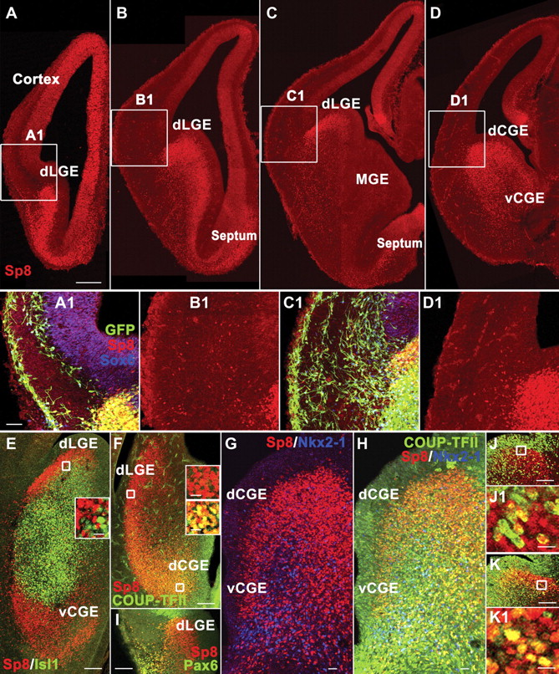
Figure 3. The spatial expression pattern of Sp8 in the forebrain of E13.5 mice. (A–D) Coronal sections show the ...
Notes:
Figure 3. The spatial expression pattern of Sp8 in the forebrain of E13.5 mice. (A–D) Coronal sections show the distribution of Sp8+ cells in the E13.5 Dlx5/6-CIE; Z/EG mouse forebrain at 4 different rostral–caudal levels. (A1–D1) Higher magnification of boxed areas of (A–D) show scattered Sp8+ cells in the cortex adjacent to the dLGE/dCGE. Note that Sp8+/GFP+ interneurons do not express Sox6 (A1 and C1). (E) The horizontal section shows that Sp8+ cells in the dLGE do not express Isl1. (F) The horizontal section shows that the vast majority of Sp8+ cells in the dCGE, but not in the dLGE, express COUP-TFII. (G and H) Coronal section through the CGE shows that Sp8+/COUP-TFII+ cells are mainly in the dCGE, whereas COUP-TFII+ and COUP-TFII+/Nkx2-1+ cells are mainly in the vCGE. (I) Sp8+/Pax6+ cells could be found in the dLGE and lateral cortical stream that migrates into the piriform cortex, but no Sp8+/Pax6+ cells are found in the neocortex. (J and K1) E13.5 mice are sacrificed 2 h after a single-pulse BrdU injection. Sp8/BrdU (J and J1) and Sp8/Ki67 (K and K1) double immunostaining reveal that there are many dividing Sp8+ cells in the SVZ of the dLGE. Scale bars are 200 μm (in A applies to A–D), 50 μm (in A1 applies to A1–D1), 100 μm (E–K), and 10 μm (inserts in E and F; J1 and K1).
Unless provided in the caption above, the following copyright applies to the content of this slide: © The Author 2011. Published by Oxford University Press. All rights reserved. For permissions, please e-mail: journals.permissions@oup.com

Slide 4
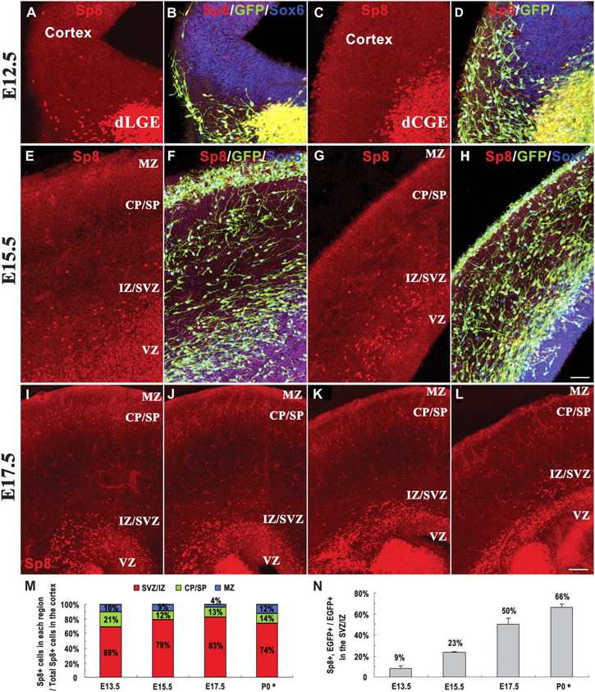
Figure 4. Origin and tangential migration of Sp8+ cortical interneurons. (A and B) Coronal sections from the region of ...
Notes:
Figure 4. Origin and tangential migration of Sp8+ cortical interneurons. (A and B) Coronal sections from the region of the rostral dLGE of E12.5 Dlx5/6-CIE, Z/EG mice show that Sp8+ cells are intermixed with MGE-derived Sox6+ cells as they invade the cortex. (C–D) By contrast, in the region of the dCGE, there are extremely few Sp8+ cells that migrate into the cortex at E12.5. (E–H) Rostral (E and F) and caudal (G and H) coronal sections from E15.5 Dlx5/6-CIE; Z/EG mice show that Sp8+ cells mainly accumulate in the cortical SVZ/IZ, whereas Sox6+ cells are distributed in the SVZ/IZ, CP, and MZ. (I–L) At E17.5, from rostral (I) to caudal (L), the majority of Sp8+ cells are in the cortical SVZ/IZ; some Sp8+ cells are also in the CP and MZ. (M) The laminar distribution of Sp8+ cells in embryonic and P0 mice. (N) There is an increase in the percentage of GFP+ interneurons that express Sp8 in the cortical SVZ/IZ of Dlx5/6-CIE; Z/EG mice from E13.5 to P0. *Sp8+ cells in the cortical SVZ are not counted in P0 mice, as it is likely that many of them migrate into the OB. Error bars are SEM. Scale bars are 50 μm (in H applies to A–H) and 100 μm (in L applies to I–L).
Unless provided in the caption above, the following copyright applies to the content of this slide: © The Author 2011. Published by Oxford University Press. All rights reserved. For permissions, please e-mail: journals.permissions@oup.com

Slide 5
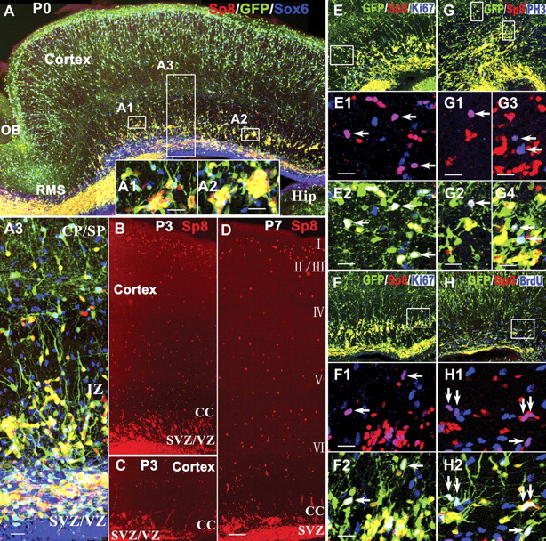
Figure 5. Location of Sp8+ interneurons in the early postnatal cortex. (A–A3) Sp8, GFP, and Sox6 triple-immunostained ...
Notes:
Figure 5. Location of Sp8+ interneurons in the early postnatal cortex. (A–A3) Sp8, GFP, and Sox6 triple-immunostained sagittal sections from Dlx5/6-CIE; Z/EG mice at P0. Note that the large number of Sp8+ interneurons that are intermixed with a smaller number of Sox6+ interneurons appear to be radially migrating from the SVZ/IZ to the cortex. (B–D) Representative sagittal sections from P3 (B and C) and P7 (D) mouse brain show many Sp8+ cells that appear to be migrating radially from the SVZ to the cortex at rostral (B and D) and caudal levels (C). Note that chain-like radial migration is frequently observed (C). (E–G4) Representative Sp8/GFP/Ki67 and Sp8/GFP/PH3 triple-immunostained sections from Dlx5/6-CIE; Z/EG mice at P0 show dividing Sp8+ cells (arrows) in the IZ at rostral (E and G) and caudal levels (F). (H–H2) Two hours after BrdU injection, P0 Dlx5/6-CIE; Z/EG mice were immediately fixed. Sp8+/GFP+/BrdU+ cells were also found in the IZ (arrows). (E1–H2) Higher magnification of boxed areas in (E–H). Hip, hippocampus. Scale bars are 100 μm (in D applies to A–H) and 20 μm (A1–A3 and E1–H2).
Unless provided in the caption above, the following copyright applies to the content of this slide: © The Author 2011. Published by Oxford University Press. All rights reserved. For permissions, please e-mail: journals.permissions@oup.com

Slide 6
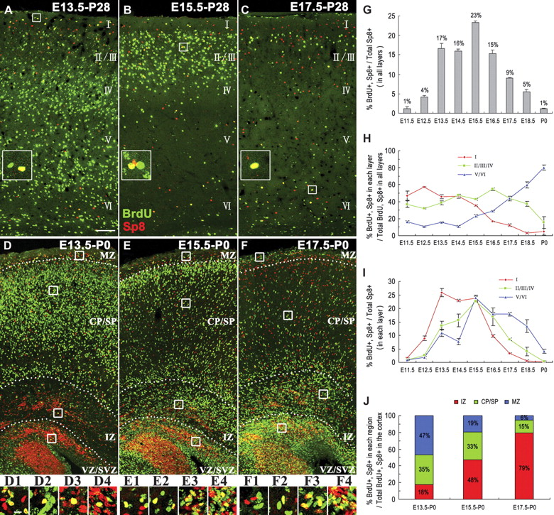
Figure 6. Birth dating and outside-in layering of the Sp8+ cortical interneurons. (A–F) E13.5, E15.5, or E17.5 mice ...
Notes:
Figure 6. Birth dating and outside-in layering of the Sp8+ cortical interneurons. (A–F) E13.5, E15.5, or E17.5 mice were given a single-pulse BrdU injection and sacrificed at P28 (A–C) or P0 (D–F). BrdU/Sp8 double immunostaining was performed on coronal brain sections. (D1–F4) Higher magnification of boxed areas (from up to down) showing that a subpopulation of BrdU+/Sp8+ interneurons accumulates in the cortical SVZ/IZ at P0, although they are born at different embryonic time points. Note that earlier born Sp8+ interneurons have already migrated into the superficial layers at P0. (G) The majority of Sp8+ cortical interneurons are born between E13.5 and E17.5 with a peak at E15.5. (H) Quantification of (A–C) showing that Sp8+ cortical interneurons are generated in an outside-in manner, with earlier born Sp8+ interneurons mainly occupying superficial layers and later born Sp8+ interneurons mainly occupying deep layers. (I) Birth dating of Sp8+ interneurons in each layer. (J) The region distribution of E13.5-, E15.5-, and E17.5-derived Sp8+ interneurons at P0. Error bars are SEM. Scale bars are 100 μm (in A applies to A–F) and 10 μm (in D1 applies to D1–F4 and inserts in A–C).
Unless provided in the caption above, the following copyright applies to the content of this slide: © The Author 2011. Published by Oxford University Press. All rights reserved. For permissions, please e-mail: journals.permissions@oup.com

