Slide 1
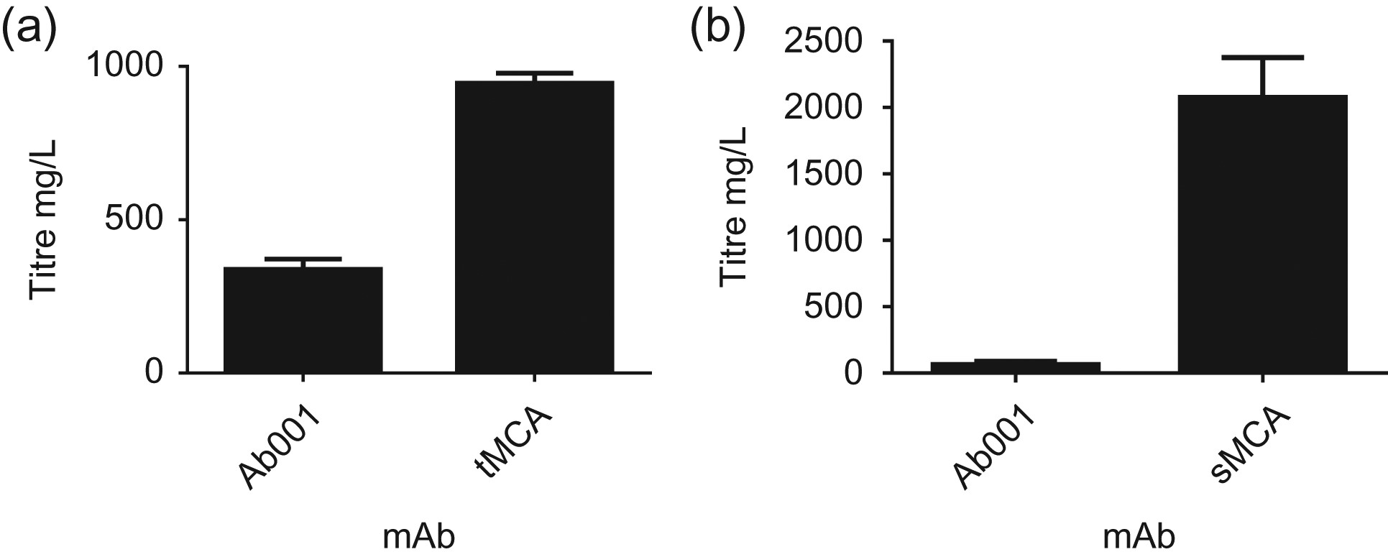
Fig. 1 Poor expression of Ab001 in transient and stable expression systems. (a) The transient expression of Ab001 ...
Notes:
Fig. 1 Poor expression of Ab001 in transient and stable expression systems. (a) The transient expression of Ab001 relative to the tMCA. Titers were analyzed from a 12-day fed-batch CHO cell culture. (b) The stable expression of Ab001 relative to the sMCA. Titers were analyzed from a 14-day fed-batch CHO cell culture. All experiments were biological replicates of n = 2. Biophysical analysis of the antibody variants studied Antibody variant% Monomer peakTm (°C)Ab001 (DDED)10064D51N (DNED)98.465E52N (DDND)10065D53N (DDEN)10066E52G97.164M27I, E52G99.563M27I, E52N99.764Ab00898.665HP-SEC size exclusion chromatography of each IgG variant was used to calculate the percentage monomer of each variant following purification. A DSF assay was carried out to determine Tm for each antibody variant.
Unless provided in the caption above, the following copyright applies to the content of this slide: © The Author 2017. Published by Oxford University Press. All rights reserved. For Permissions, please e-mail: journals.permissions@oup.com

Slide 2
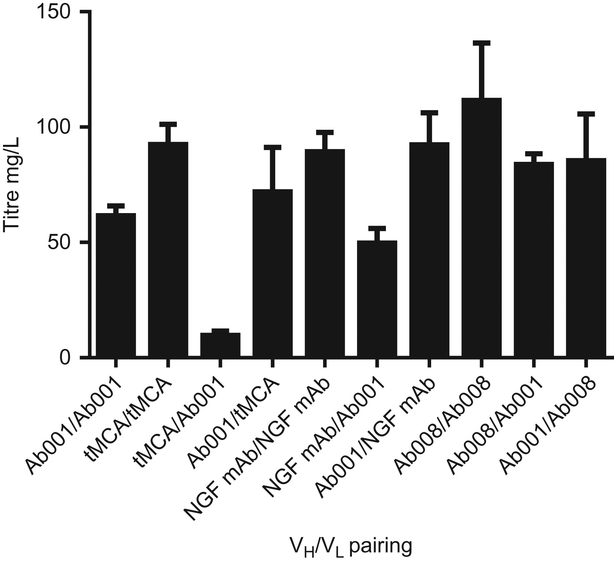
Fig. 2 Low Ab001 expression is dependent on the V_{L} and not the V_{H}. The cell culture medium ...
Notes:
Fig. 2 Low Ab001 expression is dependent on the VL and not the VH. The cell culture medium from the transfections was harvested at Day 7, and the IgG was quantitated by Protein-A-HPLC analysis. Titers from CHO transient transfections with Ab001 VH and VL plasmids in combination with each other and with the VH or VL of the tMCA, Ab008 and the NGF mAb. Titers were also measured for tMCA, NGF mAb and Ab008 as expression controls. All experiments were biological replicates of n = 3.
Unless provided in the caption above, the following copyright applies to the content of this slide: © The Author 2017. Published by Oxford University Press. All rights reserved. For Permissions, please e-mail: journals.permissions@oup.com

Slide 3
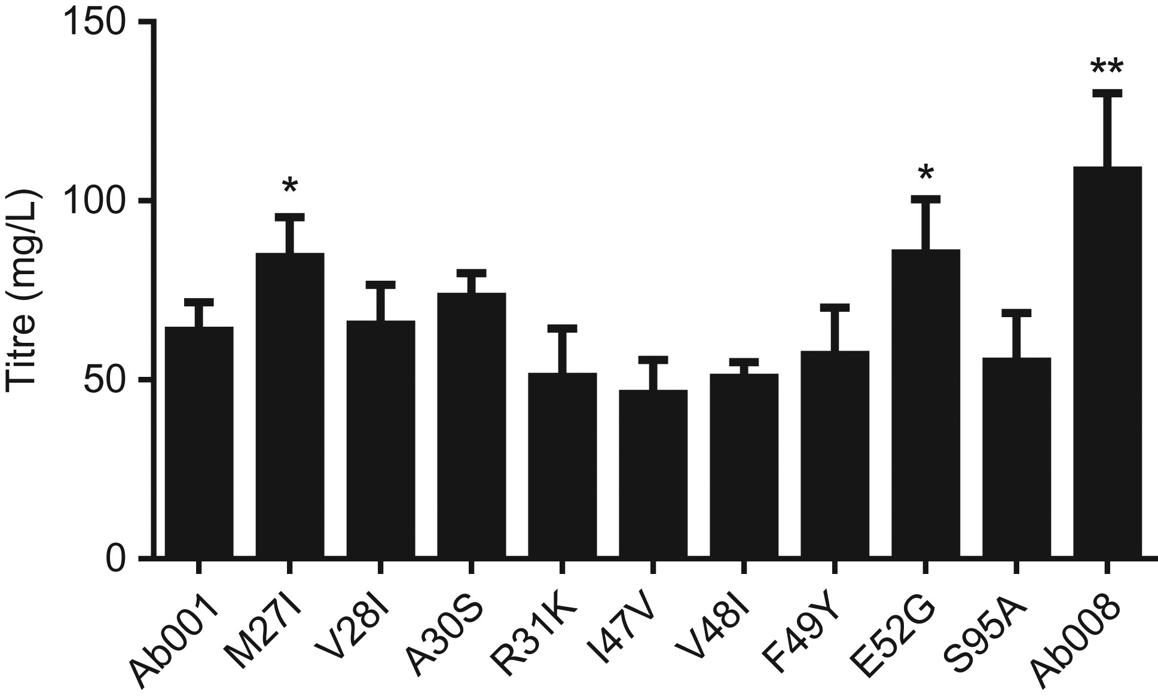
Fig. 3 Expression of Ab001 mutants. Antibody titers from the transient transfection of CHO cells with reversion ...
Notes:
Fig. 3 Expression of Ab001 mutants. Antibody titers from the transient transfection of CHO cells with reversion mutants of Ab001 to the sequence of Ab008. Two reversion mutants, M27I and E52G, exhibited significantly higher expression than Ab001. Asterisks indicate clones with significantly higher expression than Ab001; *P < 0.05, **P < 0.01 according to the two-tailed unpaired t-test. All experiments were performed in duplicate.
Unless provided in the caption above, the following copyright applies to the content of this slide: © The Author 2017. Published by Oxford University Press. All rights reserved. For Permissions, please e-mail: journals.permissions@oup.com

Slide 4
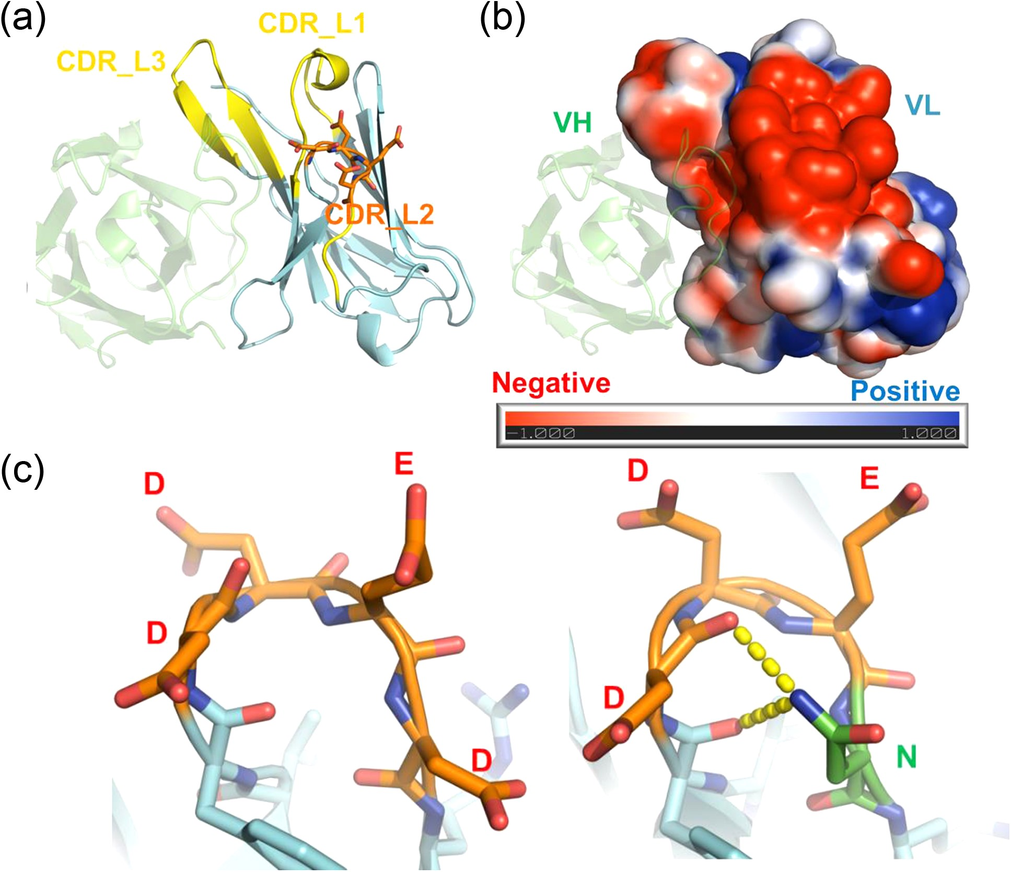
Fig. 4 Structural analysis of Ab001 Fv. (a) Antibody homology model of the Ab001 Fv region built using the closest ...
Notes:
Fig. 4 Structural analysis of Ab001 Fv. (a) Antibody homology model of the Ab001 Fv region built using the closest structural templates. The residues on the tip of VL CDR2 are shown in stick representation. (b) The surface charge distribution is displayed on the light chain. (c) Representative structures were drawn from molecular dynamics simulations of wild-type light chain (bottom left) and the D53N mutant (bottom right). The residues of interest (50–53) in Kabat numbering) on the VL CDR2 are shown as sticks and ribbons to display more atomic details of their interactions.
Unless provided in the caption above, the following copyright applies to the content of this slide: © The Author 2017. Published by Oxford University Press. All rights reserved. For Permissions, please e-mail: journals.permissions@oup.com

Slide 5
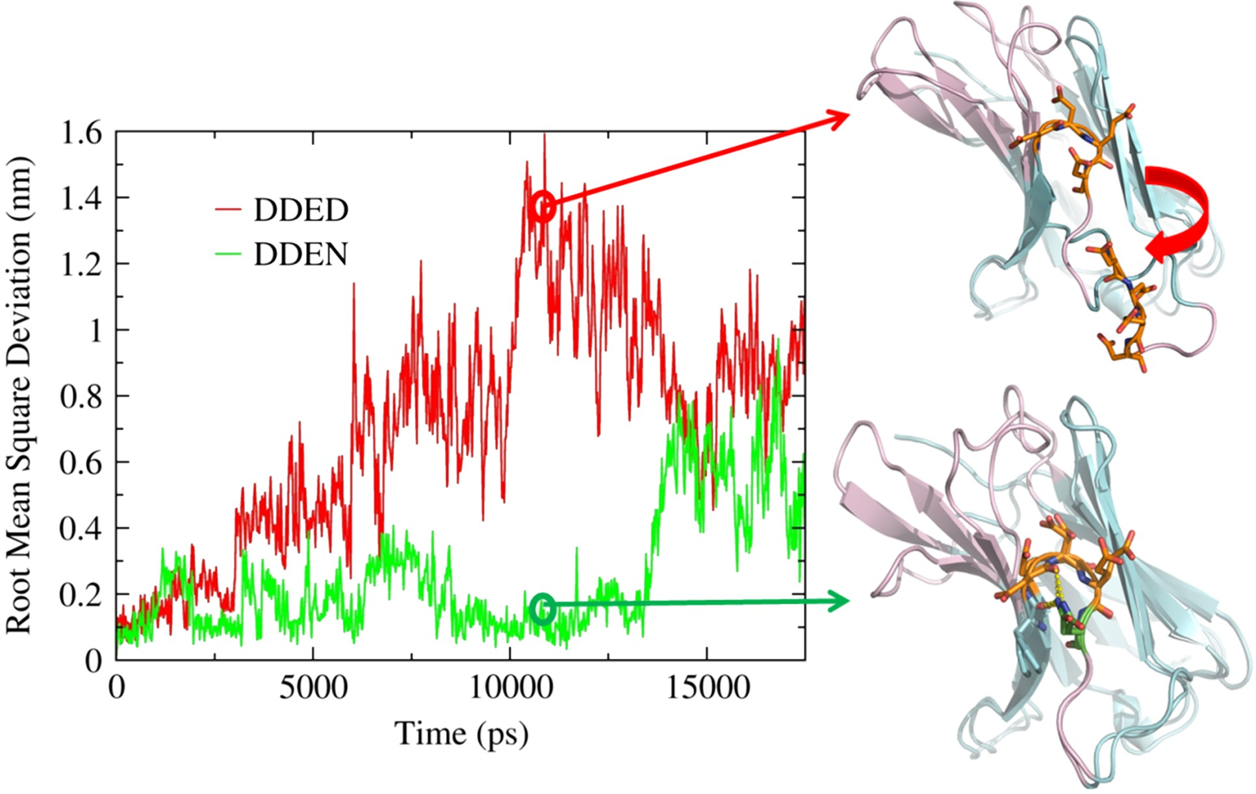
Fig. 5 Monitoring structural changes of V_{L} CDR2 during MD by computing the RMSDs. The instantaneous RMSD ...
Notes:
Fig. 5 Monitoring structural changes of VL CDR2 during MD by computing the RMSDs. The instantaneous RMSD of VL CDR2 backbones of the wild-type (top line) and D53N mutant (bottom line) system, relative to their respective starting configuration, during the thermal-stress simulation. The cartoon representations of the antibody light chains are the snapshots selected from the simulations. The representations are superimposed on their starting form to emphasize the structural deviations of the VL CDR2 loop.
Unless provided in the caption above, the following copyright applies to the content of this slide: © The Author 2017. Published by Oxford University Press. All rights reserved. For Permissions, please e-mail: journals.permissions@oup.com

Slide 6
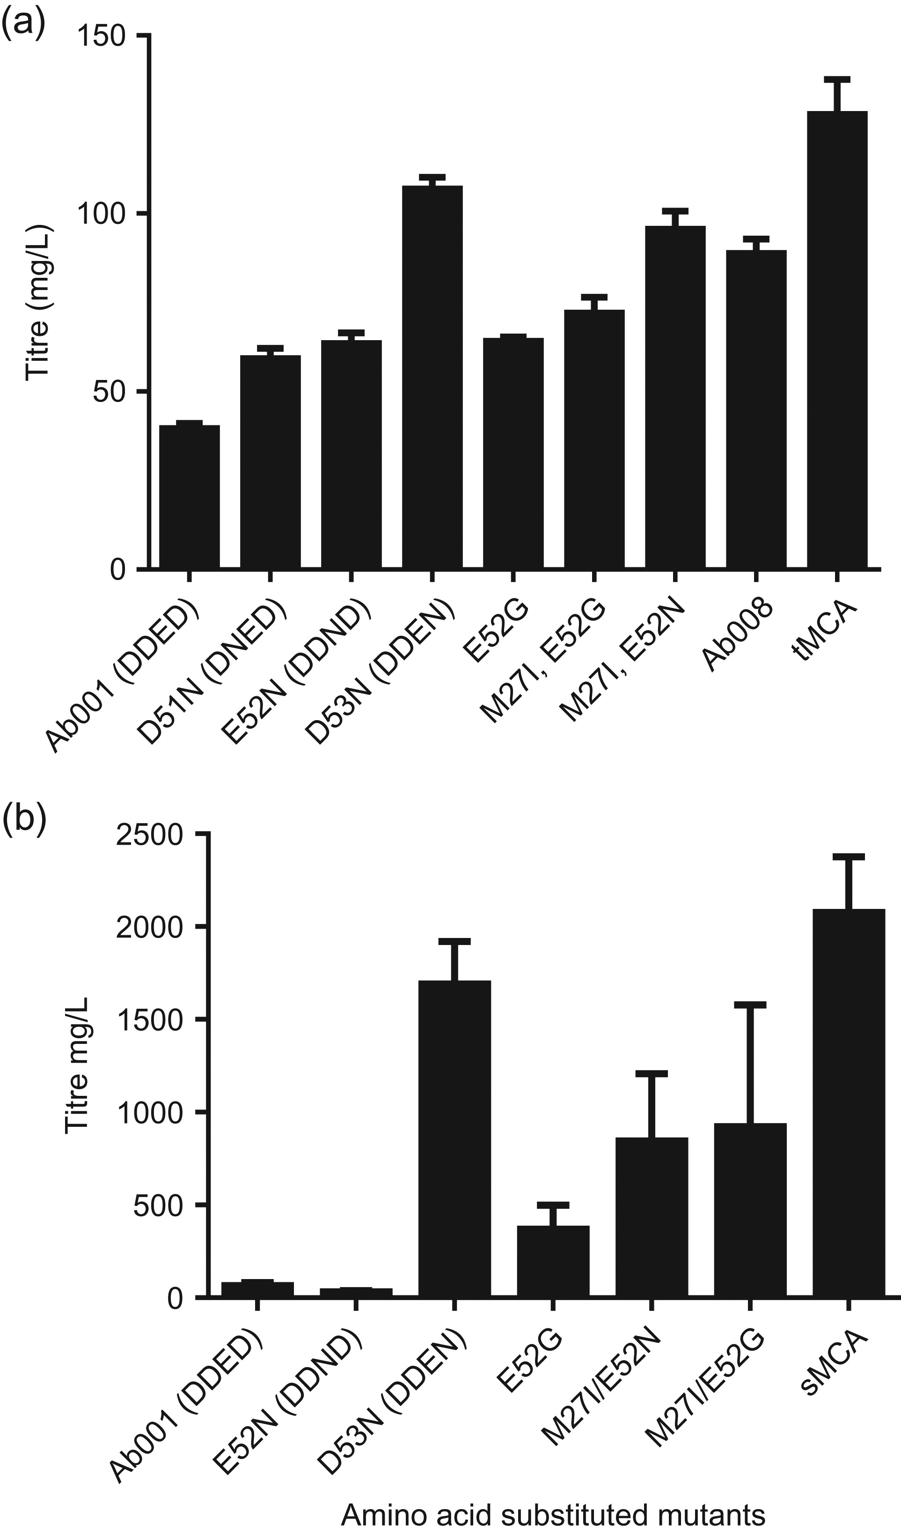
Fig. 6 Expression of structural design and reversion mutants. (a) Titers from CHO transient transfections with ...
Notes:
Fig. 6 Expression of structural design and reversion mutants. (a) Titers from CHO transient transfections with various Ab001 mutants and the tMCA. Synergistic expression improvements were observed when the M27I reversion mutant was combined with either E52G (reversion mutant) or E52N (structural design mutant). All mutants exhibited improved expression compared with unmodified Ab001 VL. (b) Stable expression testing of variants with the sMCA. Synergistic expression improvements were observed when the M27I reversion mutant was combined with either E52G (reversion mutant) or E52N (structural design mutant). All experiments were performed in biological replicates of n = 3 except for sMCA and E52N, which were performed in biological replicates of n = 2.
Unless provided in the caption above, the following copyright applies to the content of this slide: © The Author 2017. Published by Oxford University Press. All rights reserved. For Permissions, please e-mail: journals.permissions@oup.com

Slide 7
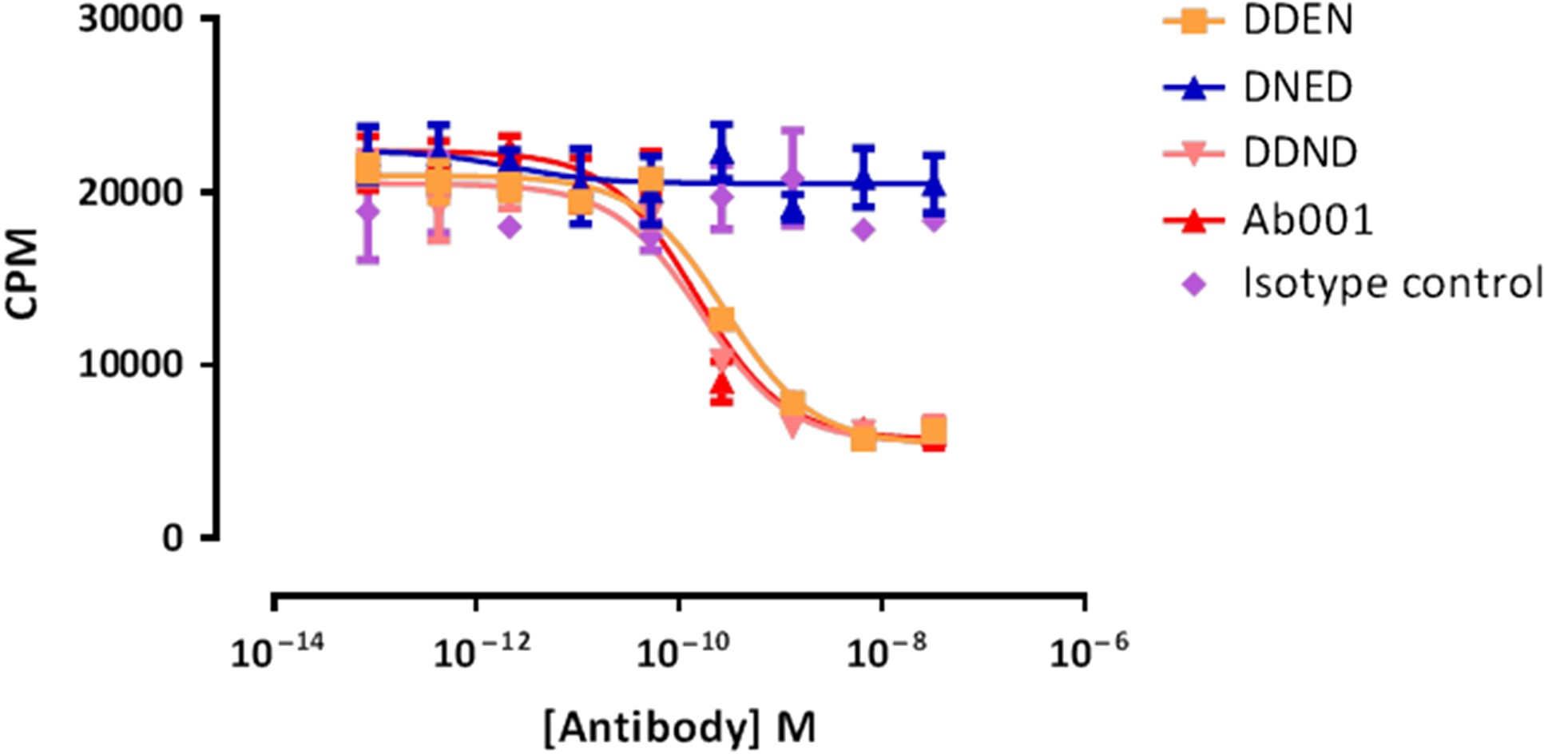
Fig. 7 TF1 proliferation assay testing the ability of anti-IL-13 antibody mutants to inhibit IL-13-driven ...
Notes:
Fig. 7 TF1 proliferation assay testing the ability of anti-IL-13 antibody mutants to inhibit IL-13-driven proliferation. Each line represents the titration curve for a single antibody species, and each data point represents a mean ± SD of assay duplicates. Representative data from a single experiment is presented from a series of three independent experiments. CPM, counts per minute.
Unless provided in the caption above, the following copyright applies to the content of this slide: © The Author 2017. Published by Oxford University Press. All rights reserved. For Permissions, please e-mail: journals.permissions@oup.com

