Slide 1
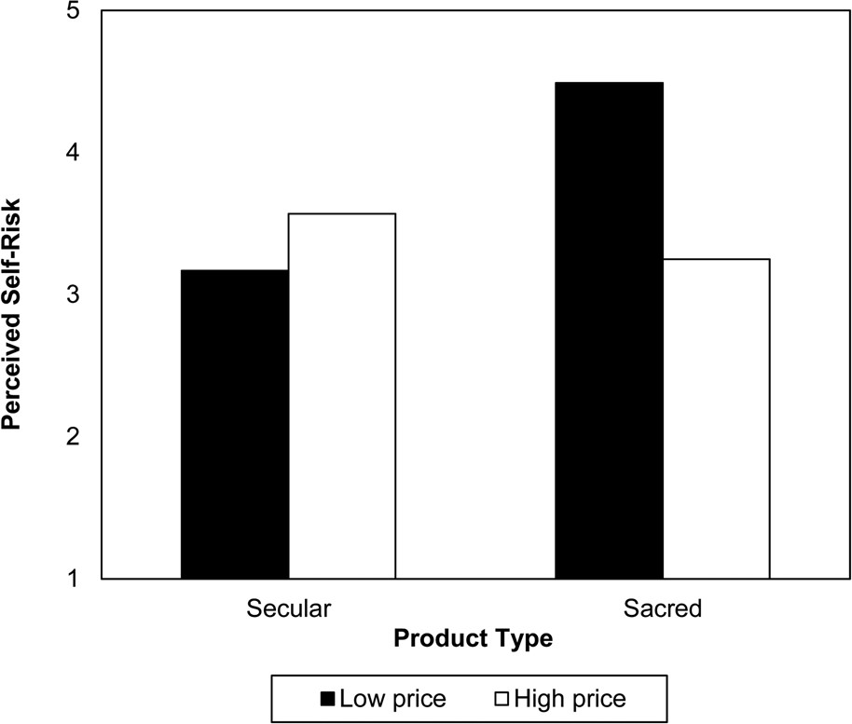
Figure 1. Study 1: Perceived Self-Risk of Age Spots (Secular)/Skin Cancer (Sacred) as a Function of Product Type and ...
Notes:
Figure 1. Study 1: Perceived Self-Risk of Age Spots (Secular)/Skin Cancer (Sacred) as a Function of Product Type and Price
Unless provided in the caption above, the following copyright applies to the content of this slide: © 2012 by JOURNAL OF CONSUMER RESEARCH, Inc.

Slide 2
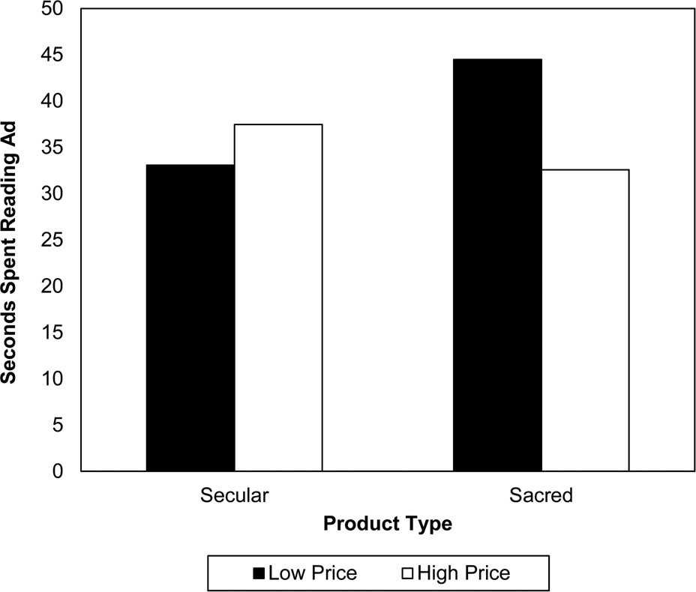
Figure 2. Study 2: Amount of Time Spent Reading Pharmaceutical Advertisement as a Function of Product Type and Price
Notes:
Figure 2. Study 2: Amount of Time Spent Reading Pharmaceutical Advertisement as a Function of Product Type and Price
Unless provided in the caption above, the following copyright applies to the content of this slide: © 2012 by JOURNAL OF CONSUMER RESEARCH, Inc.

Slide 3
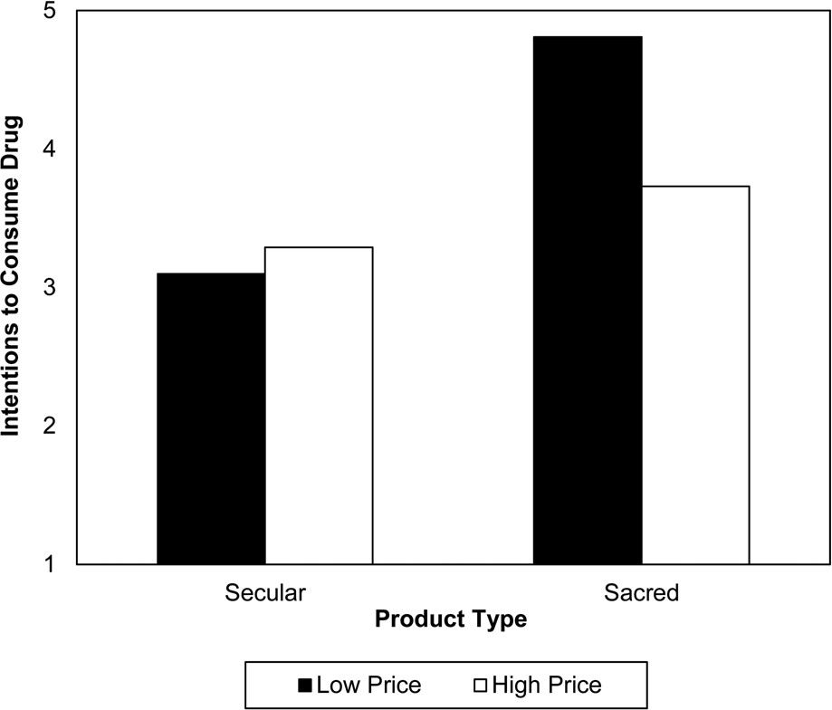
Figure 3. Study 2: Intentions to Consume Drug as a Function of Product Type and Price
Notes:
Figure 3. Study 2: Intentions to Consume Drug as a Function of Product Type and Price
Unless provided in the caption above, the following copyright applies to the content of this slide: © 2012 by JOURNAL OF CONSUMER RESEARCH, Inc.

Slide 4
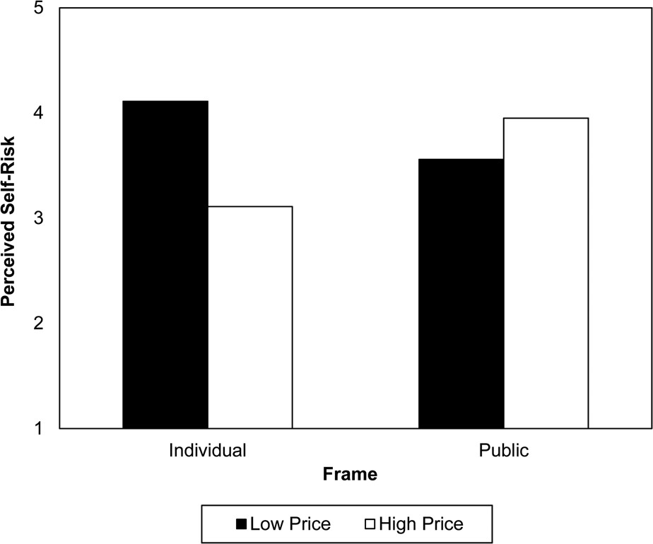
Figure 4. Study 3: Perceived Self-Risk as a Function of Health Frame and Price
Notes:
Figure 4. Study 3: Perceived Self-Risk as a Function of Health Frame and Price
Unless provided in the caption above, the following copyright applies to the content of this slide: © 2012 by JOURNAL OF CONSUMER RESEARCH, Inc.

Slide 5
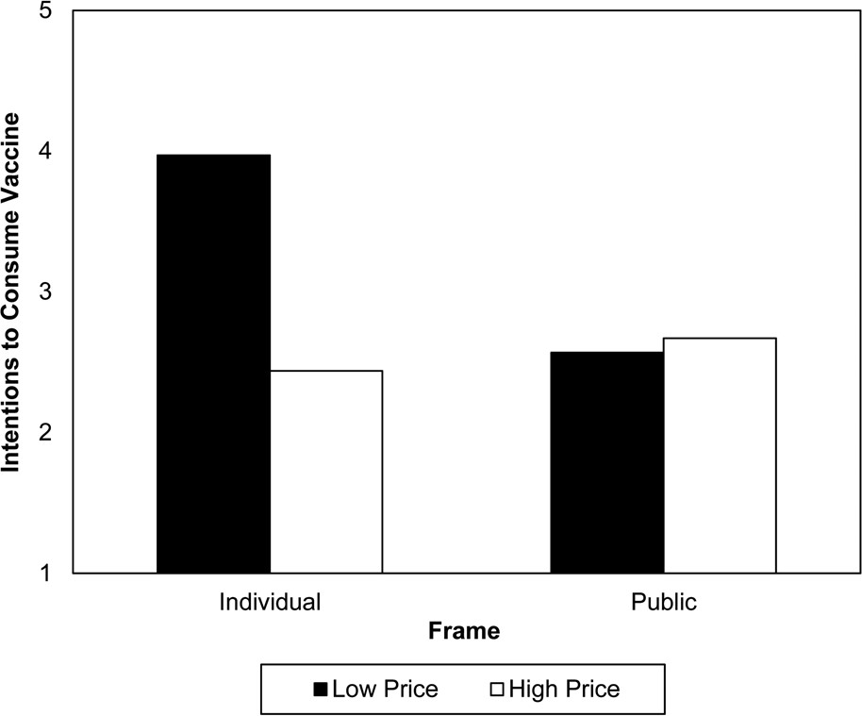
Figure 5. Study 3: Vaccine Consumption Intentions as a Function of Health Frame and Price
Notes:
Figure 5. Study 3: Vaccine Consumption Intentions as a Function of Health Frame and Price
Unless provided in the caption above, the following copyright applies to the content of this slide: © 2012 by JOURNAL OF CONSUMER RESEARCH, Inc.

Slide 6
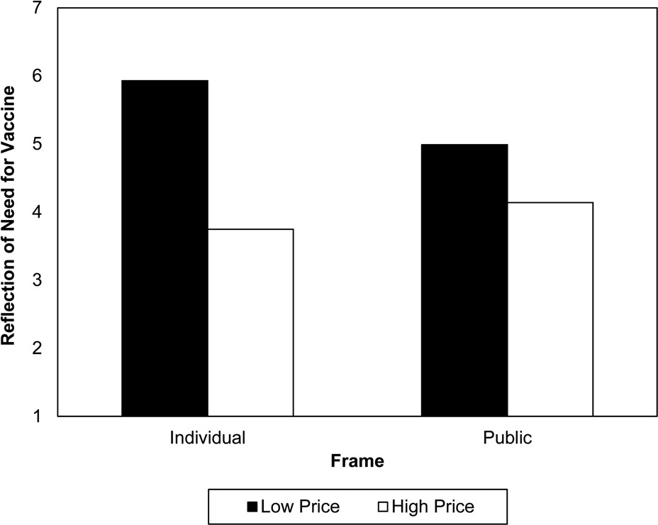
Figure 6. Study 3: Extent to Which Vaccine Price Reflects Need for Vaccine as a Function of Health Frame and Price
Notes:
Figure 6. Study 3: Extent to Which Vaccine Price Reflects Need for Vaccine as a Function of Health Frame and Price
Unless provided in the caption above, the following copyright applies to the content of this slide: © 2012 by JOURNAL OF CONSUMER RESEARCH, Inc.

Slide 7
Notes:
Unless provided in the caption above, the following copyright applies to the content of this slide: © 2012 by JOURNAL OF CONSUMER RESEARCH, Inc.

