Slide 1
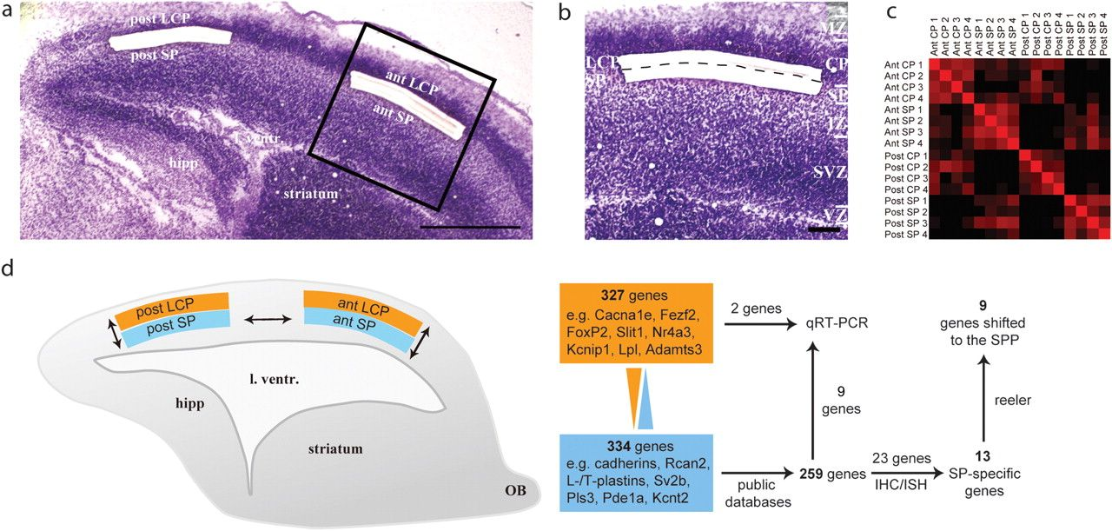
Figure 1. Overview of the experimental approach. Four cell populations were isolated by laser capture microdissection ...
Notes:
Figure 1. Overview of the experimental approach. Four cell populations were isolated by laser capture microdissection in 4 replicates, and gene expression was compared using microarrays. (a) Cresyl violet-stained cryosection after subplate (SP) and lower cortical plate (LCP) from anterior (ant) and posterior (post) cortex have been isolated. (b) High magnification of the anterior cortex showing the border between SP and LCP. (c) Heatmap of the correlation analysis across all 16 samples. Bright red squares denote a Pearson correlation coefficient of 1 and black squares a coefficient of 0. The heatmap indicates that the strongest correlations are between replicates of the same cell populations. (d) Transcript levels were compared between the ant SP and ant LCP and between the post SP and post LCP. 327 genes were more highly expressed in the SP and 334 were more highly expressed in the LCP. Based on public available datasets, 75 genes were excluded as false positives. Out of 23 selected genes, 13 were confirmed as specifically expressed in SP using IHC (IHC) or in situ hybridization (ISH). Scale bars: 500μm (a), and 100 μm (b). hipp, hippocampus; l. ventr, lateral ventricle; MZ, marginal zone; OB, olfactory bulb.
Unless provided in the caption above, the following copyright applies to the content of this slide: © The Author 2011. Published by Oxford University Press. All rights reserved. For permissions, please e-mail: journals.permissions@oup.com

Slide 2
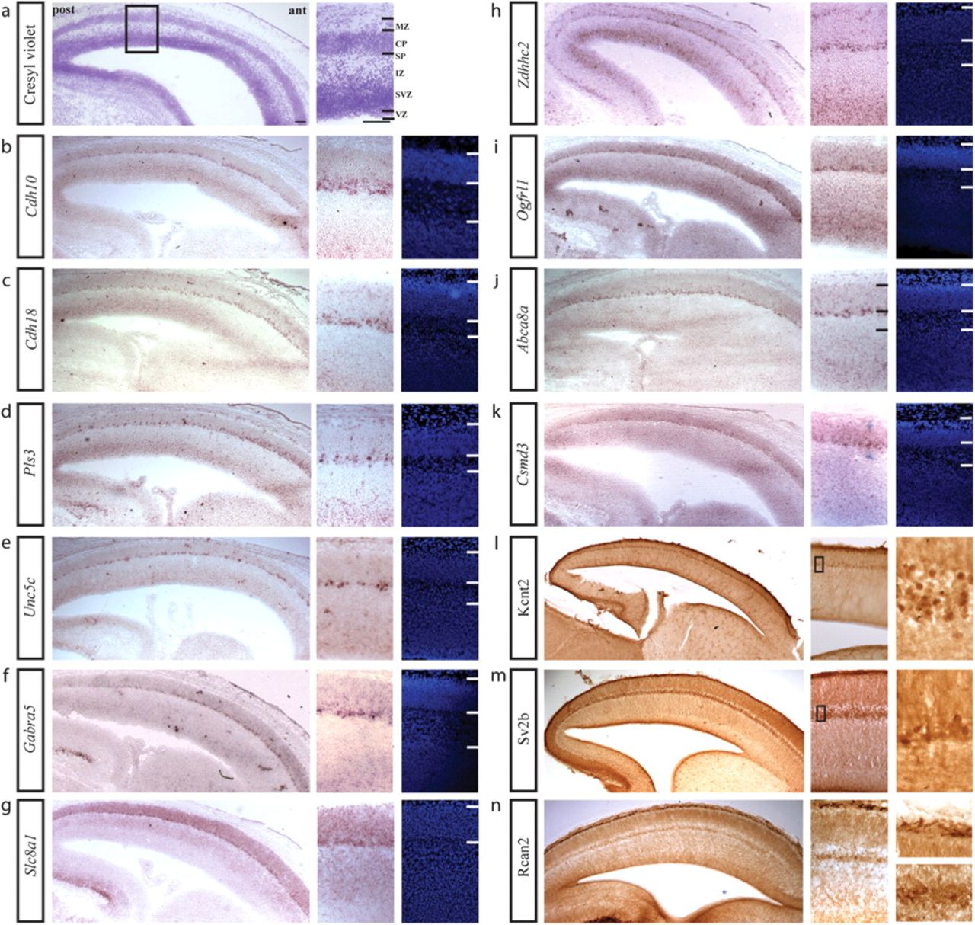
Figure 2. Genes with subplate-specific expression in the E15.5 cortex. In situ hybridization (b–k) or IHC (l–n) signals ...
Notes:
Figure 2. Genes with subplate-specific expression in the E15.5 cortex. In situ hybridization (b–k) or IHC (l–n) signals for 13 genes, which are expressed in the E15.5 subplate (SP) but not in the overlying cortical plate (CP). Kcnt2 (l) and Rcan2 (n) show additional expression in the marginal zone (MZ). A cresyl violet-stained section is shown for reference (a). The rightmost panels in (b–k) show DAPI counterstains of the same area as shown in the middle panels. Scale bars:100μm.
Unless provided in the caption above, the following copyright applies to the content of this slide: © The Author 2011. Published by Oxford University Press. All rights reserved. For permissions, please e-mail: journals.permissions@oup.com

Slide 3
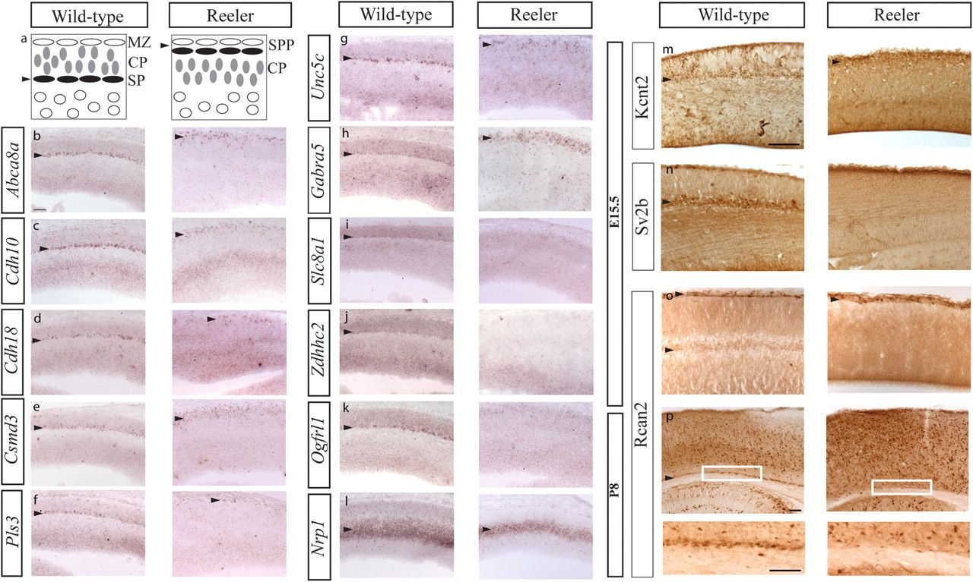
Figure 3. Shifted expression of subplate-specific genes in the reeler cortex. (a) Schema illustrating the inverted ...
Notes:
Figure 3. Shifted expression of subplate-specific genes in the reeler cortex. (a) Schema illustrating the inverted relative position of subplate (SP) and cortical plate (CP) cells in the reeler mutant. In the reeler, the preplate fails to split and remains at the top of the cortical wall as the superplate (SPP). (b–l) In situ hybridization signals in the reeler and wild-type E15.5 cortex. (m–p) Immunohistochemistry signals in the E15.5 (m–o) and P8 (p) reeler and wild-type cortex. Out of 13 genes with SP-specific expression in the wild-type cortex, 9 are expressed in the SPP in the reeler cortex (b–h, m, o). For the remaining 4 genes (i–k, n), no clear expression pattern is visible in the reeler brain. In contrast, the expression pattern of Nrp1 (l), which is primarily localized in the IZ in the wild-type cortex, remains in the same position in the reeler cortex. Scale bars:100μm.
Unless provided in the caption above, the following copyright applies to the content of this slide: © The Author 2011. Published by Oxford University Press. All rights reserved. For permissions, please e-mail: journals.permissions@oup.com

Slide 4
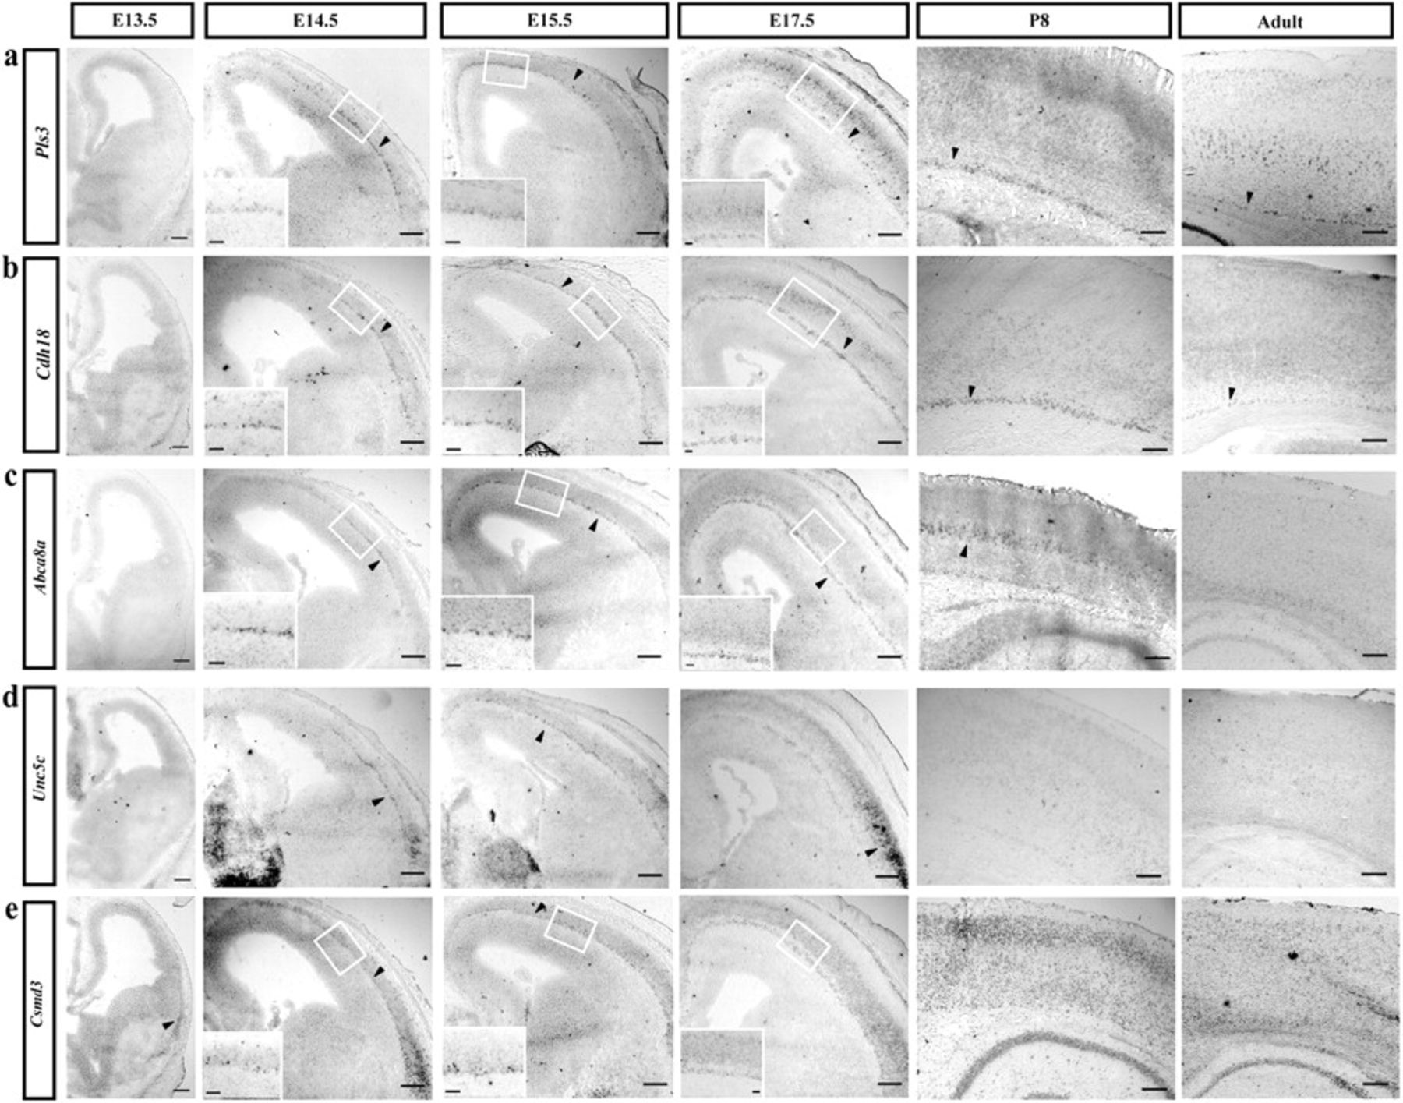
Figure 4. Developmental time course of expression of Pls3, Cdh18, Abca8a, Unc5c, and Csmd3. In situ hybridization ...
Notes:
Figure 4. Developmental time course of expression of Pls3, Cdh18, Abca8a, Unc5c, and Csmd3. In situ hybridization signals in the E13.5, E14.5, E15.5, E17.5, P8, and adult neocortex. At E13.5, only Csmd3 is expressed in the lateral cortex (arrowhead). At E14.5 and E15.5, all genes are specifically expressed in the subplate. At E17.5, Abca8a is still specifically expressed in the subplate (c), while Pls3(a) and Cdh18 (b) are expressed in the subplate and upper cortical plate. Unc5c is primarily expressed in the lateral cortical plate (d) and Csmd3 is ubiquitously expressed (e). In postnatal and adult cortex, strong expression of Pls3 (a) and Cdh18 (b) is still visible in subplate. At P8, Abca8a (c) is specifically expressed in layer V, while in the adult, Abca8a expression is no longer visible. At both P8 and adult stages, Unc5c is no longer expressed (d), while Csmd3 is ubiquitously expressed (e). Scale bars: 200μm (panels); 50μm (insets).
Unless provided in the caption above, the following copyright applies to the content of this slide: © The Author 2011. Published by Oxford University Press. All rights reserved. For permissions, please e-mail: journals.permissions@oup.com

Slide 5
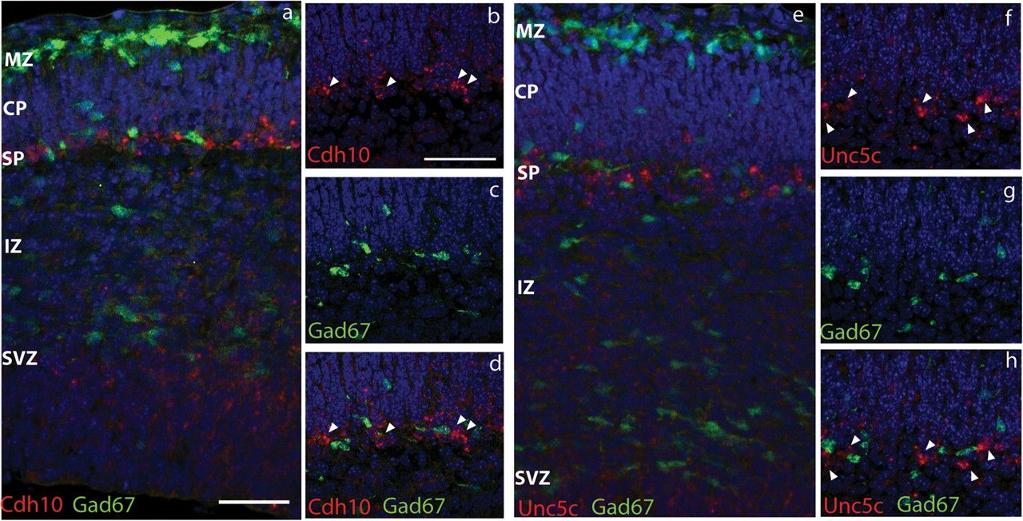
Figure 5. Expression of Cdh10 and Unc5c in the Gad67-GFP cortex. In situ hybridization against Cdh10 (a–d) and Unc5c ...
Notes:
Figure 5. Expression of Cdh10 and Unc5c in the Gad67-GFP cortex. In situ hybridization against Cdh10 (a–d) and Unc5c (e–h) was performed on sections of Gad67-GFP E15.5 cortices. GFP-positive cells are localized in the marginal zone (MZ), in the subplate (SP), and at the border between the IZ and SVZ corresponding to the 3 routes of interneuron migration (a, e). Cdh10-positive cells (a–d; arrowheads) and Unc5c-positive cells (e–h; arrowheads) are localized in the SP. No colocalization was observed between Cdh10 (red; arrowheads) and Gad67-GFP (green) (d) and between Unc5c (red; arrowheads) and Gad67-GFP (green) (h), respectively. Scale bars: 50μm.
Unless provided in the caption above, the following copyright applies to the content of this slide: © The Author 2011. Published by Oxford University Press. All rights reserved. For permissions, please e-mail: journals.permissions@oup.com

Slide 6
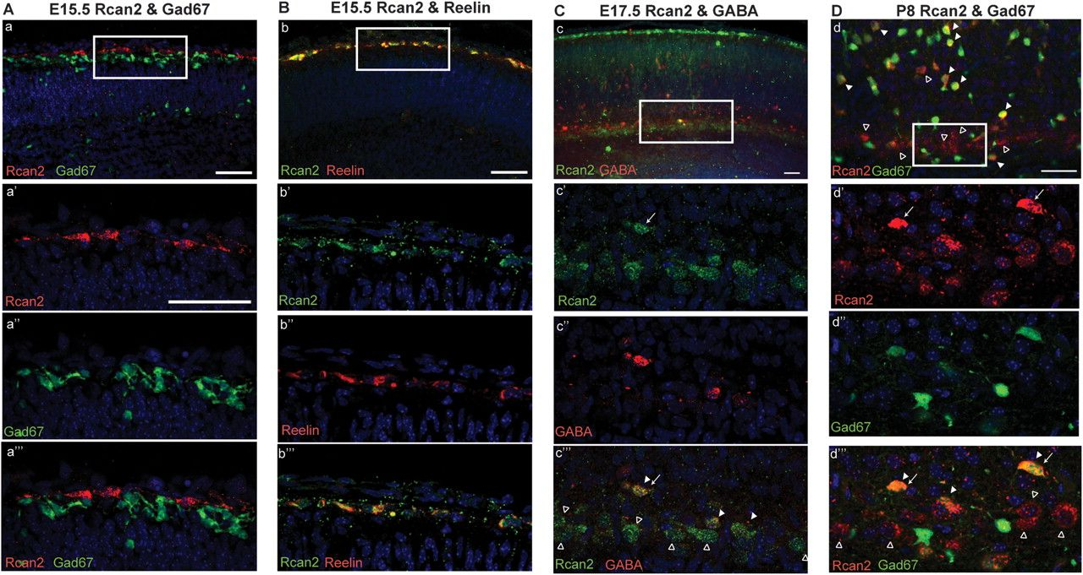
Figure 6. Colocalization between Rcan2, Gad67-GFP/GABA, and Reelin. (A) In the E15.5 cortex, IHC against Rcan2 ...
Notes:
Figure 6. Colocalization between Rcan2, Gad67-GFP/GABA, and Reelin. (A) In the E15.5 cortex, IHC against Rcan2 primarily labels horizontally orientated cells at the outer edge of the marginal zone (red, a, a′). The Rcan2-positive cells are a distinct population from the Gad67-GFP–positive cells (green, a, a′′), which are localized at the inner edge of the marginal zone (a′′′). (B) The Rcan2-positive cells in the E15.5 marginal zone (green, b′) coexpress reelin protein (red, b,b′′,b′′′). (C) At E17.5, Rcan2 is primarily expressed in the marginal zone and the subplate (green, c, c′). Sparse Rcan2-positive cells are also found within the cortical plate (arrow in c′ and c′′′). In the subplate, only a small proportion of Rcan2-positive cells coexpresses GABA (red, c′′′). (D) In the P8 cortex, strongly labeled Rcan2-positive cells are found dispersed in all layers (red, d). A band of moderately labeled Rcan2-positive cells is localized within the subplate (d, d′). Only few Rcan2-positive cells in the subplate coexpress Gad67-GFP (green, d, d′′′). In contrast, most Rcan2-positive cells outside of subplate (arrows in d and d′′′) are positive for Gad67-GFP (d, d′′′). Empty arrowheads point to single-labeled Rcan2-positive cells and filled arrowheads to double-labeled Rcan2-positive cells. Scale bars: 50μm.
Unless provided in the caption above, the following copyright applies to the content of this slide: © The Author 2011. Published by Oxford University Press. All rights reserved. For permissions, please e-mail: journals.permissions@oup.com

