Slide 1
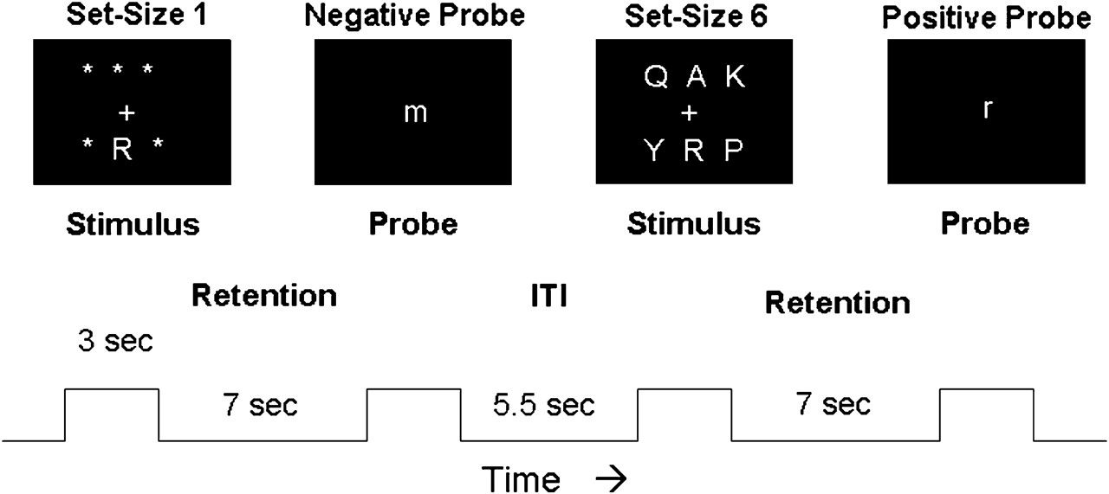
Figure 1. Schematic diagram of the DMS paradigm. Two trials are shown, the 1st with a set size of 1 and requiring a ...
Notes:
Figure 1. Schematic diagram of the DMS paradigm. Two trials are shown, the 1st with a set size of 1 and requiring a “no” response and the 2nd with a set size of 6 and requiring a “yes” response. The trial phases and their durations are listed beneath (ITI = intertrial interval).
Unless provided in the caption above, the following copyright applies to the content of this slide: © The Author 2008. Published by Oxford University Press. All rights reserved. For permissions, please e-mail: journals.permissions@oxfordjournals.org

Slide 2
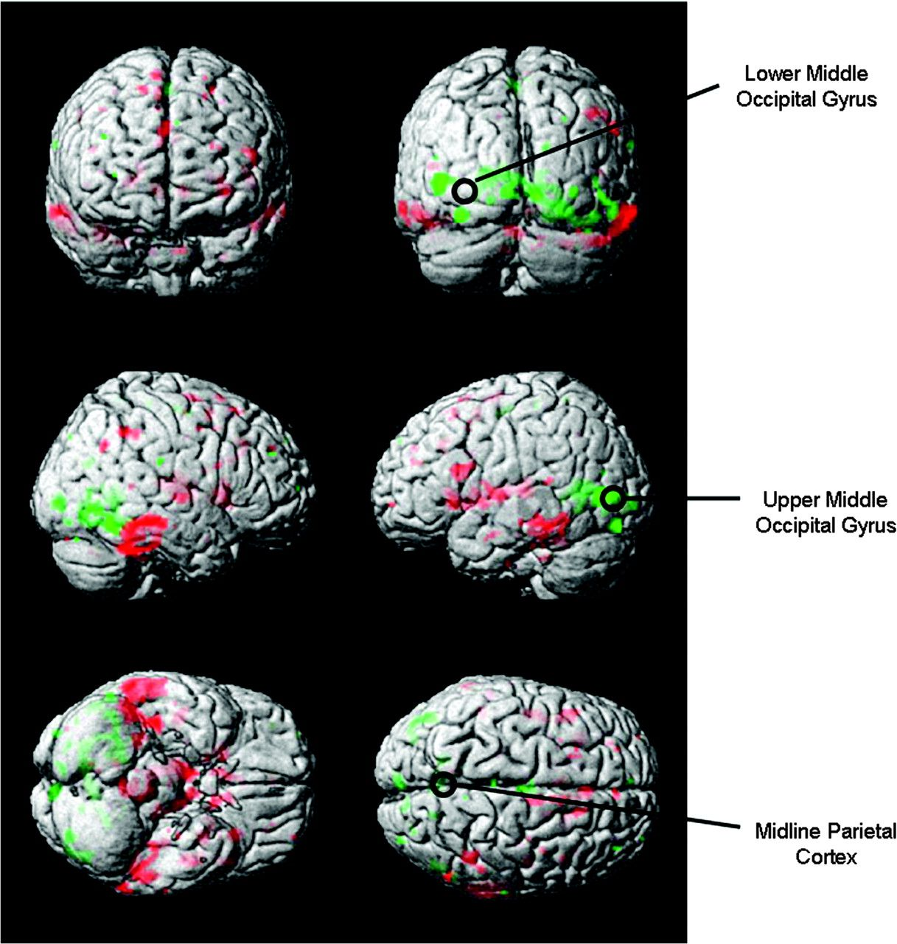
Figure 2. Surface rendered projections of brain regions whose associated activation changed in most subjects from pre- ...
Notes:
Figure 2. Surface rendered projections of brain regions whose associated activation changed in most subjects from pre- to postsleep deprivation in a previous study (Habeck et al. 2004). Green indicates areas going down in activation with sleep deprivation. Red indicates areas going up in activation with sleep deprivation. The circles mark the 3 rTMS targets.
Unless provided in the caption above, the following copyright applies to the content of this slide: © The Author 2008. Published by Oxford University Press. All rights reserved. For permissions, please e-mail: journals.permissions@oxfordjournals.org

Slide 3
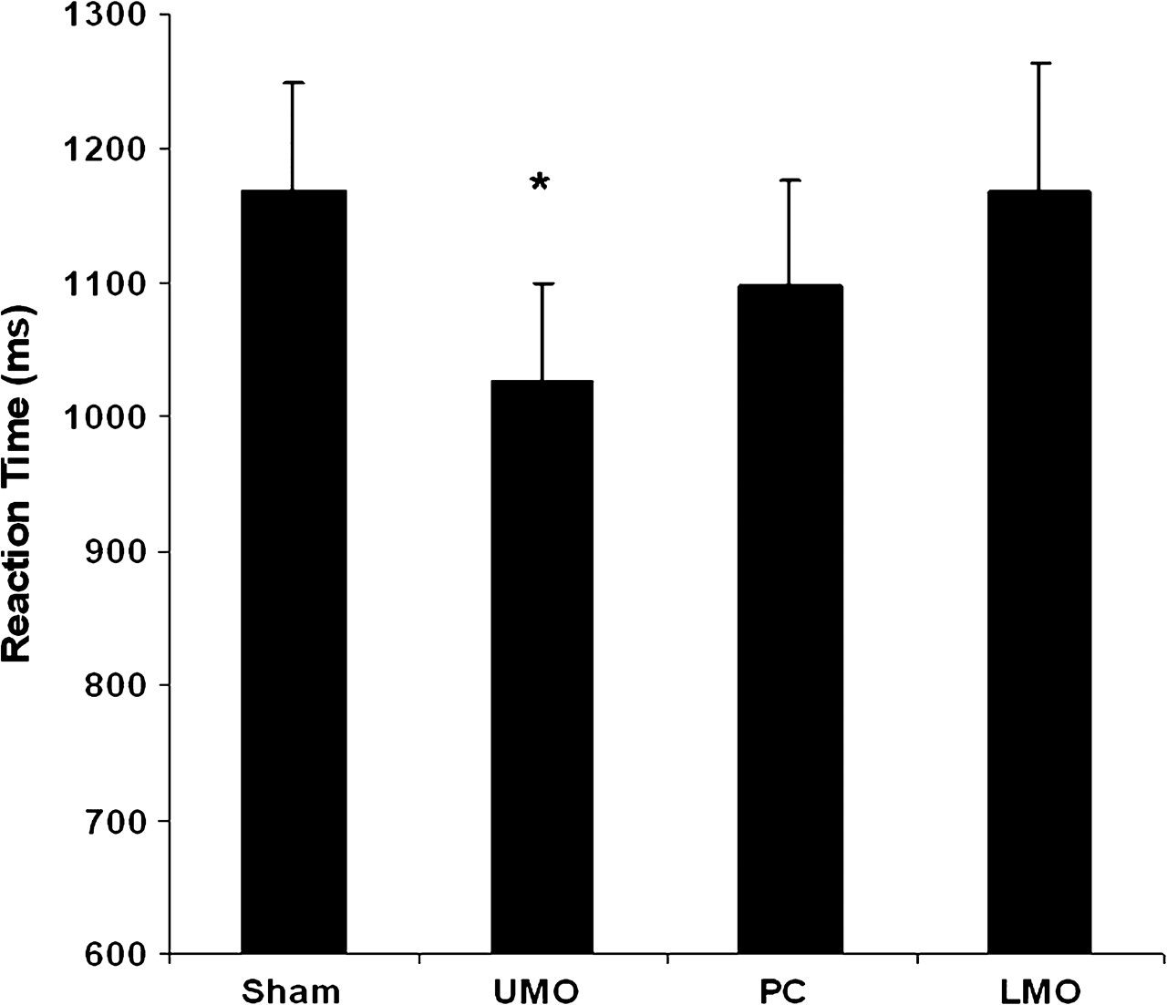
Figure 3. Mean RT in the sleep-deprived group at set size 6 with active TMS at 3 scalp locations and for sham TMS. *P < ...
Notes:
Figure 3. Mean RT in the sleep-deprived group at set size 6 with active TMS at 3 scalp locations and for sham TMS. *P < 0.005.
Unless provided in the caption above, the following copyright applies to the content of this slide: © The Author 2008. Published by Oxford University Press. All rights reserved. For permissions, please e-mail: journals.permissions@oxfordjournals.org

Slide 4
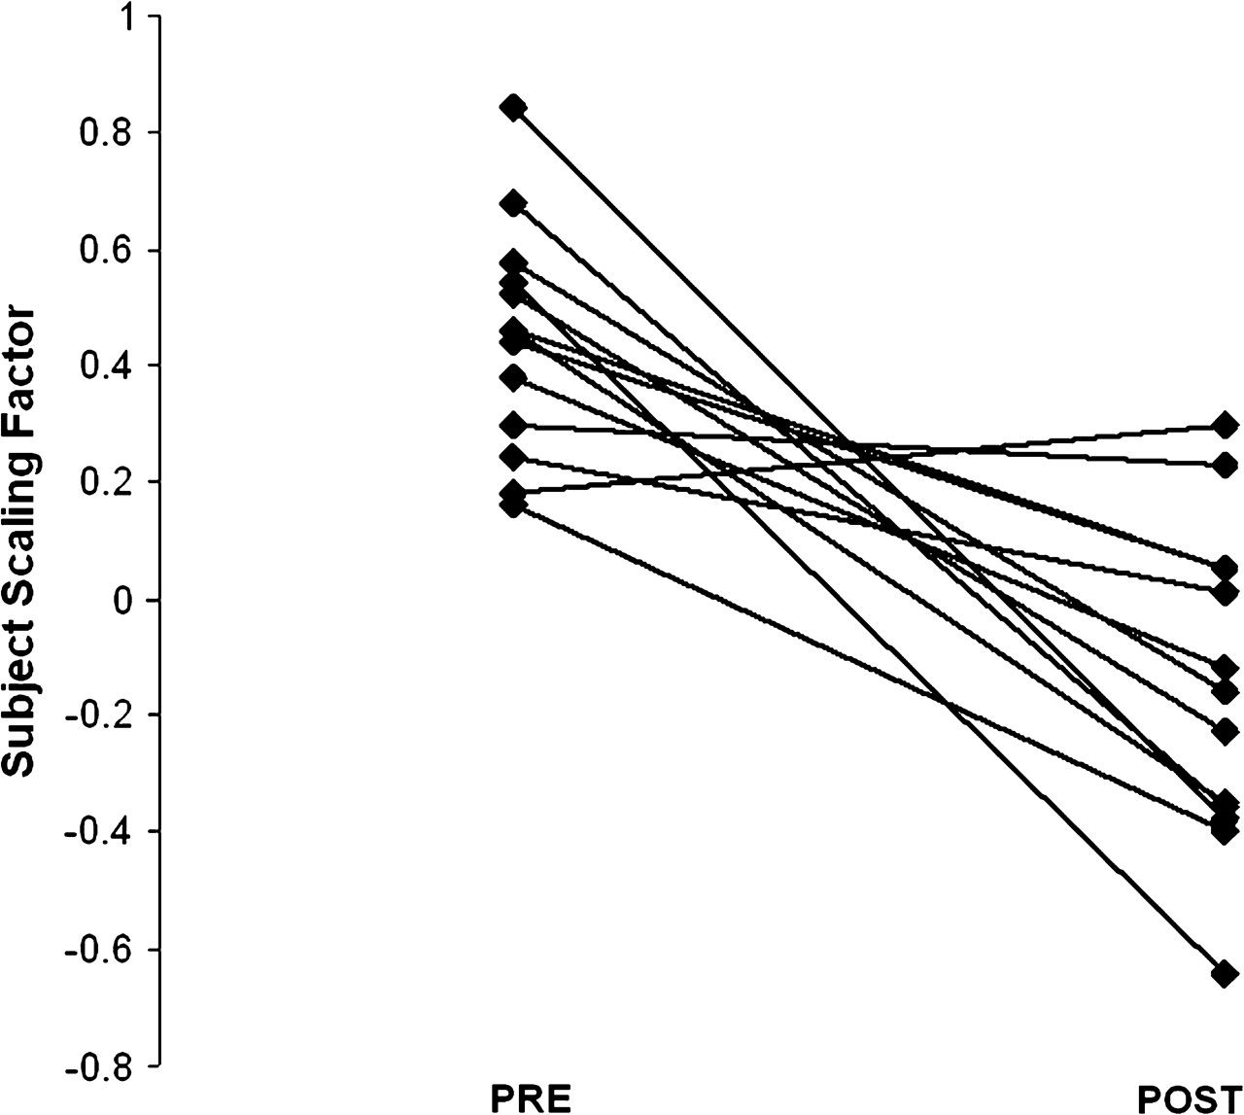
Figure 4. Subject expression of the pattern resulting from the OrT analysis: 12/13 subjects decreased their expression ...
Notes:
Figure 4. Subject expression of the pattern resulting from the OrT analysis: 12/13 subjects decreased their expression of the activation pattern.
Unless provided in the caption above, the following copyright applies to the content of this slide: © The Author 2008. Published by Oxford University Press. All rights reserved. For permissions, please e-mail: journals.permissions@oxfordjournals.org

Slide 5
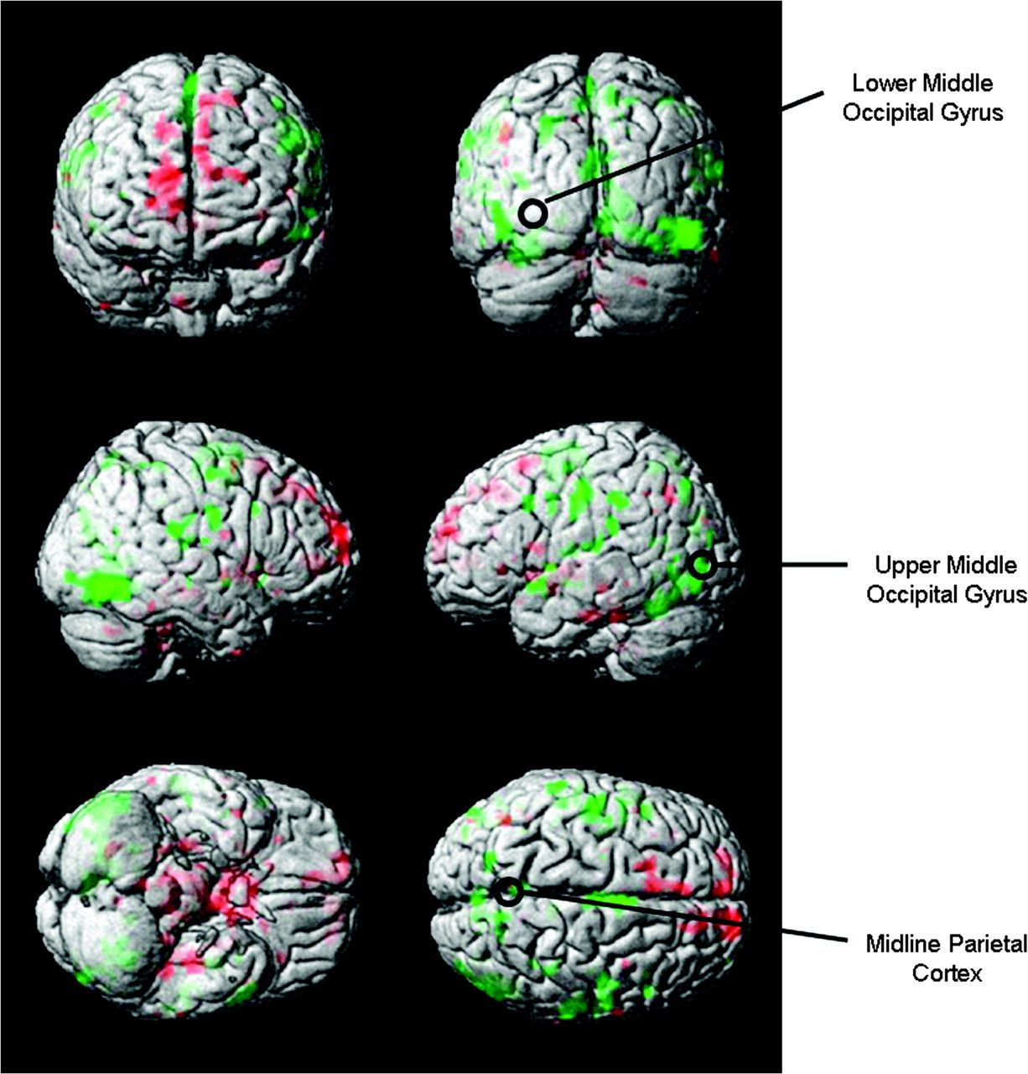
Figure 5. Surface rendered projections of brain regions whose associated activation changed in most subjects of the ...
Notes:
Figure 5. Surface rendered projections of brain regions whose associated activation changed in most subjects of the present study from pre- to postsleep deprivation. Green indicates areas going down in activation with sleep deprivation. Red indicates areas going up in activation with sleep deprivation. The circles mark the 3 rTMS targets.
Unless provided in the caption above, the following copyright applies to the content of this slide: © The Author 2008. Published by Oxford University Press. All rights reserved. For permissions, please e-mail: journals.permissions@oxfordjournals.org

Slide 6
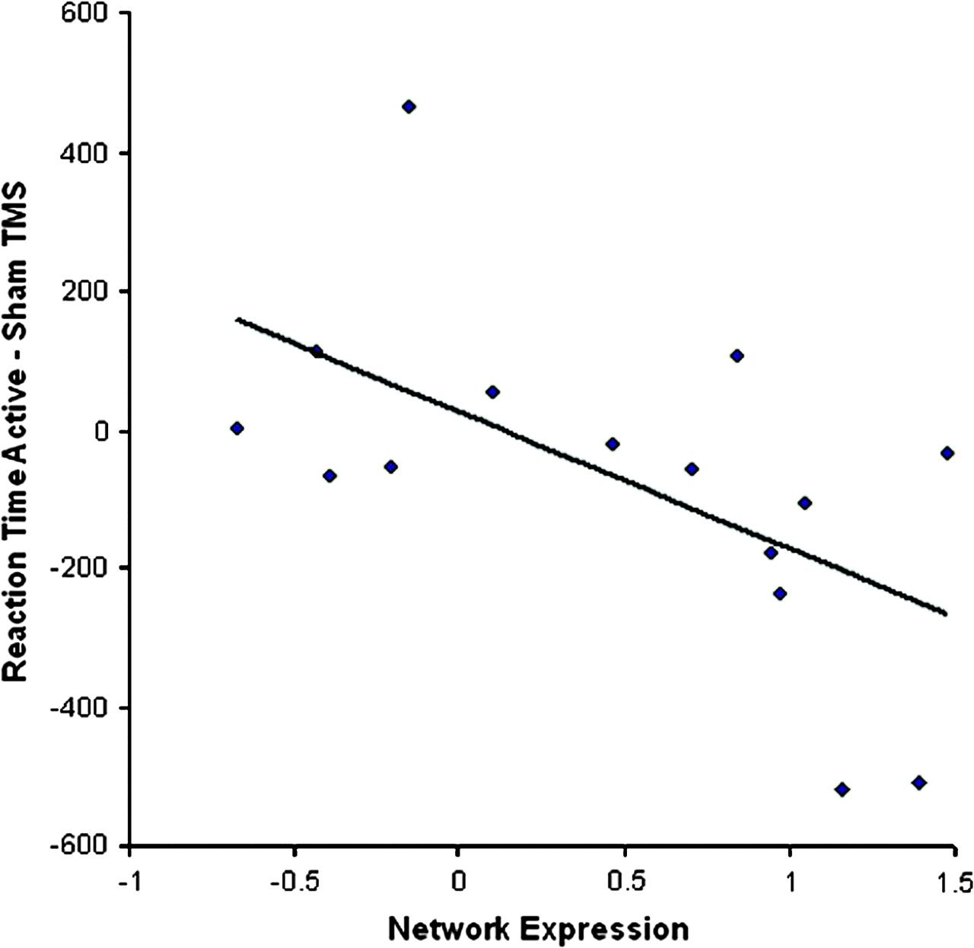
Figure 6. The improvement of RT between active TMS to UMO and sham TMS correlates (r = −0.58, P < 0.025) with the ...
Notes:
Figure 6. The improvement of RT between active TMS to UMO and sham TMS correlates (r = −0.58, P < 0.025) with the degree to which fMRI network expression is depressed following sleep deprivation.
Unless provided in the caption above, the following copyright applies to the content of this slide: © The Author 2008. Published by Oxford University Press. All rights reserved. For permissions, please e-mail: journals.permissions@oxfordjournals.org

