Slide 1
Figure 1. Sequence alignment of ABDs from filamins and homologous proteins showing the distribution of ...
Notes:
Figure 1. Sequence alignment of ABDs from filamins and homologous proteins showing the distribution of disease-associated missense mutations. Amino acids that are associated with disease are highlighted; red and yellow, PH and OPD spectrum disorders (Filamin_A), respectively; blue, atelosteogenesis disorders (Filamin_B); grey, focal segmental glomerulosclerosis (α_Actinin4); green, hereditary spherocytosis (β_Spectrin); magenta, Duchenne muscular dystrophy (Dystrophin). Residues conserved with the FLNA Lys169-Glu254 salt bridge are shown in red text. The secondary structure elements of FLNA are shown in blue above the alignment and are labelled.
Unless provided in the caption above, the following copyright applies to the content of this slide: © The Author 2009. Published by Oxford University Press. All rights reserved. For Permissions, please email: journals.permissions@oxfordjournals.org

Slide 2
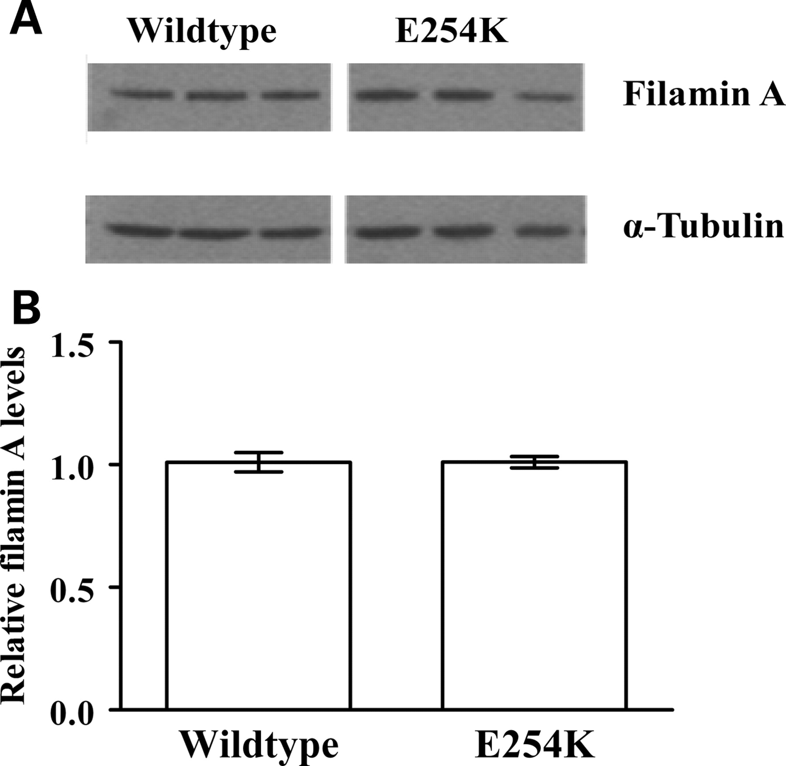
Figure 2. Expression of filamin A from OPD2 (E254K) patient cells. (A) Western blots of fibroblasts from an OPD2 ...
Notes:
Figure 2. Expression of filamin A from OPD2 (E254K) patient cells. (A) Western blots of fibroblasts from an OPD2 patient (FLNA E254K) and controls. (B) Densitometry of western blots. The FLNA concentration was normalized to the α-tubulin control and E254K is shown relative to the WT level. Error bars indicate SD from triplicate experiments.
Unless provided in the caption above, the following copyright applies to the content of this slide: © The Author 2009. Published by Oxford University Press. All rights reserved. For Permissions, please email: journals.permissions@oxfordjournals.org

Slide 3
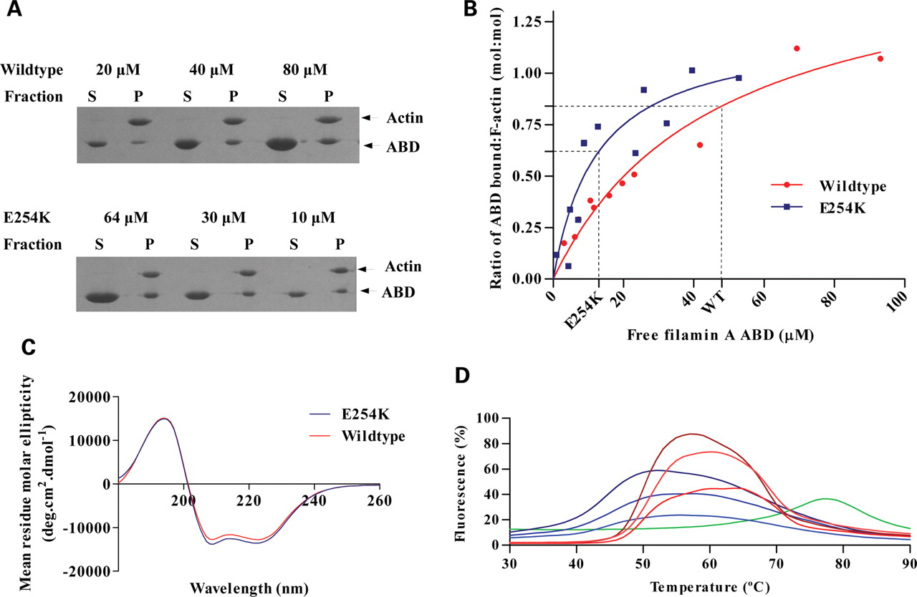
Figure 3. Comparison of E254K filamin A ABD in vitro properties with wild type (WT). (A) Representative 12% SDS–PAGE ...
Notes:
Figure 3. Comparison of E254K filamin A ABD in vitro properties with wild type (WT). (A) Representative 12% SDS–PAGE gels for WT and E254K ABD F-actin-binding assays. The total concentration of ABD included in the assay, and the supernatant (S) and pellet (P) fractions, are shown. (B) Binding curves for WT (red) and E254K (blue) ABDs with F-actin. The Kd of each protein is indicated with a dashed line; WT, 13 ± 5 µm and E254K, 48 ± 11 µm (±SEM). (C) Circular dichroism spectra of the FLNA WT (red) and E254K (blue) ABDs. (D) Differential scanning fluorimetry of FLNA ABDs. Triplicate melting curves are shown for WT (red) and E254K (blue). Lysozyme is included as a standard (green). The fluorescence of the samples is expressed as a percentage of the maximum signal (normalized to 100%).
Unless provided in the caption above, the following copyright applies to the content of this slide: © The Author 2009. Published by Oxford University Press. All rights reserved. For Permissions, please email: journals.permissions@oxfordjournals.org

Slide 4
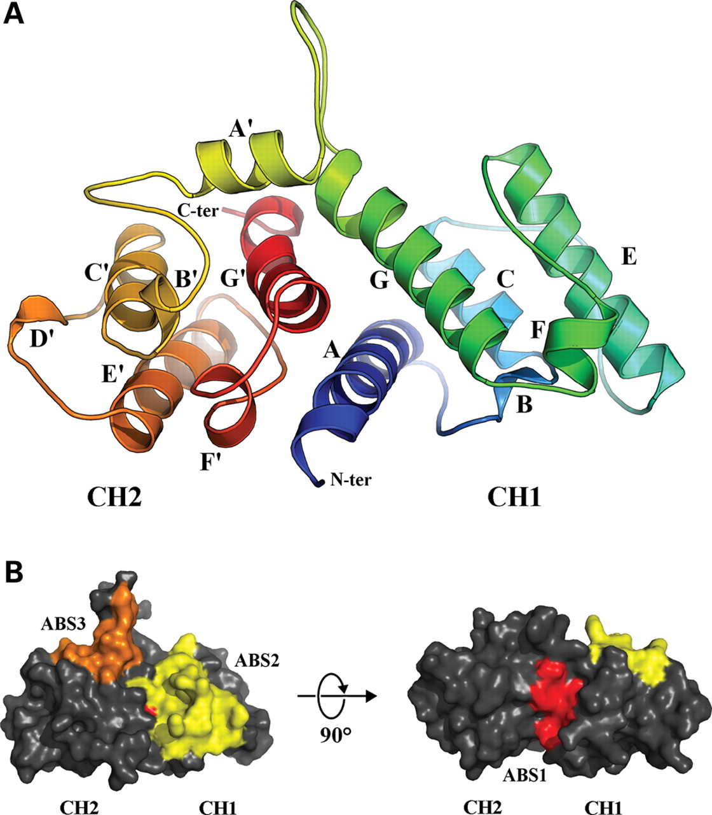
Figure 4. The structure of the filamin A actin-binding domain. (A) Cartoon representation of the FLNA ABD structure ...
Notes:
Figure 4. The structure of the filamin A actin-binding domain. (A) Cartoon representation of the FLNA ABD structure colour-coded from N-terminus (blue) to C-terminus (red). The CH1 α helices are labelled A–G, and CH2 A′–G'. (B) Surface representation of the FLNA ABD showing the three actin-binding sites: red, ABS1; yellow, ABS2; orange, ABS3. The ABD is shown in the same orientation as (A) (left) and rotated 90° about the x-axis (right).
Unless provided in the caption above, the following copyright applies to the content of this slide: © The Author 2009. Published by Oxford University Press. All rights reserved. For Permissions, please email: journals.permissions@oxfordjournals.org

Slide 5
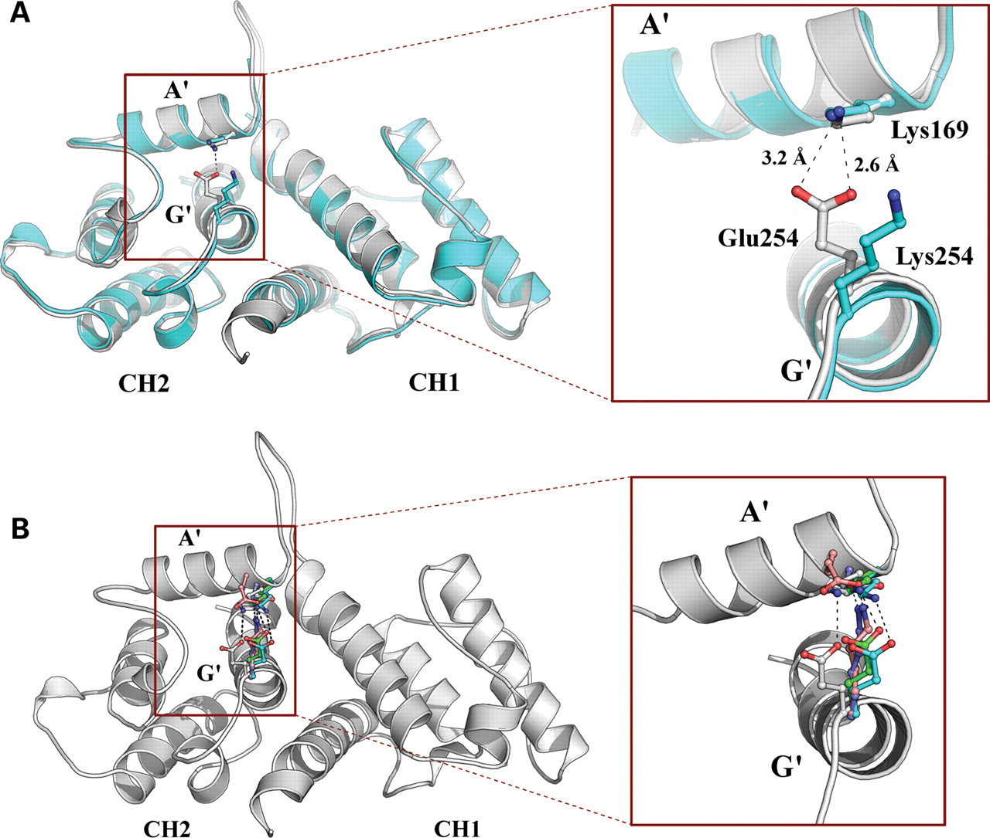
Figure 5. Effects of the E254K mutation on the filamin A ABD structure. (A) Superposition of the WT (grey) and E254K ...
Notes:
Figure 5. Effects of the E254K mutation on the filamin A ABD structure. (A) Superposition of the WT (grey) and E254K (cyan) FLNA ABD structures. Sidechains at positions 169 and 254 are shown in stick representation, and the salt bridge for WT as a dashed line. (B) Superposition of ABDs. Sidechains contributing to the conserved 169–254 salt bridge are colour coded; grey, FLNA; cyan, β-spectrin; green, α-actinin; purple, dystrophin; pink, utrophin. Helices linked by the salt bridge are labelled as A′ and G′.
Unless provided in the caption above, the following copyright applies to the content of this slide: © The Author 2009. Published by Oxford University Press. All rights reserved. For Permissions, please email: journals.permissions@oxfordjournals.org

Slide 6
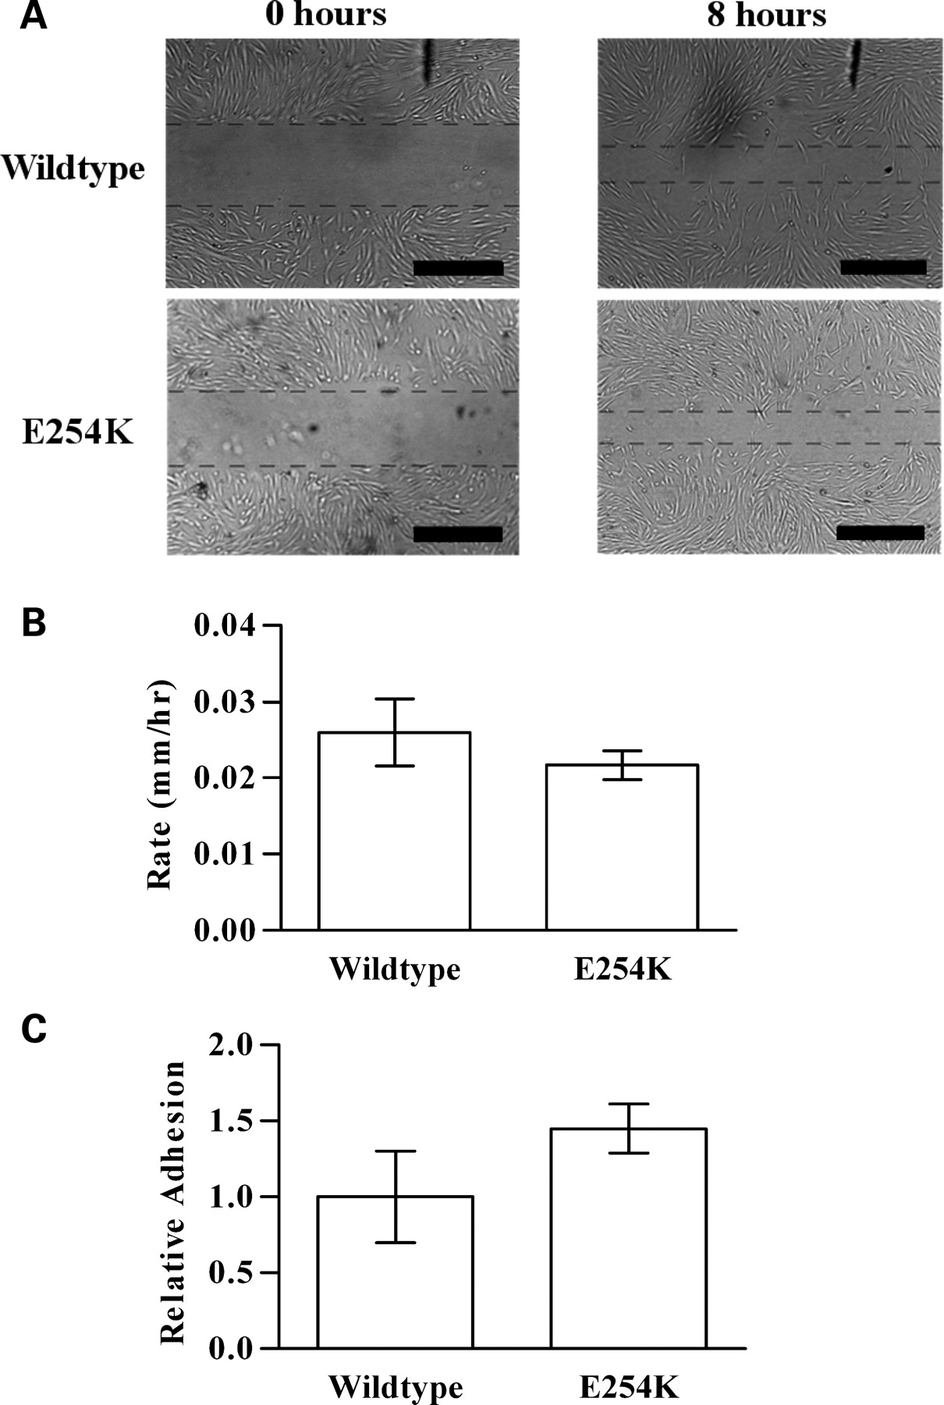
Figure 6. Comparison of migration and adhesion in OPD2 (FLNA E254K) patient fibroblasts with control fibroblasts. (A) ...
Notes:
Figure 6. Comparison of migration and adhesion in OPD2 (FLNA E254K) patient fibroblasts with control fibroblasts. (A) Light microscopy images comparing migration of FLNA E254K fibroblasts relative to control fibroblasts at time 0 (left) and 8 h (right). Scale bars represent 0.5 mm. (B) Quantification of fibroblast migration assays showing the migration rate (in mm/h) of WT and E254K fibroblasts (error bars show 1 SD). (C) Adhesion assay comparing FLNA E254K fibroblasts to control fibroblasts. The absorbance of dye from adhered E254K fibroblasts is plotted normalized to the WT (error bars show 1 SD).
Unless provided in the caption above, the following copyright applies to the content of this slide: © The Author 2009. Published by Oxford University Press. All rights reserved. For Permissions, please email: journals.permissions@oxfordjournals.org

Slide 7
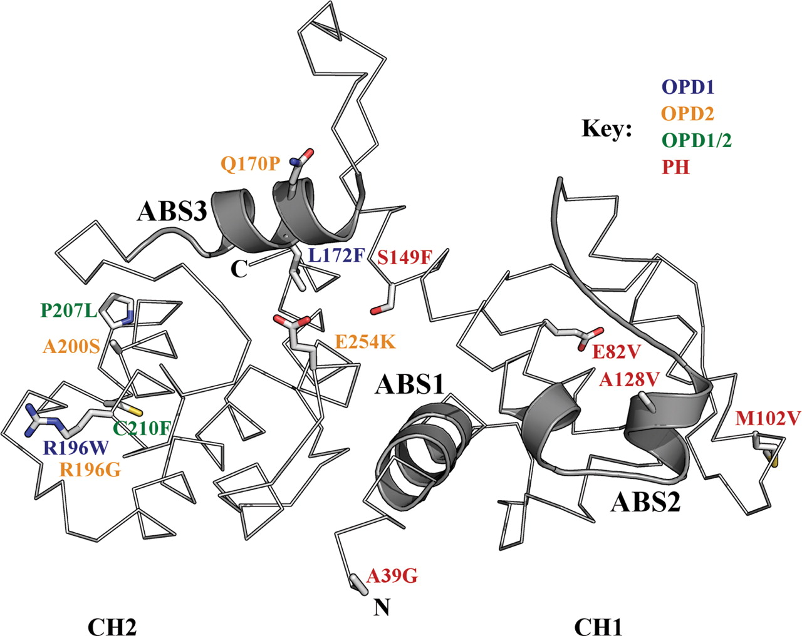
Figure 7. Disease-associated mutations mapped to the WT FLNA ABD structure. Cα trace representation of the FLNA WT ABD ...
Notes:
Figure 7. Disease-associated mutations mapped to the WT FLNA ABD structure. Cα trace representation of the FLNA WT ABD structure with the ABS (1–3) highlighted in ribbon representation. The positions of disease-associated mutations are shown in stick representation and labelled with colour coding: blue, OPD1; orange, OPD2; green, OPD1/2; red, PH.
Unless provided in the caption above, the following copyright applies to the content of this slide: © The Author 2009. Published by Oxford University Press. All rights reserved. For Permissions, please email: journals.permissions@oxfordjournals.org

