Slide 1
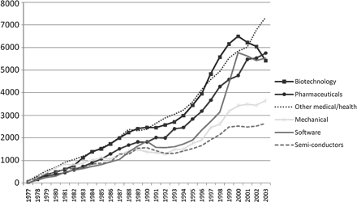
Figure 1. Patent applications in EU by sector.
Notes:
Figure 1. Patent applications in EU by sector.
Unless provided in the caption above, the following copyright applies to the content of this slide: © The Author (2009). Published by Oxford University Press. All rights reserved.

Slide 2
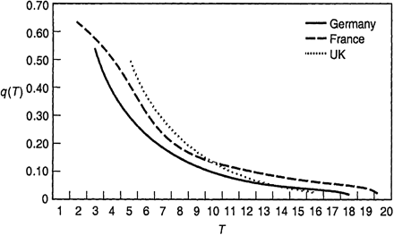
Figure 2. Patent tax rates generated by actual fee schedules.
Notes:
Figure 2. Patent tax rates generated by actual fee schedules.
Unless provided in the caption above, the following copyright applies to the content of this slide: © The Author (2009). Published by Oxford University Press. All rights reserved.

Slide 3
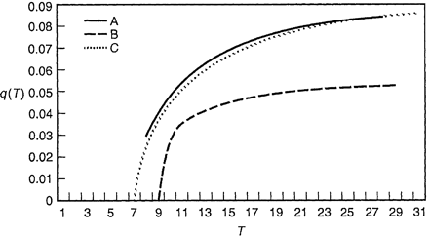
Figure 3. Patent tax rates implied by socially optimal fee schedule.
Notes:
Figure 3. Patent tax rates implied by socially optimal fee schedule.
Unless provided in the caption above, the following copyright applies to the content of this slide: © The Author (2009). Published by Oxford University Press. All rights reserved.

