Slide 1
Figure 1. Description of the cognitive task. The top panel shows an example of 2 typical trials of the cognitive task. ...
Notes:
Figure 1. Description of the cognitive task. The top panel shows an example of 2 typical trials of the cognitive task. First, the rule of classification is presented for a fixed period of 2000 ms. The participant is then asked to select one of the reference cards according to the previous rule displayed on the screen. Finally, the screen freezes for 1900 ms before the beginning of a new trial. In the lower section of the figure, the 4 conditions are presented each with an example of a sequence of the 4 conditions presented for 12 trials. In the CONTINUOUS SHIFT condition, participants never execute the same rule twice in row. In the SAME RULE condition, the same rule is executed continuously for the 12 trials. In the ALTERNATING condition, a change of rule is executed after 2, 3, or 4 consecutive trials of applying the same rule of classification. An overall total of either 5 or 6 set shifts are executed, however, the first trial was removed from our analysis leaving us always with a total of 5 set shifts. In this condition, we specified 2 distinct conditions: one in which we consider the sporadic set shifts and one in which we consider the execution of the same rule for a short amount of trials. In the CONTROL condition, participants need to match the test card with its twin.
Unless provided in the caption above, the following copyright applies to the content of this slide: © The Author 2011. Published by Oxford University Press. All rights reserved. For permissions, please e-mail: journals.permissions@oup.com

Slide 2
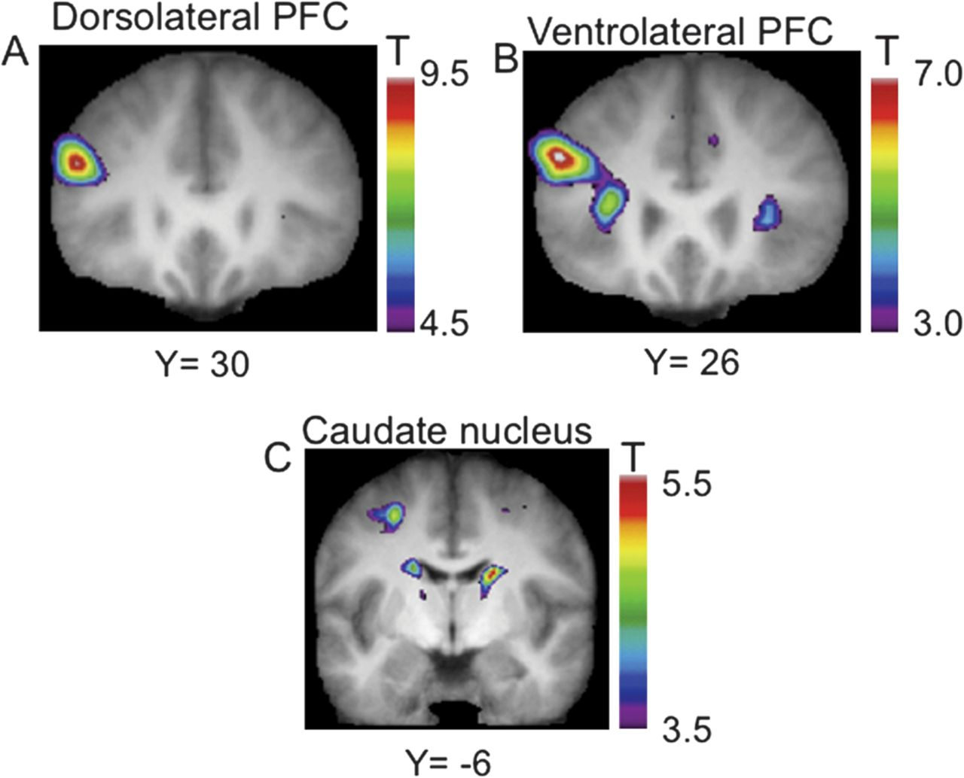
Figure 2. Location of the frontal and striatal peaks. The anatomical MRI is the average of the T₁ ...
Notes:
Figure 2. Location of the frontal and striatal peaks. The anatomical MRI is the average of the T1 acquisitions of the 15 participants transformed into standard stereotaxic space. (A) The “top left” panel shows a coronal section through the mid-dorsolateral PFC at Y = +30 mm. (B) The “top right” panel shows a coronal section through the mid-ventrolateral PFC at Y = +26 mm. (C) The “bottom” panel displays the body of the caudate nucleus through a coronal section at Y = −6 mm.
Unless provided in the caption above, the following copyright applies to the content of this slide: © The Author 2011. Published by Oxford University Press. All rights reserved. For permissions, please e-mail: journals.permissions@oup.com

Slide 3
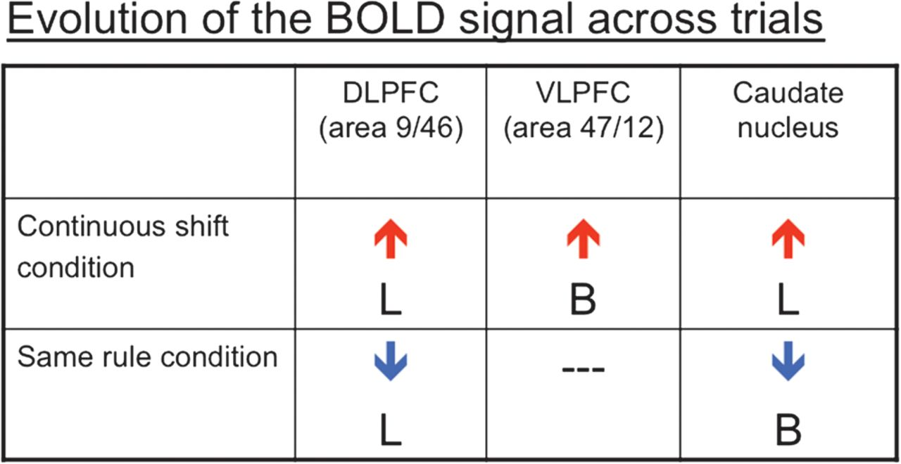
Figure 3. Correlation of the evolution of the BOLD signal according to the trial position. Each box represents the ...
Notes:
Figure 3. Correlation of the evolution of the BOLD signal according to the trial position. Each box represents the evolution of the BOLD signal according to the trial position for 2 prefrontal regions and the caudate nucleus. The red upward arrow represents a significant increase of activity across trial, while the blue downward arrow represents a significant decrease in the BOLD signal, as participants performed a specific condition. B, bilateral; L, left; DLPFC, dorsolateral PFC; VLPFC, ventrolateral PFC.
Unless provided in the caption above, the following copyright applies to the content of this slide: © The Author 2011. Published by Oxford University Press. All rights reserved. For permissions, please e-mail: journals.permissions@oup.com

