Slide 1
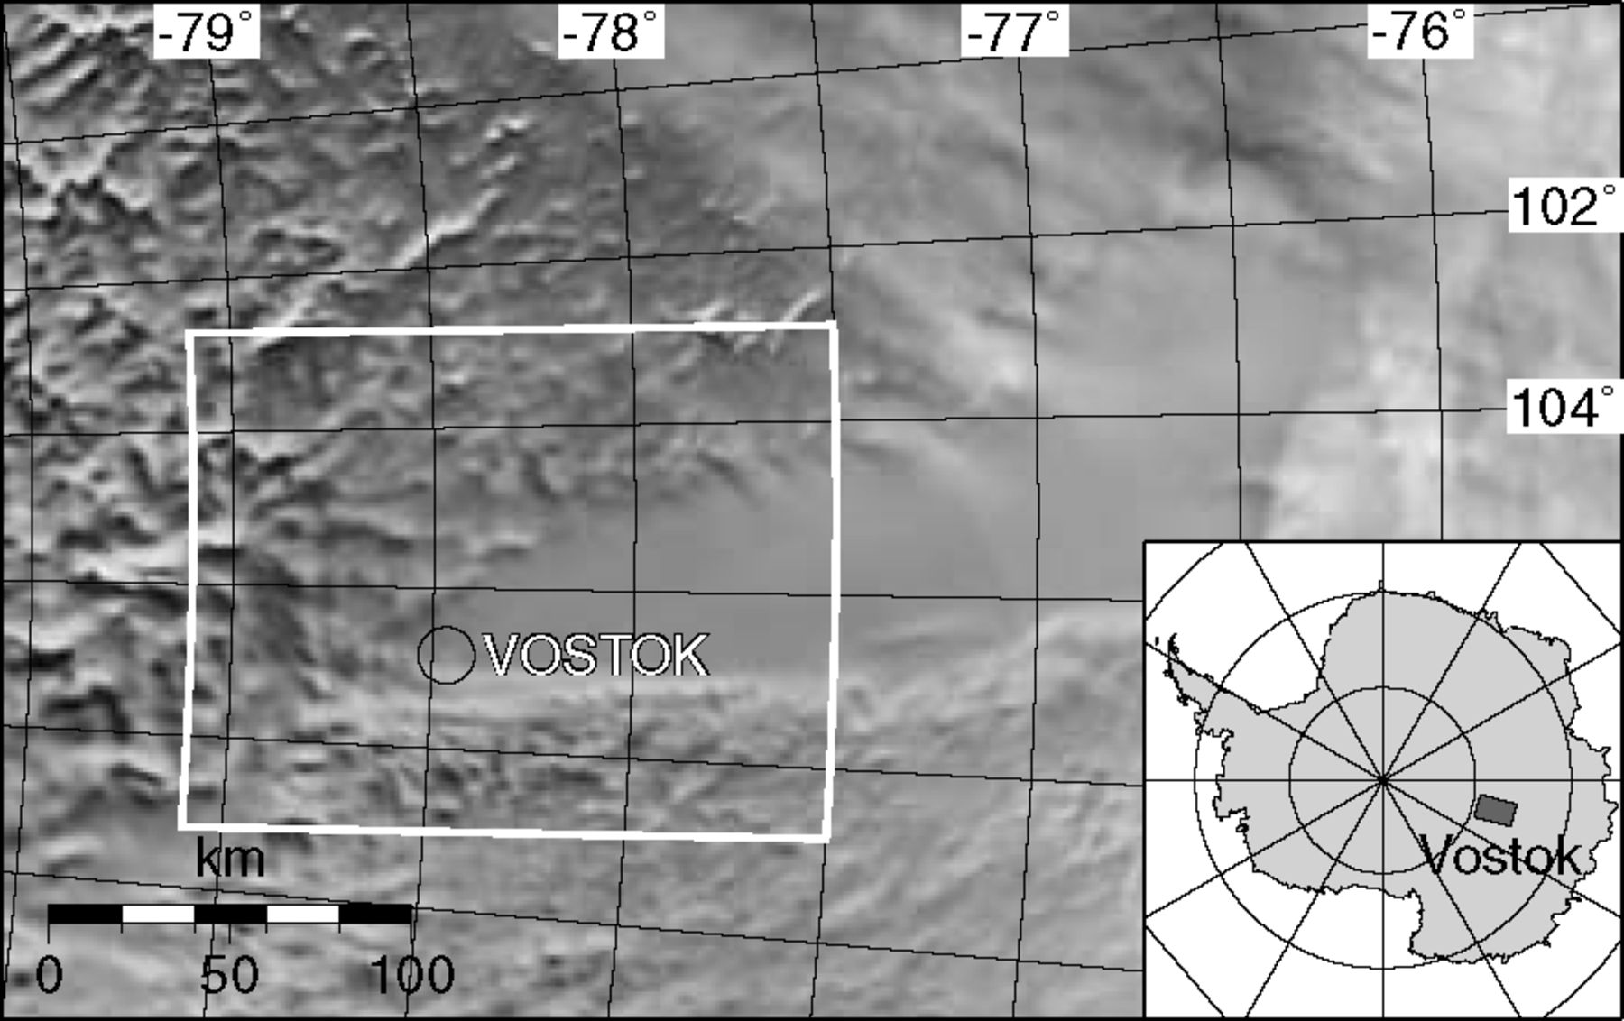
Figure 1 Radarsat mosaic (Jezek & RAMP Product Team 2002) of Lake Vostok. The clipping of Fig. 2 is indicated in ...
Notes:
Figure 1 Radarsat mosaic (Jezek & RAMP Product Team 2002) of Lake Vostok. The clipping of Fig. 2 is indicated in white; Vostok station is encircled in black.
Unless provided in the caption above, the following copyright applies to the content of this slide: © 2005 RAS

Slide 2
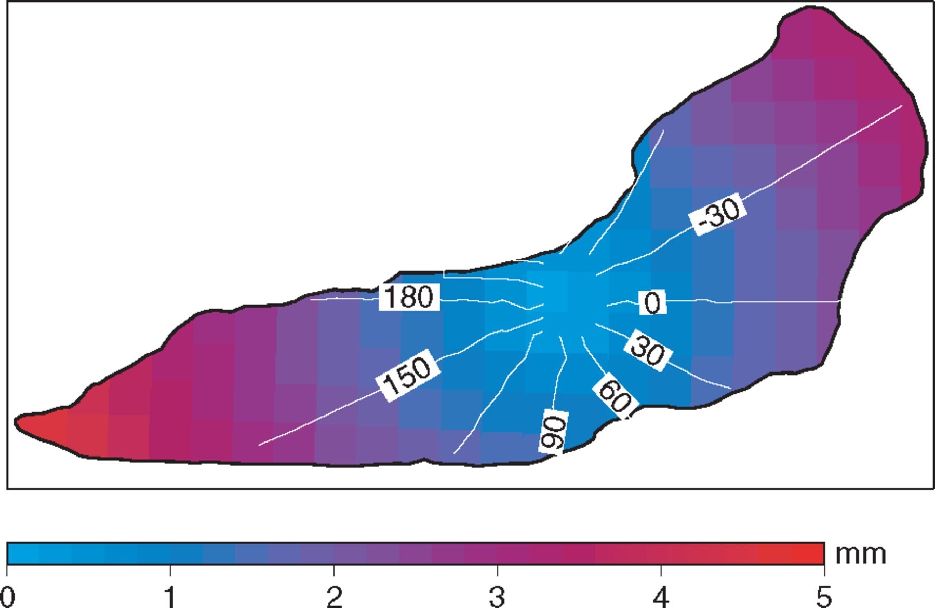
Figure 3 K₁ constituent of the differential equilibrium tide for Lake Vostok. Amplitudes are colour-coded; ...
Notes:
Figure 3 K1 constituent of the differential equilibrium tide for Lake Vostok. Amplitudes are colour-coded; phases (white lines) are defined throughout the paper as local with phase lead positive as conventionally used for earth tides.
Unless provided in the caption above, the following copyright applies to the content of this slide: © 2005 RAS

Slide 3
Table 1 Amplitudes A and local phases ø of the differential equilibrium tides modelled for Vostok station. Only ...
Notes:
Table 1 Amplitudes A and local phases ø of the differential equilibrium tides modelled for Vostok station. Only constituents with amplitudes larger than 0.5 mm are listed.
Unless provided in the caption above, the following copyright applies to the content of this slide: © 2005 RAS

Slide 4
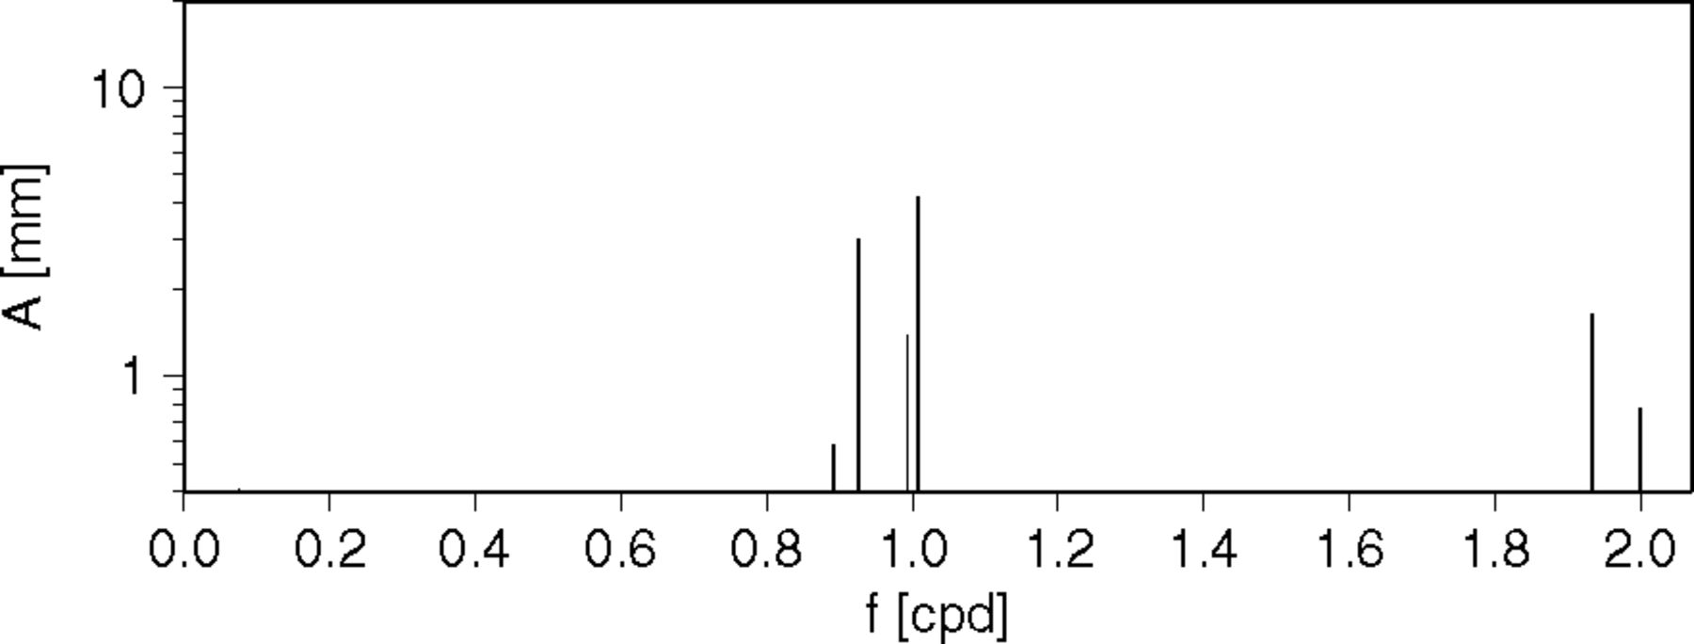
Figure 4 Amplitudes of the differential equilibrium tides at Vostok station.
Notes:
Figure 4 Amplitudes of the differential equilibrium tides at Vostok station.
Unless provided in the caption above, the following copyright applies to the content of this slide: © 2005 RAS

Slide 5
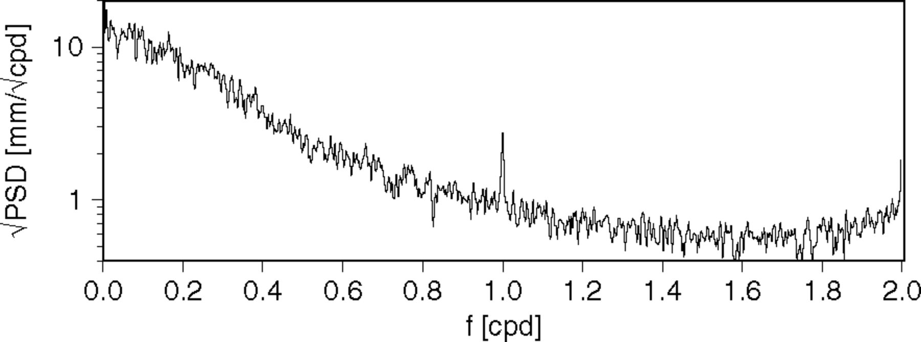
Figure 5 Power spectral density of the inverse barometer effect (IBE) at Vostok station. Note that the graph shown ...
Notes:
Figure 5 Power spectral density of the inverse barometer effect (IBE) at Vostok station. Note that the graph shown here cannot be directly compared to the amplitudes in Fig. 4.
Unless provided in the caption above, the following copyright applies to the content of this slide: © 2005 RAS

Slide 6
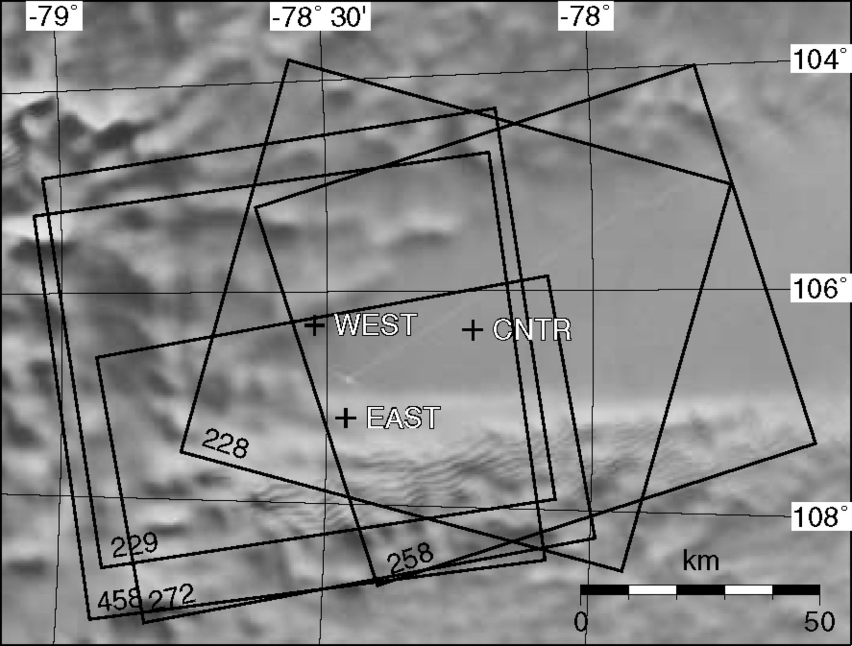
Figure 2 Southern part of Lake Vostok. Synthetic aperture radar (SAR) scenes shown in Figs 8 and 9 are outlined as ...
Notes:
Figure 2 Southern part of Lake Vostok. Synthetic aperture radar (SAR) scenes shown in Figs 8 and 9 are outlined as black frames, the locations of the Global Positioning System (GPS) points observed in 2001/2002 (CNTR, EAST) and 2002/2003 (CNTR, EAST, WEST) are marked by crosses.
Unless provided in the caption above, the following copyright applies to the content of this slide: © 2005 RAS

Slide 7
Table 2 Global Positioning System (GPS) observation schedule and total number of simultaneous -hr sessions for each ...
Notes:
Table 2 Global Positioning System (GPS) observation schedule and total number of simultaneous -hr sessions for each baseline. For the observations Trimble 4000SSI receivers were used. The setup at the sites included solar panels and batteries, which enabled a continuous operation during a couple of weeks. The sampling rate was set to 30 s.
Unless provided in the caption above, the following copyright applies to the content of this slide: © 2005 RAS

Slide 8
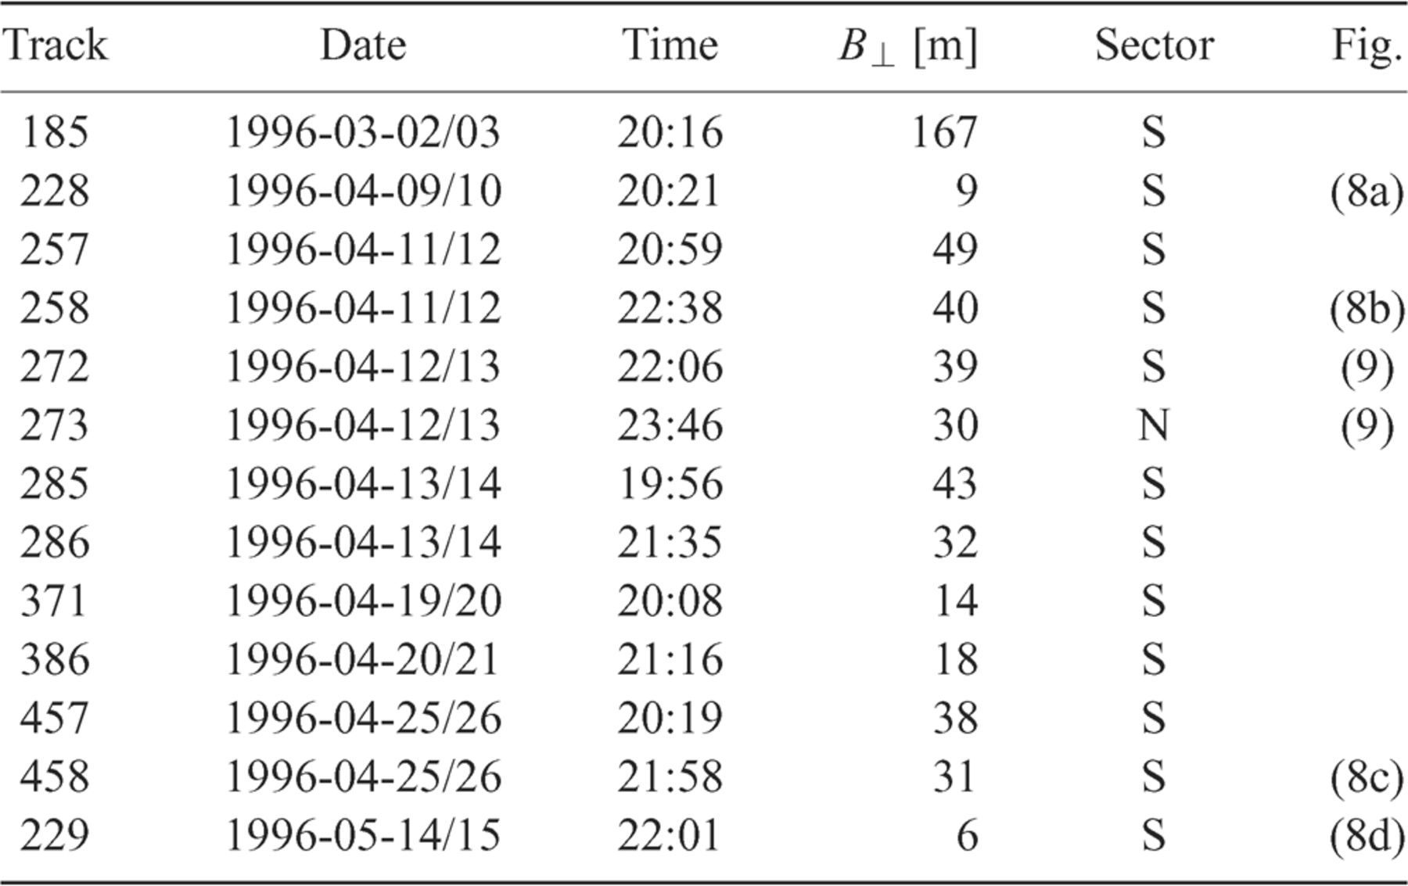
Table 3 List of synthetic aperture radar (SAR) scenes used in this study. B⊥ is the baseline component ...
Notes:
Table 3 List of synthetic aperture radar (SAR) scenes used in this study. B⊥ is the baseline component perpendicular to the line of sight of the radar. Column labelled sector lists which part on the lake is mapped by the respective scene (S, south; N, north); the last column indicates the figure showing the corresponding interferogram.
Unless provided in the caption above, the following copyright applies to the content of this slide: © 2005 RAS

Slide 9
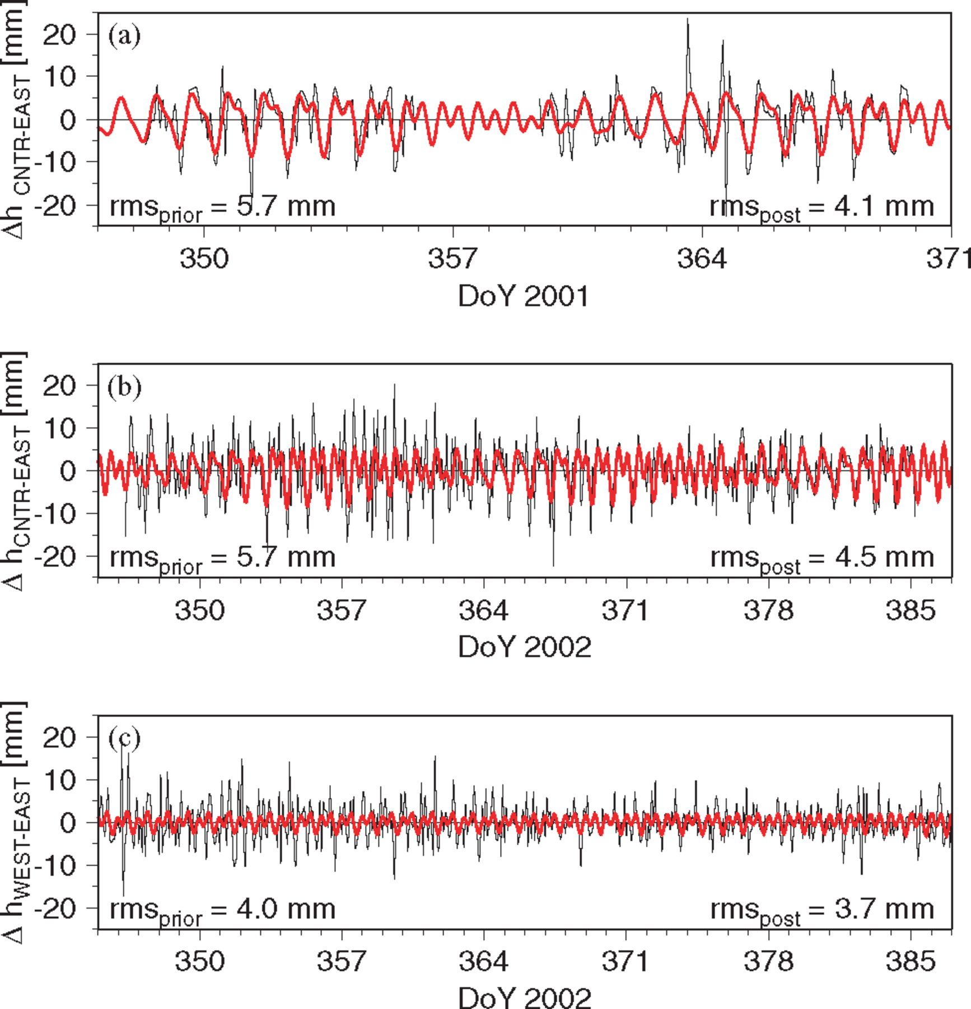
Figure 6 High-resolution time-series of height differences Δh (black) and the result of the tidal analysis (red). (a) ...
Notes:
Figure 6 High-resolution time-series of height differences Δh (black) and the result of the tidal analysis (red). (a) Baseline EAST–CNTR in season 2001/2002; (b) baseline EAST–CNTR in season 2002/2003; (c) baseline EAST–WEST in the second season for comparison.
Unless provided in the caption above, the following copyright applies to the content of this slide: © 2005 RAS

Slide 10
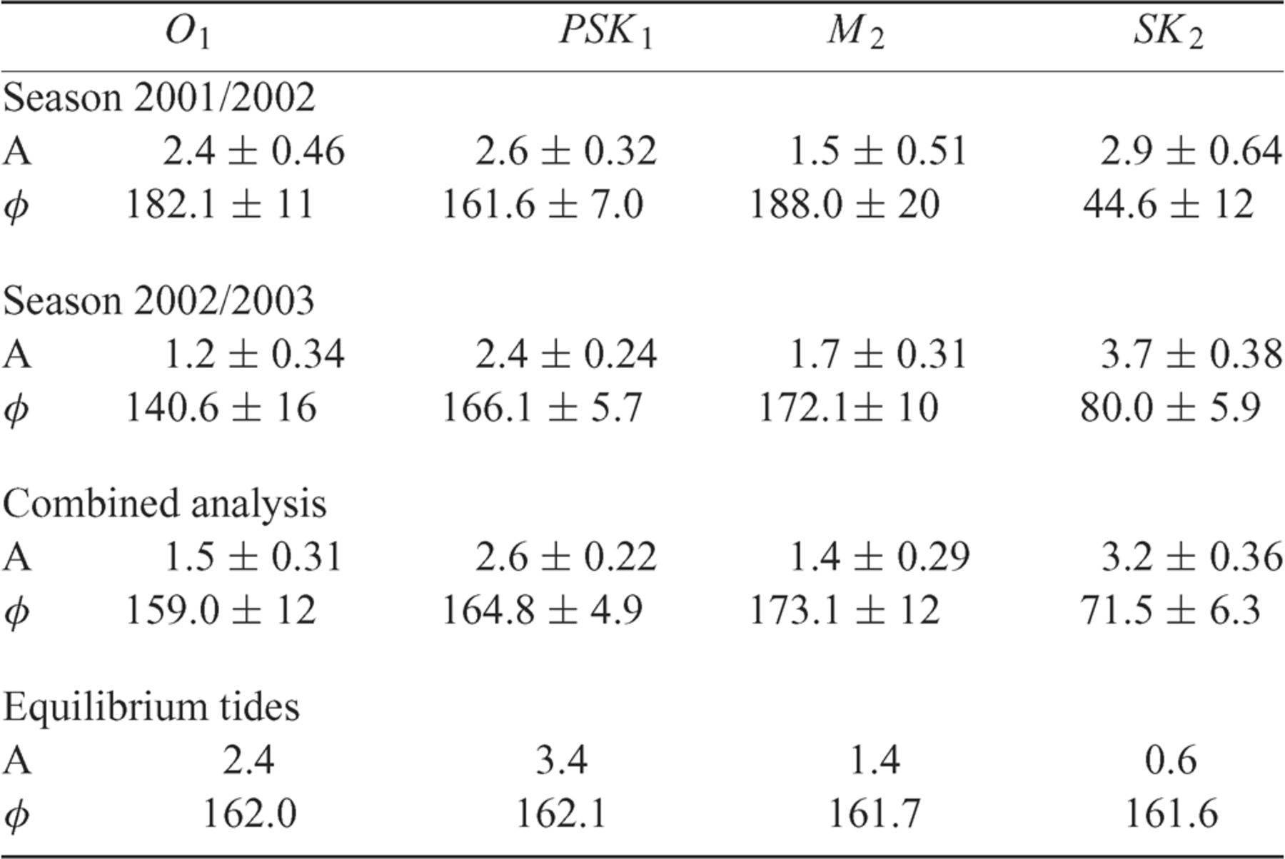
Table 4 Tidal constituents (amplitudes A in mm and local phases φ in °) and their standard deviations estimated from ...
Notes:
Table 4 Tidal constituents (amplitudes A in mm and local phases φ in °) and their standard deviations estimated from the baseline EAST–CNTR in both seasons. For comparison, the amplitudes and local phases of the differential equilibrium tides for the location of the Global Positioning System (GPS) station CNTR are listed as well.
Unless provided in the caption above, the following copyright applies to the content of this slide: © 2005 RAS

Slide 11
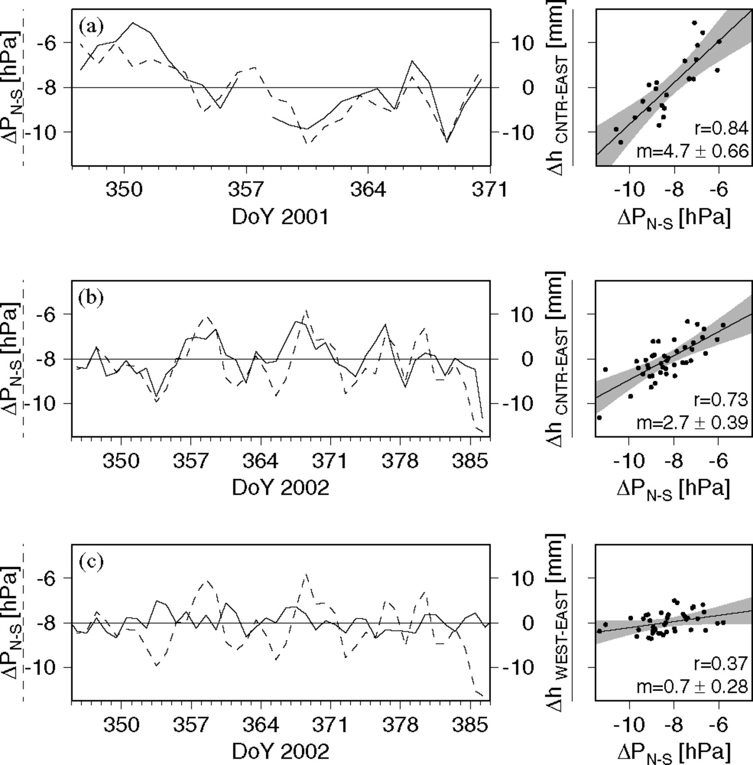
Figure 7 Time-series of daily solutions Δh (full line) and air pressure difference ΔP across the lake from the NCEP ...
Notes:
Figure 7 Time-series of daily solutions Δh (full line) and air pressure difference ΔP across the lake from the NCEP model (broken line). On the right-hand side, the resulting correlograms are shown with m being the regression coefficient and r the correlation coefficient. (a) Baseline EAST–CNTR in season 2001/2002; (b) baseline EAST–CNTR in season 2002/2003; (c) baseline EAST–WEST on grounded ice for comparison showing no significant correlation between height difference and air pressure difference.
Unless provided in the caption above, the following copyright applies to the content of this slide: © 2005 RAS

Slide 12
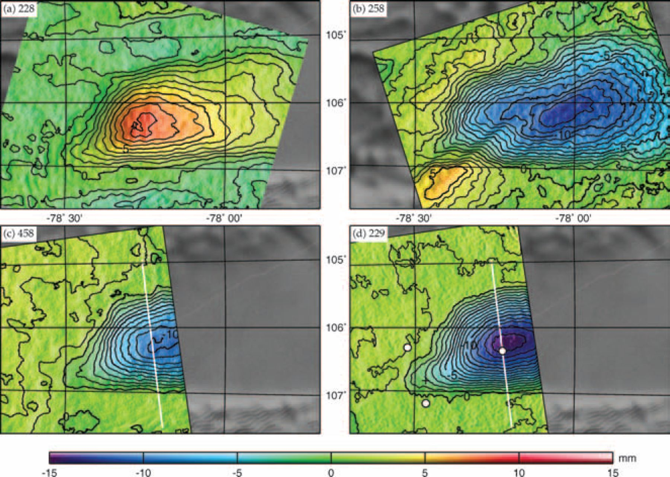
Figure 8 Vertical displacement of the lake surface revealed in four interferograms (see Table 3). While interferogram ...
Notes:
Figure 8 Vertical displacement of the lake surface revealed in four interferograms (see Table 3). While interferogram (a) shows a rise of the lake surface, the other three indicate a falling surface between the first and second data acquisition of the respective scenes. The white lines in subfigures (c) and (d) show the profiles analysed in Fig. 11. Subfigure (d) also indicates the positions of the Global Positioning System (GPS) sites.
Unless provided in the caption above, the following copyright applies to the content of this slide: © 2005 RAS

Slide 13
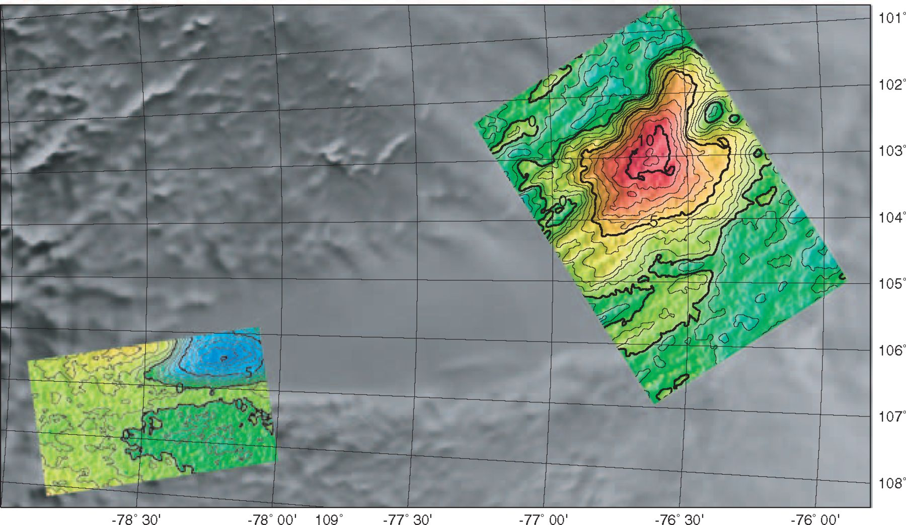
Figure 9 Comparison of vertical displacement in the north (track 273) and the south (track 272) of the lake between ...
Notes:
Figure 9 Comparison of vertical displacement in the north (track 273) and the south (track 272) of the lake between 1996 April 12 and 13. These interferograms were recorded 100 min apart showing an uplift between the two acquisitions of the northern part and a subsidence in the south. The scale is the same as in Fig. 8.
Unless provided in the caption above, the following copyright applies to the content of this slide: © 2005 RAS

Slide 14
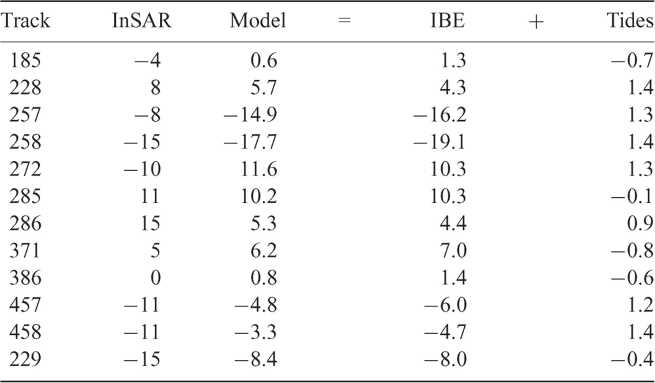
Table 5 Comparison of the observed vertical displacements in the interferograms of the south with the model ...
Notes:
Table 5 Comparison of the observed vertical displacements in the interferograms of the south with the model predictions represented by the sum of inverse barometer effect (IBE) and differential equilibrium tides. Unit: mm.
Unless provided in the caption above, the following copyright applies to the content of this slide: © 2005 RAS

Slide 15
Figure 10 (a) Pressure difference (curves and dots) around the acquisitions and resulting vertical deformation (bars) ...
Notes:
Figure 10 (a) Pressure difference (curves and dots) around the acquisitions and resulting vertical deformation (bars) for the interferograms shown in Figs 8 and 9. (b) Regression between the modelled deformation consisting of tides and inverse barometer effect (IBE) and the observations in all 12 interferograms. Full dots indicate interferograms shown in Figs 8 and 9.
Unless provided in the caption above, the following copyright applies to the content of this slide: © 2005 RAS

Slide 16
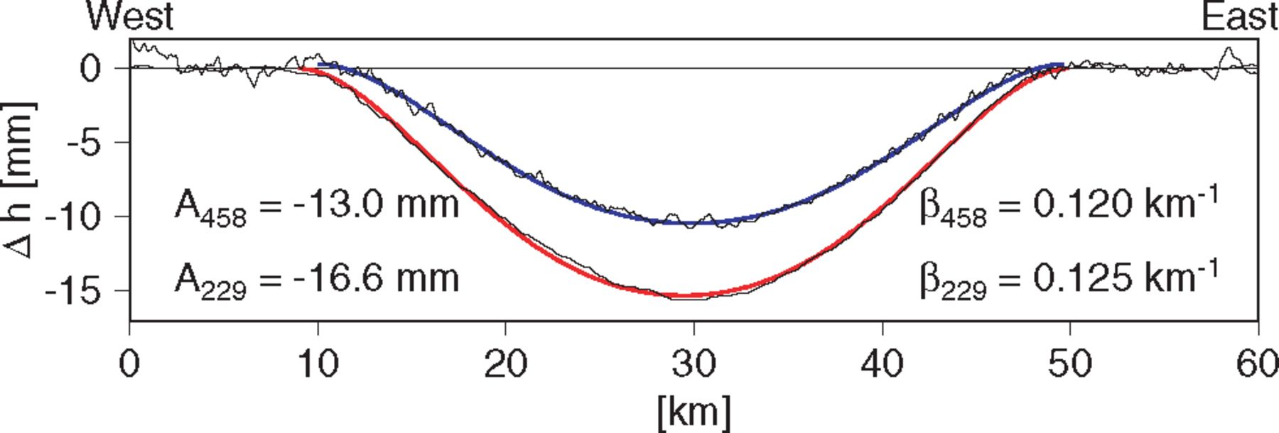
Figure 11 Solution of the boundary value problem with constant grounding-line curvature (eq. 4) for interferograms 458 ...
Notes:
Figure 11 Solution of the boundary value problem with constant grounding-line curvature (eq. 4) for interferograms 458 (blue) and 229 (red), respectively. Observations from both interferograms are indicated as thin lines.
Unless provided in the caption above, the following copyright applies to the content of this slide: © 2005 RAS

