Slide 1
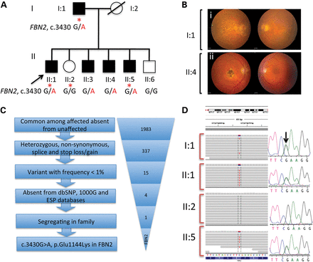
Figure 1. Identification of Glu1144Lys mutation in FBN2 using whole exome sequencing. (A) Pedigree of a two-generation ...
Notes:
Figure 1. Identification of Glu1144Lys mutation in FBN2 using whole exome sequencing. (A) Pedigree of a two-generation family, Fam-979 with early-onset macular degeneration. Samples used for exome sequencing are marked by red asterisks. Filled symbols represent members affected with early-onset macular dystrophy. (B) Fundus images of two affected members. (C) Step-wise filtration of variant to identify disease-causing mutation. (D) Sequencing reads showing the heterozygous variant, c.3430 G > A, p.Glu1144Lys in exon 26 of FBN2 gene in IGV viewer and confirmation using Sanger sequencing.
Unless provided in the caption above, the following copyright applies to the content of this slide: Published by Oxford University Press 2014. This work is written by (a) US Government employee(s) and is in the public domain in the US.

Slide 2
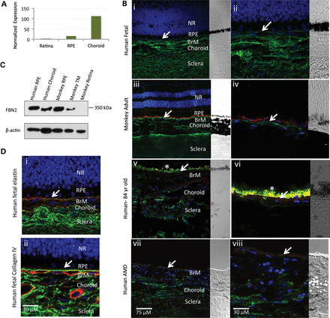
Figure 2. Expression analysis of FBN2 in human and monkey eyes. (A) FBN2 transcript level in human fetal retina, RPE ...
Notes:
Figure 2. Expression analysis of FBN2 in human and monkey eyes. (A) FBN2 transcript level in human fetal retina, RPE and choroid. (B) FBN2 is expressed in human fetal, adult monkey and AMD donors. FBN2 signal was abundant in BrM, choroid and sclera in human fetal (i–ii) and adult monkey (iii–iv) (shown in green fluorescence). In aged human (v–vi) and in individuals with AMD (vii–viii), FBN2 signals were seen in choroid and sclera though expression was conspicuously absent in BrM. Although Bruch's membrane is still visible in these sections, RPE is no longer present because of widespread degeneration and cell death, which is a common feature of advanced AMD including geographic atrophy (C) Immunoblot analysis of the tissue lysates from normal human (RPE and choroid) and monkey (RPE, TM and retina). (D) Co-localization was also observed with elastin and collagen IV antibody in human fetal sections (i–ii). NR, neural retina; RPE, retinal pigment epithelium; BrM, Bruch's membrane; TM, trabecular meshwork. Green signals are for FBN2, red signal is for elastin (Di) and collagen IV (Dii) and blue represent the DAPI stained nuclei. Arrows indicate the location of BrM in sections.
Unless provided in the caption above, the following copyright applies to the content of this slide: Published by Oxford University Press 2014. This work is written by (a) US Government employee(s) and is in the public domain in the US.

Slide 3
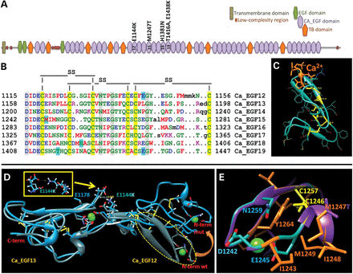
Figure 3. Homology modeling of wild-type and mutant FBN2 variants. (A) Putative structural domains and variants ...
Notes:
Figure 3. Homology modeling of wild-type and mutant FBN2 variants. (A) Putative structural domains and variants identified are located in Ca_EGF domains 12, 15, 18, and 19, respectively. (B) Multiple sequence alignment of Ca_EGF-motifs 12–19. Each of 8 Ca_EGF domains has consensus sequence DhpE where h and p are hydrophobic and polar residues, respectively. Conserved positions of cysteines and disulfide bonds are shown by yellow background and by black lines (SS), respectively. Locations for missense changes are shown by cyan background. (C) Homology modeling of Ca_EGF domain structure is shown by cyan ribbon. Each domain contains a short anti-parallel β-sheet and three loops stabilized by disulfide bridges. The motif of first four residues which includes two conserved negatively charged residues (Asp, Glu) involved in Ca2+ binding as well as the Ca2+ atom are shown by orange. Cysteine residues are yellow. (D) The superposition of wild-type (sea green) and mutant (blue) structures for a pair of Ca_EGF domains 12 and 13. p.Glu1144Lys variant causes change in structural orientation of the Ca_EGF12 domain. Calcium atom is shown by green. The effect of the structural change is associated with a salt bridge formation between positively charged lysine 1144 and negatively charged Glu1178 is shown in inset. (E) Replacement of hydrophobic methionine with polar threonine in the p.Met1247Thr mutant variant decreases hydrophobic potential of a cluster formed by hydrophobic residues Met1247, Ile1248, Met1249.
Unless provided in the caption above, the following copyright applies to the content of this slide: Published by Oxford University Press 2014. This work is written by (a) US Government employee(s) and is in the public domain in the US.

Slide 4
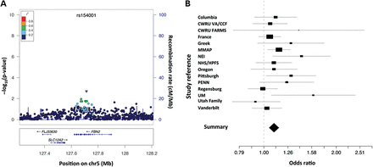
Table 1. Meta-analysis of association of rs154001 (p.Val965Ile) with AMD AMD, age-related macular degeneration; BrM, ...
Notes:
Table 1. Meta-analysis of association of rs154001 (p.Val965Ile) with AMD AMD, age-related macular degeneration; BrM, Bruch’s membrane; CCA, congenital contractural arachnodactyly; EGF, epidermal growth factor-like; ECM, extracellular matrix; FBN, fibrillin; GWAS, genome-wide association studies; RPE, retinal pigment epithelium. Logistic regression, with no covariates, was used to compare advanced cases and controls in each study. Bold values represent combined values from meta-analysis data. Figure 4.Meta-analysis of a common FBN2 coding SNP, rs154001. (A) LocusZoom plots for association signal in the 200 kb region surrounding the FBN2 gene (40). The representative non-synonymous SNP (rs154001) for this region is shown by purple inverted triangle. (B) Forest plot for rs154001 association in 10 337 cases and 11 174 controls across 15 cohorts.
Unless provided in the caption above, the following copyright applies to the content of this slide: Published by Oxford University Press 2014. This work is written by (a) US Government employee(s) and is in the public domain in the US.

