Slide 1
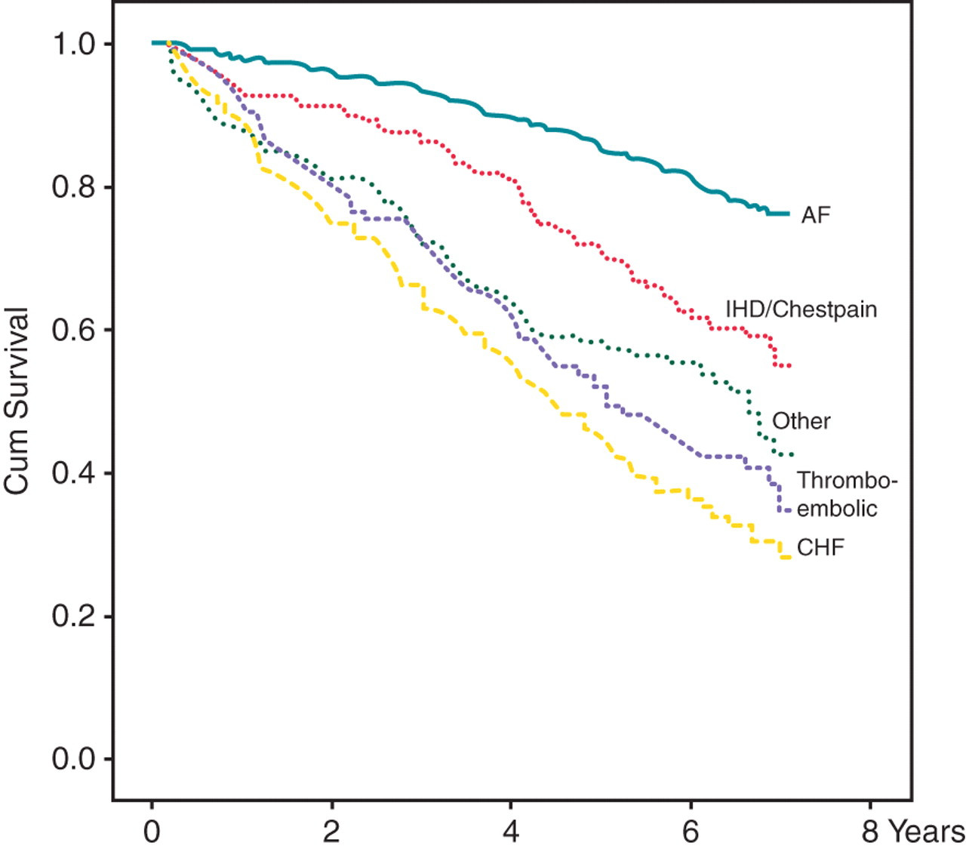
Figure 1 Survival in relation to the principal diagnosis at the first cardiovascular-related re-hospitalization. AF, ...
Notes:
Figure 1 Survival in relation to the principal diagnosis at the first cardiovascular-related re-hospitalization. AF, atrial fibrillation (n = 469); IHD/Chest pain, ischaemic heart disease or admission due to unspecified chest pain (n = 139); Thrombo-embolic, ischaemic stroke or TIA, arterial or pulmonary embolism (n = 116); CHF, congestive heart failure (n = 146); Other, all other cardiovascular diagnoses (n = 108). Differences were statistically significant between all groups except between ‘Thrombo-embolic' and ‘CHF' and between ‘Thrombo-embolic' and ‘Other'.
Unless provided in the caption above, the following copyright applies to the content of this slide: Published on behalf of the European Society of Cardiology. All rights reserved. © The Author 2011. For permissions please email: journals.permissions@oup.com.

