Slide 1
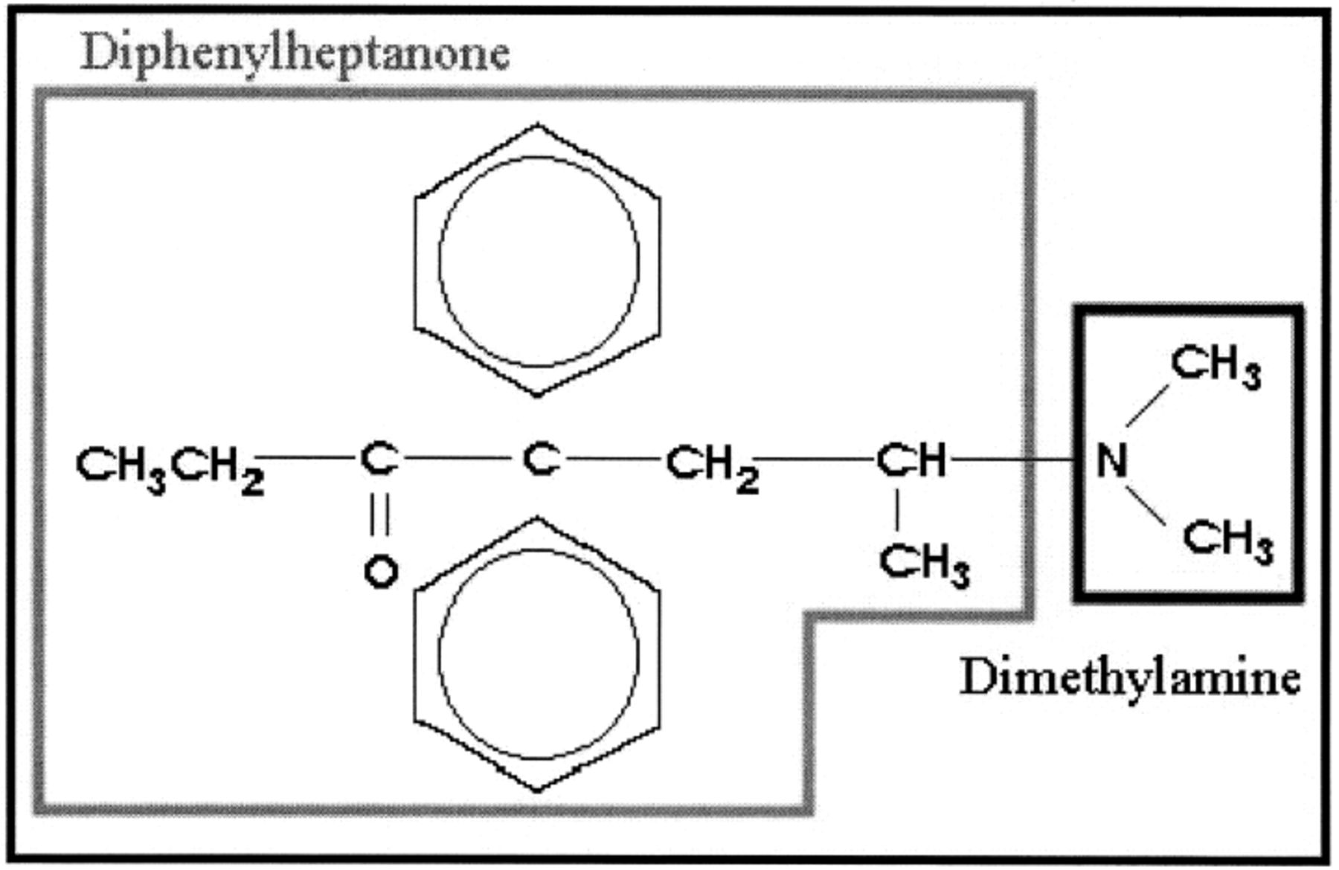
Figure 1 Chemical structure of methadone highlighting diphenylheptanone and dimethylamine components.
Notes:
Figure 1 Chemical structure of methadone highlighting diphenylheptanone and dimethylamine components.
Unless provided in the caption above, the following copyright applies to the content of this slide:

Slide 2
Figure 2 Structure of common opioids.
Notes:
Figure 2 Structure of common opioids.
Unless provided in the caption above, the following copyright applies to the content of this slide:

