Slide 1
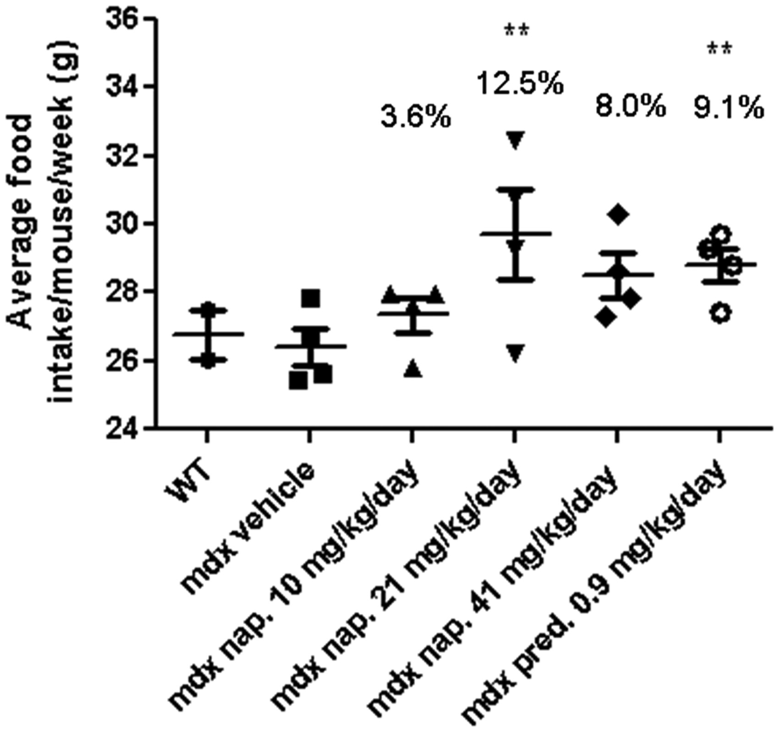
Figure 1. Analysis of food consumption by WT and mdx mice at 42 weeks of age following 9 months of treatment. Data are ...
Notes:
Figure 1. Analysis of food consumption by WT and mdx mice at 42 weeks of age following 9 months of treatment. Data are expressed as means ± S.E.M. (n = 10 animals for the WT and n = 15 animals for the mdx vehicle-, naproxcinod- and prednisolone-treated mice). **P ≤ 0.01, comparing mdx vehicle-treated mice and mdx mice treated with 21 mg/kg/day naproxcinod or 0.9 mg/kg/day prednisolone.
Unless provided in the caption above, the following copyright applies to the content of this slide: © The Author 2014. Published by Oxford University Press. All rights reserved. For Permissions, please email: journals.permissions@oup.com

Slide 2
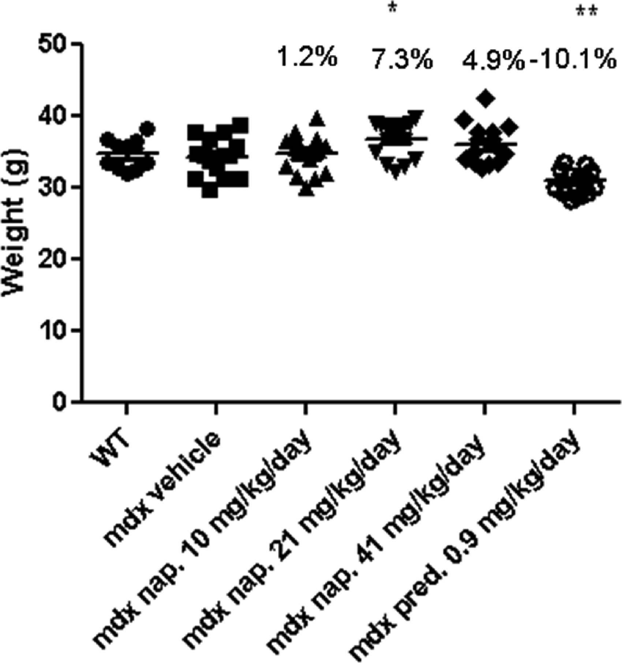
Figure 2. BW measurement of WT and mdx mice treated with either vehicle, or various concentrations of naproxcinod or ...
Notes:
Figure 2. BW measurement of WT and mdx mice treated with either vehicle, or various concentrations of naproxcinod or prednisolone at 42 weeks of age following 9 months of treatment. Data are expressed as means ± S.E.M. (n = 10 animals for the WT mice and n = 15 animals for mdx vehicle-, naproxcinod- and prednisolone-treated mdx mice). *P ≤ 0.05 and **P ≤ 0.01, comparing mdx vehicle-treated mice and mdx mice treated with 21 mg/kg/day naproxcinod or 0.9 mg/kg/day prednisolone.
Unless provided in the caption above, the following copyright applies to the content of this slide: © The Author 2014. Published by Oxford University Press. All rights reserved. For Permissions, please email: journals.permissions@oup.com

Slide 3
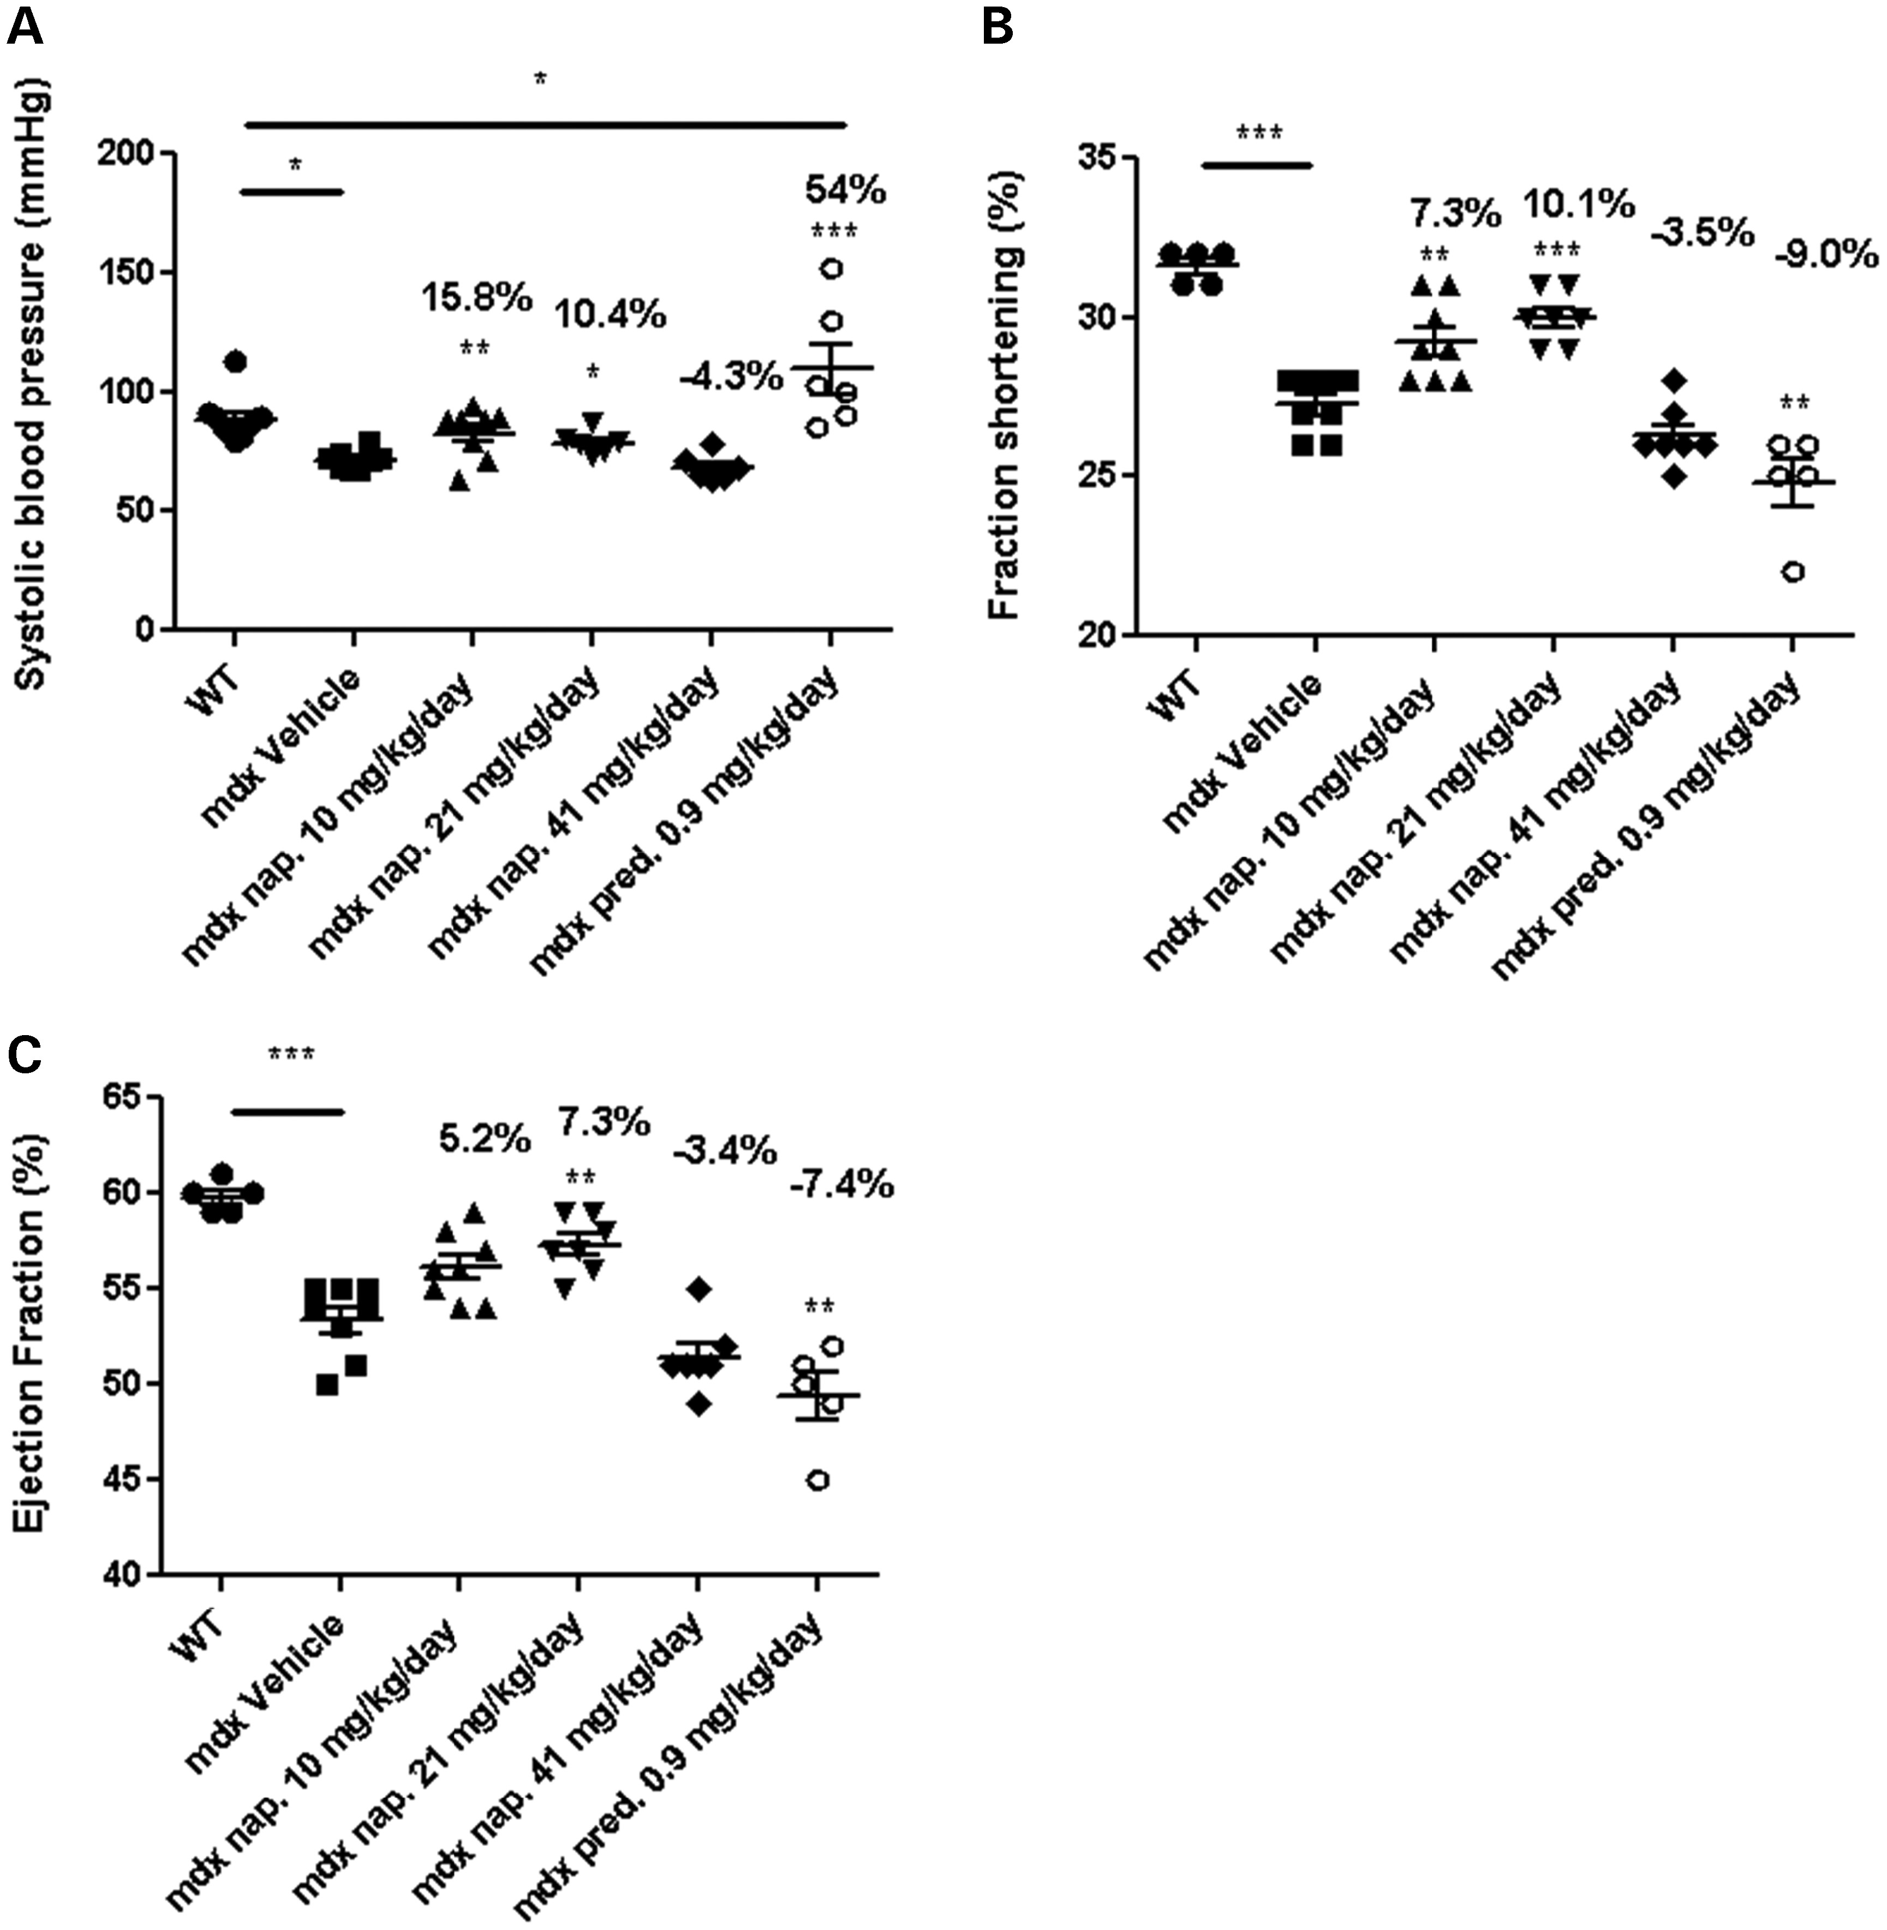
Figure 3. BP (A) and echocardiography measurements (B and C) for WT and mdx mice treated with either vehicle, one of ...
Notes:
Figure 3. BP (A) and echocardiography measurements (B and C) for WT and mdx mice treated with either vehicle, one of various concentrations of naproxcinod, or 0.9 mg/kg/day prednisolone at 42 weeks of age following 9 months of treatment. Data are expressed as means ± S.E.M. For systolic BP measurements: n = 8 animals for mdx vehicle-treated mice and 10 mg/kg/day naproxcinod-treated mice; n = 6 animals for 0.9 mg/kg/day prednisolone-, 21 mg/kg/day naproxcinod- and 41 mg/kg/day naproxcinod-treated mice; n = 10 animals for WT. For echocardiography: n = 8 animals for mdx vehicle-treated mice and 10 mg/kg/day naproxcinod-treated mice; n = 5 animals for 0.9 mg/kg/day prednisolone; n = 7 animals for 21 mg/kg/day naproxcinod- and 41 mg/kg/day naproxcinod-treated mice; n = 5 animals for WT. *P ≤ 0.05, **P ≤ 0.01 and ***P ≤ 0.001, comparing mdx vehicle-treated mice and various treatment groups. The percentages above each of the plots indicate the percentage change from the mdx vehicle-treated group.
Unless provided in the caption above, the following copyright applies to the content of this slide: © The Author 2014. Published by Oxford University Press. All rights reserved. For Permissions, please email: journals.permissions@oup.com

Slide 4
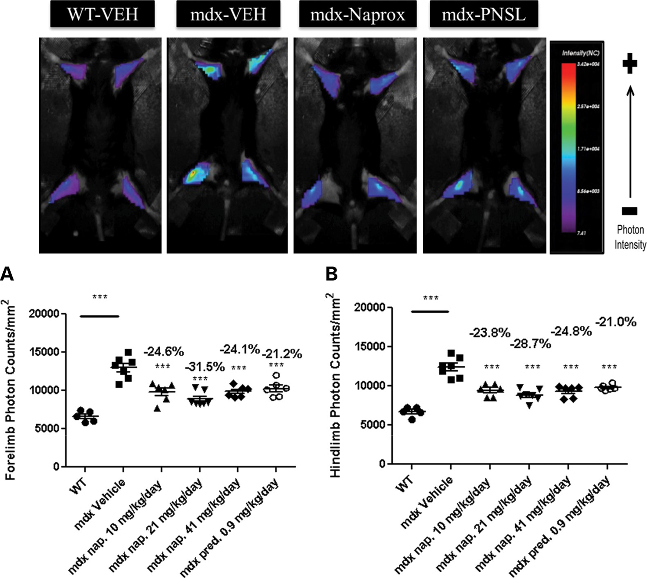
Figure 4. Optical imaging of the forelimbs and hindlimbs of WT and mdx mice treated with either vehicle, various ...
Notes:
Figure 4. Optical imaging of the forelimbs and hindlimbs of WT and mdx mice treated with either vehicle, various concentrations of naproxcinod or 0.9 mg/kg/day prednisolone at 42 weeks of age following 9 months of treatment. (A) Forelimb photon counts and (B) hindlimb photon counts were used as a direct measure of inflammation in live animals. Data are expressed as means ± S.E.M. (n = 7 animals for mdx vehicle-treated mice and 21 mg/kg/day naproxcinod-treated mice; n = 6 animals for 0.9 mg/kg/day prednisolone-, 10 mg/kg/day naproxcinod- and 41 mg/kg/day naproxcinod-treated mice; n = 5 animals for WT). ***P ≤ 0.001, comparing mdx vehicle-treated mice and various treatment groups. The percentages above each of the plots indicate the percentage change from the mdx vehicle-treated group.
Unless provided in the caption above, the following copyright applies to the content of this slide: © The Author 2014. Published by Oxford University Press. All rights reserved. For Permissions, please email: journals.permissions@oup.com

Slide 5
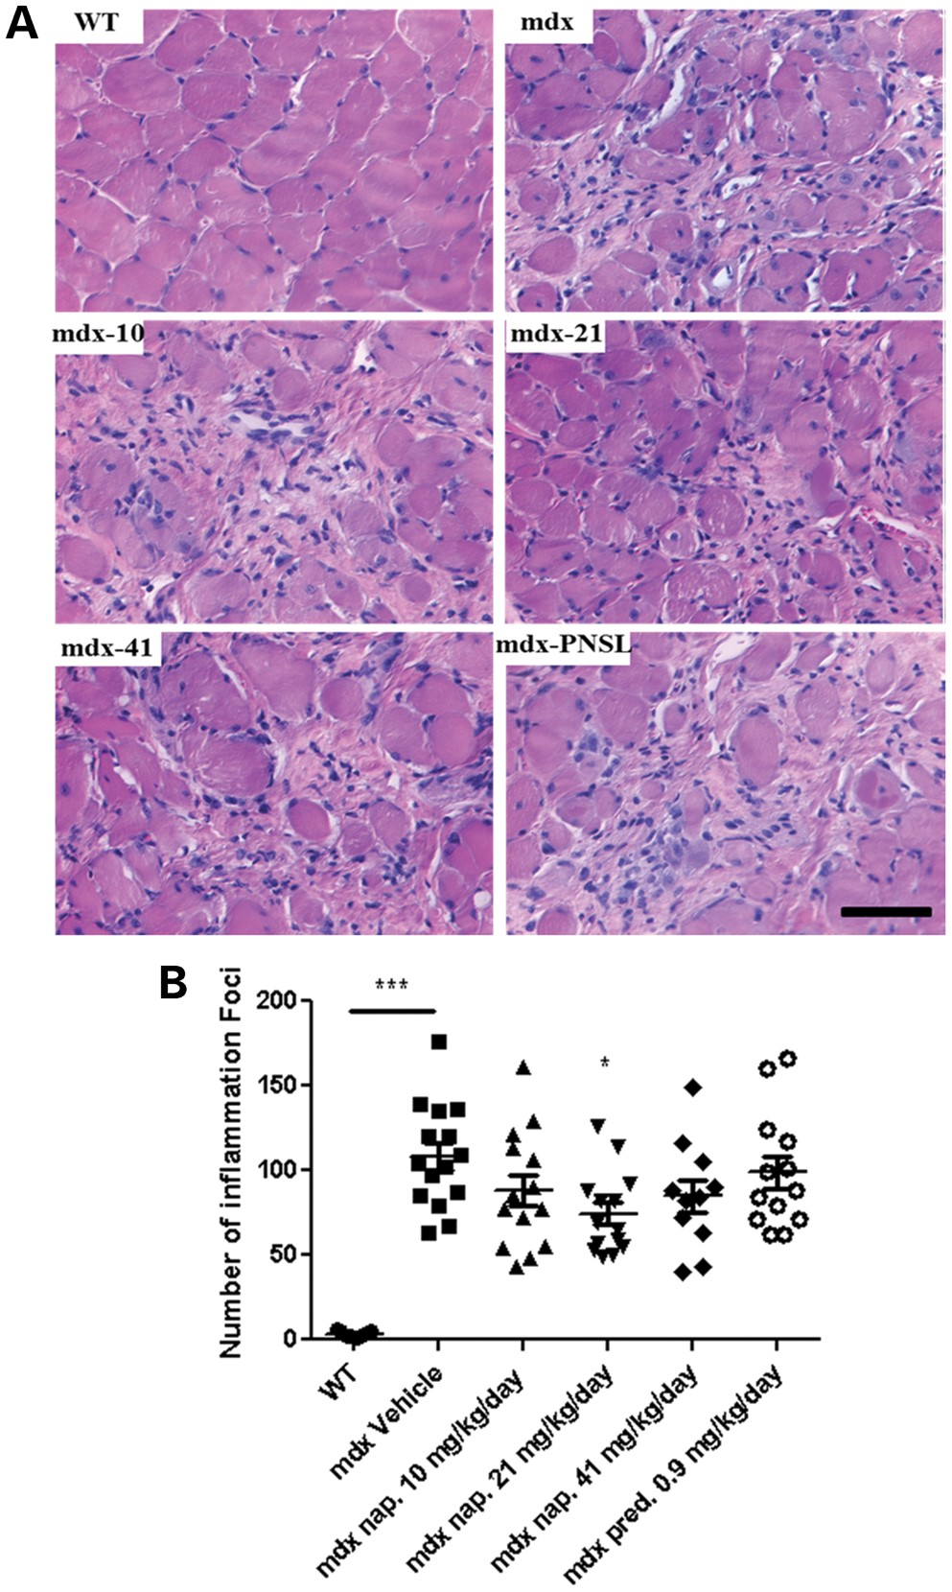
Figure 5. Quantification of inflammation in the diaphragm of WT and mdx mice treated with either vehicle, various ...
Notes:
Figure 5. Quantification of inflammation in the diaphragm of WT and mdx mice treated with either vehicle, various concentrations of naproxcinod or 0.9 mg/kg/day prednisolone at 42 weeks of age following 9 months of treatment. (A) Representative histological images of the diaphragm and (B) quantification of the number of inflammatory foci within the diaphragm to determine the effects of the treatment on the inflammation. Data are expressed as means ± S.E.M. (n = 7 for mdx vehicle-treated mice and 21 mg/kg/day naproxcinod-treated mice; n = 6 for 0.9 mg/kg/day prednisolone-, 10 mg/kg/day naproxcinod- and 41 mg/kg/day naproxcinod-treated mice; n = 5 for WT). *P ≤ 0.05 and ***P ≤ 0.001, comparing mdx vehicle-treated mice and various treatment groups. Bar = 200 µm.
Unless provided in the caption above, the following copyright applies to the content of this slide: © The Author 2014. Published by Oxford University Press. All rights reserved. For Permissions, please email: journals.permissions@oup.com

Slide 6
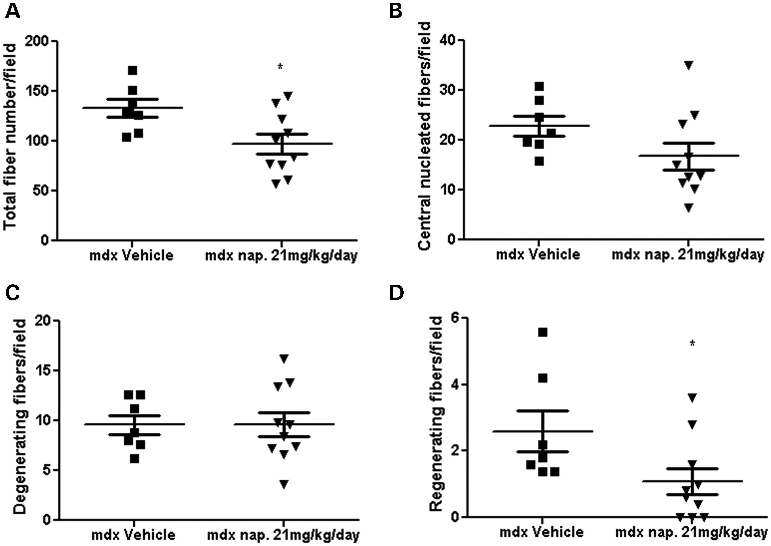
Figure 6. Histological quantification of the total fiber number (A), number of centrally nucleated muscle fibers (B), ...
Notes:
Figure 6. Histological quantification of the total fiber number (A), number of centrally nucleated muscle fibers (B), number of degenerating muscle fibers (C) and number of regenerating fibers (D) in mdx vehicle-treated mice and mdx mice treated with 21 mg/kg/day naproxcinod. Data are expressed as means ± S.E.M. (n = 7 for mdx vehicle-treated mice and n = 10 for 21 mg/kg/day naproxcinod-treated mice). *P ≤ 0.05, comparing mdx vehicle-treated mice and mdx mice treated with 21 mg/kg/day.
Unless provided in the caption above, the following copyright applies to the content of this slide: © The Author 2014. Published by Oxford University Press. All rights reserved. For Permissions, please email: journals.permissions@oup.com

Slide 7
Figure 7. Quantification of the area of fibrosis in the heart of mdx mice and mdx mice treated with 21 mg/kg/day ...
Notes:
Figure 7. Quantification of the area of fibrosis in the heart of mdx mice and mdx mice treated with 21 mg/kg/day naproxcinod at 42 weeks of age following 9 months of treatment. (A) Representative images of the heart from mdx vehicle-treated mice and mdx mice treated with 21 mg/kg/day naproxcinod. (B) Quantification of the area of fibrosis in the heart, expressed as a percentage of the whole heart. There was a 26% mean reduction in the fibrosis in the hearts of mdx mice treated with 21 mg/kg/day naproxcinod as compared with mdx vehicle-treated mice but this difference did not reach statistical significance. Data are expressed as means ± S.E.M. (n = 8 for mdx vehicle-treated mice and 21 mg/kg/day naproxcinod-treated mice). Bar = 200 µm.
Unless provided in the caption above, the following copyright applies to the content of this slide: © The Author 2014. Published by Oxford University Press. All rights reserved. For Permissions, please email: journals.permissions@oup.com

